Slide 1
Variable Star Classification with Deep Learning
Sage and Jalal (The MultiModal Maestros)

Slide 2
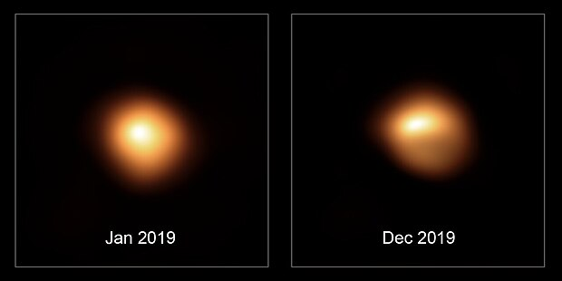
Background
What are variable stars?
Stars whose apparent brightness change with time
Extrinsic vs intrinsic
Why do they change?
Why do we care?
Stellar formation histories
Galactic evolution
Cepheid variables + the Hubble Tension
Past work?
Spectral vs photometric
Dataset-specific
Notes:
sage

Slide 3
Previous Work
“Periodic variable star classification with deep learning: handling data imbalance in an ensemble augmentation way”
To clean the dataset, used phase-folded light curves and excluded points with extra high deviation/error values
Deals with class imbalance by generating artificial light curves for data augmentation, applying Gaussian Process
Best model reached about 86% overall accuracy, with the most misclassifications coming from the classes with the least data
“The ASASSN catalogue of variable stars: The Serendipitous Survey”
Used a random forest classifier, trained on 16 variability features
Model was designed to classify 10 distinct classes of stars
Removed variables with irregular characteristics from consideration
Notes:
jalal

Slide 4
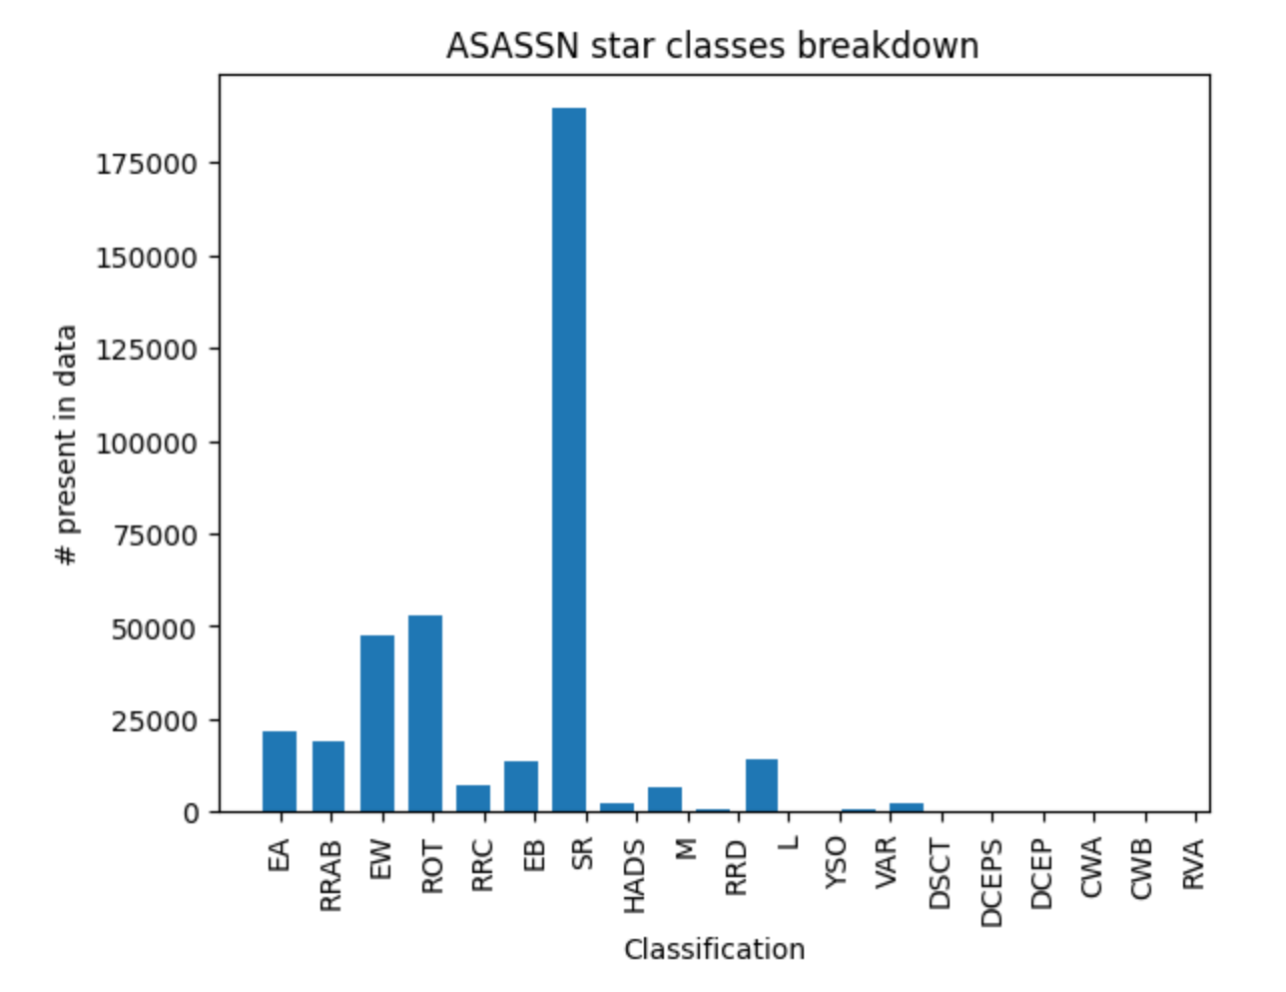
Dataset: The ASASSN Catalogue
of Variable Stars
Contains light curves 378,319 variable stars with over 180 million total observations.
19 classifications of stars
Very wide class imbalances! (Classes range from 175,000 entries to < 100)
Notes:
jalal

Slide 5
Data preparation
For each lightcurve:
Subtract off initial timestamp
Drop outlying points with large errors
Fit with SuperSmoother
Denoise with GHKSS
Downsample if oversampled
Distance normalization with Gaia
Gaia uncertainty propagation
calculate catch22+2 metrics
Create class-balanced training set from most populated classes
Notes:
sage

Slide 6
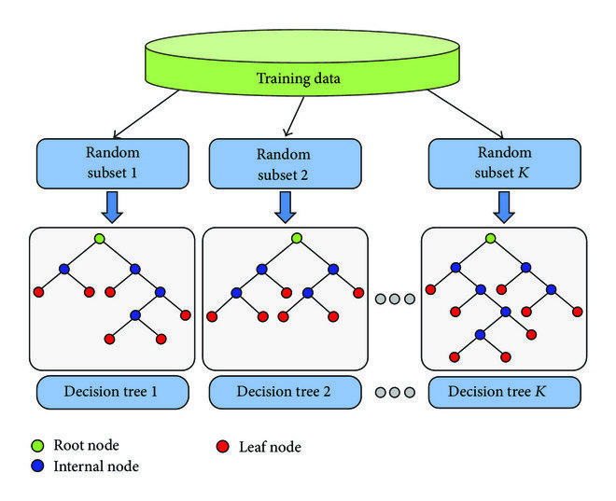
Baseline Model
We used a Random Forest Classifier as our baseline model through TensorFlow
Using small hyper parameters
Multiple smaller trees, small max depth
We used F1 as our metric of evaluation to compare the deep learning model and the baseline
Notes:
sage

Slide 7
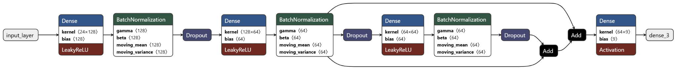
Metric-Based Model
Classifying based on derived metrics (arrays of scalars)
Uses LeakyReLU to avoid both vanishing gradient and dead neurons
We use HeNormal because LeakyReLU is asymmetric
Tweaked design over time
Fewer layers, batch normalization, reduced dropout rate/batch size, increased number of neurons, L2 regularization
Notes:
jalal

Slide 8
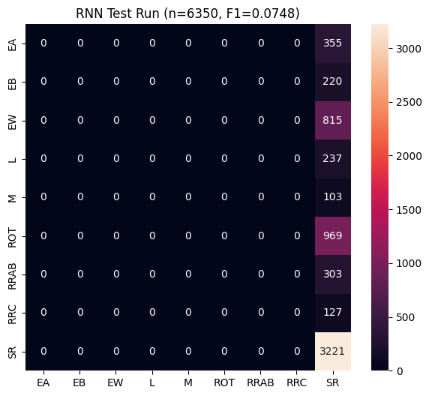
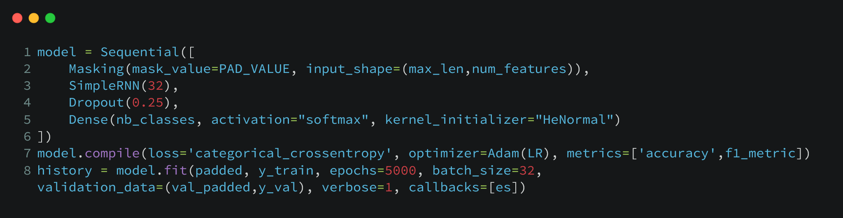

RNN Model
Some research has suggested that RNNs can learn to deal with non-uniformly-sampled data, so our reach goal was to make an RNN model that could classify based on the lightcurves themselves, not just their metric representations.
Notes:
sage

Slide 9
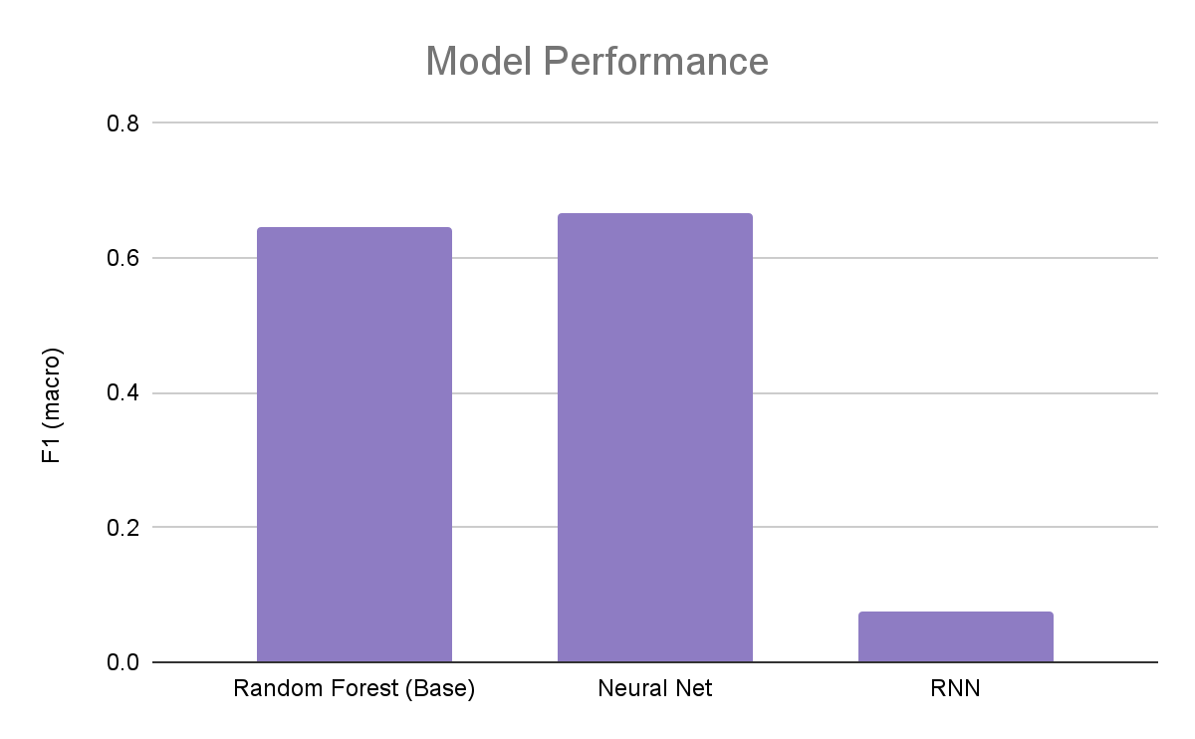
Comparison: Model Performance
Baseline model: F1 = 0.645
MLP (first iteration): F1 = 0.118
Model overhaul: F1 = 0.478
Reduced dropout rate: F1 = 0.529
Reduced batch size: F1 = 0.565
Batch normalization: F1 = 0.535
Increased number of neurons: F1 = 0.640
L2 regularization: F1 = 0.668
MLP (final iteration) = F1 = 0.668
Notes:
jalal

Slide 10
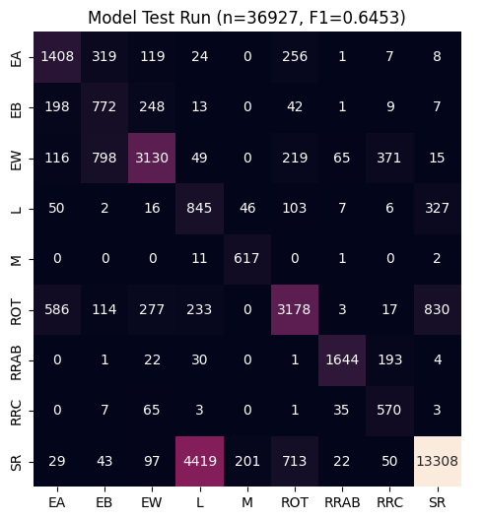
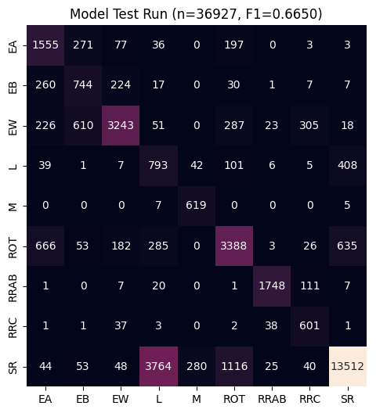
Comparison: Model Performance
Baseline
MLP
RNN

Slide 11
Discussion
A lot of future work
more use of Gaussian processes
expand to use more of the dataset (more compute required)
better distance estimates for tighter errors with Gaia DR4
more exploration of metric choice on accuracy
more exploration in RNN/LSTM model architecture
Results
definitely more potential for different RNN architectures
Baseline and MLP models show overlap in misclassifications - probably a feature of the data
Compute limitations make exploring the solution space difficult (as anticipated)
Notes:
sage

Slide 12
Citations
Boone, Kyle. Avocado: Photometric Classification of Astronomical Transients with Gaussian Process Augmentation. 11 July 2019. arXiv.org, https://doi.org/10.3847/1538-3881/ab5182.
Höppner, Frank. “Less Is More: Similarity of Time Series under Linear Transformations.” Proceedings of the 2014 SIAM International Conference on Data Mining (SDM), Society for Industrial and Applied Mathematics, 2014, pp. 560–68. epubs.siam.org (Atypon), https://doi.org/10.1137/1.9781611973440.65.
Jayasinghe, T., et al. “The ASAS-SN Catalog of Variable Stars I: The Serendipitous Survey.” Monthly Notices of the Royal Astronomical Society, vol. 477, no. 3, July 2018, pp. 3145–63. arXiv.org, https://doi.org/10.1093/mnras/sty838.
Kang, Zihan, et al. “Periodic Variable Star Classification with Deep Learning: Handling Data Imbalance in an Ensemble Augmentation Way.” Publications of the Astronomical Society of the Pacific, vol. 135, no. 1051, Sept. 2023, p. 094501. arXiv.org, https://doi.org/10.1088/1538-3873/acf15e.

