Slide 1
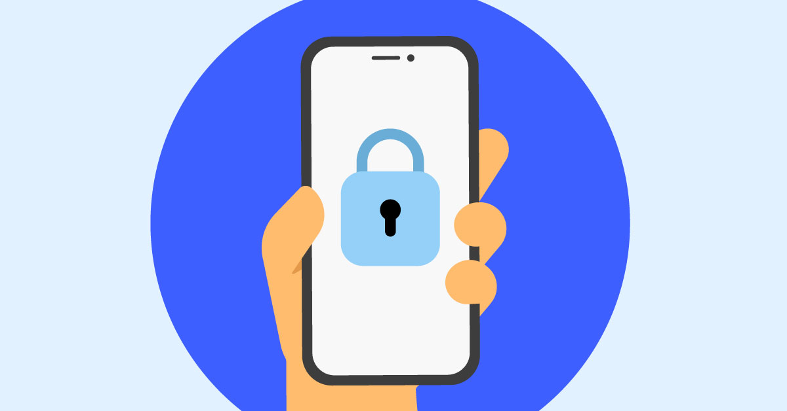

How to Compromise a Cell Phone?
By: Jacob Nagle

Slide 2
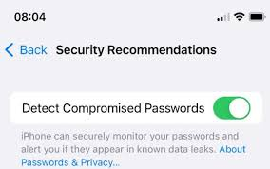
What Does It Mean To Compromise?
According to Webster Dictionary, to be Compromised means that, “made vulnerable (as to attack or misuse) by unauthorized access, revelation, or exposure” (Webster, 2024).

Slide 3
Different Methods to Compromising
There are 7 Common methods to how a phone can be Compromised:
1. Social Engineering.
2. Malvertising
3. Smishing
4. Malware
5. Pretexting
6. Breaking in via Bluetooth
7. Man in the middle WIFI attacks
Mobile security often beats PCs, but users can still be fooled and smartphones can still be hacked (Fruhlinger, 2021).
Even though cell phones are made to be more secure, they are not fully immune. It can happen anytime.

Slide 4
What are the More Dangerous Methods?
(From my research, these seem to be the easiest to fall for and to be hacked.) Smishing attacks are very common, but very easy to fall for. These are text messages that contain a link that may look very legitimate. This can lead to sensitive information being stolen from the victim.
Breaking in via Bluetooth is a very common way for victims to be attacked. This is because of how easy it is to get access to someone's device and attack it. This is due to the weakened security protocols. “Hackers can gain access to calls, texts, and authentication codes via Bluetooth. It becomes easier for hackers to break into your device if you leave your Bluetooth connection unregulated. Luckily, physical proximity to the device is important for Bluetooth hacking” (Shivanandhan, 2023).
Another common, but dangerous attack to watch out for would be, malware attacks. This is because of hackers can steal any credentials they need just from the victim doing something as simple as installing a malicious app or even just not updating their device. “Malware is any software designed to harm computers, networks, or mobile devices. It can come in various forms such as viruses, spyware, adware, or Trojans” (Shivanandhan, 2023).

Slide 5
What are Some Common Vulnerabilities?
Outdated Software: The updates that your phone manufacturer pushes out are very important. The reason these software updates are important is because they not only keep your phone fresh with new software models, but they help with the security of the device as far as how vulnerable your device is to hacking. There are a lot of people that not only just forget and overlook these updates, but they completely ignore them and this leads to outdated software.
Weak Passwords: Having a weak password opens multiple ways for a hacker to even guess at these passwords and gain access to all sorts of sensitive information you have.

Slide 6
What to Avoid?
When you are trying not to have your information open for attackers to gain, there some things to watch out for:
Only download trusted apps from your devices trusted app store.
Be sure to always have your phone with you, letting an attacker gain physical access to your device is the best way to have your device hacked.
Keep your device updated.
Do not open links unless they were sent from a trusted source.
Do not connect via Bluetooth nor via Wi-Fi to public access points (Kaspersky, 2024).

Slide 7
What Happens If Your Cell Phone is Compromised?
The most common and noticeable issue would be how slow your device is running.
The cell phone will often experience lagging and crashing along with frequent freezing.
Your device will have sudden battery drainage. Malware will cause your device battery to drain faster more than normal.
There will be unexpected increases in the data usage.
“Noticing unusual behavior or signs of hacking can help you take immediate action” (Asurion ,2024).

Slide 8

What to do When Your Phone Has Been Compromised?
If there is any speculation that your device is being hacked, here are immediate actions you must take:
Change your passwords and delete any suspicious apps or files.
Changing your password is a must, this allows you to create a much stronger password.
Contact your network provider or mobile carrier.
Contacting your network provider will allow them to give you advice and guidance.
Install antivirus software and security patches.
Installing the antivirus will help prevent attacks in the future.
Factory reset your device as a last resort (Asurion, 2024).
“If all else fails and you're unable to regain control of your phone, consider performing a factory reset” (Asurion, 2024).

Slide 9
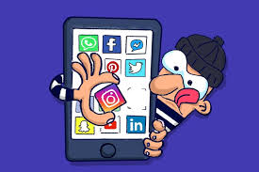
Does Social Media Play a Role?
Social media is on almost everyone's phone nowadays. Social media hacking can lead to your phone being compromised as well. When someone gets access to a persons social media account, they can get access to other personal information due to the fact that most people use the same passwords for social media as they do personal accounts.

Slide 10

What is Remote Exploitation?
“Remote exploitation techniques are used to exploit a product or a component of a product by an attacker who does not have access to the computer being targeted” (O’Reilly, 2024).
“Once a remote connection is established, an attacker might execute adversary-controlled code, most likely with a goal to move laterally to that system” (Extrahop, 2024).

Slide 11

Location Tracking Can Happen
When someone has gained access to your device, it is possible for them to have access to your location.
As anyone could imagine, this is very important. This can lead to not only harmful threats, but life threatening harm.
Cell Phones work with GPS, this can give any user access to the devices location at any spot.
Tracking location can happen through wifi and Bluetooth connections as well. This is the most common type of tracking (Bitsikas, 2024).

Slide 12
References
Webster Dictionary. 2024. https://www.merriam-webster.com/dictionary/compromised
Fruhlinger, Josh. 2021. “How to hack a phone: 7 common attack methods explained”. https://www.csoonline.com/article/509643/how-to-hack-a-phone.html
Shivanandhan, Manish. 2023. “Digital Intruders – Top Ways Hackers Can Breach Your Smartphone’s Security”. https://www.freecodecamp.org/news/how-hackers-can-breach-your-smartphones-security/
Kaspersky. 2024. “How to remove a hacker from your smartphone”. https://usa.kaspersky.com/resource-center/threats/how-to-stop-phone-hacking
Asurion. 2024. “Phone hacked? Here's what to do: step-by-step guide”. https://www.asurion.com/connect/tech-tips/what-to-do-if-your-phone-has-been-hacked/
Extrahop. 2024. “REMOTE SERVICES EXPLOITATION - DEFINITION, EXAMPLES, & PREVENTION”. https://hop.extrahop.com/resources/attacks/remote-services-exploitation/#:~:text=Remote%20services%20exploitation%20is%20a,error)%20or%20a%20valid%20account.
Bitsikas, Evangelos . 2024. “New smartphone vulnerability discovered by Northeastern Ph.D. student reveals hackers could track your location”. https://news.northeastern.edu/2023/07/27/phone-location-tracking-research/

