Slide 1
Android Workshop
AngelHack Paris 2013

Slide 2
about:me
Android developer since 2009
Dozen of application on the Google Play Store
(and Github of course)
Android Engineer @ Deezer (SDK)
@xgouchet / +Xavier Gouchet
workshop@xgouchet.fr

Slide 3
Schedule
Introduction
about:android
Hands On
Building a Git client for Android
Tips & tricks
Building a connected App
Questions & Answers

Slide 4
Introduction
about:android

Slide 5
Hands on
Building a Git client for Android

Slide 6
Tips & Tricks
Building a connected App

Slide 7
Check available network
boolean available = false;
ConnectivityManager connMgr = (ConnectivityManager)
context.getSystemService(Context.CONNECTIVITY_SERVICE);
NetworkInfo networkInfo = connMgr.getActiveNetworkInfo();
if (networkInfo != null) {
available = networkInfo.isConnected();
}
return available;

Slide 8
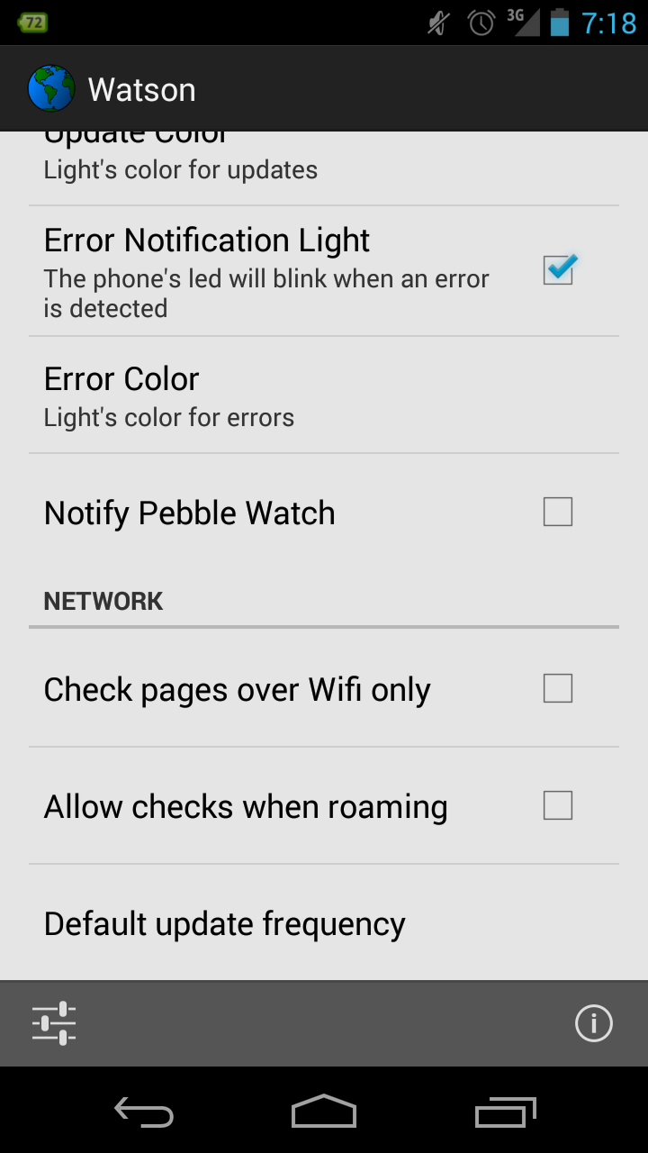
Give the user choices

Slide 9
Give the user choices
available = networkInfo.isConnected();
// test to prevent roaming
if (!allowRoaming) {
available &= (!networkInfo.isRoaming());
}
// test for Wifi only
if (wifiOnly) {
available &= (networkInfo.getType() ==
ConnectivityManager.TYPE_WIFI);
}

Slide 10
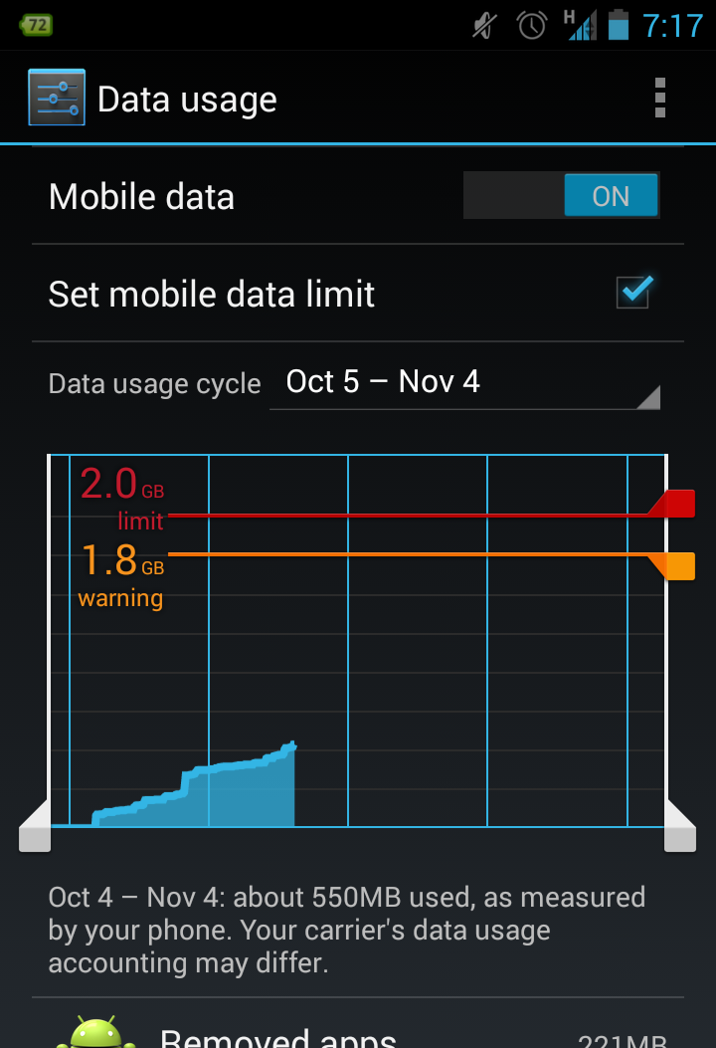
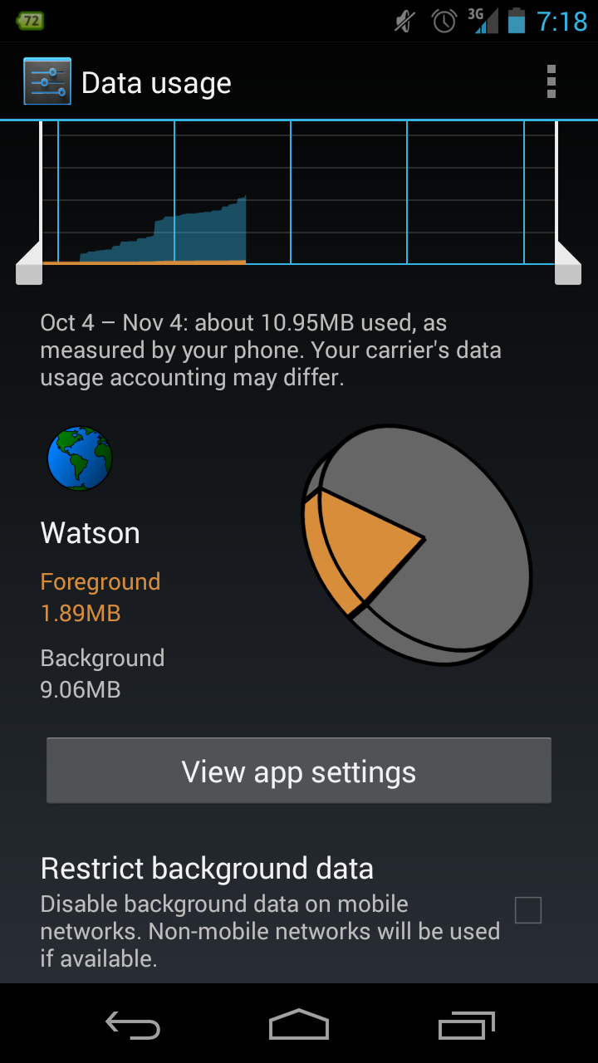
Set a Network Preferences Screen

Slide 11
Set a Network Preferences Screen
<intent-filter>
<action
android:name="android.intent.action.MANAGE_NETWORK_USAGE" />
<category
android:name="android.intent.category.DEFAULT" />
</intent-filter>

Slide 12
Expect unstable Network
Expect network errors
Do not show cryptic messages to the user
Recover whenever possible
Test outside the office
(subway, countryside, lifts)

Slide 13
Expect no Network
Don't keep a blank screen
Keep data in cache
Allow delayed actions
(record actions now, send to server later)
Disable buttons and menus

Slide 14
Allow resuming (large) downloads
HttpURLConnection connection = (HttpURLConnection)
url.openConnection();
connection.setRequestMethod("GET");
connection.setRequestProperty("Range", "bytes=21010-47021");
HTTP/1.1 206 Partial content
Date: Sat, 19 Oct 2013 15:25:42 GMT
Last-Modified: Sat, 20 Apr 2013 18:13:37 GMT
Content-Range: bytes 21010-47021/47022
Content-Length: 26012
Content-Type: image/png

Slide 15
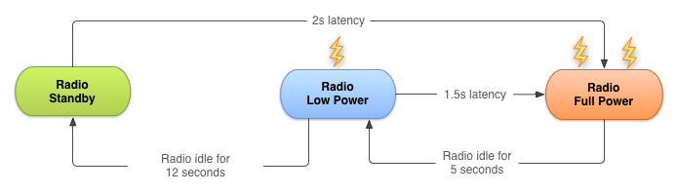
Protect battery life

Slide 16
Fetch data in background
// compute first call time 5 minutes from now
Calendar calendar = Calendar.getInstance();
calendar.add(Calendar.MINUTE, 5);
long trigger = calendar.getTimeInMillis();
// set one hour delay between each call
long delay = 1000L * 60L * 60L;
// Setup alarm
AlarmManager alarmManager = (AlarmManager) context.getSystemService(Context.ALARM_SERVICE);
alarmManager.setRepeating(AlarmManager.RTC, trigger,
delay, pendingIntent);

Slide 17
Always use background threads
Use AsyncTask from Activities
Use IntentService (instead of Service)
Cancel task/service whenever needed

Slide 18
Questions & Answers
Or let's just chat...

Slide 19
Thanks for your attention
Now go and make some Apps !

Slide 20
Android Workshop
AngelHack Paris 2013

