Slide 1
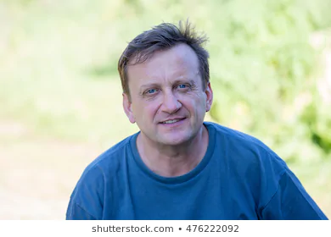
“I'd really like to just get away from it all with the family in a beautiful spot and sink some lures.”
Bill Ballard
44 years old
Bank Branch Manager
Phoenix, AZ
Enjoys fishing and spending time with family
Outgoing, conservative, religious
Pains
Cleaning out plants from his outboard boat motor
Losing valuable fishing lines to underwater plants
Goals
Finding a pristine lake with few plants for fishing
A great place to take the kids swimming

Slide 2

“I'm really interested in connecting with like-minded people in my field and securing a job after college!”
Melissa Cottrell
20 years old
Undergraduate student
Athens, OH
Passionate about hydrology and environmental science
Shy, liberal, loves the outdoors and traveling, spiritual but not religious
Pains
Incomplete information on pondweeds and other freshwater species
She doesn't know anyone with the same passions
Goals
Finding a job working in aquatic biology
Getting better at field identification of plants and animals

Slide 3

“I just don't have the time or energy to deal with all these requests from the county, the State, and the EPA!”
Randy Savage
63 years old
Irrigation District President
Grand Junction, CO
Expert on water rights and farming management
Well-educated, world traveler, refined, and experienced.
Pains
Environmental compliance with water distribution
Managing all the biomass from snails, plants, etc. in his water supply
Goals
Hiring professionals to conduct routine sampling and monitoring in his water supply.

