Slide 1
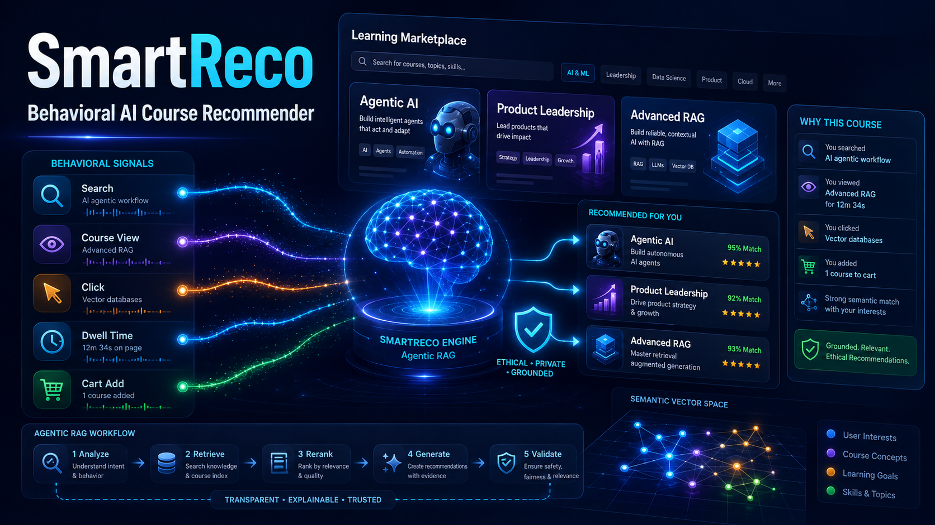
SMARTRECO • BEHAVIORAL AI COURSE RECOMMENDER
Behavior becomes a trusted learning path
SmartReco observes meaningful on-site intent, retrieves active courses semantically, and explains every recommendation.
1
Observe
2
Understand
3
Retrieve
4
Persuade
5
Validate
Views • Searches • Clicks • Dwell • Cart
Weighted intent + fingerprint
Hybrid search + diversity
Grounded Mesh narrative
Active SQL IDs only
WHY IT STANDS OUT
20 min
50
100%
Adaptive recommendations stay stable between meaningful behavior changes—reducing AI cost while keeping the experience relevant.
cooldown
event batch
catalog validated
01
Notes:
[Sources]
- User-provided SmartReco project specification in this conversation.
- User-referenced demo video: https://www.youtube.com/watch?v=2rj6-67mTsU
- User-provided/generated SmartReco thumbnail used as the slide background.

Slide 2
AGENTIC RAG • RELIABLE OPERATIONS • RESPONSIBLE PERSONALIZATION
Built for the demo—and engineered beyond it
A server-rendered marketplace with one controlled path from behavior to a grounded recommendation.
1
Analyze
2
Retrieve
3
Rerank
4
Generate
5
Validate
›
›
›
›
Intent + recency
SQL + Chroma
Relevance + diversity
Mesh narrative
Active catalog IDs
Explicit LangGraph nodes create a visible workflow trace; every model and embedding call goes through Mesh API.
CONSISTENCY
EFFICIENCY
OPERATIONS
TRUST
SQL + transactional vector outbox
Threshold + cooldown + cache
Retry failed syncs + scheduler
Evidence, consent-ready, no dark patterns
Demo story: Admin adds courses → learner behavior shifts → recommendations adapt → evidence and traces prove why.
02
Notes:
[Sources]
- User-provided SmartReco project specification in this conversation.
- User-referenced demo video: https://www.youtube.com/watch?v=2rj6-67mTsU
- User-provided/generated SmartReco thumbnail used as the slide background.

