Slide 1
Deep Reinforcement Learning with Double Q-learning Google Deepmind – Dec 2015 – Hado van Hasselt, Arthur Guez, David Silver
Presented by: T1 - James Bocinsky and Lorenzo Tabares

Slide 2
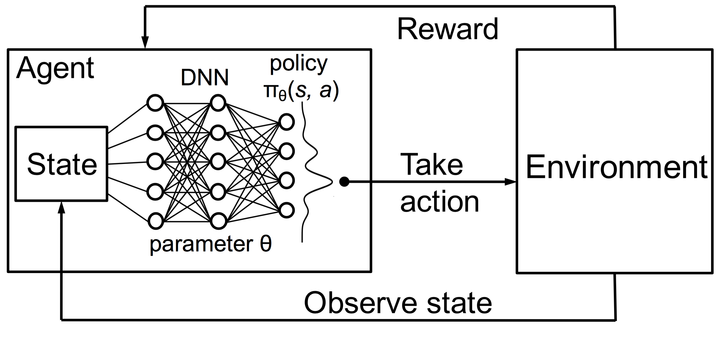
Reinforcement Learning
Agent – game player
State – current game environment
Actions – action performed by agent at a given state
Reward – defined by some aspect of the game to encourage
Reinforcement learning uses its actions and the corresponding reward it received to properly learn a policy (state/action relationship)

Slide 3
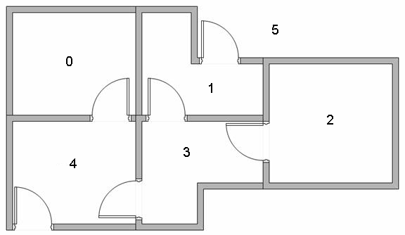
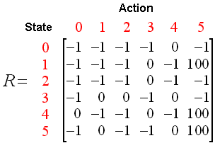
Background (Q Learning)
Intuition Example
Goal: exit building to state 5
Used to solve sequential decision problems
Learn estimates for the optimal value of each action
The Optimal Policy
Maximize reward in current state and for future states
Optimal Action Values
Estimated with Q-Learning through observations

Slide 4
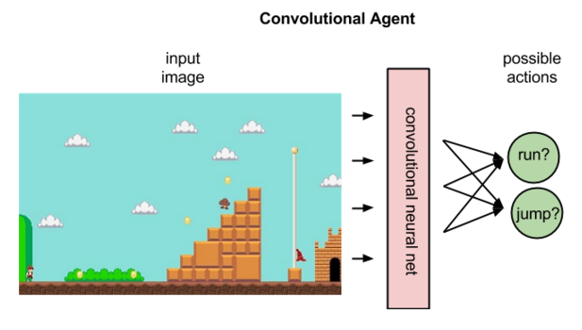
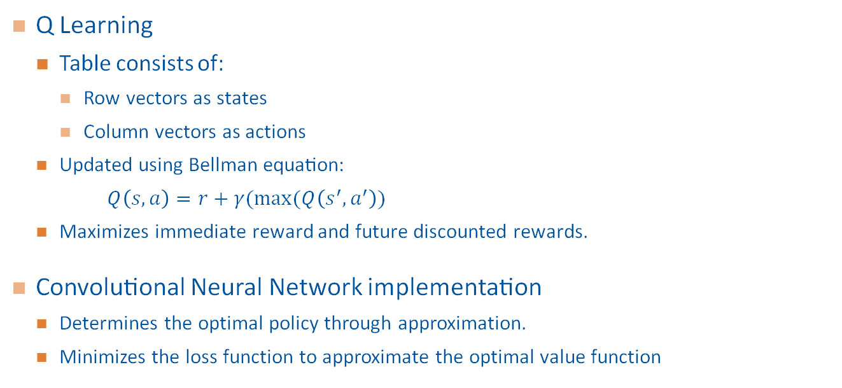
Deep Q-Learning (DQN)
Q Learning
Table consists of:
Row vectors as states
Column vectors as actions
Updated using Bellman equation:​
$Q\left(s,a\right)=r+γ(max⁡(Q\left(s^{′},a^{′}\right))$
Maximizes immediate reward and future discounted rewards.​
Convolutional Neural Network implementation​
Determines the optimal policy through approximation.
Minimizes the loss function to approximate the optimal value function
Notes:
For some reason this slide cant be edited so I'm going to type everything again in the slide above it (6)

Slide 5
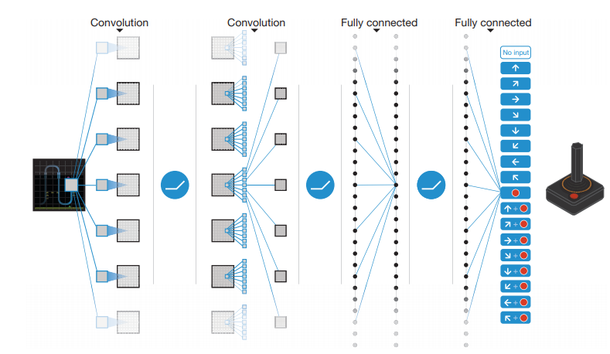
Paper's Architecture
DQN – 3 convolution layers followed by 1 fully connected
~ 1.5M parameters
Input – Last 4 frames of Atari game
Provides DQN with a sense of movement in the game
Output – game controls

Slide 6
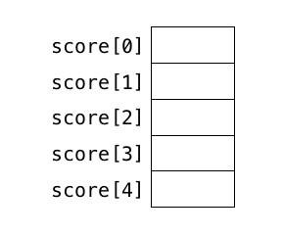
High Level Algorithm
Two networks of the same architecture are used
"Online" network – Used to form memory of previous actions and rewards given
"Target" network – Uses memory to calculate loss
Random Sample Memory
Online (θ)
Target (θ⁻)
Observe reward
Calculate Loss
Memory
Back Prop Loss
Notes:
For some reason this slide cant be edited so I'm going to type everything again in the slide above it (6)

Slide 7
Updating weights
Memory is formed
Loss calculated from target network parameters
Weights copied every tau steps
Target network is essentially the Online network at a snapshot in time
Online (θ)
Target (θ⁻)
Copy Weights
Notes:
For some reason this slide cant be edited so I'm going to type everything again in the slide above it (6)

Slide 8
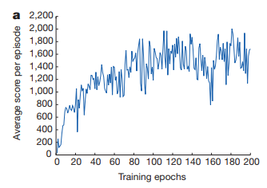
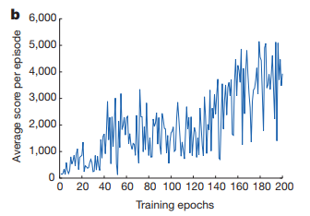
Double DQN Motivation
Policy – the state action relationships
DQN – is unstable due to policy reward overestimation
Overestimation – when the policy's reward estimation is overly large
This does not typically affect the ability to learn a policy as long as values are uniformly higher than relative action preferences, but this is not always the case

Slide 9


Formal Equations
Q value function
Parameter update equation (should remind you of typical SGD)
Target Output

Slide 10

Proposed Double DQN
Original Target Evaluation
Double Deep Q-Learning Target Evaluation
Action is still calculated through online network parameters (θ)
However evaluation is done through target network parameters (θ⁻)

Slide 11
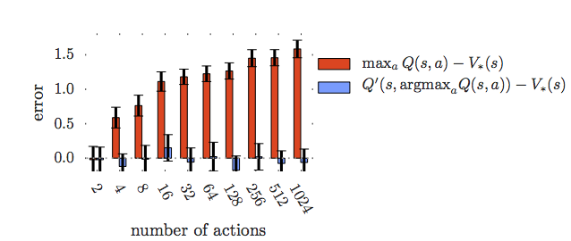
Overoptimism Dependent on Action Space
Error increases with number of actions for DQN, but not for Double DQN

Slide 12
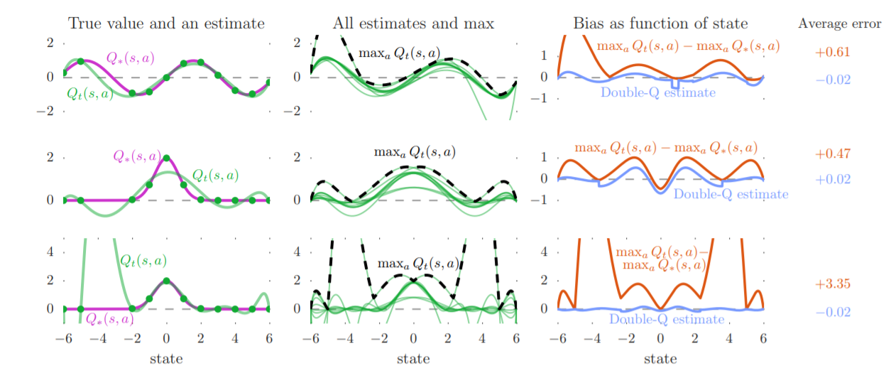
Learning Overestimations
True distribution:
sin(s)
2exp(-s²)
2exp(-s²)

Slide 13
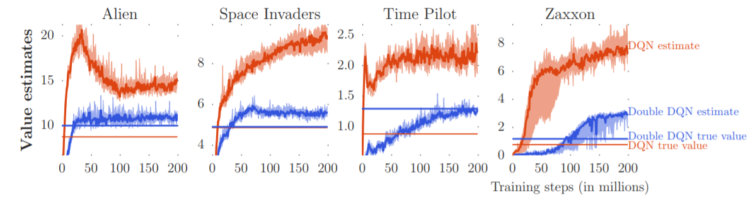
Overestimation Comparison
Horizontal line represents actual reward returned from each visited state.
If there was no bias, you should see the estimate meet the horizontal line at the end of training

Slide 14
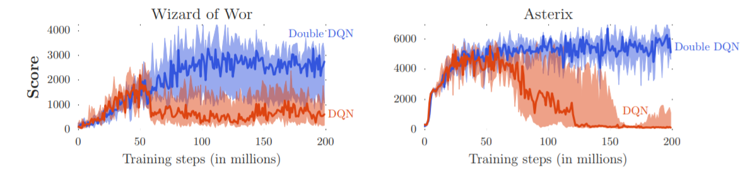
Overestimation Comparison
Once overestimation begins you see the score of DQN drop severely.
Double DQN does not overestimate and is seen to be much more stable over training.

Slide 15
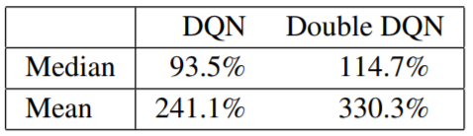
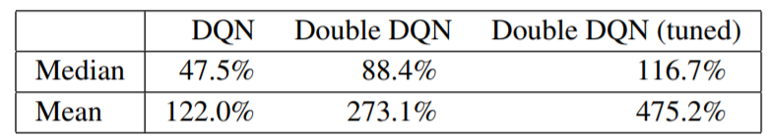
Performance Comparison
If training is done for a short amount of time, the difference between DQN vs Double DQN is not that much.
When you do more training you can see that DQN overestimates and decreases in performance, showing that Double DQN is more stable.
5 mins of play
30 mins of play

Slide 16
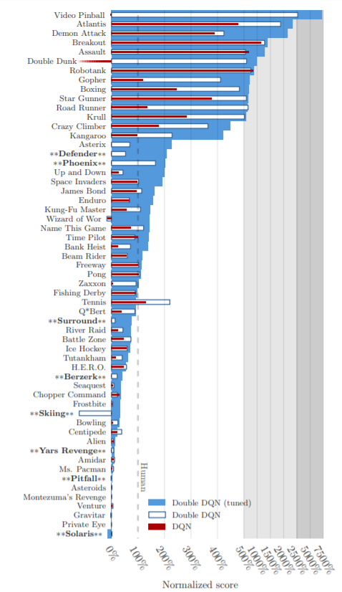

Performance Comparison
Scores normalized relative to human score
100% score is at human level
Tuned Double DQN performs better than a human for more than half of the games tested
Exceeds regular DQN

Slide 17
Positives
Extensive use of Graphs
Helps visualized results
Concrete evidence
Proofs and derivations were provided with all claims and formulas
The authors provided good intuition for why double DQN would have such strong results with visualizations and equations

Slide 18
Negatives
No discussion on
Potential problems using Double DQN
Future improvements on the design
Further application
Why double DQN affected certain games more drastically than others
Details of architecture

Slide 19
Impact
DQN
Proven to be overoptimistic and reduce performance
Double DQN
Mitigates overestimation
Achieved record performance on Atari 2600 games
Can be used in future DQN projects to reduce training instability and uncertainty
Provides more confidence that the solution it formed is reasonable due to stability

Slide 20
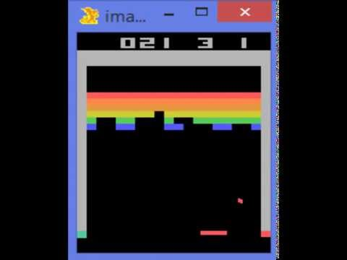
Video Demo Short video demo: https://youtu.be/V1eYniJ0Rnk

Slide 21
Questions?

