Slide 1
Super Resolution
Tianshu Lu, Pei Qian, Xinjie Zhuang, Josh Bodah

Slide 2
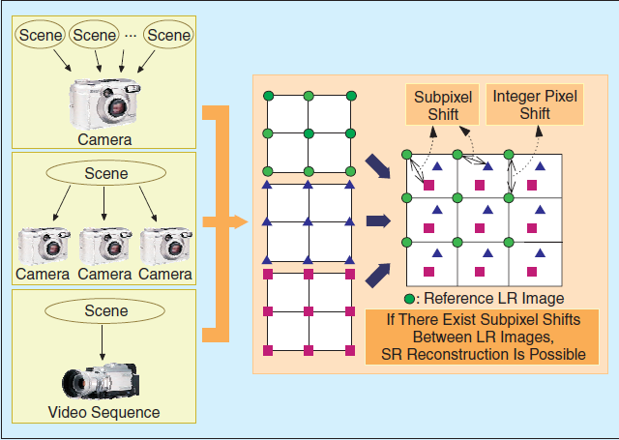
Problem Overview

Slide 3
Frequency Domain Methods
Original approach taken by Tsai and Huang

Slide 4
Spatial Domain Methods
More commonly used
Nonuniform Interpolation
MAP
POCS
Hybrid

Slide 5
Spatial Domain Methods
SR image reconstruction methods consists of 3 stages:
-Registration
-Interpolation onto HR grid
-Removing blur and noise
Registration
Or
Motion
Estimation
Interpolation onto an HR Grid
Restoration for Blur and Noise Removal
y1
y2
…
…
z
yp-1
yp

Slide 6
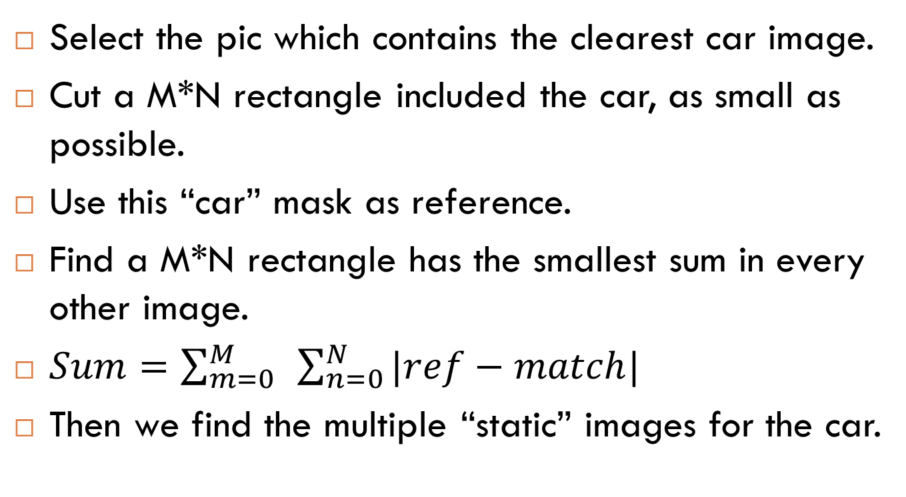
Find the car
Select the pic which contains the clearest car image.
Cut a M*N rectangle included the car, as small as possible.
Use this “car” mask as reference.
Find a M*N rectangle has the smallest sum in every other image.
$Sum=\sum_{m=0}^{M}{ }\sum_{n=0}^{N}{|ref−match| }$
Then we find the multiple “static” images for the car.

Slide 7

Image results
original image
match mask
captured car

Slide 8












Captured car image

Slide 9









Captured car image

Slide 10
Nonuniform Interpolation
Approach:
1) Find subpixel motion via block-matching algorithm
2) Interpolate to fill empty pixels

Slide 11
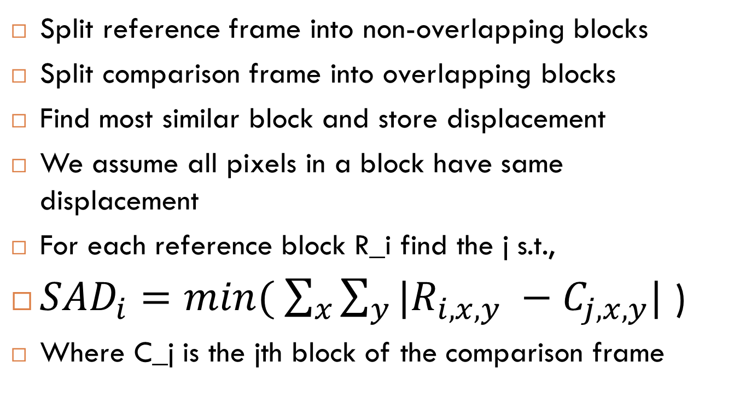
Block Matching
Split reference frame into non-overlapping blocks
Split comparison frame into overlapping blocks
Find most similar block and store displacement
We assume all pixels in a block have same displacement
For each reference block R_i find the j s.t.,
${SAD}_{i}=min⁡( \sum_{x}{\sum_{y}{|R_{i,x,y}}} −C_{j,x,y}|$ )
Where C_j is the jth block of the comparison frame

Slide 12
Finding Subpixel Motion
Step 1 Calculate the best motion vector at pixel precision.
Step 2 Search for the best half-pixel precision motion vector at eight half-pixel positions around the point of minimum given in step 1. These new positions contain interpolated values.
Step 3 Compare the current block with eight new interpolated blocks around the best half-pixel position. These blocks contain values that are interpolated from pixel precision image data and half-pixel precision interpolated data.

Slide 13
Interpolation
Step 1 Place the first LR frame pixels in their corresponding positions of the HR image
Step 2 New pixels from comparison frames will be placed in empty positions of the HR grid if there is sub-pixel motion.
Step 3 After filling all possible positions, empty HR pixel values will be interpolated to achieve the final SR image.

Slide 14
Results

Slide 15
Results

Slide 16
Results

Slide 17
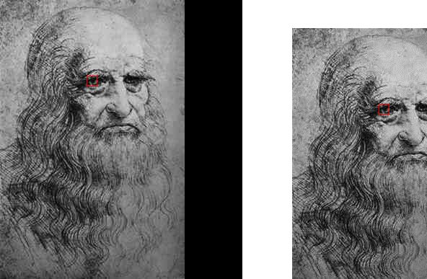
Results

Slide 18
MAP
Maximize A Posteriori

Slide 19
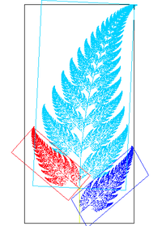
MAP(motion estimation)
Affine Transformation
Minimum Absolute Error

Slide 20
MAP(Iteration)
Step 1: Begin at n=0 with initial estimate being the interpolated low resolution frame 1.
Step 2: For k = 1,2,…,p, find
Step 3: Compute the gradient
Step 4: Let .
Step 5: Let n = n + 1 and go to step 2.

Slide 21
References
S. C. Park, M. K. Park, and M. G. Kang (May 2003) Super-resolution Image Reconstruction: a Technical Overview, IEEE Signal Processing Magazine, Vol. 20 321-36.
D. Barreto, L. D. Alvarez, and J. Abad (2005) Motion Estimation Techniques in Super-Resolution Image Reconstruction. A Performance Evaluation
S. Borman, R. Stevenson (July 1998) Spatial Resolution Enhancement of Low-Resolution Image Sequences A Comprehensive Review with Directions for Future Research
R. Hardiey, K. Barnardz, and E. Armstrong (1996) Joint MAP Registration and High Resolution Image Estimation Using a Sequence of Undersampled Images, IEEE Transactions on Image Processing
L. Shih-Chieh and C. Chih-Ting (2008) Reconstructing Vehicle License Plate from Low Resolution Images using Nonuniform Interpolation Method, International Journal of Image Processing, Volume (1) : Issue (2)

