Slide 1


Building the Ultimate Safety Net with Integration Tests
Jimmy Bogard
@jimmybogard.com
github.com/jbogard
jimmybogard.com

Slide 2
Why Test?

Slide 3
Shifting Left
Design
Code
Integrate
Q/A
Acceptance
Release

Slide 4
Types of Tests
UI
Integration
Unit

Slide 5
Simple Application Use Case
NOT Unit Testable
QuerySomethingFromDatabase();
DoTheActualBusinessLogic();
SaveTheThingToTheDatabase();
Unit Testable
NOT Unit Testable

Slide 6
Complex Application Use Case
NOT Unit Testable
QuerySomethingFromDatabase();
DoSomeLogic();
GetAnotherThingFromDatabase();
DoMoreLogic();
SaveTheThingToTheDatabase();
Unit Testable
NOT Unit Testable
Unit Testable
NOT Unit Testable

Slide 7
Unit Testing Challenges
We have to compromise design to shoehorn unit tests
Our tests become brittle because we rely on mocking
Too many false positives/negatives
Destroyed confidence!

Slide 8
Integration Testing to the Rescue!

Slide 9
Integration Testing Rules
No mocks!
Real direct dependencies
Fake what we can’t control (external dependencies)
Match “real-world” usage

Slide 10
Demo

Slide 11
Move to Testing Diamond
UI
UI
Integration
Unit
Integration
Unit

Slide 12
Building the Ultimate Safety Net with Integration Tests
Jimmy Bogard
@jimmybogard.com
github.com/jbogard
jimmybogard.com

Slide 13
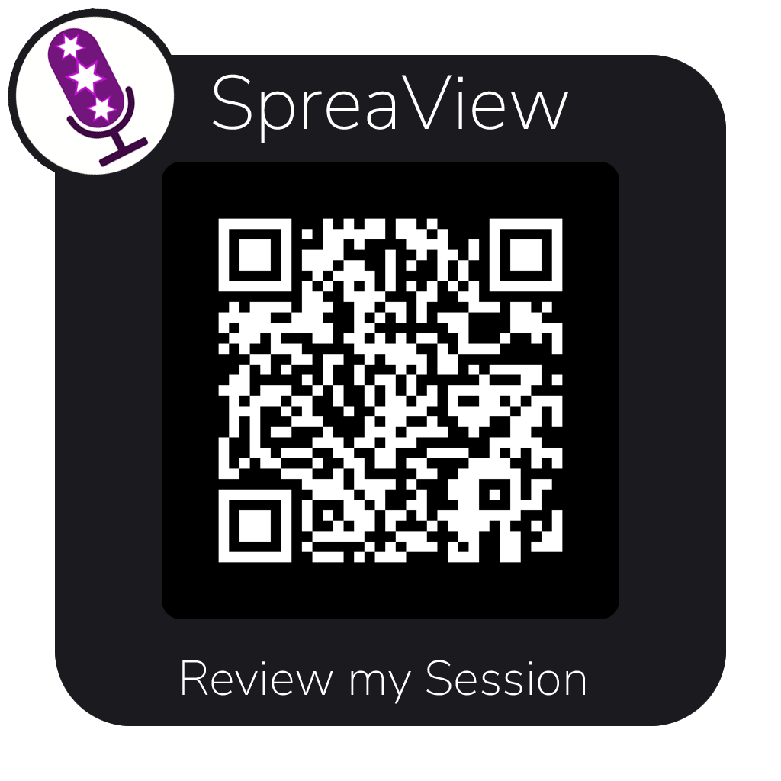
Building the Ultimate Safety Net with Integration Tests
github.com/jbogard/presentations
Jimmy Bogard
@jimmybogard.com
jimmybogard.com

