Slide 1


DDD with Vertical Slice Architecture
Jimmy Bogard
@jbogard
github.com/jbogard
jimmybogard.com

Slide 2
What is Domain-Driven Design?
Notes:
An architectural design strategy in which we selectively distill, organize, and abstract the body of knowledge from the users to the software

Slide 3
What is a domain model?
Notes:
From PoEAA: An object model of the domain that incorporates both behavior and data.
Key – data AND behavior
Beyond nouns and verbs

Slide 4
What is Vertical Slice Architecture?
Notes:
An architectural design strategy in which we selectively distill, organize, and abstract the body of knowledge from the users to the software

Slide 5
Axes of change
View Unapproved Invoices
Approve Invoice
Reject Invoice
UI Layer
Domain Objects
Repository
Database

Slide 6
Vertical Slice Architecture Model and organize application architecture around axes of change, vertical slices

Slide 7
Vertical Slices

Slide 8
Move code to single place

Slide 9
Move service methods to classes
Invoice Service
void Approve()
ApproveInvoice {}
void Reject()
RejectInvoice {}
void Flag()
FlagInvoice {}

Slide 10
(micro)Services to Handlers
Input
Request Handler
Output

Slide 11
Request/Response with MediatR
IRequest<T>
IRequest
Handler
<TRequest, TResponse>
TResponse
Task<TResponse> Handle(
TRequest request) {
}

Slide 12
Architecture in slices
Validation
Use Case Agnostic
Authentication
Authorization
Feature
Feature
Feature
Feature
Feature
Feature
Feature
Feature
Feature
Feature
Feature
Feature
Feature
Feature
Domain Model
Use Case Specific
Persistence

Slide 13
Architecture in slices
Validation
Use Case Agnostic
Authentication
Authorization
Feature
Feature
Feature
Feature
Feature
Feature
Feature
Feature
Feature
Feature
Feature
Feature
Feature
Feature
Domain Model
Domain Model
Use Case Specific
Persistence

Slide 14
But my code, it sucks!

Slide 15
Red
Green
Refactor

Slide 16
¯\_(ツ)_/¯
¯\_(ツ)_/¯
Refactor

Slide 17
Shoulders of Giants

Slide 18




Slide 19
Current State

Slide 20
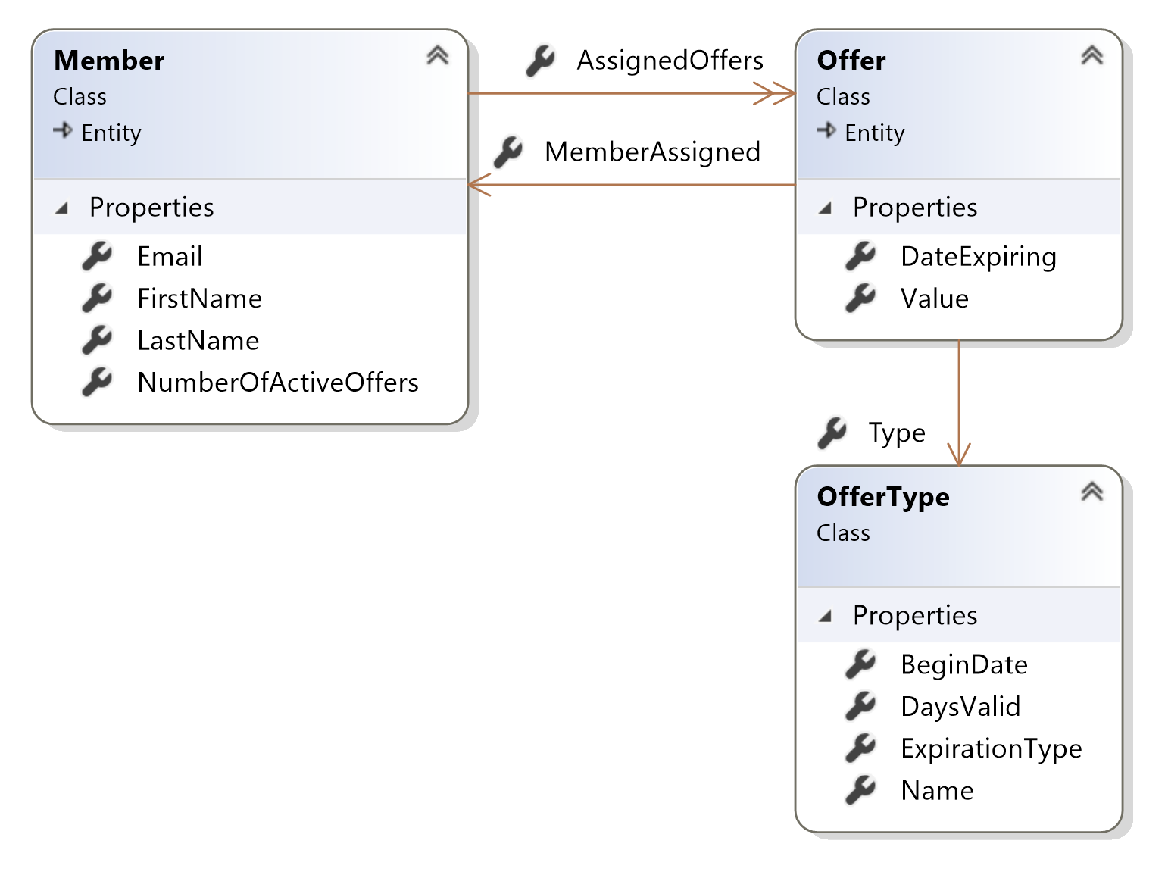

Slide 21
Where’s the behavior?

Slide 22
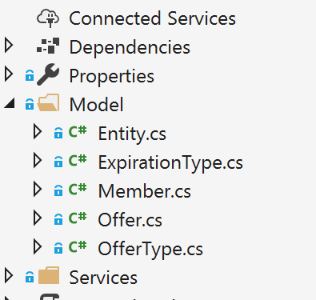

Slide 23

DDD with Vertical Slice Architecture Training
Dec 10th-12th in Milan(o?)
20% discount code Community20

Slide 24
DDD with VSA
Jimmy Bogard
@jbogard
github.com/jbogard
jimmybogard.com
github.com/jbogard/presentations

