Slide 1


Modularizing the Monolith
Jimmy Bogard
@jbogard
github.com/jbogard
jimmybogard.com

Slide 2
How did we get here?

Slide 3
The App
The Database

Slide 4

The App
The Database

Slide 5
The App
The Database

Slide 6
The Frontend
The Backend
The Database

Slide 7
The Frontend
The Backend
The Database

Slide 8
The Frontend
API Gateway (GraphQL or whatevs)
Catalog Service
Pricing Service
Content Service
Cart Service
Account Service
Checkout Service

Slide 9
The Frontend
API Gateway (GraphQL or whatevs)
Catalog Service
Pricing Service
Content Service
Cart Service
Account Service
Checkout Service

Slide 10
But that’s not what happened…

Slide 11
The Frontend
API Gateway (GraphQL or whatevs)
Catalog Service
Pricing Service
Content Service
Cart Service
Account Service
Checkout Service
x 1000

Slide 12
Over-emphasized “micro” Misunderstood “service”

Slide 13
Boundaries are hard

Slide 14
Distributed systems are harder

Slide 15
Doing both is harder-er

Slide 16
The App
The Database

Slide 17
The App
The Database

Slide 18
Monolith: System with exactly one unit of deployment

Slide 19
Bad Monolith: Software whose design, information model, and interface combine multiple competing and interfering domains into one single application and data model.

Slide 20
AKA “Big Ball of Mud”

Slide 21
Good Monolith: Monolith that is not bad

Slide 22
Good Monolith: Monolith that is easy to change

Slide 23
UI Layer
Business Logic Layer
Data Access Layer
Database

Slide 24
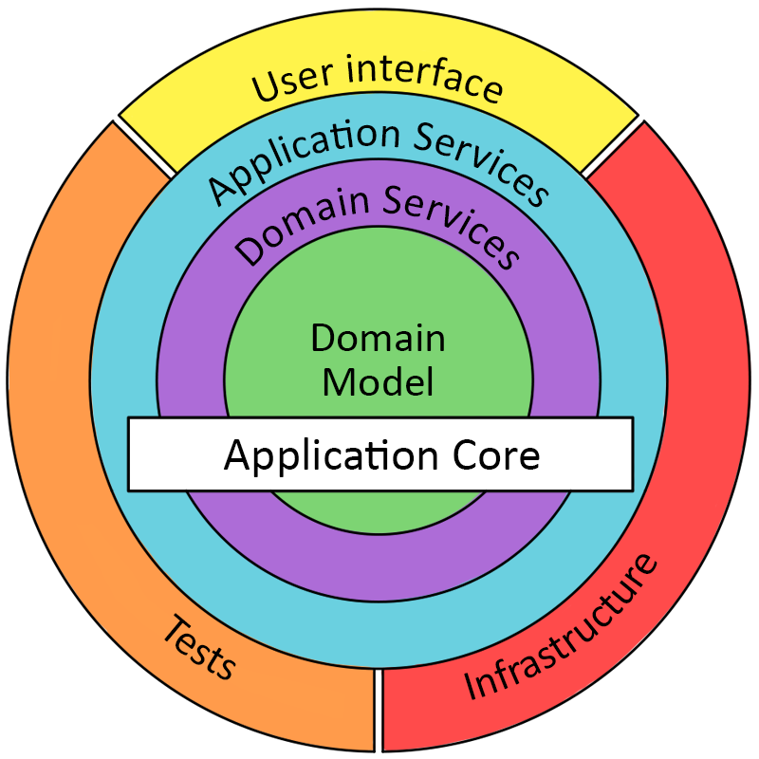
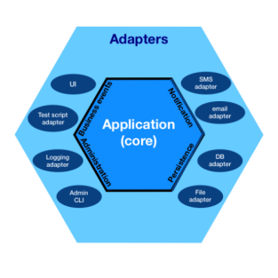
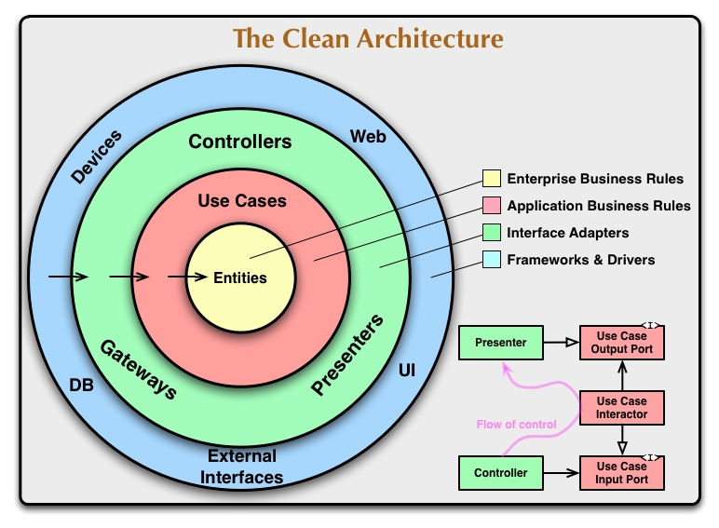

Slide 25
Solution: We need boundaries

Slide 26
Vertical Slice Architecture
View Unapproved Invoices
Approve Invoice
Reject Invoice
UI Layer
Domain Objects
Repository
Database

Slide 27
Modules must:
Be independent and interchangeable
Contain all logic and data to produce desired functionality
Have a defined interface

Slide 28
Independent
Module
Module
Module
Module
Module
Module

Slide 29
Independent
Module
Module
Module
Module
Module
Module
Bus/ Mediator

Slide 30
Strong Dependency
Module
Module

Slide 31
Weak Dependency
Module
Module

Slide 32
Merged Modules
Module

Slide 33
Slices into Modules
Module
View Unapproved Invoices
Approve Invoice
Reject Invoice
UI Layer
Domain Objects
Repository
Database

Slide 34
Underwriting
Accounting
Defining Boundaries
Enterprise Accounts
Claims
Ops

Slide 35
Boundaries are easier to draw when the source is tangible

Slide 36
Your boundaries will be wrong! (Plan accordingly)

Slide 37
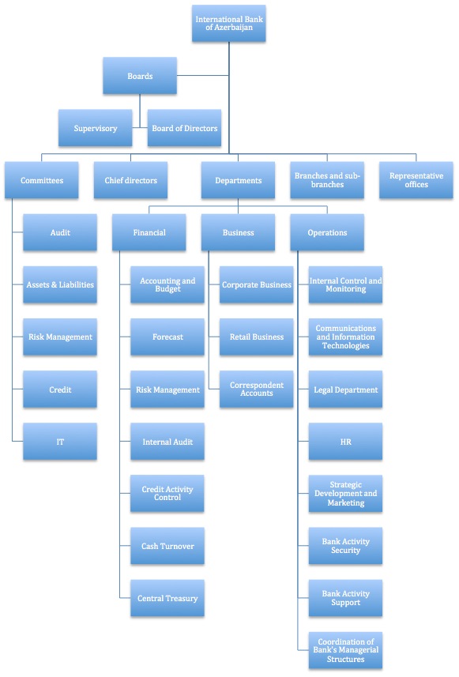
Org Boundary?
(Conway's Law)

Slide 38
Reverse Conway?

Slide 39
Value Chain Alignment

Slide 40
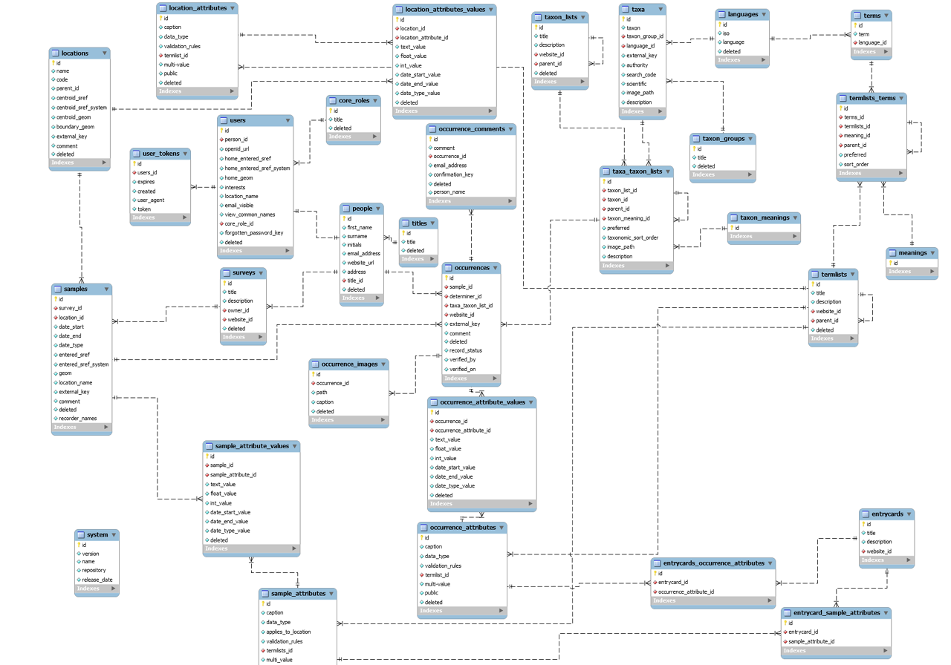
Data Boundaries?
Notes:
Anemic Services

Slide 41
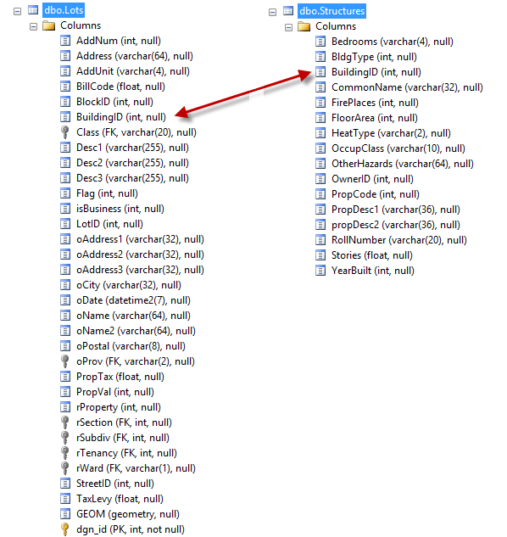
Data Boundary Issues
Notes:
Where to slice? Who reads? Who writes? Which fields? When in the value stream

Slide 42
Volume Manufacturing
Business or Functional Areas?
Discrete Manufacturing
Packing
Sourcing
Shipping
Notes:
Anemic Services

Slide 43
Batch Manufacturing
Discrete Manufacturing
Value Streams?
Procurement
Onboarding
Notes:
Can cross organizations and lead to composition which is a hard problem

Slide 44
Modules without contracts or encapsulation
Module
Module

Slide 45
Encapsulating modules with contracts
Module
Module
Publish
Subscribe
Event

Slide 46
Refactoring to slices

Slide 47
Vertical Slice Architecture
View Unapproved Invoices
Approve Invoice
Reject Invoice
UI Layer
Domain Objects
Repository
Database

Slide 48
Move code to single place

Slide 49
Move service methods to classes
Invoice Service
void Approve()
ApproveInvoice {}
void Reject()
RejectInvoice {}
void Flag()
FlagInvoice {}

Slide 50
Commands and Queries
Web App
GET
Query
Handler
Response
Query
POST
Command
Handler
Response
Command

Slide 51
One model in, one model out
Query
Handler
Response
Command
Handler
Response

Slide 52
Complete encapsulation
Request
Response

Slide 53
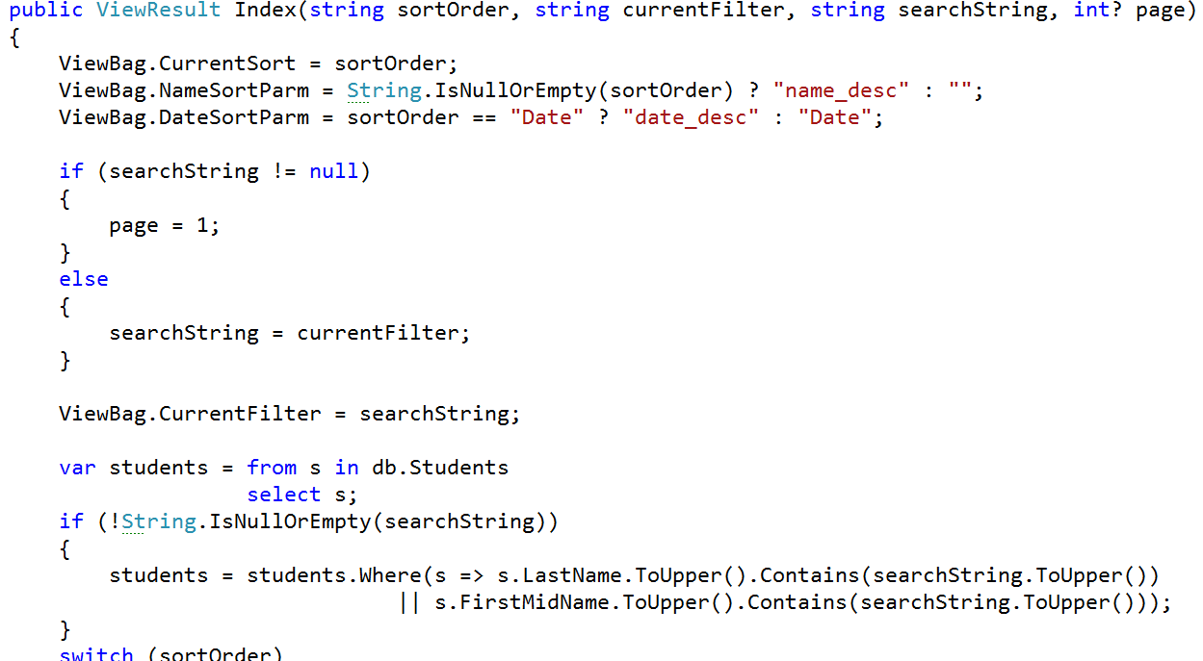
Modeling Queries

Slide 54
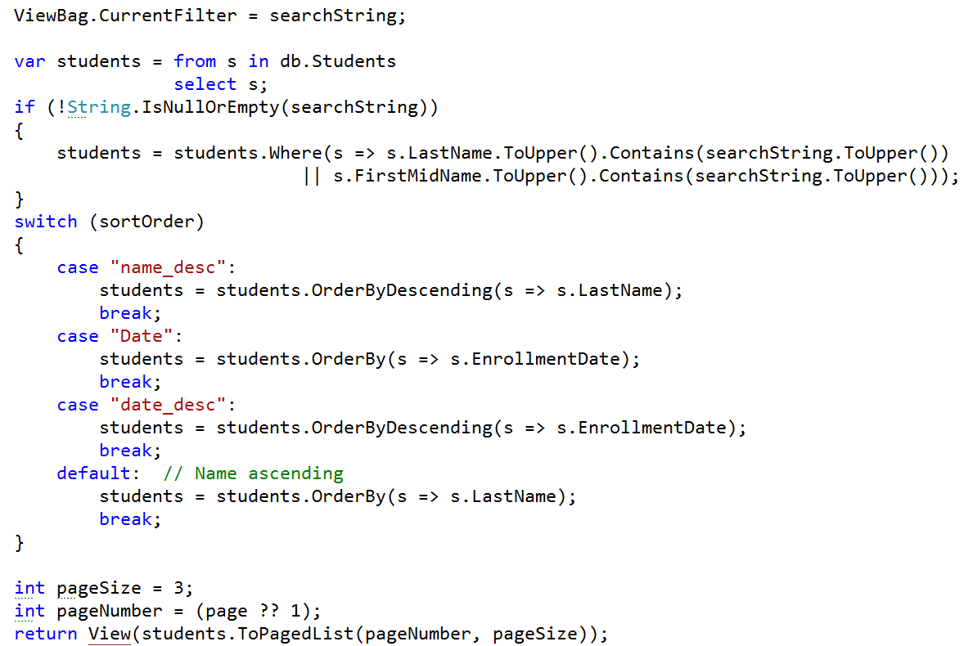
Modeling outputs

Slide 55
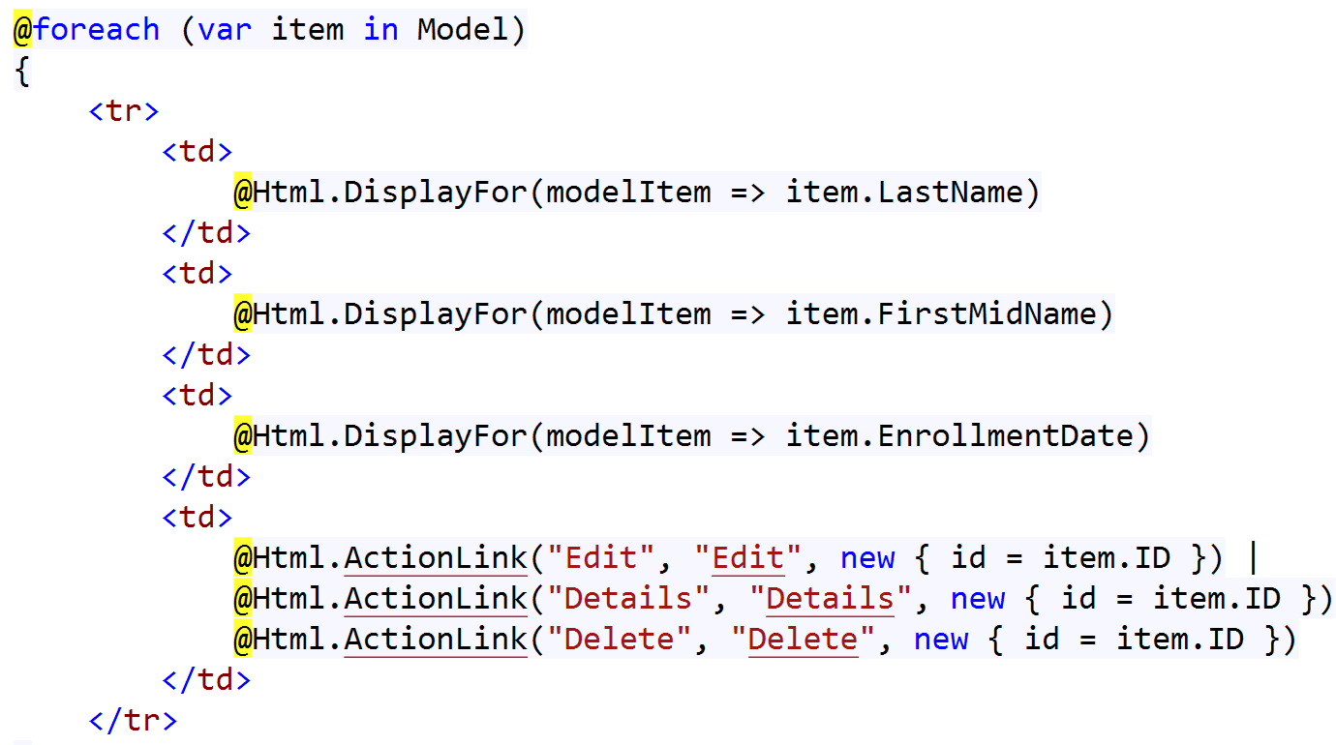
Modeling outputs

Slide 56
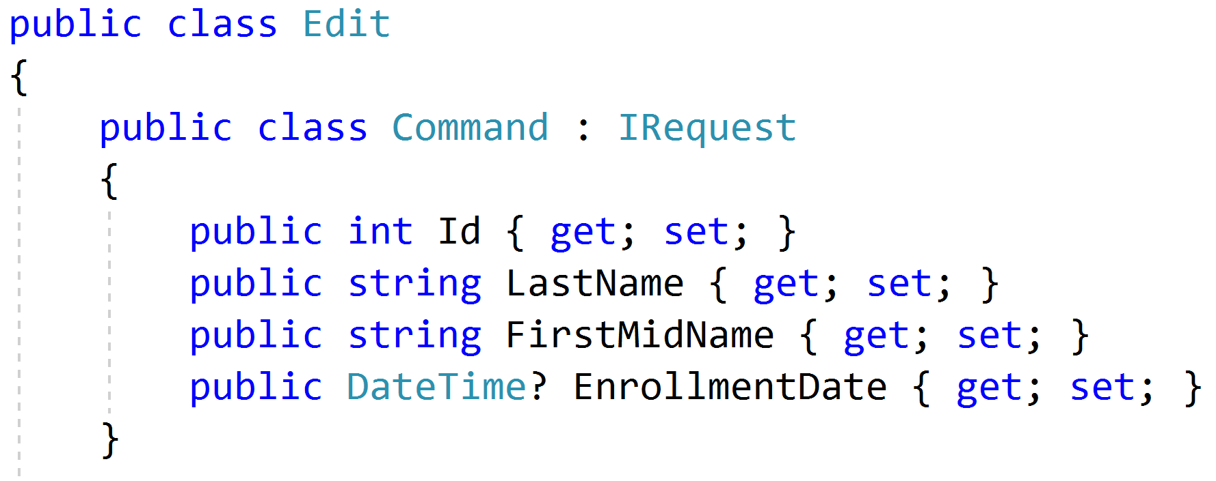
Modeling Commands

Slide 57
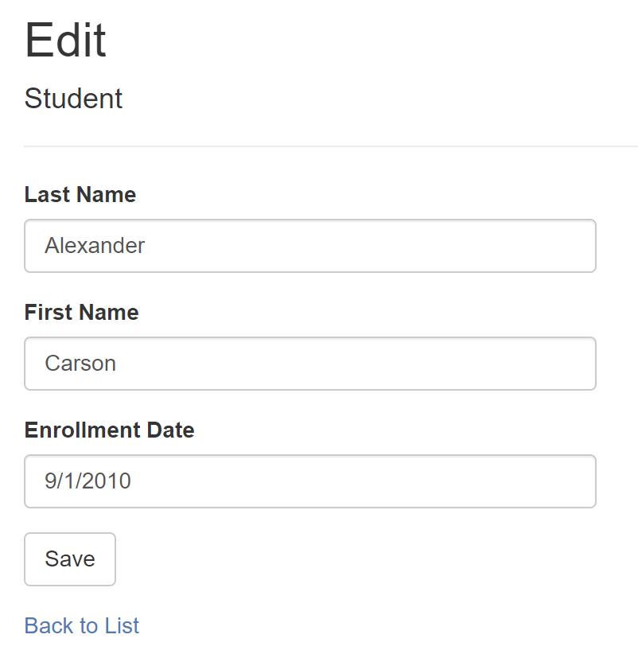
Commands as Forms

Slide 58
Task-Based UIs
Transfer
Student Details
Request
Handler
Response
Transfer
Correct
Schedule
…
…
…
…
…
…
…
Correct
Request
Handler
Response
Schedule
Request
Handler
Response

Slide 59
Grouping Slices into Modules
Module
View Unapproved Invoices
Approve Invoice
Reject Invoice
UI Layer
Domain Objects
Repository
Database

Slide 60
Data Boundaries

Slide 61

Single source of truth

Slide 62
?
?
?
$24.99
$25.49
$24.99
$24.99
$24.99
Catalog
Cart
Order
Fulfillment
Customer Journey and Value Stream

Slide 63
Migrating Data Paths
Old
New
Monolith
Notes:
Dual-write
Modify read paths
Modify write paths
Remove old data

Slide 64
Assessing Module Boundaries

Slide 65
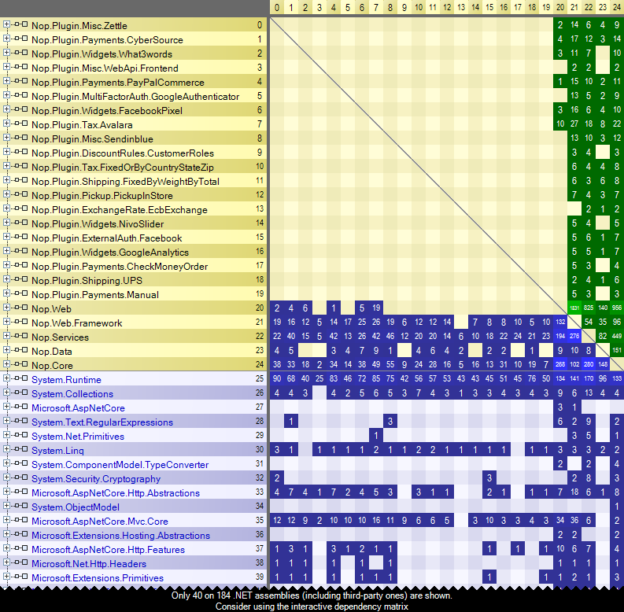
Static Analysis

Slide 66
Extracting Modules into (Micro)Services

Slide 67
What is a (micro)service?
Independently deployable
Loosely coupled
Autonomous

Slide 68
What is autonomy?
Independent ownership, availability, and delivery
Manage information and access
Handle failures
Maintain contracts

Slide 69
Modules to services
Module
Module
Publish
Subscribe
Event

Slide 70
Facades to encapsulate
Service
Module
API
Facade
Publish
Subscribe
Event

Slide 71
Sync to async messaging
Service
Module
API
Facade
Publish
Subscribe
Broker

Slide 72
Key Takeaways
No one wants a big ball of mud
Boundaries are critical to facilitate change
Slices make it easier to move towards modules
Shaping boundaries is easier in a monolith

Slide 73
Modularizing the Monolith
Jimmy Bogard
@jbogard
github.com/jbogard
jimmybogard.com

