Slide 1


Consistency and Agreements in Distributed Systems
Jimmy Bogard
@jimmybogard.com
github.com/jbogard
jimmybogard.com

Slide 2
A Simpler Time…

Slide 3
The Database
The App

Slide 4
The Database
The App
UPDATE Orders
SET Status = 3
WHERE Id = 123

Slide 5
The Database
The App

Slide 6
The Database
The App
SELECT Status
FROM Orders
WHERE Id = 123

Slide 7
The Database
The App
SELECT Status
FROM Orders
WHERE Id = 123
And all was good.jpg

Slide 8
The Database
The App

Slide 9
The Database
The App
UPDATE Orders
SET Status = 4
WHERE Id = 123
UPDATE Inventory
SET Quantity = Quantity – 3
WHERE ProductId = 456

Slide 10
The Database
The App

Slide 11
The Database
The App
SELECT Status
FROM Orders
WHERE Id = 123
SELECT Quantity
FROM Inventory
WHERE ProductId = 456

Slide 12
The Database
The App

Slide 13
The Database
The App
UPDATE Orders
SET Status = 4
WHERE Id = 123
UPDATE Inventory
SET Quantity = Quantity – 3
WHERE ProductId = 456

Slide 14
The Database
The App
UPDATE Orders
SET Status = 4
WHERE Id = 123
UPDATE Inventory
SET Quantity = Quantity – 3
WHERE ProductId = 456

Slide 15
The Database
The App
UPDATE Orders
SET Status = 4
WHERE Id = 123
UPDATE Inventory
SET Quantity = Quantity – 3
WHERE ProductId = 456

Slide 16
The Database
The App
UPDATE Orders
SET Status = 4
WHERE Id = 123
UPDATE Inventory
SET Quantity = Quantity – 3
WHERE ProductId = 456

Slide 17
✓
The Database
The App
UPDATE Orders
SET Status = 4
WHERE Id = 123
UPDATE Inventory
SET Quantity = Quantity – 3
WHERE ProductId = 456

Slide 18
A Slight Wrinkle…

Slide 19
The Database
The App

Slide 20
Sales Database
The App

Slide 21
Sales Database
UPDATE Orders
SET Status = 4
WHERE Id = 123
The App
Stock Database

Slide 22
Sales Database
UPDATE Orders
SET Status = 4
WHERE Id = 123
The App
Stock Database

Slide 23
Sales Database
UPDATE Orders
SET Status = 4
WHERE Id = 123
The App
Stock Database
UPDATE Inventory
SET Quantity = Quantity – 3
WHERE ProductId = 456

Slide 24
✓
Sales Database
UPDATE Orders
SET Status = 4
WHERE Id = 123
The App
Stock Database
UPDATE Inventory
SET Quantity = Quantity – 3
WHERE ProductId = 456

Slide 25
Sales Database
UPDATE Orders
SET Status = 4
WHERE Id = 123
The App
Stock Database
UPDATE Inventory
SET Quantity = Quantity – 3
WHERE ProductId = 456

Slide 26
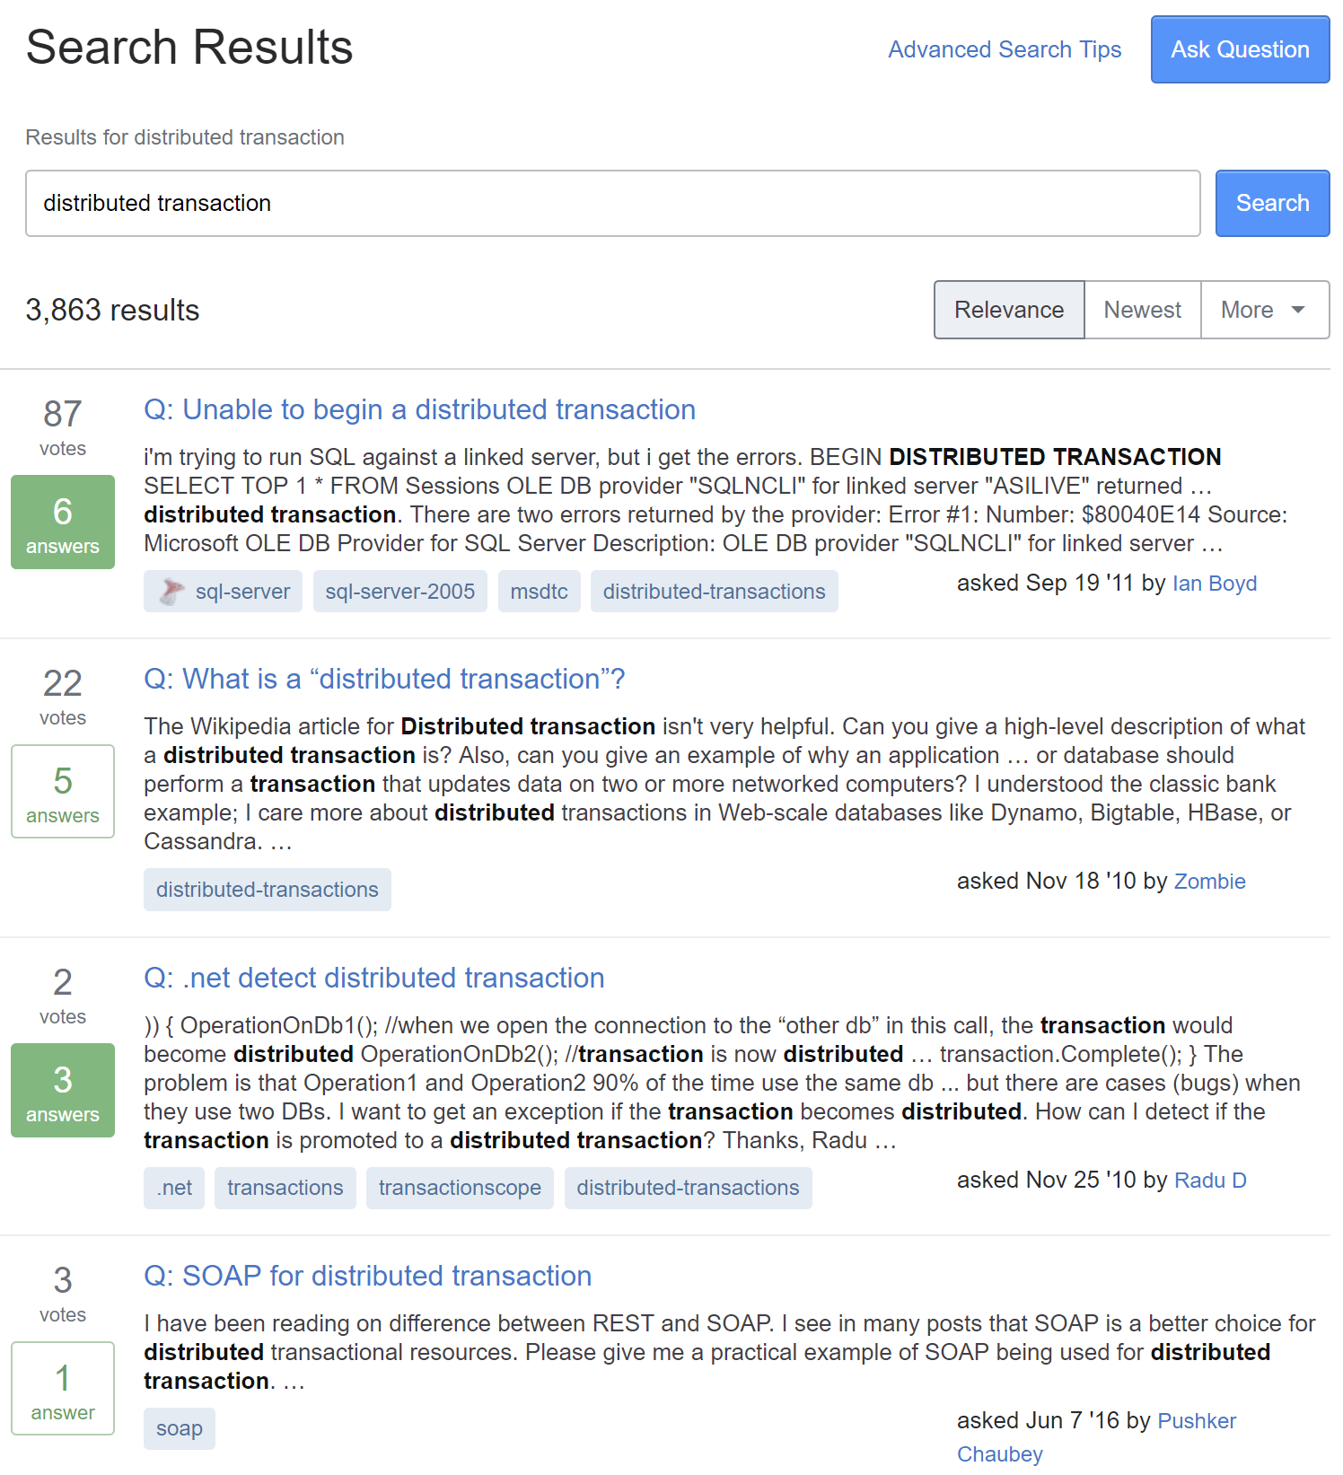

Slide 27
Distributed Transaction?

Slide 28
A database transaction in which two or more network hosts are involved

Slide 29
Most common protocol: Two-Phase Commit (aka 2PC)

Slide 30
Prepare
Resource A
Coordinator
Feedback
Resource B
Commit

Slide 31
Prepare
Resource A
Coordinator
Feedback
Resource B
Commit

Slide 32
✓
SQL Server
MS DTC
SQL Server

Slide 33
Always On
SQL Server
SQL Server
MS DTC
SQL Server

Slide 34
Azure
SQL Server
MS DTC
SQL Server

Slide 35
✓
SQL Server
MS DTC
MSMQ

Slide 36
SQL Server
MS DTC
RabbitMQ

Slide 37
NoSQL DB
MS DTC

Slide 38
2PC Summary
Transactions in a single resource – yes
Transactions across identical resources – no
Transactions across disparate resources – no
Transactions across multiple items – YesSQL and NoSQL

Slide 39
SomeDB
2PC
SomeMQ

Slide 40
Microservices Communication
Consuming messages from AMQP
Multiple writes to database
Producing messages to AMQP
All in a single "transactional" activity

Slide 41
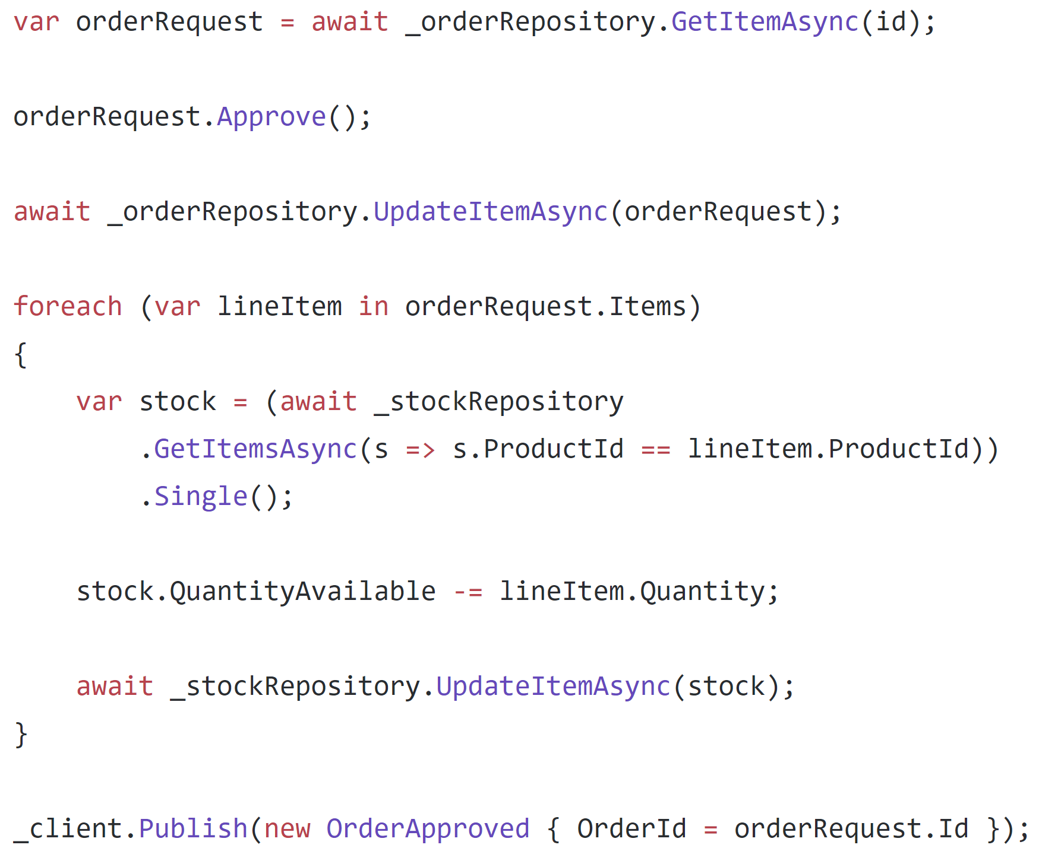

Slide 42
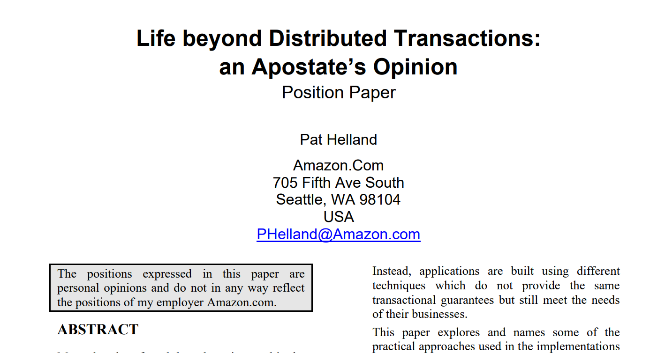

Slide 43
Epiphany: Assume a transactional boundary of a single aggregate

Slide 44
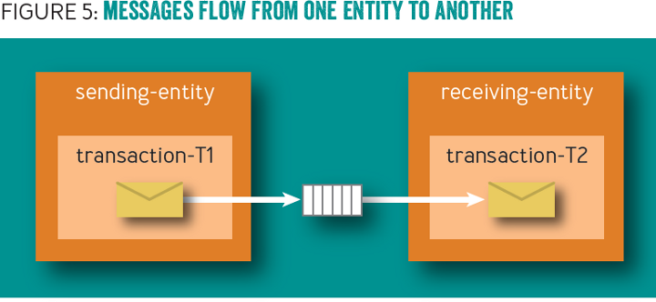

Slide 45
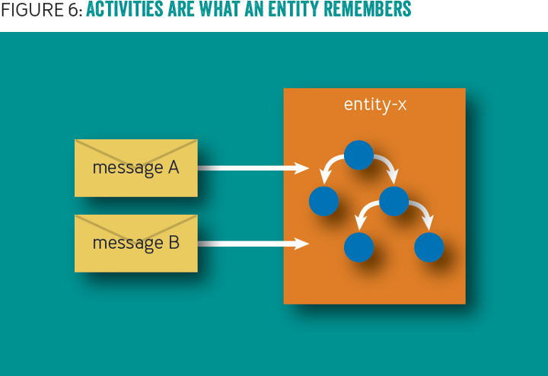

Slide 46
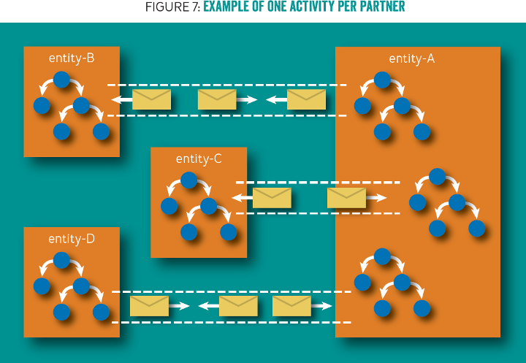

Slide 47
Aggregate
Aggregate
Business Data
Business Data
Outbox
Outbox
Inbox
Inbox

Slide 48
Microservice A
Microservice B
Aggregate
Aggregate
Data
Data
In
In
Out
Out
Microservice c
Aggregate
Data
In
Out
Notes:
3 documents participating in a single request, but no way to coordinate a transaction between the 3

Slide 49
Facilitating communication with a dispatcher

Slide 50
Microservice A
Microservice B
Aggregate
Aggregate
Data
Data
In
In
Out
Out
Microservice c
Aggregate
Data
In
Out
Notes:
3 documents participating in a single request, but no way to coordinate a transaction between the 3

Slide 51
Microservice A
Microservice B
Aggregate
Aggregate
Data
Data
…
…
In
In
Out
Out
Microservice c
Aggregate
Data
In
Out
Notes:
Initial request initiates changes in the first document. It needs to communicate to the others so it creates a couple of domain events.

Slide 52
Microservice A
Microservice B
✓
Aggregate
Aggregate
Data
Data
…
…
In
In
Out
Out
Microservice c
Aggregate
Data
In
Out
Notes:
The transaction for the first document document commits, including the domain events

Slide 53
Microservice A
Microservice B
✓
Aggregate
Aggregate
Data
Data
…
…
In
In
Out
Out
Microservice c
Aggregate
Data
Dispatcher
In
Out
Notes:
The domain event dispatcher is responsible for taking domain events and dispatching them to event handlers (and eventually other documents)

Slide 54
Microservice A
Microservice B
✓
Aggregate
Aggregate
Data
Data
…
…
In
In
Out
Out
Microservice c
Aggregate
Data
Dispatcher
In
Out
Notes:
The dispatcher reads the first event from the document

Slide 55
Microservice A
Microservice B
✓
Aggregate
Aggregate
Data
Data
…
…
In
In
Out
Out
Microservice c
Aggregate
Data
Dispatcher
In
Out
Notes:
And will dispatch it to handlers, who know how to match domain events to documents

Slide 56
Microservice A
Microservice B
✓
Aggregate
Aggregate
Data
Data
…
…
…
…
In
In
Out
Out
Microservice c
Aggregate
Data
Dispatcher
In
Out
Notes:
The first domain event is matched to an document, and the document handles it by mutating its data and storing this handled domain event in its inbox

Slide 57
Microservice A
Microservice B
✓
✓
Aggregate
Aggregate
Data
Data
…
…
…
…
In
In
Out
Out
Microservice c
Aggregate
Data
Dispatcher
In
Out
Notes:
This document document transaction succeeds

Slide 58
When things go wrong

Slide 59
Microservice A
Microservice B
✓
✓
Aggregate
Aggregate
Data
Data
…
…
…
…
In
In
Out
Out
Microservice c
Aggregate
Data
Dispatcher
In
Out
Notes:
This document document transaction succeeds

Slide 60
Microservice A
Microservice B
✓
✓
Aggregate
Aggregate
Data
Data
…
…
…
…
In
In
Out
Out
Microservice c
Aggregate
Data
Dispatcher
In
Out
Notes:
Upon dispatch to the second document however, this one fails, so no data is written and no event stored in the outbox

Slide 61
Microservice A
Microservice B
✓
✓
Aggregate
Aggregate
Data
Data
…
…
…
…
In
In
Out
Out
Microservice c
Aggregate
Data
Dispatcher
In
Out
Retry
Notes:
Detecting a failure, the dispatcher sends a durable message to an document retry queue, noting the document type and ID to retry domain events.

Slide 62
Retries

Slide 63
Microservice A
Microservice B
Aggregate
Aggregate
Data
Data
…
…
…
…
In
In
Out
Out
Microservice c
Aggregate
Data
Dispatcher
In
Out
Retry
Notes:
For retries, the dispatcher reads messages from the document retry queue.

Slide 64
Microservice A
Microservice B
Aggregate
Aggregate
Data
Data
…
…
…
…
In
In
Out
Out
Microservice c
Aggregate
Data
Dispatcher
In
Out
Retry
Notes:
The dispatcher then pulls the document and attempts to re-dispatch its domain events to the relevant handlers

Slide 65
Microservice A
Microservice B
Aggregate
Aggregate
Data
Data
…
…
…
…
In
In
Out
Out
Microservice c
Aggregate
Data
Dispatcher
In
Out
Retry
Notes:
For the first document, it sends the domain event to the handler

Slide 66
Microservice A
Microservice B
Aggregate
Aggregate
Data
Data
…
…
…
…
In
In
Out
Out
Microservice c
Aggregate
Data
Dispatcher
In
Out
Retry
Notes:
The document checks its inbox and compares the ID of the incoming domain event to its inbox of processed events

Slide 67
Microservice A
Microservice B
¯\_(ツ)_/¯
Aggregate
Aggregate
Data
Data
…
…
…
…
In
In
Out
Out
Microservice c
Aggregate
Data
Dispatcher
In
Out
Retry
Notes:
It sees that the message has already been processed, so ignores the event. Handling the domain event maintains idempotency, so that receiving a domain event at-least-once results in the actual processing of the event to only happen once

Slide 68
Microservice A
Microservice B
¯\_(ツ)_/¯
Aggregate
Aggregate
Data
Data
…
…
…
…
In
In
Out
Out
Microservice c
Aggregate
Data
…
…
Dispatcher
In
Out
Retry
Notes:
The dispatcher notifies the next handler of a domain event

Slide 69
Microservice A
Microservice B
¯\_(ツ)_/¯
Aggregate
Aggregate
Data
Data
…
…
…
…
In
In
Out
Out
Microservice c
✓
Aggregate
Data
…
…
Dispatcher
In
Out
Retry
Notes:
However, this document has not processed this domain event before, so it processes the domain event and stores it in its inbox.

Slide 70
Microservice A
Microservice B
¯\_(ツ)_/¯
Aggregate
Aggregate
Data
Data
…
…
…
…
In
In
Out
Out
Microservice c
✓
Aggregate
Data
…
…
Dispatcher
In
Out
Retry
Notes:
Now that all handlers have successfully processed the domain event, the dispatcher tells the originating document that the domain event can safely be deleted (or marked as processed)

Slide 71
Microservice A
Microservice B
✓
¯\_(ツ)_/¯
Aggregate
Aggregate
Data
Data
…
…
…
…
In
In
Out
Out
Microservice c
✓
Aggregate
Data
…
…
Dispatcher
In
Out
Retry
Notes:
The originating document is now saved, and we repeat for all domain events.

Slide 72
Complex Agreements with Sagas

Slide 73
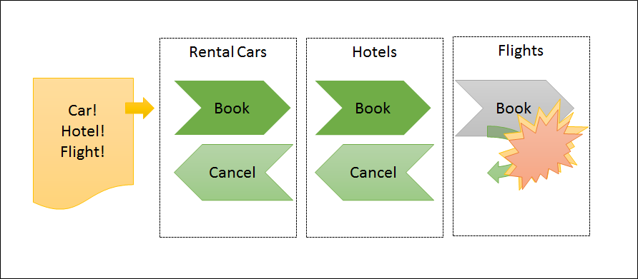

Slide 74
An order can be fulfilled when: The request is approved The stock is confirmed

Slide 75
Order Request
Order Fulfillment
Stock

Slide 76
Order Request
Order Fulfillment
OrderCreated
Stock

Slide 77
Order Request
Order Fulfillment
OrderCreated
Stock

Slide 78
Order Request
Order Fulfillment
StockRequest [123]
Stock

Slide 79
Order Request
Order Fulfillment
StockRequest [123]
StockRequest [456]
Stock

Slide 80
Order Request
Order Fulfillment
StockRequest [123]
StockRequest [456]
StockRequest [789]
Stock

Slide 81
Order Request
Order Fulfillment
Stock
StockRequest [123]
StockRequest [456]
StockRequest [789]

Slide 82
Order Request
Order Fulfillment
Stock
StockRequestConfirmed [123]
StockRequest [456]
StockRequest [789]

Slide 83
Order Request
Order Fulfillment
Stock
StockRequestConfirmed [123]
StockRequestConfirmed [456]
StockRequest [789]

Slide 84
Order Request
Order Fulfillment
Stock
StockRequestConfirmed [123]
StockRequestConfirmed [456]
StockRequestConfirmed [789]

Slide 85
Order Request
Order Fulfillment
StockRequestConfirmed [123]
StockRequestConfirmed [456]
StockRequestConfirmed [789]
Stock

Slide 86
Order Request
Order Fulfillment
OrderApproved
Stock

Slide 87
Order Request
Order Fulfillment
OrderApproved
Stock

Slide 88
Order Request
Order Fulfillment
OrderFulfillmentSuccessful
Stock

Slide 89
Order Request
Order Fulfillment
OrderFulfillmentSuccessful
Stock

Slide 90
Order Request
✓
Order Fulfillment
Stock

Slide 91
An order can be canceled when: The stock is denied OR The request is rejected

Slide 92
An order can be canceled when: The stock is denied OR The request is rejected

Slide 93
Order Request
Order Fulfillment
StockRequest [123]
StockRequest [456]
StockRequest [789]
Stock

Slide 94
Order Request
Order Fulfillment
Stock
StockRequest [123]
StockRequest [456]
StockRequest [789]

Slide 95
Order Request
Order Fulfillment
Stock
StockRequestConfirmed [123]
StockRequest [456]
StockRequest [789]

Slide 96
Order Request
Order Fulfillment
Stock
StockRequestConfirmed [123]
StockRequestConfirmed [456]
StockRequest [789]

Slide 97
Order Request
Order Fulfillment
Stock
StockRequestConfirmed [123]
StockRequestConfirmed [456]
StockRequestDenied [789]

Slide 98
Order Request
Order Fulfillment
StockRequestConfirmed [123]
StockRequestConfirmed [456]
StockRequestDenied [789]
Stock

Slide 99
Order Request
Order Fulfillment
CancelOrderRequest
StockReturnRequested [123]
StockReturnRequested [456]
Stock

Slide 100
Order Request
Order Fulfillment
CancelOrderRequest
Stock
StockReturnRequested [123]
StockReturnRequested [456]

Slide 101
Order Request
✓
Order Fulfillment
Stock

Slide 102
An order can be canceled when: The stock is denied OR The request is rejected

Slide 103
Order Request
Order Fulfillment
OrderRejected
Stock

Slide 104
Order Request
Order Fulfillment
OrderRejected
Stock

Slide 105
Order Request
Order Fulfillment
StockReturnRequested [123]
StockReturnRequested [456]
StockReturnRequested [789]
Stock

Slide 106
Order Request
Order Fulfillment
Stock
StockReturnRequested [123]
StockReturnRequested [456]
StockReturnRequested [789]

Slide 107
Order Request
✓
Order Fulfillment
Stock

Slide 108
Demo

Slide 109
Find the transactional boundaries

Slide 110
SQL Server
row1
row2
row3
Outbox
Id
Type
Body
Dispatcher
Tx
RabbitMQ

Slide 111
Broker
Bounded Context A
Bounded Context B
Dispatcher
Translator
Receiver
Dispatcher
SQL
SQL
Outbox
Inbox

Slide 112
Demo
Notes:
DocumentFeedObserver

Slide 113
Our lessons
Distributed transactions are "Easy" locally
Distributed transactions are hard/impossible when…distributed
Find the transactional boundary
Outbox to coordinate communication

