Slide 1
AppStore
Deploy
Template-development
<Game>-master
Template-development
<Game>-development
Pull
Clone
Template-development
Template-master
Template-development
Template-development
Pull

Slide 2
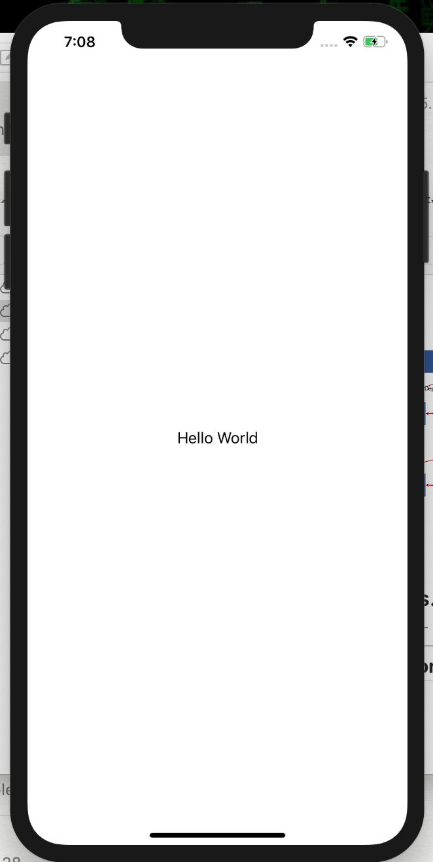
InApp-Store-Screen
Data-Privacy-Screen
Main-Screen
Menu-Buttons
Game-View
InApp-Offer-Screen
Launch-Screen
Settings-Screen
Game-Center-Screen
Banner
External-Links-Screen
Feedback-Screen
Video-Screen
Replay-Screen

