Slide 1

Domain Shift in Artificial Neural Networks: A Survey of Domain Adaptation Techniques
Case study for 21CSE326T Artificial Neural Networks
Jai
Aggam Singh Arora
Areeb Akhtar
Ujwal M
Guide: Dr. Kothai G
Department of Computational Intelligence
SRM Institute of Science and Technology, Kattankulathur
November 2026

Slide 2
Motivation: a model that works in one hospital fails in another
• Zech et al. (2018) trained CNNs to detect pneumonia in chest radiographs.
• Tested at outside hospitals, the models did worse than at their training hospital in 3 of 5 comparisons.
• The same models could identify the hospital system from the image alone.
• The model had learned cues unrelated to pneumonia, such as scanner and hospital artifacts.
3 of 5
comparisons with lower accuracy at outside hospitals
99.95%
hospital-system detection, NIH
99.98%
hospital-system detection, Mount Sinai
Zech et al., PLOS Medicine 15(11): e1002683, 2018.
21CSE326T Artificial Neural Networks | SRM Institute of Science and Technology, Kattankulathur
2

Slide 3
What is domain shift
A model is trained on data from a source distribution and used on data from a different target distribution, for the same task. Held-out accuracy on the source then says little about accuracy in deployment.
Type | What changes | Example
Covariate shift | Input distribution P(x); P(y | x) is unchanged | Different scanner, camera, lighting or background
Label shift | Class proportions P(y); P(x | y) is unchanged | A disease is more common at one hospital
Concept shift | The relation P(y | x) itself | Label meaning drifts over time or between annotators
This work focuses on covariate shift in image classification, where the target domain has no labels (unsupervised domain adaptation).
21CSE326T Artificial Neural Networks | SRM Institute of Science and Technology, Kattankulathur
3

Slide 4
Why accuracy drops: the Ben-David bound
ε_T(h) ≤ ε_S(h) + ½ d_HΔH(S, T) + λ
ε_T(h)
Target error: what we care about and cannot measure without target labels.
ε_S(h)
Source error: low, because we train on it.
d_HΔH(S, T)
Divergence between the two domains as seen by the hypothesis class. Domain adaptation tries to shrink this term.
λ
Error of the best single hypothesis on both domains. If it is large, no method can adapt.
Ben-David et al., Machine Learning 79(1-2): 151-175, 2010.
21CSE326T Artificial Neural Networks | SRM Institute of Science and Technology, Kattankulathur
4

Slide 5
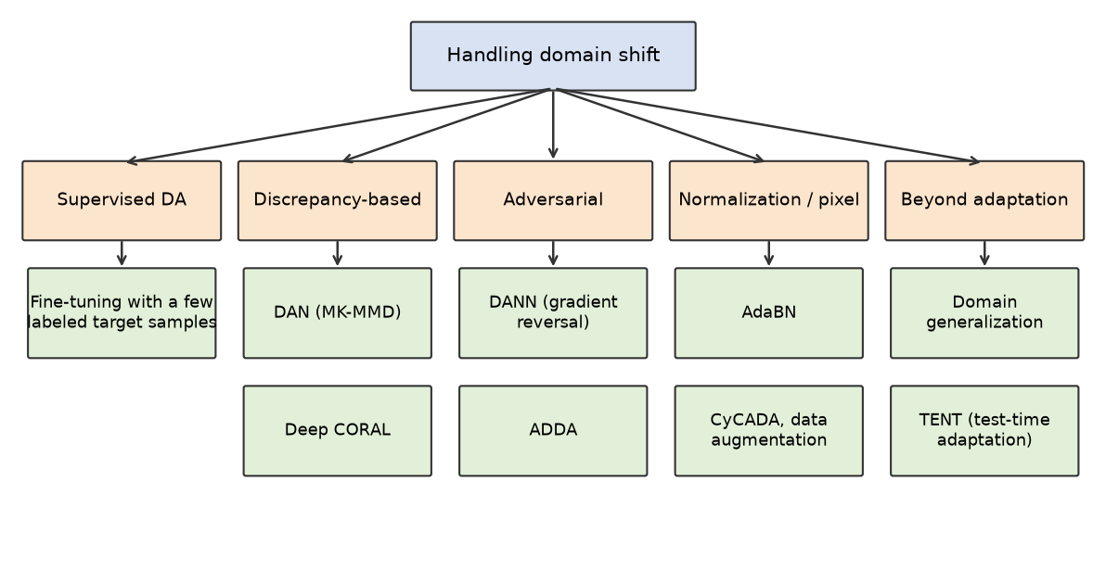
Taxonomy of approaches
21CSE326T Artificial Neural Networks | SRM Institute of Science and Technology, Kattankulathur
5

Slide 6
Methods surveyed
Method | Core idea | Target data at training
Fine-tuning | Continue training on labeled target data | Labeled
DAN (2015) | Penalize multi-kernel MMD between domains on task-specific layers | Unlabeled
Deep CORAL (2016) | Align second-order statistics (covariances) of the features | Unlabeled
DANN (2015) | Domain classifier with a gradient reversal layer; features become domain-invariant | Unlabeled
ADDA (2017) | Untied target encoder trained against a domain discriminator | Unlabeled
AdaBN (2016) | Replace batch-norm statistics with statistics of the target data | Unlabeled, no training
CyCADA (2018) | Pixel-level and feature-level adaptation with cycle consistency | Unlabeled
TENT (2021) | Minimize prediction entropy on test batches, updating BN parameters | Unlabeled, at test time
21CSE326T Artificial Neural Networks | SRM Institute of Science and Technology, Kattankulathur
6

Slide 7
Experiment: MNIST to MNIST-M
Question: how much of the accuracy lost to domain shift can a cheap method (AdaBN) and an adversarial method (DANN) recover, with no target labels?
Method | Role | Uses target images | Uses target labels
Source-only | Lower reference: ignore the shift | No | No
AdaBN | Re-estimate BN statistics on target images | Yes | No
DANN | Adversarial feature alignment | Yes | No
Target-only | Upper bound | Yes | Yes
Metric: gap closed = (method - source-only) / (target-only - source-only), on MNIST-M test accuracy, computed per seed.
21CSE326T Artificial Neural Networks | SRM Institute of Science and Technology, Kattankulathur
7

Slide 8
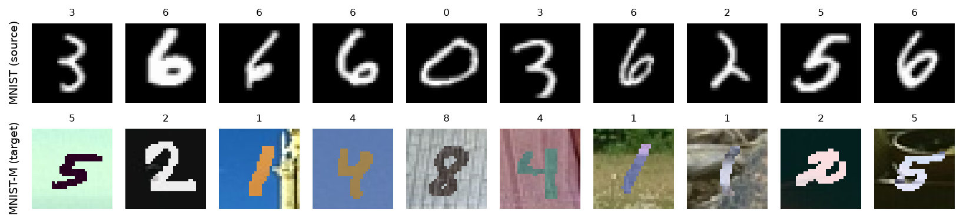
Datasets
 | MNIST (source) | MNIST-M (target)
Content | Handwritten digits, grayscale, resized to 32x32 and copied to 3 channels | MNIST digits blended with random photo patches, 32x32 RGB
Source | torchvision download | Hugging Face dataset Mike0307/MNIST-M
Training / test | 10,000 random training images / 10,000 test | 10,000 random training images / 9,001 test
21CSE326T Artificial Neural Networks | SRM Institute of Science and Technology, Kattankulathur
8

Slide 9
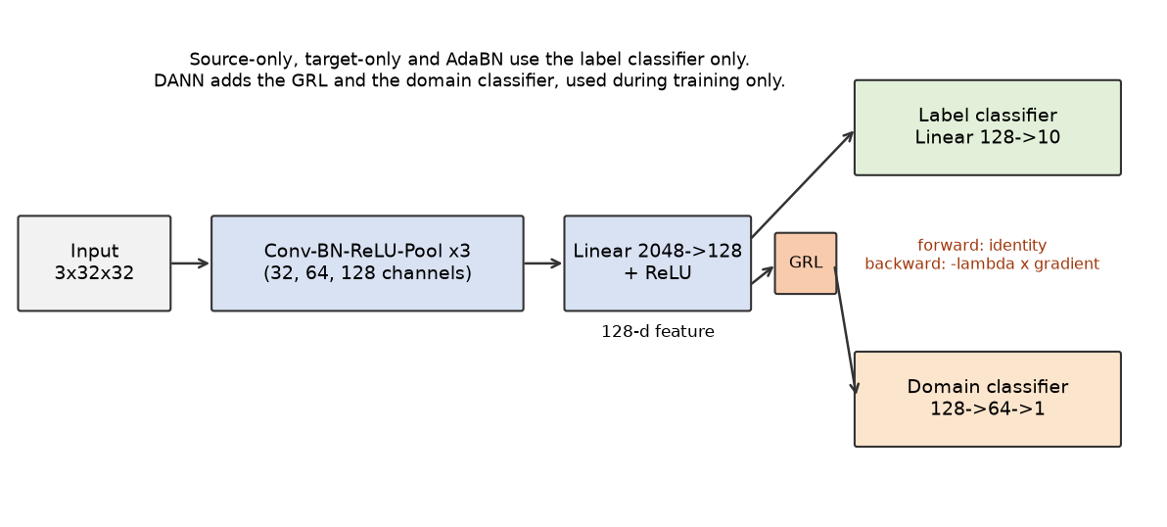
Shared backbone and DANN components
Three Conv-BatchNorm-ReLU-MaxPool blocks (32, 64, 128 channels), a 128-d feature layer and a 10-way classifier. Every method uses this backbone; DANN adds the gradient reversal layer and a domain classifier.
21CSE326T Artificial Neural Networks | SRM Institute of Science and Technology, Kattankulathur
9

Slide 10
AdaBN and DANN
AdaBN
DANN
• Take the source-only model and keep all weights fixed.
• Recompute each BatchNorm layer's mean and variance on unlabeled target images.
• Two sets of statistics: source for MNIST, target for MNIST-M, so MNIST accuracy is unchanged.
• No training: about 1 second.
• A domain classifier on the 128-d features separates source from target.
• The gradient reversal layer is the identity going forward and multiplies the gradient by -λ going backward, so the feature extractor learns to confuse the domain classifier.
• Label loss on source only; λ = 2 / (1 + exp(-10p)) - 1 rises from 0 to 1.
• A concatenated source and target batch goes through the backbone, so BN statistics are mixed.
21CSE326T Artificial Neural Networks | SRM Institute of Science and Technology, Kattankulathur
10

Slide 11
Training setup
Item | Value
Optimizer | SGD, momentum 0.9
Learning rate | 0.01 / (1 + 10p)^0.75, p = training progress from 0 to 1 (Ganin and Lempitsky)
Batch size / epochs | 128 / 30, identical for every method
Training data | 10,000 images per domain
Seeds | 0, 1, 2 (all reported, none selected)
Hardware | CPU only; about 7 minutes per seed for all four methods
Before the final run, the preprocessing of both domains was audited (same format, range and normalization) and no problem was found. AdaBN is evaluated with source statistics on MNIST and target statistics on MNIST-M.
21CSE326T Artificial Neural Networks | SRM Institute of Science and Technology, Kattankulathur
11

Slide 12
Results
Mean ± std over 3 seeds, test accuracy (%)
Method | MNIST | MNIST-M | Gap closed
Source-only | 98.75 ± 0.07 | 19.62 ± 2.56 | -
AdaBN | 98.75 ± 0.07 | 47.63 ± 2.77 | 37.6 ± 1.6 %
DANN | 98.69 ± 0.05 | 39.47 ± 5.47 | 26.7 ± 5.7 %
Target-only | 94.01 ± 2.02 | 94.18 ± 0.10 | 100 (by definition)
A model at 98.75% on MNIST scores 19.62% on MNIST-M. AdaBN recovers 37.6% of the gap, DANN 26.7%.
21CSE326T Artificial Neural Networks | SRM Institute of Science and Technology, Kattankulathur
12

Slide 13
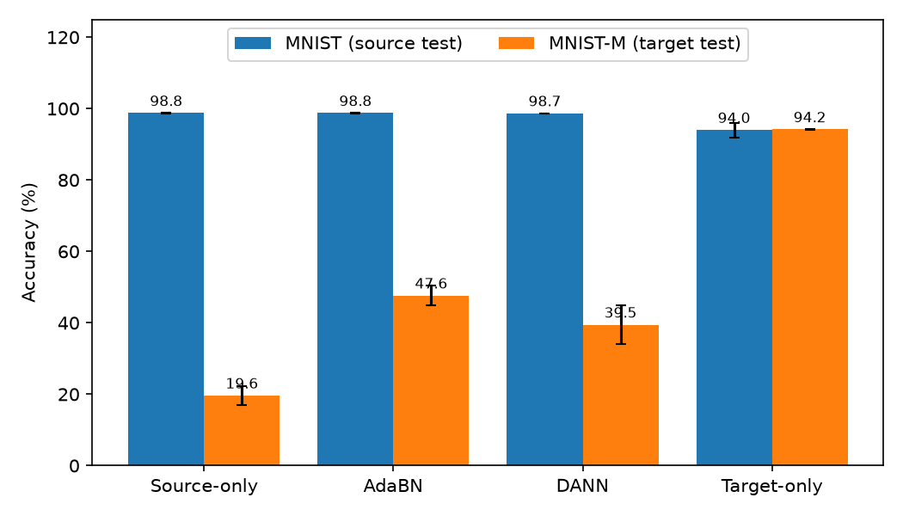
Accuracy by method and per-seed MNIST-M results
MNIST-M (%) | Seed 0 | Seed 1 | Seed 2
Source-only | 20.28 | 22.39 | 16.21
AdaBN | 48.29 | 50.64 | 43.96
DANN | 45.71 | 40.31 | 32.40
Target-only | 94.17 | 94.06 | 94.31
Gap closed (%) | Seed 0 | Seed 1 | Seed 2
AdaBN | 37.9 | 39.4 | 35.5
DANN | 34.4 | 25.0 | 20.7
AdaBN is ahead of DANN in every seed.
21CSE326T Artificial Neural Networks | SRM Institute of Science and Technology, Kattankulathur
13

Slide 14
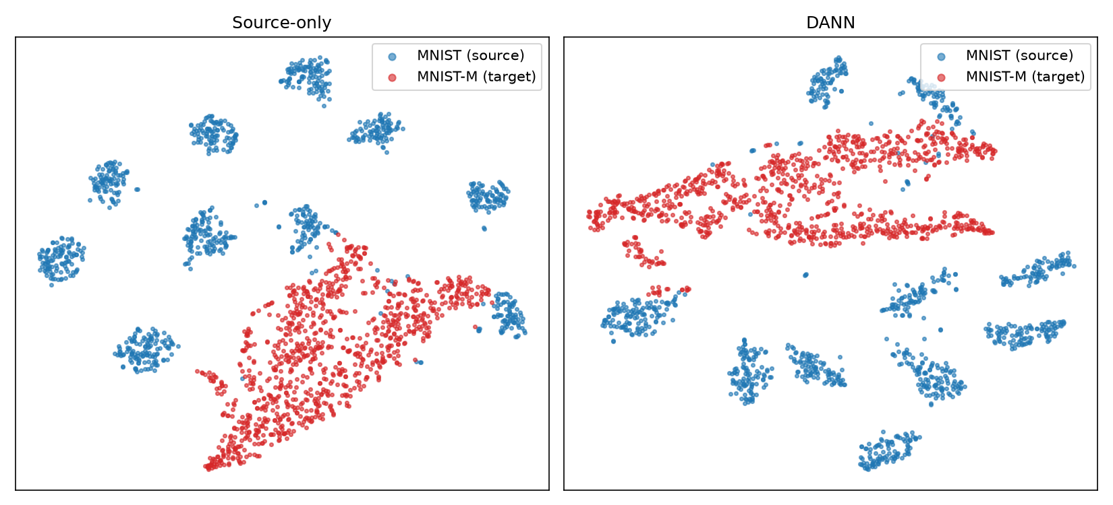
Feature space: source-only vs DANN
t-SNE of 128-d features, seed 0. DANN's domain loss reached ln 2 (about 0.693), the value for a chance-level domain classifier, yet source and target features still sit in separate regions.
21CSE326T Artificial Neural Networks | SRM Institute of Science and Technology, Kattankulathur
14

Slide 15
Findings and limitations
Findings
Limitations
• The shift is large: 98.75% on MNIST falls to 19.62% on MNIST-M.
• AdaBN closed more of the gap than DANN in every seed, with no training.
• DANN improved on source-only in every seed but varies more across seeds (gap closed 20.7 to 34.4).
• A domain loss at chance did not mean the domains were aligned.
• Not directly comparable to Ganin and Lempitsky (57.5% source-only, 81.5% DANN): different network, data size and MNIST-M copy.
• Toy benchmark with a synthetic shift; may not transfer to real shifts such as hospitals.
• Small CNN, 10,000 images per domain, 30 epochs, 3 seeds.
• DANN was not tuned per method. Why it trails AdaBN here was not tested; mixed BN statistics and small data are candidates.
• Only AdaBN and DANN were run. The other surveyed methods are described, not implemented.
21CSE326T Artificial Neural Networks | SRM Institute of Science and Technology, Kattankulathur
15

Slide 16
Conclusion and references
• Domain shift is a deployment risk that held-out accuracy on the training distribution does not reveal.
• In this setup, re-estimating batch-norm statistics (AdaBN) was the cheapest and most reliable adaptation method; DANN gave a smaller and less stable gain.
• Code, results and report: github.com/jboiie/domain-shift-ann-survey
References
Zech et al. (2018). Variable generalization performance of a deep learning model to detect pneumonia in chest radiographs. PLOS Medicine 15(11): e1002683.
Ben-David et al. (2010). A theory of learning from different domains. Machine Learning 79(1-2): 151-175.
Ganin & Lempitsky (2015). Unsupervised domain adaptation by backpropagation. ICML, PMLR 37: 1180-1189.
Ganin et al. (2016). Domain-adversarial training of neural networks. JMLR 17(59): 1-35.
Li et al. (2016). Revisiting batch normalization for practical domain adaptation. arXiv:1603.04779.
Wang & Deng (2018). Deep visual domain adaptation: A survey. Neurocomputing 312: 135-153.
21CSE326T Artificial Neural Networks | SRM Institute of Science and Technology, Kattankulathur
16

