Slide 1

Domain Shift in Artificial Neural Networks: A Survey of Domain Adaptation Techniques
Case Study Review: 21CSE326T Artificial Neural Networks
SRM Institute of Science and Technology, Kattankulathur
Guide Name:
Dr. Kothai G
Department of Computational Intelligence
Student Name & Registration Number
Jai - RA2411026010131
Aggam Singh Arora - RA2411026010139
Areeb Akhtar - RA2411026010154
Ujwal M - RA2411026010157

Slide 2
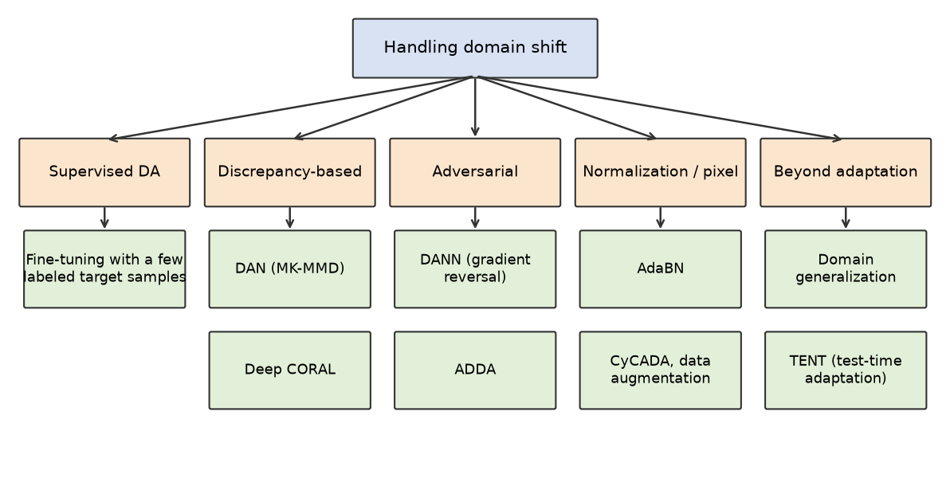
Introduction
• Neural networks assume that training and deployment data come from the same distribution. Under domain shift this fails, and held-out accuracy gives no warning.
• Zech et al. (2018): pneumonia CNNs did worse at outside hospitals in 3 of 5 comparisons and identified the hospital system with 99.95% (NIH) and 99.98% (Mount Sinai) accuracy.
• Domain adaptation uses unlabeled target data to reduce the gap. The figure shows the families of methods surveyed.

Slide 3
Abstract
• This work surveys domain shift in neural networks and the main families of domain adaptation methods: fine-tuning, discrepancy-based (DAN, Deep CORAL), adversarial (DANN, ADDA), normalization-based (AdaBN, TENT), pixel-level (CyCADA) and domain generalization.
• A controlled experiment trains one small CNN on MNIST and tests it on MNIST-M, comparing source-only, target-only, AdaBN and DANN with the same network, data and training recipe.
• Over three seeds, MNIST-M accuracy is 19.62% for source-only, 47.63% for AdaBN, 39.47% for DANN and 94.18% for target-only.
• AdaBN closed more of the gap than DANN in every seed. DANN's domain loss reached ln 2, yet t-SNE still shows the two domains apart.
• The benchmark is a toy one, so the conclusions are limited accordingly.

Slide 4
Problem Statement
• A model trained on a source domain loses accuracy on a target domain, and target labels are usually not available.
• Source accuracy hides the loss: the same network scores 98.75% on MNIST and 19.62% on MNIST-M.
• Question: using only unlabeled target images, how much of the lost accuracy can AdaBN and DANN recover under an identical network, data and training recipe?
• Published comparisons use different networks, data sizes and recipes, which makes the answer hard to read from the literature.

Slide 5
Literature Survey
S.No. | Title / Author / Publication | Methodology | Research Gap / Limitation | Result / Contribution
1 | Variable generalization performance of a deep learning model to detect pneumonia in chest radiographs. Zech et al., PLOS Medicine, 2018 | CNNs trained on chest X-rays from hospital systems, tested internally and at outside hospitals | Studies the failure only; proposes no adaptation method | Lower accuracy at outside hospitals in 3 of 5 comparisons; hospital system identified at 99.95% (NIH) and 99.98% (Mount Sinai)
2 | A theory of learning from different domains. Ben-David et al., Machine Learning, 2010 | Theoretical analysis of target error under domain shift | A guarantee, not a training method; the divergence term is hard to compute exactly | Target error is bounded by source error plus domain divergence plus the error of the best joint hypothesis
3 | Deep visual domain adaptation: A survey. Wang and Deng, Neurocomputing, 2018 | Survey of deep domain adaptation for visual recognition | No controlled comparison of the methods | Organizes deep adaptation methods by training loss and data setting
4 | Domain generalization: A survey. Zhou et al., IEEE TPAMI, 2023 | Survey of methods that use no target data at training time | Survey only; no new experiments | Taxonomy of domain generalization methods and open problems

Slide 6
Literature Survey (Contd.)
S.No. | Title / Author / Publication | Methodology | Research Gap / Limitation | Result / Contribution
5 | Learning transferable features with deep adaptation networks (DAN). Long et al., ICML, 2015 | Multi-kernel MMD penalty on task-specific layers | Needs a kernel choice and unlabeled target data at training time | Higher target accuracy than baselines on standard image benchmarks
6 | Deep CORAL: Correlation alignment for deep domain adaptation. Sun and Saenko, ECCV Workshops, 2016 | Differentiable loss that aligns feature covariances of source and target | Aligns second-order statistics only | Simple loss that adds no parameters; competitive on Office-31
7 | Unsupervised domain adaptation by backpropagation (DANN). Ganin and Lempitsky, ICML, 2015 | Domain classifier trained jointly with the features through a gradient reversal layer | Adversarial training can be unstable; needs unlabeled target data | MNIST to MNIST-M: 57.5% source-only to 81.5% with DANN (their setup)
8 | Domain-adversarial training of neural networks. Ganin et al., JMLR, 2016 | Full DANN formulation with theory and the lambda schedule | Aligns marginal feature distributions only | Evaluated on image classification and person re-identification

Slide 7
Literature Survey (Contd.)
S.No. | Title / Author / Publication | Methodology | Research Gap / Limitation | Result / Contribution
9 | Adversarial discriminative domain adaptation (ADDA). Tzeng et al., CVPR, 2017 | Untied target encoder trained against a domain discriminator | Multi-stage adversarial training | Competitive results on digit and Office adaptation tasks
10 | Revisiting batch normalization for practical domain adaptation (AdaBN). Li et al., arXiv, 2016 | Replace batch-norm statistics with target statistics; no training | Only for networks with batch norm; adapts means and variances only | Gains with no extra training; can be combined with other methods
11 | CyCADA: Cycle-consistent adversarial domain adaptation. Hoffman et al., ICML, 2018 | Pixel-level translation and feature-level adaptation with cycle consistency | Heavy: needs generative adversarial training | Adaptation on digit benchmarks and synthetic-to-real segmentation (GTA5 to Cityscapes)
12 | Tent: Fully test-time adaptation by entropy minimization. Wang et al., ICLR, 2021 | Minimize prediction entropy on test batches, updating batch-norm scale and shift | Needs test batches and relies on confident predictions | Lower error under corruption and shift without source data or labels

Slide 8
Research Gaps
1. Inconsistent comparison: methods are reported with different networks, data sizes and training recipes, so their results cannot be compared directly.
2. Cheap baselines: a normalization-only method such as AdaBN needs no training and is a useful reference next to adversarial methods.
3. Domain loss as a signal: a domain classifier at chance is often read as aligned features, but invariant representations have limits (Zhao et al., 2019).
4. Real shifts: benchmark shifts are mostly synthetic or curated, while deployment shifts such as hospitals are harder to benchmark.
5. Variance: single-run results hide seed variance, which is large for adversarial training.

Slide 9
Objectives
1. To survey the types of domain shift and the main families of domain adaptation methods.
2. To compare source-only, AdaBN, DANN and a target-only upper bound on MNIST to MNIST-M with one network and one training recipe.
3. To report mean and standard deviation over seeds 0, 1 and 2, with every individual seed shown.
4. To measure the share of the source-to-target accuracy gap that each method closes.
5. To inspect the learned features with t-SNE and compare them with the DANN domain loss.
6. To publish the code, results and report so the experiment can be reproduced.

Slide 10
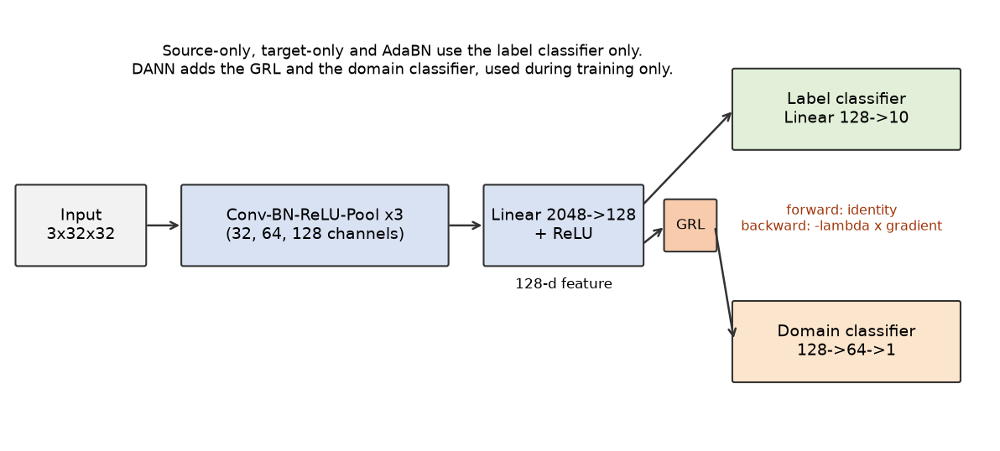
Methodology
• Source-only / target-only: train on MNIST or MNIST-M labels. Target-only is the upper bound.
• AdaBN: replace batch-norm statistics with target statistics, no training. MNIST is scored with source statistics.
• DANN: domain classifier behind a gradient reversal layer (identity forward, -lambda times gradient backward), lambda = 2 / (1 + exp(-10p)) - 1.

Slide 11
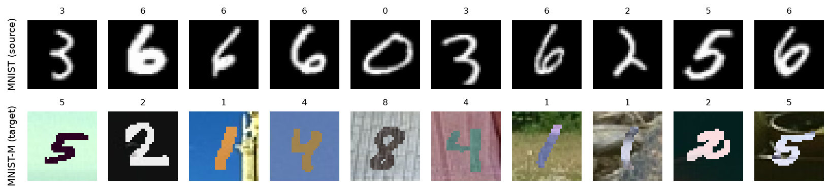
Experimental Setup
Item | Value
Domains | MNIST (source), MNIST-M from Hugging Face Mike0307/MNIST-M (target); 32x32, 3 channels
Data | 10,000 training images per domain; full test sets (10,000 and 9,001)
Backbone | 3 x Conv-BN-ReLU-MaxPool (32, 64, 128), Linear 2048 to 128, Linear 128 to 10
Optimizer | SGD, momentum 0.9, lr = 0.01 / (1 + 10p)^0.75
Training | batch size 128, 30 epochs, seeds 0, 1, 2, CPU only

Slide 12
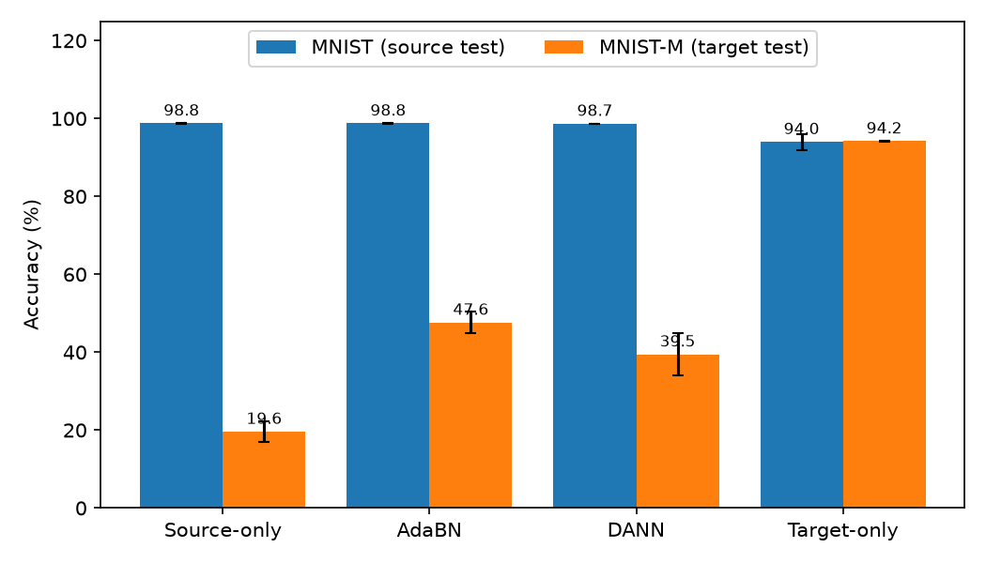
Comparative Analysis of Models
Method | MNIST acc. (%) | MNIST-M acc. (%) | Gap closed (%)
Source-only | 98.75 ± 0.07 | 19.62 ± 2.56 | -
AdaBN | 98.75 ± 0.07 | 47.63 ± 2.77 | 37.6 ± 1.6
DANN | 98.69 ± 0.05 | 39.47 ± 5.47 | 26.7 ± 5.7
Target-only | 94.01 ± 2.02 | 94.18 ± 0.10 | 100 (by definition)
Mean ± std over seeds 0, 1, 2. AdaBN is ahead of DANN in every seed.

Slide 13
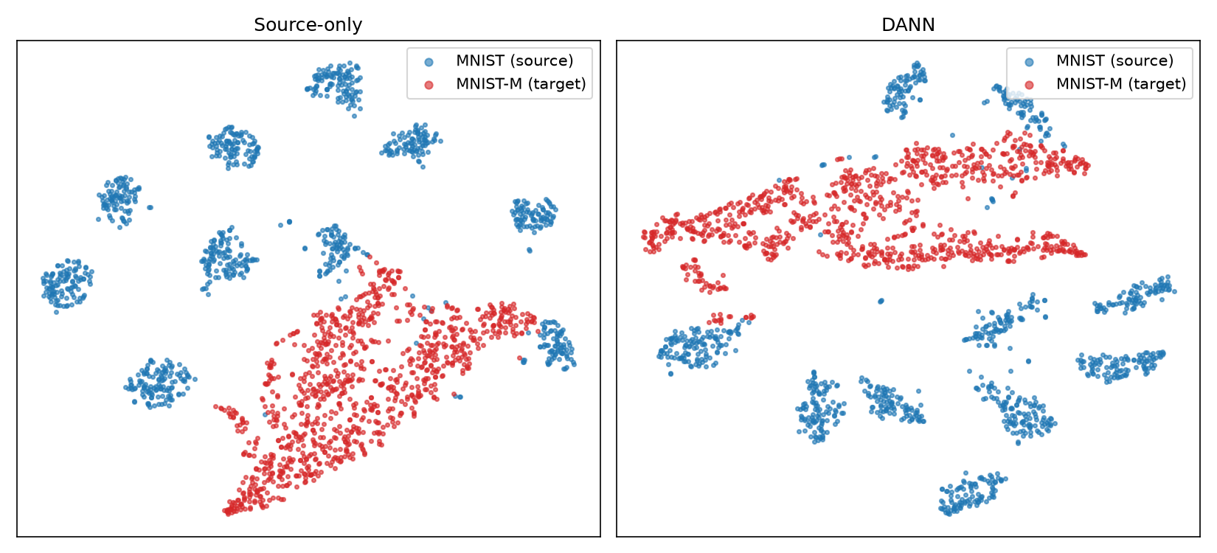
Feature-Space Analysis
• DANN's domain loss reached ln 2 (about 0.693), the value for a chance-level domain classifier.
• Source and target features still sit in separate regions, so a chance-level domain loss did not mean aligned features.
• The plot shows seed 0 only; it is a visual check, not a measurement.

Slide 14
Conclusion and Limitations
• Domain shift is a deployment risk that held-out source accuracy does not reveal.
• AdaBN closed 37.6% of the gap with no training. DANN closed 26.7% with larger variation across seeds. AdaBN was ahead in every seed.
• Reporting a normalization-only baseline next to adversarial methods is cheap and informative.
Limitations
• Toy benchmark with a synthetic shift, a small CNN, 10,000 images per domain and 3 seeds.
• Why DANN trails AdaBN here was not tested; mixed batch-norm statistics and small data are candidates.
• Not directly comparable to Ganin and Lempitsky (57.5% source-only, 81.5% DANN): different network, data size and MNIST-M copy.
• Only AdaBN and DANN were run; the other surveyed methods are described, not implemented.

Slide 15
References
1. J. R. Zech et al., “Variable generalization performance of a deep learning model to detect pneumonia in chest radiographs,” PLOS Medicine, vol. 15, no. 11, e1002683, 2018.
2. S. Ben-David et al., “A theory of learning from different domains,” Machine Learning, vol. 79, pp. 151-175, 2010.
3. Y. Ganin and V. Lempitsky, “Unsupervised domain adaptation by backpropagation,” ICML, PMLR 37, pp. 1180-1189, 2015.
4. Y. Ganin et al., “Domain-adversarial training of neural networks,” JMLR, vol. 17, no. 59, pp. 1-35, 2016.
5. Y. Li et al., “Revisiting batch normalization for practical domain adaptation,” arXiv:1603.04779, 2016.
6. M. Long et al., “Learning transferable features with deep adaptation networks,” ICML, PMLR 37, pp. 97-105, 2015.
7. B. Sun and K. Saenko, “Deep CORAL: Correlation alignment for deep domain adaptation,” ECCV Workshops, LNCS 9915, pp. 443-450, 2016.
8. E. Tzeng et al., “Adversarial discriminative domain adaptation,” CVPR, pp. 7167-7176, 2017.
9. J. Hoffman et al., “CyCADA: Cycle-consistent adversarial domain adaptation,” ICML, PMLR 80, pp. 1989-1998, 2018.
10. D. Wang et al., “Tent: Fully test-time adaptation by entropy minimization,” ICLR, 2021.
11. M. Wang and W. Deng, “Deep visual domain adaptation: A survey,” Neurocomputing, vol. 312, pp. 135-153, 2018.
12. K. Zhou et al., “Domain generalization: A survey,” IEEE TPAMI, vol. 45, no. 4, pp. 4396-4415, 2023.
13. H. Zhao et al., “On learning invariant representations for domain adaptation,” ICML, PMLR 97, pp. 7523-7532, 2019.

Slide 16


