Slide 1
Dataiku Data Scientist Technical Assessment
Jules Boistard
18/01/2022

Slide 2

Problem statement
Goal : identify characteristics associated with a person making more or less than $50k a year
Population : individuals living in the US (from 1994/95 US Census Bureau surveys)
Dataset :
~300k observations (homogenous groups of individuals
40 features (age, sex, race, education, field of work, type of job, etc.)
+ 1 target variable : low income (<50k) / high income (>50k)
Binary Classification Problem
Inferential model
0
1
Predict income class as accurately as possible based on the given set of features
Maintain explainability throughout data modelling

Slide 3

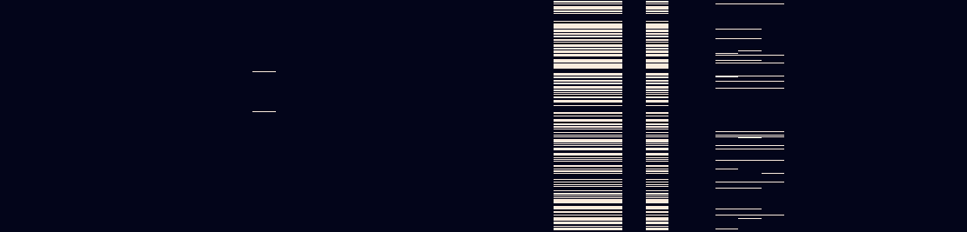
Data cleaning
Duplicates & conflicting instances :
Duplicates : same exact observations (target variable included)
Conflicts : same features values but different target class
To pick between the two classes for conflicts, decision was made based on the highest total instance weight across all observations for each class
 | Train set | Test set | Total
Instances | 199 523 | 99 762 | 299 285
Duplicates | 46 627 | 20 898 | 67 525
Conflicts | 89 | 38 | 127
Drop rate | 23.4% | 21.0% | 22.6%
Note that provided we had domain expertise and the ability to collect additional data, we could end up with extra features allowing us to tell these observations apart, and keep them for better predictive power during modelling
Missing values
4 features had ~50% of missing values → dropped
5 features had smaller missing values rate → kept with imputation (most frequent class)
Observations
(missing values are in white)
Features

Slide 4
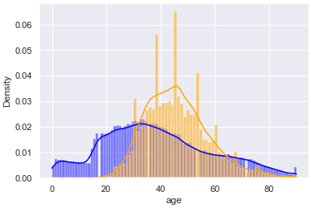
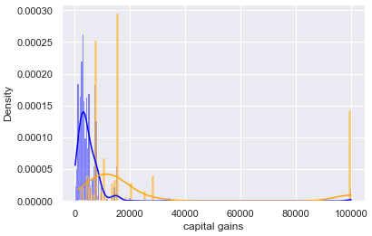
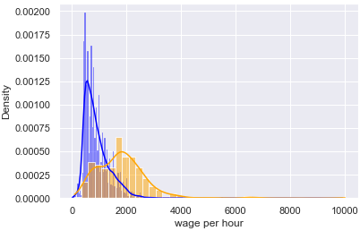
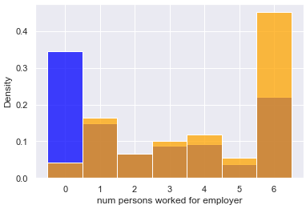
Distributions within target classes
Class imbalance issue :
« Low income (<50k) », the majority class, accounts for ~92% of all obs.
Easier too look at variables distributions withing each class
Notable distributions for numerical features
Low income (blue)
High income (yellow)
Age : children (under 18) belong exlusively to the "low income" class, as could be expected
Capital gains : gains > 10k are almost exclusively belonging to the “high income” class
Wage per hour: wages > 2k are almost exclusively belonging to the “high income” class
Nb of employees in company : people without a job largely belong to the “low income” class (not very informative)

Slide 5
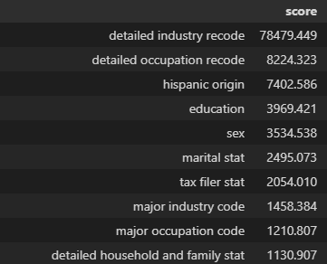
Distributions within target classes
Categorical features : using chi2 tests, we can find the most relevant features for classification. Among the top 10, we can extract some useful insights
Industry : high incomes much more frequent in public administration and finance/insurance/real estate for instance
Occupation : high incomes much more frequent among professional specialties and executives/maangers
Education : high incomes much more frequent above Bachelor’s Degree
Sex : female are underrepresented within the high income class
Marital status: > 75% of high income individuals are married (not divorced nor widowed)
Householders : much more frequent among the high income class than the low income class

Slide 6
Data pre processing
Missing values :
Drop features with 50% missing values
Impute remaining missing values with most frequent category of feature
One hot encoding of categorical variables
Standard scaling for numerical features
Resampling with SMOTE to try and overcome class imbalance problem
Additional features based on available information :
earnings estimate based on wage, weeks worked, capital gains/losses and dividends from stocks
company size estimate based on segments in documentation
tax amount estimate based on earnings estimate and US federal tax rates and brackets for 1995
1
2
3
4
5
Two simple baseline models were used to evaluate pre-processing steps performance : logistic regression and decision tree
Based on the results, resampling was kept for linear model only, whereas extra features were kept for tree-based models only

Slide 7
Model tuning and selection
Scoring metric : macro average f1 score accross both classes to account for class imbalance
Competing models :
Random Forest (tree-based)
Gradient Boosting (tree-based)
Stochastig Gradient Descent (linear model)
Note : to maintain explainability throughout the modelling process, more complex models, such as neural networks, were set aside
Selection : grid search for hyper-parameter tuning combined with cross-validation
Best performing model :
Gradient Boosting
(500 estimators, 0.1 learning rate and max depth of 5)
 | Precision | Recall | F1-Score
Low income (<50k) | 95,62% | 98,21% | 96,90%
High income (>50k) | 68,93% | 45,95% | 55,86%
Macro average | 82,28% | 72,58% | 76,38%

Slide 8
Key points
Room for improvement : the score is still rather low, espcially zooming in on the minority class (high incomes)
Collect additional observations of the minority class to resolve balancing issue. We should not be that much limited by available data (as in a fraud detection problem), as >50k incomes should be common enough to gather a sufficient sample of observations.
Perform more feature engineering with domain expertise and gathering of extra data if necessary
Take a deeper dive into feature importance, for instance by computing Shapley values, after modelling
Further investigate dependencies in-between features to avoid multicollinearity

