Slide 1


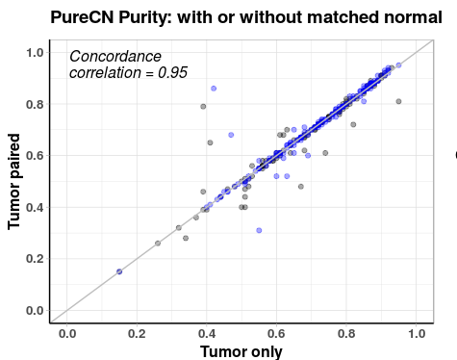
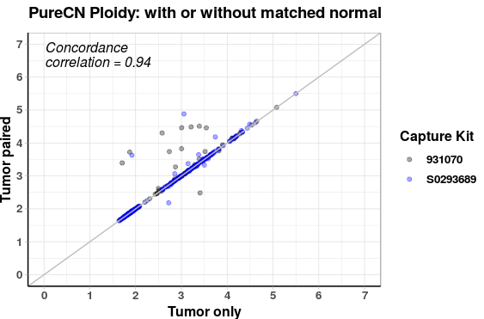
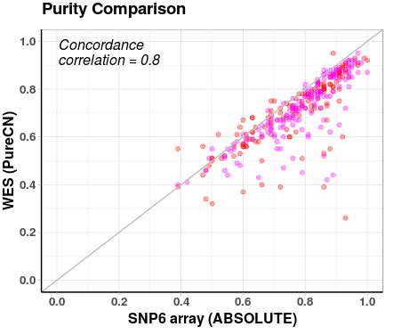
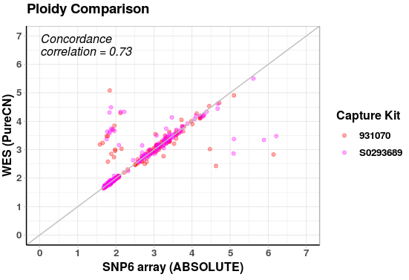
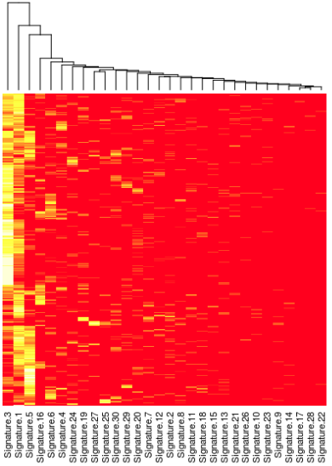
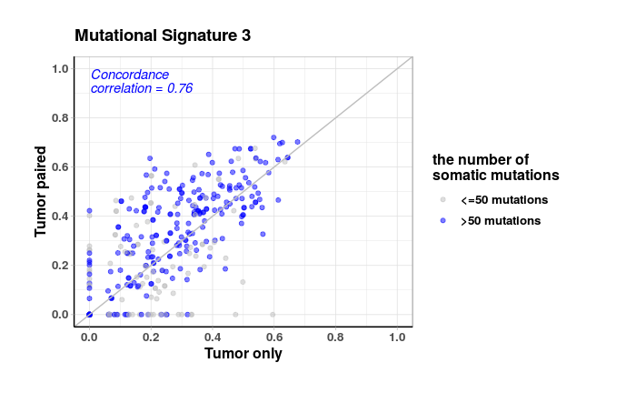
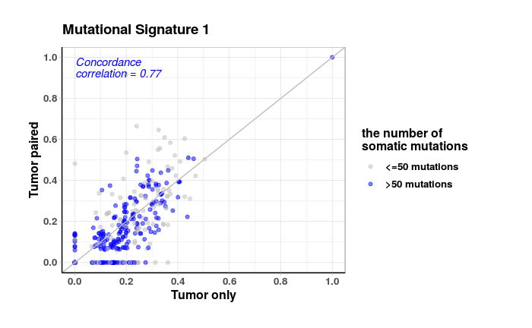
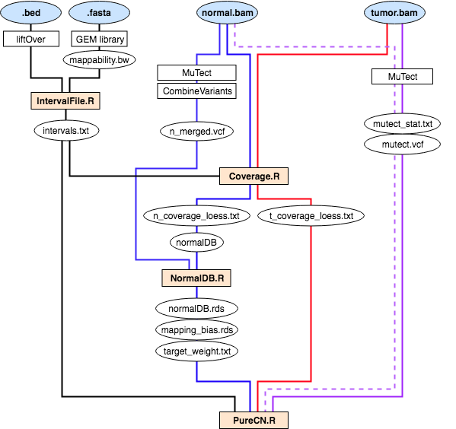
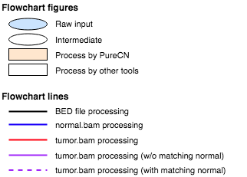
Absolute copy number analysis of whole exome sequencing without matched normal
Sehyun Oh*^{1,2}, Ludwig Geistlinger^{1,2}, Markus Riester³, and Levi Waldron^{1,2}
¹School of Public Health, City University of New York, New York, NY
²Institute for Implementation Science in Population Health, New York, NY
³Novartis Institutes for Biomedical Research, Cambridge, MA
Abstract
Absolute copy number of cancer cells is obscured by tumor purity, ploidy, and heterogeneity. Commonly used algorithms for absolute copy number analysis rely on high quality genome-wide data with matched normal profiles, which are not available in clinical situations. We benchmarked the PureCN algorithm in whole exome tumor sequencing data of ovarian cancer from TCGA against SNP6 arrays with matched normal profiles.
Introduction
DNA copy number variation (CNV) is measured as a ratio of cancer cell to normal cell copy number (relative copy #)
Absolute copy number is obscured by
purity: cancer cells are very often mixed with an unknown fraction of normal cells
ploidy: the actual quantity of DNA in the cancer cells is unknown
heterogeneity: the cancer cell population may undergo subclonal evolution
Absolute CNV analysis enables inference of loss of heterozygosity (LOG) and COSMIC “Mutational Signatures”, which can be relevant to therapy
Absolute CNV analysis requires simultaneous inference of all the above – first accomplished by the ABSOLUTE software
However, ABSOLUTE is difficult to implement and mainly applied to SNP microarray data with matched normal.
Whole exome sequencing (WES) is now common in clinical research but provides much less coverage of the genome than SNP arrays
Matched normal sample are often not available, making it challenging to differentiate germline from somatic single nucleotide variants (SNVs)
PureCN is an R/Bioconductor package for estimating tumor purity, ploidy, loss of heterozygosity (LOH), classification of SNVs, and absolute copy number from WES
This project provides the first benchmark comparing absolute copy number analysis of WES without matched normal to high-quality gold standard data.
Methods
Applied PureCN to 324 ovarian cancer WES data from TCGA, no matched normals
Applied ABSOLUTE to SNP6 data of 309 of above samples, with matched normals
Compared purity and ploidy estimates
Compared the construction of COSMIC mutational signatures
Results
Figure 1: Purity and Ploidy: WES with or without matched normal. Concordance is very high, discrepancies occur only in very challenging tumors for either method.
Figure 2: Purity and Ploidy for SNP6 array vs. WES. High concordance indicates feasibility of using WES data despite low genome coverage, different exome capture kits, and sequencing biases.
PureCN workflow
324 TCGA ovarian cancer samples
30 Mutational Signatures in COSMIC
Figure 3: Inference of COSMIC mutational signatures in ovarian cancer. Left: COSMIC signatures 1 and 3 are the most frequently identified by WES. Right: Per-tumor frequency of mutational signatures 1 and 3 maintains accuracy without matched normal (Pearson correlation ~0.76)
Conclusions
PureCN analysis of ovarian cancer WES without matched normals enables:
Accurately estimation tumor ploidy and purity
Proper inference of COSMIC mutational signatures
References
PureCN: Riester, M. et al. (2016) PureCN: copy number calling and SNV classification using targeted short read sequencing, Source Code Biol Med.
ABSOLUTE: Carter, SL. et al. (2012) Absolute quantification of somatic DNA alterations in human cancer, Nature Biotechnology.
MuTECT: Cibulskis, K. et al. (2013) Sensitive detection of somatic point mutations in impure and heterogeneous cancer samples, Nature Biotechnology
COSMIC: Alexandrov, LB. et al. (2015) Clock-like mutational processes in human somatic cells, Nature Genetics (https://cancer.sanger.ac.uk/cosmic/signatures)
Focus on two COSMIC Mutation Signatures frequent in ovarian cancer
Signature 1: found in most tumors and all cancer types. Aetiology: endogenous mutational process initiated by spontaneous deamination of 5-methylcytosine
Signature 3: Characteristic of breast, ovarian, and pancreatic cancers. Aetiology: failure of DNA double-strand break-repair by homologous recombination

