Slide 1



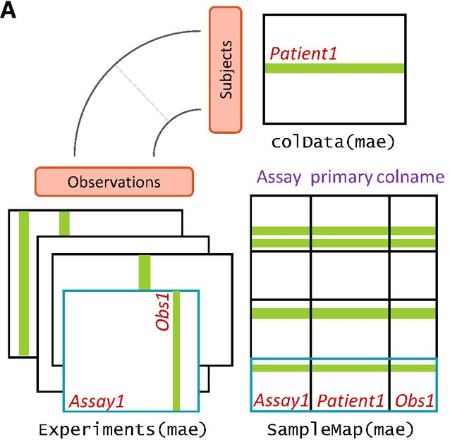

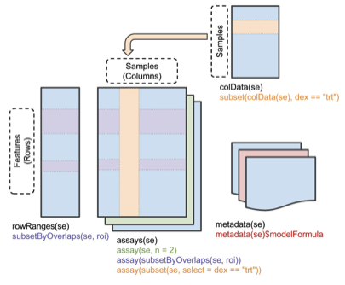
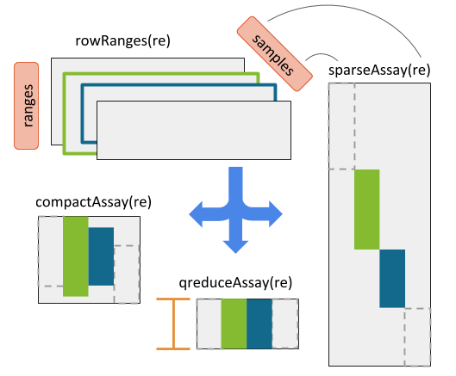
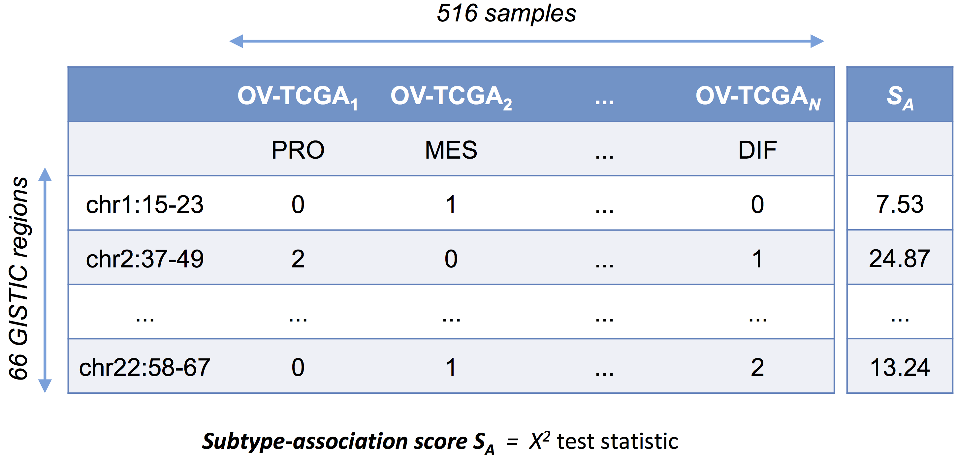
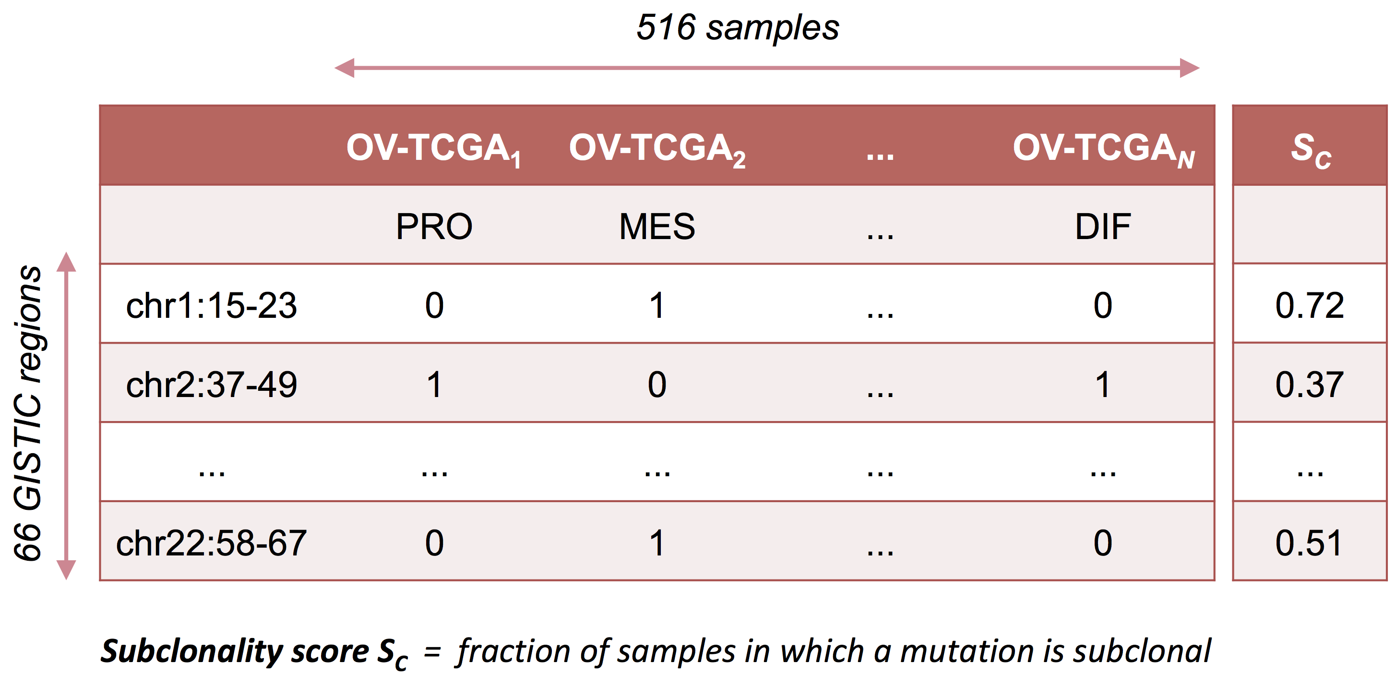
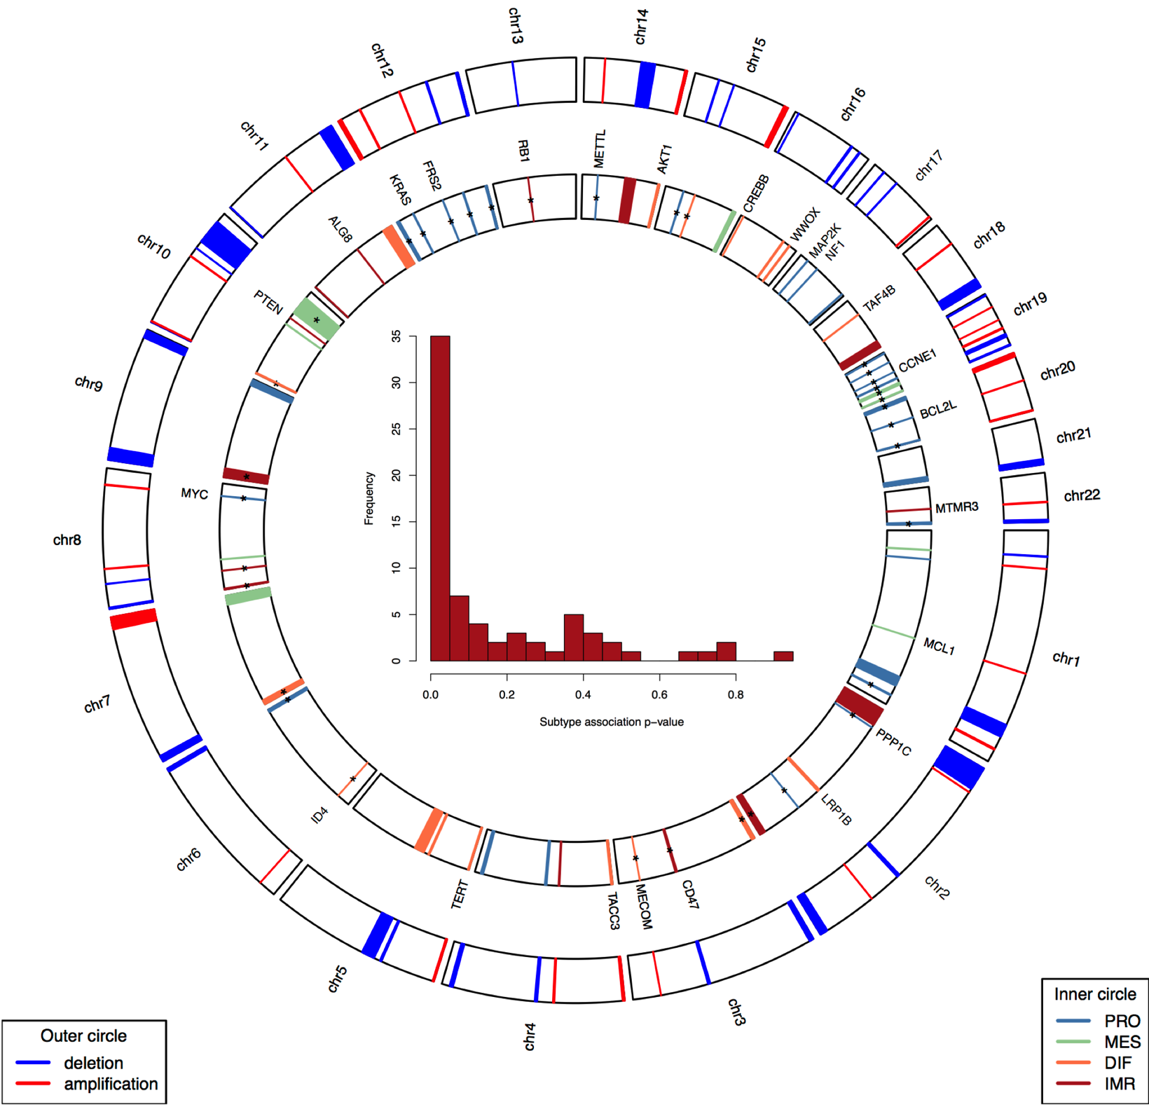
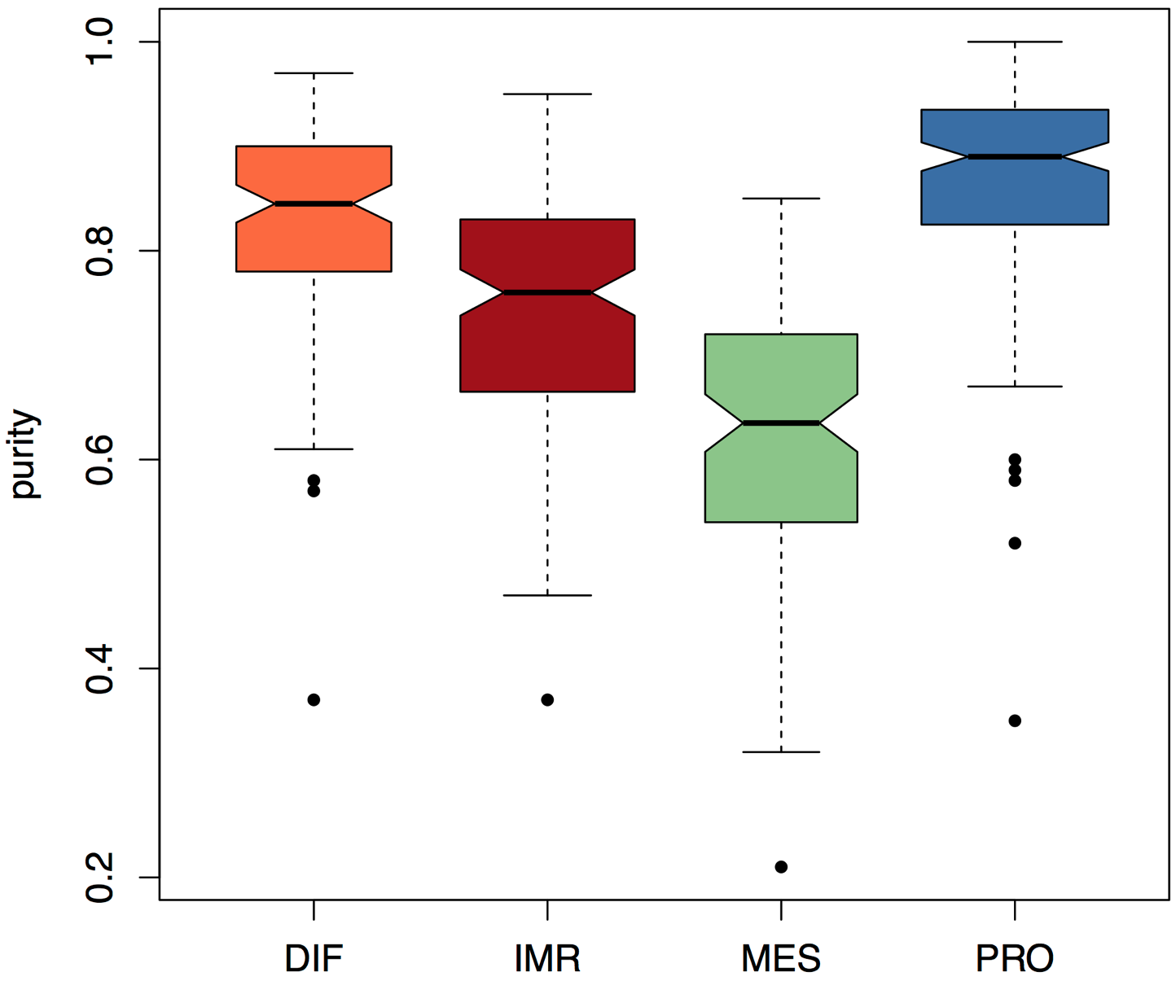
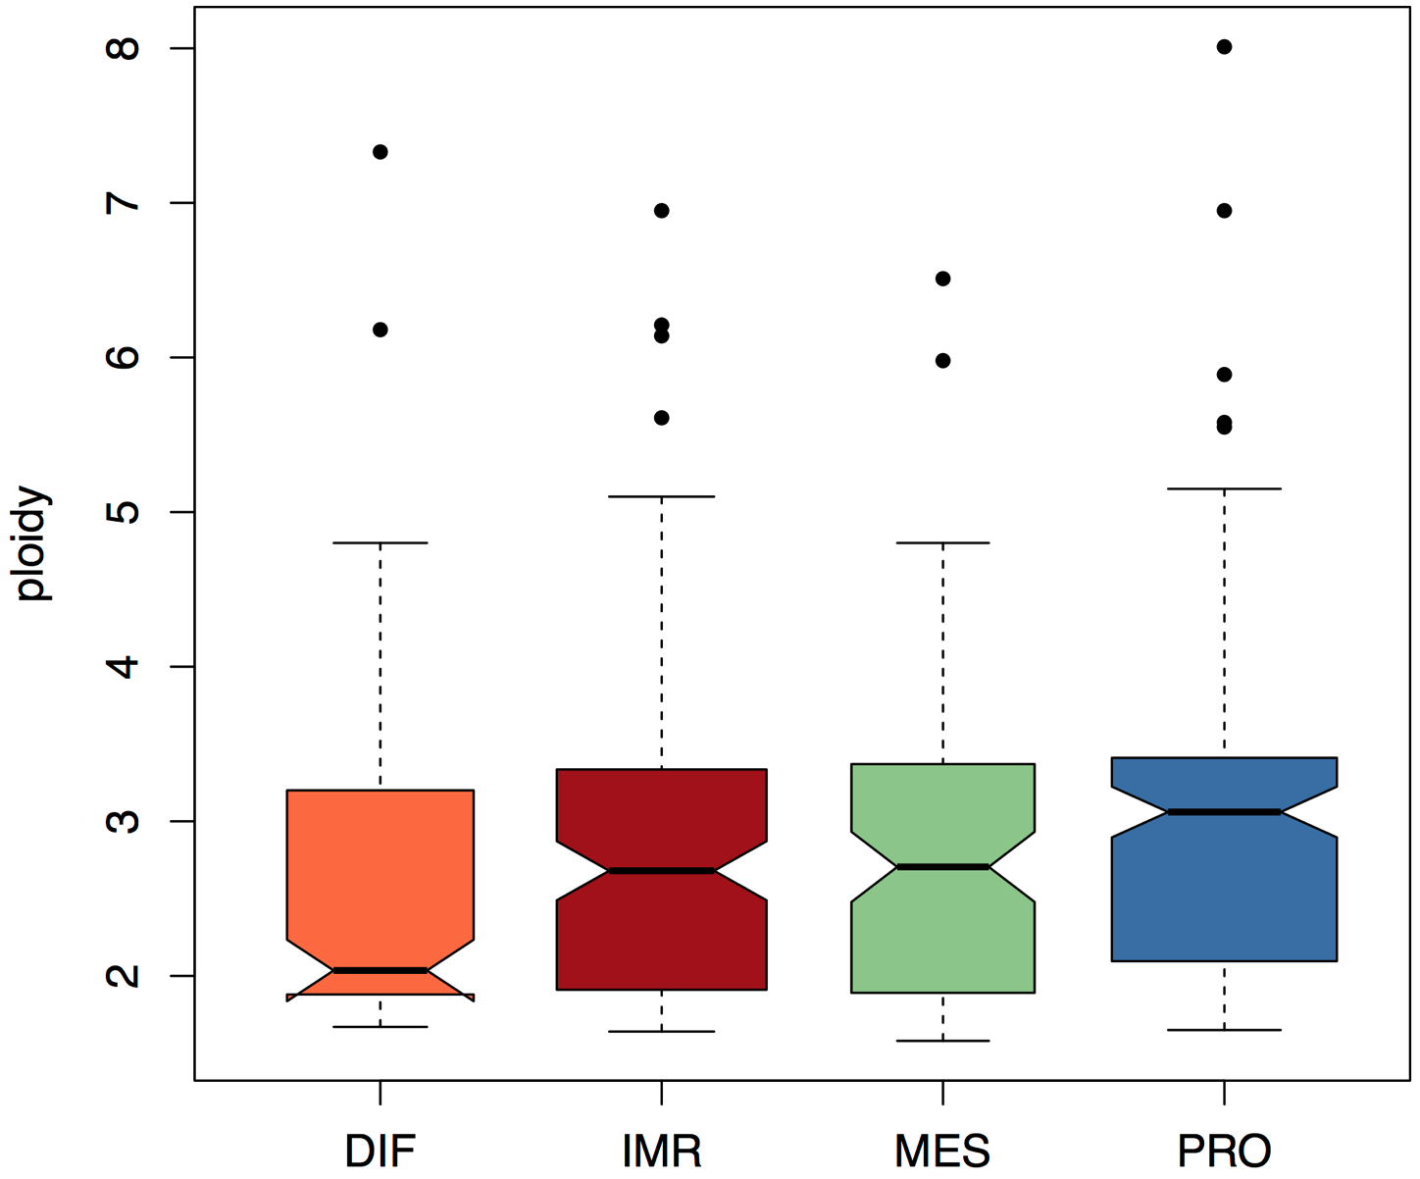
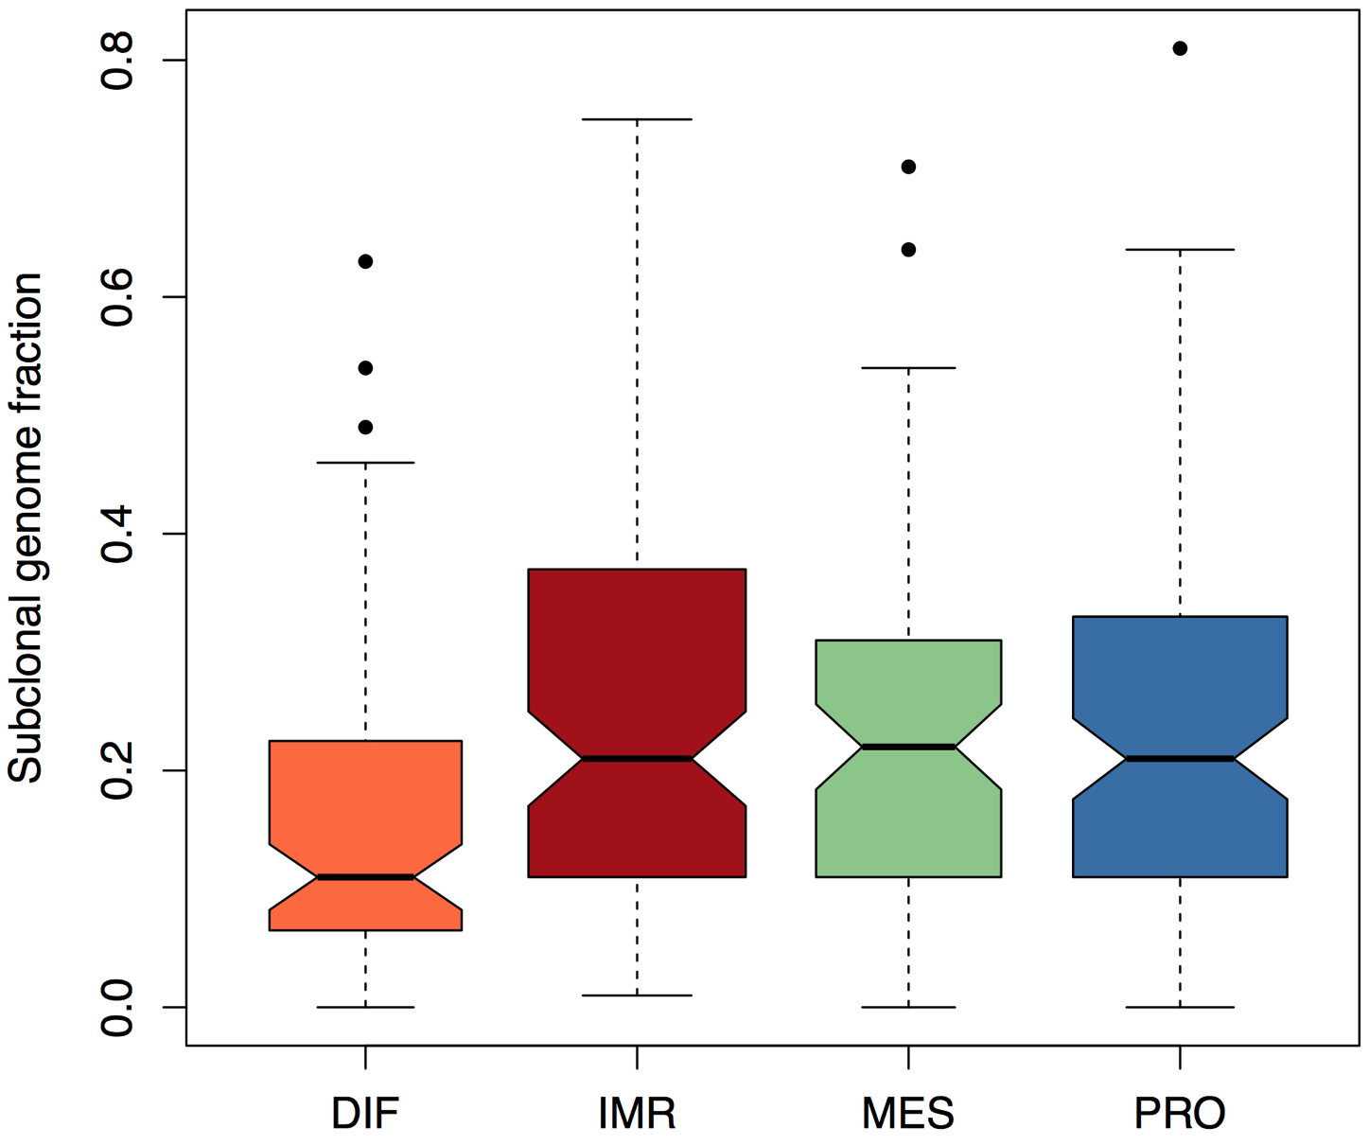
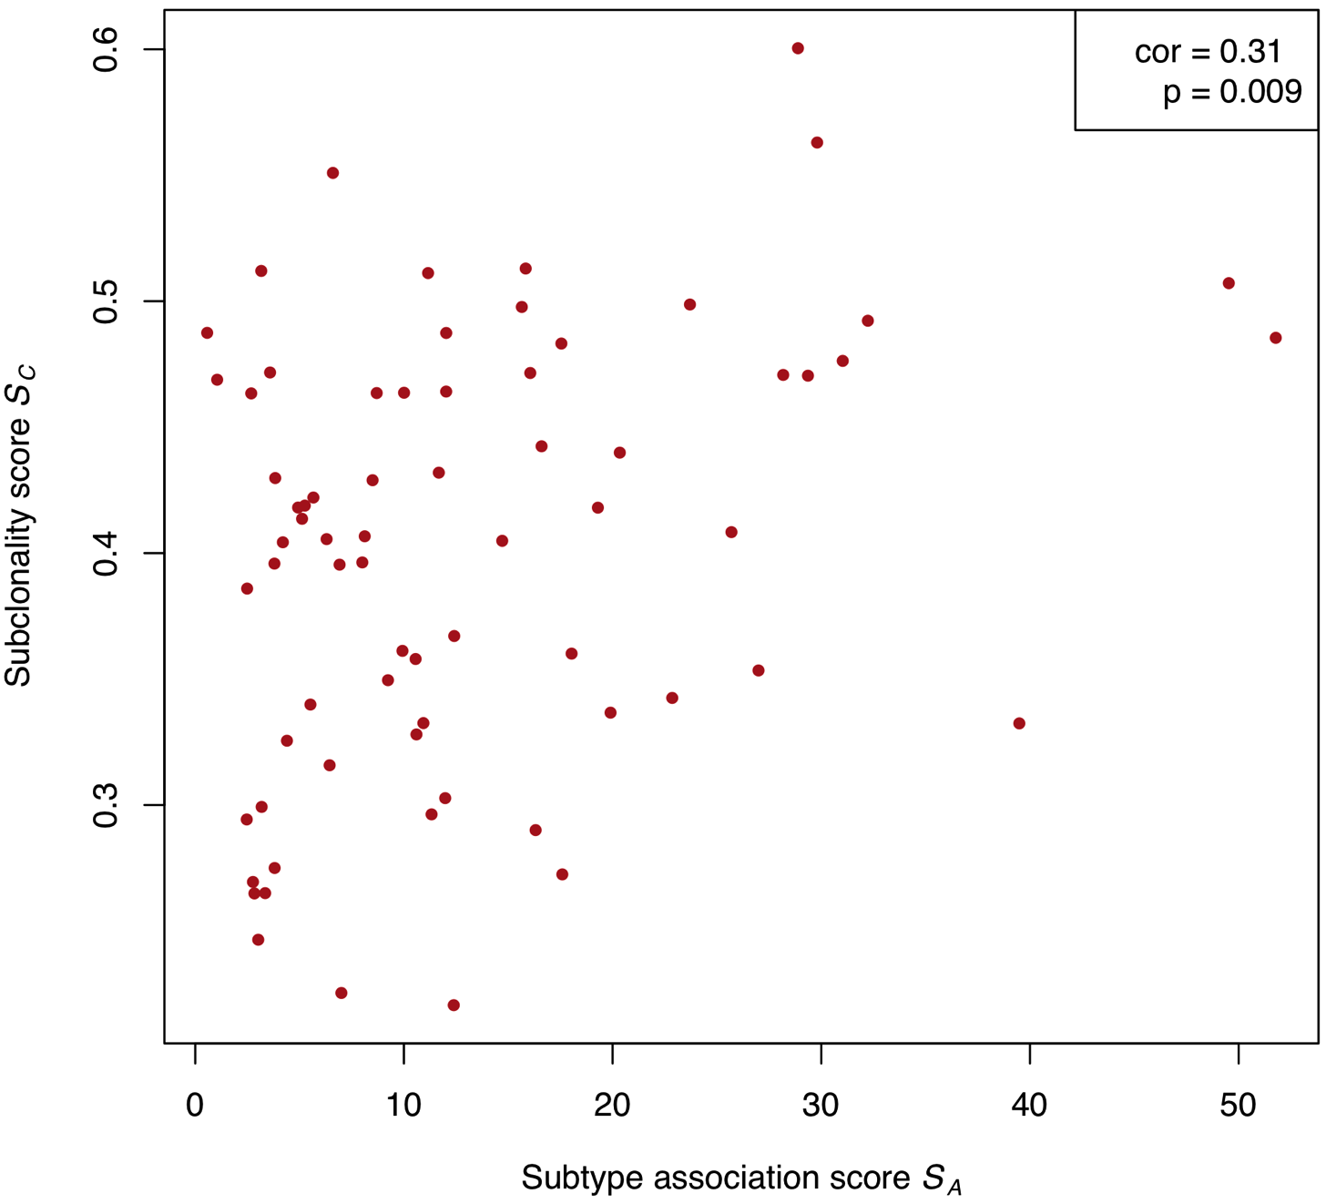
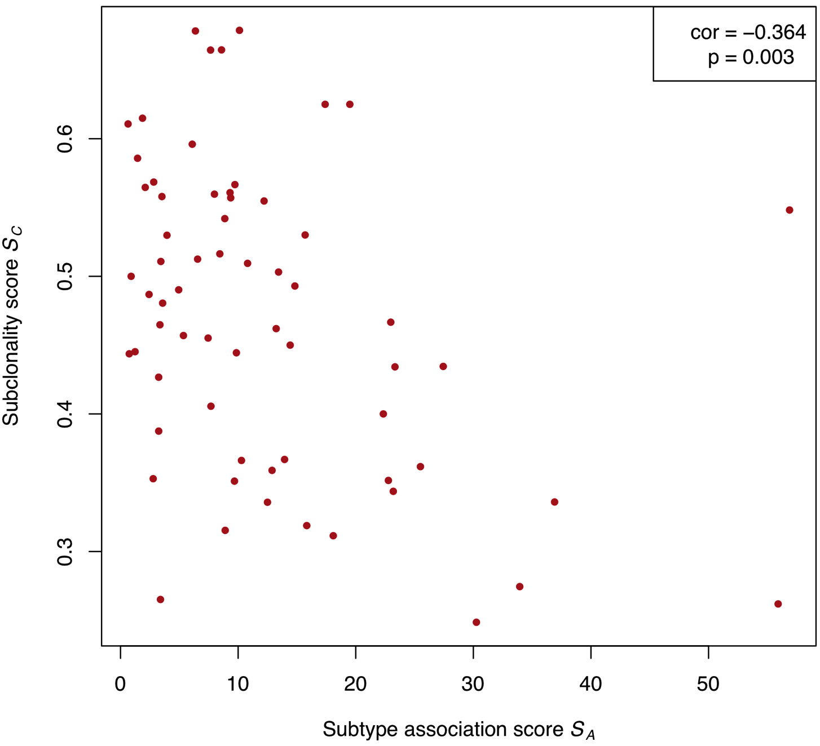
Multi-omic analysis of subtype heterogeneity in high-grade serous ovarian carcinoma
Ludwig Geistlinger¹, Sehyun Oh¹, Marcel Ramos¹, Lucas Schiffer¹, Michael Birrer²,
Martin Morgan³, Giovanni Parmigiani⁴, Markus Riester⁵, and Levi Waldron¹
¹Institute for Implementation Science in Population Health, School of Public Health,
City University of New York, 55 W 125th St, New York, NY 10027, USA
INTRODUCTION
METHODS and RESULTS
CONCLUSIONS
High-grade serous ovarian carcinoma (HGSOC) is a molecularly heterogeneous disease in which clinically similar cases can exhibit dramatically different response to treatment.
Several studies have identified transcriptome subtypes of HGSOC, yet the interpretation and clinical utility of these subtypes remain controversial (Chen et al., Clin Cancer Res, 2018).
It has been estimated that 90% of HGSOC tumors are polyclonal, and clonal spread of HGSOC has been directly inferred from single-nucleus sequencing.
If clonal propagation leads to multiple subtypes, then even unambiguously classifiable tumors might be contaminated by small amounts of another subtype that could lead to relapse after subtype-specific therapy.
We therefore test the hypothesis that the previously proposed subtypes tend not to be shared between intratumor clones, implying that they differentiate late in tumorigenesis.
1
Data aquisition
MultiAssayExperiment
Ramos et al., Cancer Res, 2017
MultiAssayExperiment:
data structure for representing and analyzing multi-omics experiments,
curatedTCGAData: provides MultiAssayExperiment objects constructed from selected TCGA assays through Broad Institute’s GDAC Firehose pipeline (Ramos et al., Bioconductor, 2018),
used here to obtain and coordinate subtype assignment, GISTIC2, and ABSOLUTE SCNA calls on a partly overlapping set of tumor samples.
RaggedExperiment:
implements ragged array schema for genomic location data,
provides rectangular table interface with genomic range information (rows) and sample annotation (columns),
intuitive SummarizedExperiment-like access, while leveraging the comprehensive set of operations on genomic ranges (Lawrence et al., PLoS Comput Biol, 2013),
used here to coordinate the analysis of the ABSOLUTE subclonality calls, and to summarize subclonality in focal GISTIC2 regions (via qreduceAssay).
Unprecedented analysis of HGSOC subtypes in the context of intra-tumor subclonal heterogeneity
Addresses the currently unresolved question of whether proposed subtypes are early or late events in tumorigenesis
Findings indicate that proposed HGSOC subtypes are late events, and thus less likely to be shared among tumor subclones
Questions the suitability of proposed molecular subtypes for targeted treatment as targeting a single subtype in a poly-clonal tumor will just change the genotypic demographics of the tumor
Current and future directions include consistency check of ABSOLUTE calls with PureCN (Riester et al., Source Code Biol Med, 2016), and direct inference of subtype heterogeneity from single cell sequencing data (Winterhoff et al., Gynecol Oncol, 2017)
Subtypes
GISTIC2
ABSOLUTE
3
Subclonality
2
Subtype association
REFERENCES
OBJECTIVES
SummarizedExperiment:
data structure storing matrix-like assays,
rows: genomic ranges; columns: samples,
used here to coordinate analysis of focal GISTIC2 regions and their subtype association (χ² test)
Carter et al. (2012) Absolute quantication of somatic DNA alterations in human cancer. Nat Biotechnol 30(5):413-21.
Chen et al. (2018) Consensus on molecular subtypes of high-grade serous ovarian carcinoma. Clin Cancer Res, accepted. DOI: 10.1101/162685.
Huber et al. (2015) Orchestrating high-throughput genomic analysis with Bioconductor. Nat Methods 12(2):115-21.
Lawrence et al. (2013) Software for computing and annotating genomic ranges.
PLoS Comput Biol 9(8):e1003118.
Mermel et al. (2011) GISTIC2.0 facilitates sensitive and condent localization of the targets of focal somatic copy-number alteration in human cancers. Genome Biol 12(4):41.
Riester et al. (2016) PureCN: copy number calling and SNV classication using targeted short read sequencing. Source Code Biol Med 11:13.
Ramos and Morgan (2017) RaggedExperiment: representation of sparse experiments and assays across samples. DOI: 10.18129/B9.bioc.RaggedExperiment
Ramos et al. (2017) Software for the integration of multiomics experiments in Bioconductor. Cancer Res 77(21):e39-42.
Ramos et al. (2018) curatedTCGAData: curated data from The Cancer Genome Atlas as MultiAssayExperiment objects. DOI: 10.18129/B9.bioc.curatedTCGAData
The Cancer Genome Atlas Research Network (2011) Integrated genomic analyses of ovarian carcinoma. Nature 474(7353):609-15.
The Cancer Genome Atlas Research Network (2017) Comprehensive and integrated genomic characterization of adult soft tissue sarcomas. Cell 171(4), 950-65.
Winterhoff et al. (2017) Single cell sequencing reveals heterogeneity within ovarian cancer epithelium and cancer associated stromal cells. Gynecol Oncol 144(3):598-606.
This hypothesis is tested in The Cancer Genome Atlas HGSOC cases by:
considering recurrent subtype-associated DNA copy number alterations,
inferring per-alteration heterogeneity from SNP arrays and whole-exome sequencing, and
testing whether subtype-associated alterations display different intra-tumor heterogeneity than other alterations
For testing this hypothesis, we focus on somatic copy number alterations (SCNAs).
GISTIC2 (Mermel et al., Genome Biol, 2011):
detects SCNAs that are more recurrent than expected by chance,
distinguishes cancer-driving events from random passenger mutations,
separates broad arm-level events from focal events of small range
ABSOLUTE (Carter et al., Nat Biotechnol, 2012):
infers tumor purity and ploidy directly from the analysis of SCNAs,
purity: intermixture of cancer cells with normal cells,
ploidy: often abnormal DNA content of cancer cells,
identifies SCNAs not fitting a tumor's purity / ploidy relationship as a consequence of subclonal evolution
Subtypes (TCGA, Nature, 2011):
tumor clustering by transcriptome similarity,
resulted in 4 subtypes: differentiated, immunoreactive, mesenchymal, and proliferative
SummarizedExperiment
Huber et al., Nat Methods, 2015
RaggedExperiment
Ramos and Morgan, Bioconductor, 2017
Null hypothesis:
Subtype-associated DNA alterations occur no earlier or later than other alterations
H₀ : ρ( S_{A} , S_{C} ) = 0 ρ ... Spearman correlation
4
Correlation: Subtype association / Subclonality
OV: ρ( S_{A} , S_{C} ) > 0 ➔ subtype-associated SCNAs tend to be subclonal, suggests
that subtypes are late events in tumor evolution
SARC: ρ( S_{A} , S_{C} ) < 0 ➔ subtype-associated SCNAs tend to be not subclonal, suggests
that subtypes are early / intrinsic events in tumor evolution
CONTACT
Ludwig.Geistlinger@sph.cuny.edu
Levi.Waldron@sph.cuny.edu
Acknowledgements:
Ovarian cancer work funded by NCI #7R03CA191447 (to Waldron), infrastructure work funded by NCI ITCR #5U24CA180996 (to Morgan).
²Comprehensive Cancer Center, University of Alabama, 1824 6th Avenue South, Birmingham, AL 35233, USA
³Roswell Park Cancer Institute, 665 Elm St, Bualo, NY 14203, USA
⁴Department of Biostatistics and Computational Biology, Dana-Farber Cancer Institute, Harvard Medical School, 450 Brookline Avenue, Boston, MA 02215, USA
⁵Novartis Institutes for BioMedical Research, 250 Massachusetts Ave, Cambridge, MA 02139, USA
OV
SARC
Subtype characterization with ABSOLUTE. Subtype-stratied purity (left), ploidy (middle), and subclonal genome fraction (right) of TCGA HGS ovarian tumors as inferred by ABSOLUTE. Tumors of differentiated subtype are characterized by high purity, but signcantly lower ploidy and subclonality than the other three subtypes.
Genomic distribution of subtype-associated SCNAs.
Outer circle: focal CN amplifcations and deletions
Inner circle: Subtype association (*FDR < 0.1)
Histrogram: nominal p-value distribution obtained from testing subtype assocation of each SCNA (χ² test).

