Slide 1



Organisations, culture & food safety Link to publication
Challenge
The FSA has a long-standing interest in food safety culture. But there was no framework to join it all up.
Method
Rapid review and comparison of salient frameworks.
Finding
Several tools seem quite good! Alas, none suffices to cover for the needs of both regulators and businesses.
Because…

Slide 2
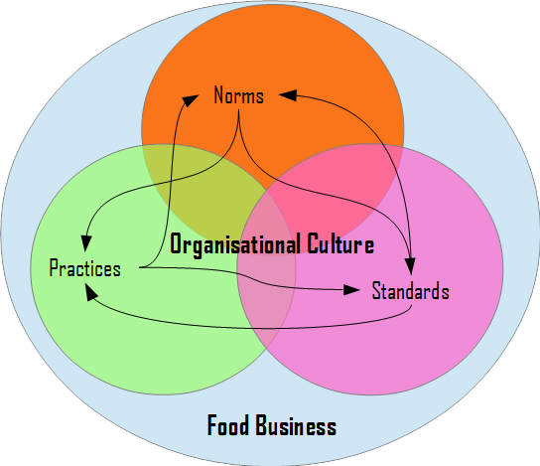
REASON A
Culture is all-encompassing and regulators are probably wise to avoid accidental oversights in any given area. However, business-oriented tools benefit from focus (aka. pros and cons of holism)

Slide 3
REASON B
Primary needs are diametrically different (aka. fitness for purpose).
Regulatory diagnosis
Primary need is to spot issues that may lead to food safety or integrity incidents.
Help businesses improve
Primary need is to introduce change where they currently lack support.

Slide 4
Solution
From sample, Wright’s toolkit closest to a realised regulatory solution.
Pilot, pilot, pilot.
From sample, GFSI closest to a realised management solution.
Pilot, pilot, pilot.
Caveat! A holistic definition of food safety culture that explicitly considers norms, practices, and standards is needed because the regulatory side of the cycle would lack perspective otherwise.

Slide 5
Contact
Dr Jose A Bolanos
https://www.josebolanos.xyz,
j.bolanos@lse.ac.uk,
j@josebolanos.xyz.
Alternatively,
applicable FSA contacts:
vanna.aldin@food.gov.uk,
joana.disson@food.gov.uk.

