Slide 1
Reduced Peritonitis in Peritoneal Dialysis Patients
James Bonaffini & Lisa Chen
BME 6060
Notes:
full title slide with the course, the team, and the Project Title (new)
Something like, "Reduced Peritonitis in Peritoneal Dialysis Patients"
UVA logo or footer on each slide
start with the slide you prepared for the session with Jody Reyes
expand on your initial indications of incidence and prevalence of the clinical concerns that justify your project selection
demographic, cultural, economic, history, regional, or even international (ie lower incidence of PD infections in Taiwan)
At least one slide that lists specific questions you want to ask our UVA data systems.
indicate your primary or secondary sources for each set of data.
5-10 citations

Slide 2
Renal Team
Problem Statement: The purpose of this project is to decrease the incidence of peritonitis for current and future peritoneal dialysis (PD) patients by identifying infection in its early stages and refining/replacing the mechanics of existing PD devices.
Due to recent shift towards home dialysis, cases of peritonitis may increase rapidly over the course of the next 10-15 years. Thus, we have “Current” and “PD-Assimilated” statuses, representing a 10-fold increase in number of PD patients and peritonitis events.
 | Current | PD-Assimilated (Early 2030s)
PD Patients | 50,000 | 500,000+
Peritonitis Events Yearly (40-70% chance) | 20,000-35,000 | 200,000-350,000
Data from US Renal Data System Annual Report (2018)
Notes:
expand on your initial indications of incidence and prevalence of the clinical concerns that justify your project selection

Slide 3
Specifics of Clinical Concern
Executive Order on Advancing American Kidney Health
Push for home dialysis – 80% of new patients by 2025 (a very large increase!)
Approximately 7% of End Stage Renal Disease (ESRD) patients use PD (USRDS)
Peritonitis Incidence rate is 0.67 per patient per year
Admissions to the hospital for PD patients are most commonly due to infection (USRDS)
Heavy financial burden: peritonitis-related hospitalization average around $3,100 in the US.
The mortality for an episode of peritonitis is 5% and is a cofactor for mortality in another 16% of affected patients (Salzer, William L. 2018. “Peritoneal Dialysis-Related Peritonitis: Challenges and Solutions.” )

Slide 4
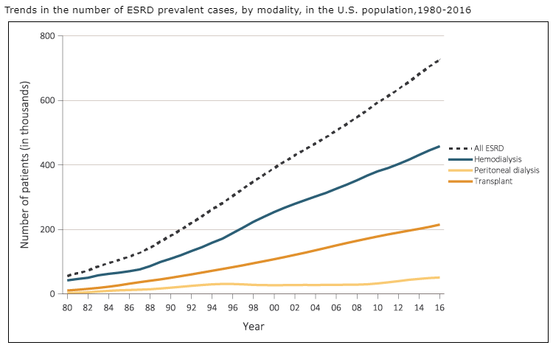
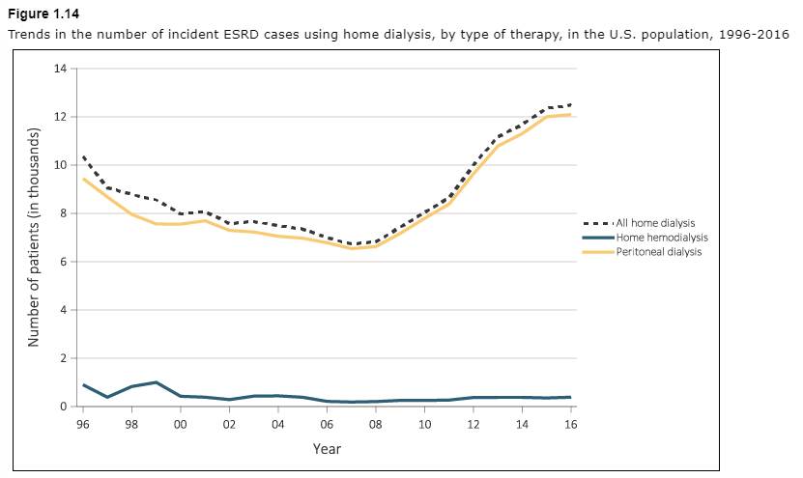
ESRD Incidence and Prevalence
Left: ESRD Cases have been increasing in the US – prevalent cases are at approximately 750K in America, with the value increasing by about 25K every year due to increased diagnosis and increased lifespan
Right: Most people that choose home dialysis every year opt for PD: 12K a year
Source: United States Renal Data System 2018 Report

Slide 5
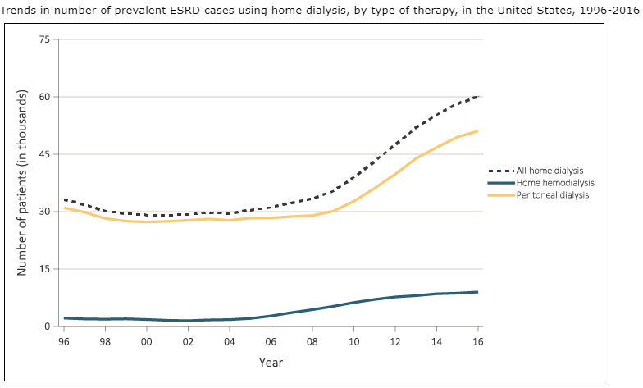
ESRD Incidence and Prevalence
Prevalent Home dialysis cases in the US. Use of PD has increased and sustained in the last decade.
Source: United States Renal Data System 2018 Report

Slide 6
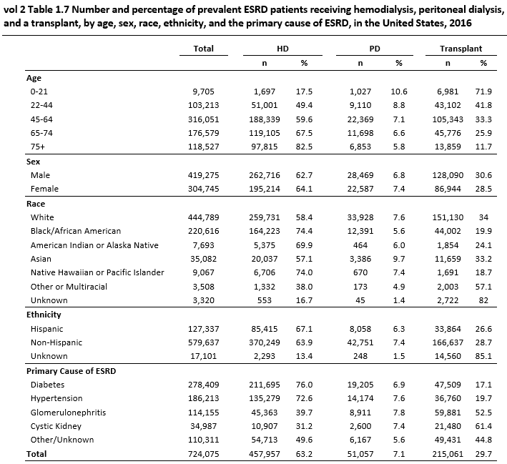
ESRD Modalities
Major Takeaways:
More likely to use PD if you are younger than if you are older
This may point to the fact that PD is more hands-on than in-clinic dialysis
More likely to use PD if you are White or Asian than if you are Black or Hispanic
Source: United States Renal Data System 2018 Report

Slide 7
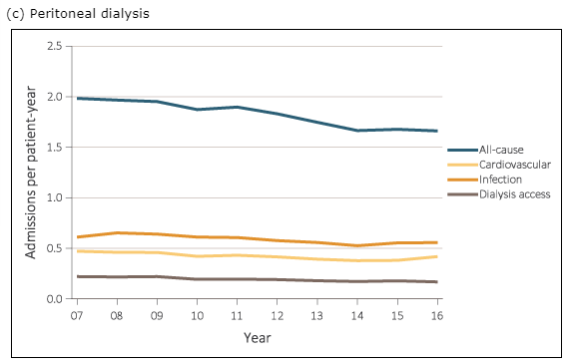
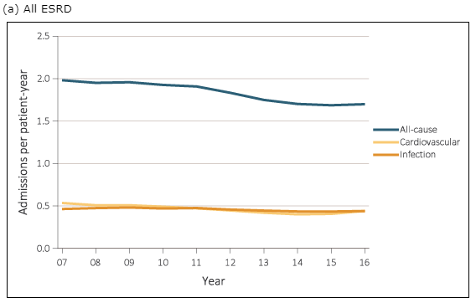
Hospital Admissions
Left: The top cause that PD patients are admitted to the hospital is infection. Hospital admissions have decreased over time, but infection admissions have not.
Right: Infection is less of an issue in all ESRD cases than it is in PD.
Source: United States Renal Data System 2018 Report

Slide 8
Peritonitis - Pathogenesis
The most common pathogens are coagulase-negative staphylococcal species (eg., Staphylococcus epidermidis) that commonly colonize human skin and hands, and Staphylococcus aureus, which together are responsible for 50% or more of infections – touch contamination.
Identification of bacteria is critical in focusing the antimicrobial treatment (gram negative bacteria doesn’t respond to treatment as easily as gram positive bacteria). Results are available within 3-5 days.
Treatment usually takes the form of intraperitoneal antibiotic for 2 weeks
Catheter removal may be necessary if the patient has not responded to treatment within 5-7 days
Source: Salzer, William L. 2018. “Peritoneal Dialysis-Related Peritonitis: Challenges and Solutions.” International Journal of Nephrology and Renovascular Disease 11 (June): 173–86.

Slide 9
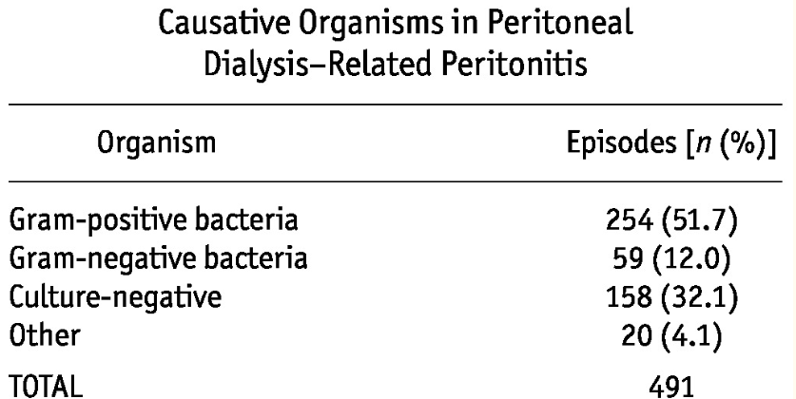
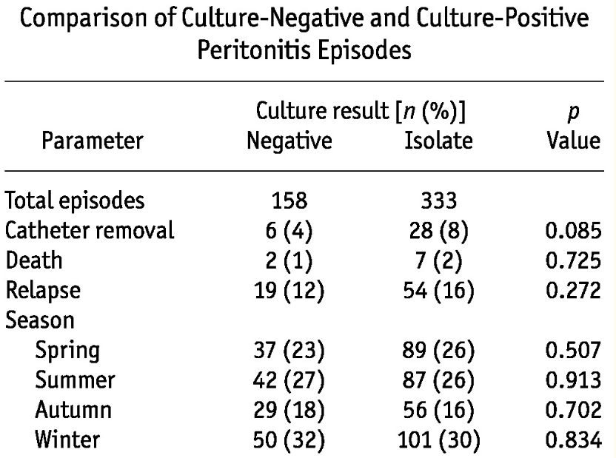
Peritonitis – Pathogenesis and Result
Above: Most cases are from gram-positive bacteria, which is the most treatable by antibiotics.
Right: No difference in the outcomes for treatment of culture-negative vs isolated peritonitis
Main Takeaway: Early identification of Peritonitis is of the utmost importance, because treatment is usually effective
Source: Kocyigit, Ismail, Aydin Unal, Derya Karademir, Sami Bahcebasi, Murat H. Sipahioglu, Bulent Tokgoz, Oktay Oymak, and Cengiz Utas. 2012. “Improvement in Culture-Negative Peritoneal Dialysis-Related Peritonitis: A Single Center’s Experience.” Peritoneal Dialysis International : Journal of the International Society for Peritoneal Dialysis 32 (4): 476–78.

Slide 10
Specific Demographics
Notes:
demographic, cultural, economic, history, regional, or even international (ie lower incidence of PD infections in Taiwan)
Some things to take into account: social determinants of health
Pets or little children
Zip code
Fluency in English
Comorbities

Slide 11
Specific Questions for UVA Data Systems
ESRD Patients
Which modality are they choosing first?
How much education do they have of the different modalities before they decide (sessions attended, consultations, appointments)?
Comorbidities?
Demographics?
Location or proximity to clinic
At what stage was CKD detected?
ESRD cause
Mortality Rate by modality
PD Patients
How long have they been on PD?
Automatic (cycler, overnight) or Continuous Ambulatory PD (CAPD)
Compliance – sessions performed vs missed, checkups
Remote or in-person checkups (this is only a recent option with TYTO)
How expensive is PD as a service per patient?
Notes:
At least one slide that lists specific questions you want to ask our UVA data systems.
indicate your primary or secondary sources for each set of data.
Incidence rate of peritonitis from peritoneal dialysis patients at UVA hospital
Rate of admissions into the hospital because of peritonitis
Zip code of these patients
How they are getting these infections?

Slide 12
Specific Questions for UVA Data Systems
Peritonitis (per PD patient)
Number of Previous Events
Length of time on PD
What type of bacteria (gram positive or gram negative) or pathogen?
Patient Location
Readmissions within 1 month
Did patient have to switch to Hemodialysis after this event?
Demographics of patient
Hospital Admissions (per PD Patient)
Cause for admission
Alternative pathogenesis of Peritonitis?
Length of admission
Total cost of admission
Notes:
At least one slide that lists specific questions you want to ask our UVA data systems.
indicate your primary or secondary sources for each set of data.
Incidence rate of peritonitis from peritoneal dialysis patients at UVA hospital
Rate of admissions into the hospital because of peritonitis
Zip code of these patients
How they are getting these infections?

Slide 13
Data Science Synthesis – What can we prove?
For each of these prospective Data Science Projects we shall:
Compare results if peritonitis rates were lowered or if peritonitis cases were caught earlier (due to our novel products)
Extrapolate output data as if the PD population were to increase 10-fold
Group data by
Demographic
Patient Location
Comorbidity
Outcomes for PD
Input Data
Number of years on PD
Differential time of dialysis: PD vs HD
Rate of mortality
Rate of Peritonitis events
Rates of switching to HD
Number of hospital admissions
Amount of education receive
Synthesize an outcome metric
Mortality
Notes:
Peritonitis (per PD patient)
Number of Previous Events
Length of time on PD
What type of bacteria (gram positive or gram negative) or pathogen?
Patient Location
Readmissions within 1 month
Did patient have to switch to Hemodialysis after this event?
Demographics of patient
Hospital Admissions (per PD Patient)
Cause for admission
Alternative pathogenesis of Peritonitis?
Length of admission
Total cost of admissionESRD Patients
Which modality are they choosing first?
How much education do they have of the different modalities before they decide (sessions attended, consultations, appointments)?
Comorbidities?
Demographics?
Location or proximity to clinic
At what stage was CKD detected?
ESRD cause
Mortality Rate by modality
PD Patients
How long have they been on PD?
Automatic (cycler, overnight) or Continuous Ambulatory PD (CAPD)
Compliance – sessions performed vs missed, checkups
Remote or in-person checkups (this is only a recent option with TYTO)
How expensive is PD as a service per patient?

Slide 14
Data Science Synthesis – What can we prove?
Cost to the Health System
Input Data
Cost of PD vs HD
Hospital admission cost
Hospital admission length
Readmissions
Cost of Peritonitis treatment
Synthesize a Cost Metric
Dollar cost
Amount of clinician time use
Positive margin generated?
Quality of Life for PD patients
Input Data
Rate of Peritonitis events
Length of time on PD
Distance from clinic (time saved)
Number of Hospital admissions
Number of days spent in hospital
Synthesize a Quality of Life Metric
Length of time on PD?
Notes:
Peritonitis (per PD patient)
Number of Previous Events
Length of time on PD
What type of bacteria (gram positive or gram negative) or pathogen?
Patient Location
Readmissions within 1 month
Did patient have to switch to Hemodialysis after this event?
Demographics of patient
Hospital Admissions (per PD Patient)
Cause for admission
Alternative pathogenesis of Peritonitis?
Length of admission
Total cost of admission
ESRD Patients
Which modality are they choosing first?
How much education do they have of the different modalities before they decide (sessions attended, consultations, appointments)?
Comorbidities?
Demographics?
Location or proximity to clinic
At what stage was CKD detected?
ESRD cause
Mortality Rate by modality
PD Patients
How long have they been on PD?
Automatic (cycler, overnight) or Continuous Ambulatory PD (CAPD)
Compliance – sessions performed vs missed, checkups
Remote or in-person checkups (this is only a recent option with TYTO)
How expensive is PD as a service per patient?

Slide 15
Sources
“United States Renal Data System. 2018 USRDS Annual Data Report: Epidemiology of Kidney Disease in the United States.” 2018. National Institutes of Health, National Institute of Diabetes and Digestive and Kidney Diseases, Bethesda, MD, 2018. https://www.usrds.org/2018/view/Default.aspx.
Salzer, William L. 2018. “Peritoneal Dialysis-Related Peritonitis: Challenges and Solutions.” International Journal of Nephrology and Renovascular Disease 11 (June): 173–86. https://doi.org/10.2147/IJNRD.S123618.
Kocyigit, Ismail, Aydin Unal, Derya Karademir, Sami Bahcebasi, Murat H. Sipahioglu, Bulent Tokgoz, Oktay Oymak, and Cengiz Utas. 2012. “Improvement in Culture-Negative Peritoneal Dialysis-Related Peritonitis: A Single Center’s Experience.” Peritoneal Dialysis International : Journal of the International Society for Peritoneal Dialysis 32 (4): 476–78. https://doi.org/10.3747/pdi.2011.00153.

