Slide 1
The Patient Care Continuum Empathy Mapping
BME 6550
Lisa Chen, James Bonaffini
Jonathan Rosen

Slide 2

Exercise
Customer Profile
Name: Steve Miller
Age: 41
Tech savvy, has started and run a successful technology consulting business for the last 15 years
Income Range: $1-2Million/year
Location: Charlottesville
Education: College Dropout but very intelligent and outgoing
Has a wife of 18 years and 7 children, the bread-winner for his family, frequently travels for work, works up to 70 hours a week.
He tries to keep in shape but the combination of his job and wanting to spend the rest of his free time with his family doesn’t always mean he has time to exercise.
He values his image of a high-power businessman; wants to always come off as intelligent, professional, and in-control
Parents died early of in a freak car accident; he has no idea of chronic illness background nor has he had any major health issues
Because of his travel and lack of time, he doesn’t always have the best diet, but has been blessed with a fast metabolism
Has been diagnosed with stage 5 Chronic Kidney disease (out of 5 stages), will soon need to be put on dialysis.
His goal is to be able to perform home dialysis for best transition to being a CKD patient
Steve

Slide 3
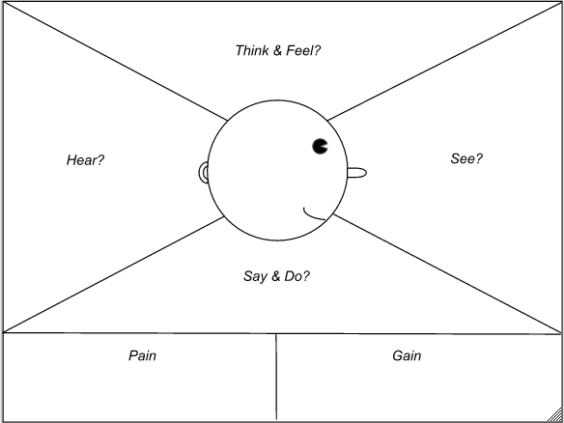
Exercise
Customer Empathy Map
How will his job and travel be affected?
Will his transition to dialysis go smoothly?
Will he be able to support his family and keep up with his kids?
Coworkers are living their life normally while he is affected by this situation
Wife and kids are nervous about his needs and condition
Steve
“Only elderly people are affected by this”
Kids are scared of his healthcare dependency
Adjust his schedule to account for this new need
Be more aware of his waning ability due to dialysis exhaustion
Put up a façade to make it seem like nothing is wrong
Loss of vigor
Loss of independence
Humility and appreciation for healthcare workers
Fear of being unable to perform at his job
Living – without dialysis, you die
Hope for the future

Slide 4
Exercise
Vascular access surgery
Vascular access maturation
Dialysis
Setup for home dialysis
Customer Journey Map
Diagnosis of CKD
Steve
I wish
That this wasn’t so invasive
That this didn’t take so long
This didn’t make me feel so exhausted
I had done this sooner
I didn’t have to deal with this.
Emotions
I hate
The hospital environment and being away from work
The scarring and body changes
How many times I have to do this and how long it takes
I had done this sooner
The inconvenience
I feel
Nervous that it doesn’t go well
Optimistic that this form of dialysis will be most compatible with my and my family’s lifestyle
Scared
Optimistic that this will work and keep me alive
Bored, cold and nauseous
Customer Experience (Journey Map)
Go to Dr. office because not feeling well.
Get bloodwork and urgent diagnosis
Dr. recommends AV fistula for easy access.
Schedule outpatient procedure with local hospital
Period of waiting 4-6 weeks while fistula becomes stronger
In the interim, using a catheter to dialyze 3 times/wk
3 sessions/wk, 3-4 hours per session at the UVA hospital
Install a home dialysis machine.
Family members get educated about using the machine.
4-5 sessions/wk.
Process Steps

Slide 5
Exercise
Emotional Rollercoaster- Identify Opportunities for Intervention
Diagnosis of CKD
Vascular access surgery
Vascular access maturation
Dialysis
Setup for home dialysis
Steve
I did not expect this, I am shocked
I hope the Dr. is right, I hope this won’t hurt too much
This is taking me away from work and making me feel exhausted
This will get better after this AV fistula matures
I’m going to be able to work more and be with my family more often
Life is good
Customer Experience (Emotional Rollercoaster)

Slide 6
Exercise
Other Specifics:
How did he find out he had a problem:
Based on the little access to family history (parents died), there is no history of kidney-related issues. Feeling very ill for several days, makes an appointment at UVA. Bloodwork is done by a clinician and his condition is found out and acted upon immediately. AV fistula surgery is schedules and Steve receives dialysis though a catheter at the UVA renal care clinic
Where are they now in the continuum:
Steve is undergoing dialysis at home while waiting for a kidney transplant. The home dialysis allows him more autonomy and it is not as taxing as 3x/weekly dialysis. Luckily the US government takes care of dialysis costs, but he is still unable to work as much as before.
Future:
Waiting on a kidney transplant and will likely have to wait for many years. In the meantime he will have to keep managing his home dialysis schedule and keep checking in with doctors regarding his status.
Steve

