Slide 1
The Renal Continuum of Care: Problem Selection
Lisa Chen & James Bonaffini
Clinical Advocate: Dr. Brendan Bowman
Associate Professor & Medical Director of UVA Outpatient Dialysis Clinics

Slide 2
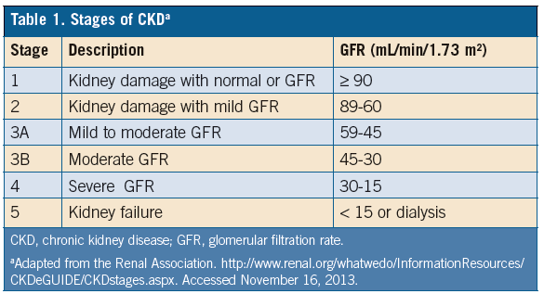
The Renal Continuum
Early Detection and Diagnosis
Preservation of Kidney Function
Vascular Access
Renal Replacement Therapy
Transition to Home Dialysis
Transplant

Slide 3
Problems
Early detection and diagnosis
Kidney function assessment is lacking
GFR Estimation is Poor
Patients do not seek advanced kidney care until late-stage Chronic Kidney Disease (CKD)
Preservation of Kidney Function
Acute Kidney Injury Prevention in the ICU is lacking
Patients with CKD possess comorbidities with care plans that conflict with preservation of kidney function

Slide 4
Problems
Renal Replacement Therapy (RRT)
Dialysis and associated is an insufficient therapy
Dialysis does not filter out larger waste molecules
Dialysis is not run 24/7
RRT does not always make up for lack of hormone function
Dialysis does not always leave patients within correct electrolyte ranges
Dialysis does not always leave patients with the correct amount of fluid

Slide 5
Problems
Renal Replacement Therapy (RRT)
Diets are difficult to manage
Brady-arrhythmias are difficult to detect or predict in ESRD patients
Access to dialysis is limited by clinic schedules
It is difficult to ensure in-clinic hemodialysis machines are clean
Patients often do not complete their dialysis treatments
Leave early, arrive late
Incorrect ultrafiltration rates
Difficulty in drug dosing leads to incorrect hormone levels
“The long break” causes a dangerous shift in electrolyte levels

Slide 6
Problems
Vascular Access
Vascular access function measurement is imprecise
Techniques used in Interventional Radiology to fill a sterile syringe with medication is hazardous
Catheters are difficult to keep dry
Visualizing and tracking a catheter through vessel networks is difficult
Patients can be in extreme pain during catheter placement

Slide 7
Problems
Transition to Home dialysis
There are mental barriers to home dialysis
Needle sticking
Caretaker gets burned out
There are physical barriers to home dialysis
Machine tubing easily becomes kinked
It is difficult to remove air bubbles from home hemodialysis tubing
Caretakers have good vision and dexterity
Infection is common with peritoneal dialysis

Slide 8
Top 4 Favorites & Rationale
Patients do not seek advanced kidney care until late stage chronic kidney disease
Vascular access function measurement is imprecise
Patient electrolyte concentration is uncontrolled during the “long break”
Infection is common in peritoneal dialysis

Slide 9
Basic Pugh Chart

