Slide 1
Renal Continuum of Care Update
Lisa Chen & James Bonaffini

Slide 2
Problem Statement
The purpose of this project is to reduce admission to the UVA Hospital for peritonitis for peritoneal dialysis (PD) patients by identifying infection in its early stages and lowering patient-caused home infection rates.
Notes:
Admission
More uncomfortable
Expensive
Reduce viability of PD
Kidney-care takes a back-seat
Identifying infection
Patients look at the bag for cloudiness – qualitative
Patients are not always able to assess correctly (diabetes/eyesight) or are not educated correctly
Checkups are only once a month
Effluent dialysate is usually discarded
Patient-caused
PD is operated by the patient
Transfer case
Sterility measures are not taken (example- lady who walked around the house with her open tube)
Dexterity is not great for some patients

Slide 3
Why This Problem is Worth Solving
CKD Costs Medicare over $100 Billion every year
Executive Order on Advancing American Kidney Health
Push for home dialysis
Approximately 700,000 ESRD patients total in USA
ESRD Costs Medicare over $35 Billion every year
Approximately 7% of End Stage Renal Disease (ESRD) patients use PD
200,000 patients have kidney transplants

Slide 4
Why This Problem is Worth Solving
Demographics
Caucasian Incidence Rate of ESRD is 300 per million/year
Compared to Caucasians, the African American Population is 3 times more likely to suffer from ESRD
Notes:
Hispanic Population is 1.3x more likely
African Americans – comorbidities
5-7 minutes restating why this problem is worth solving. It could be the size of the demographic, the rate of change of that demographic, the economic cost of the current situation, the lack of alternative treatments, the availability or lack of availability of new technologies, or any combination.

Slide 5
Why This Problem is Worth Solving
PD is more easily learned and less taxing than home hemodialysis
PD better fits into work schedules than hemodialysis
Making PD more approachable will result in higher utilization of the procedure and facilitate in the transfer to home dialysis modalities
Less infection will result in longer viability of the Peritoneum
Less infection will result in fewer hospital admissions
Notes:
Admission
More uncomfortable
Expensive
Reduce viability of PD
Kidney-care takes a back-seat
Identifying infection
Patients look at the bag for cloudiness – qualitative
Patients are not always able to assess correctly (diabetes/eyesight) or are not educated correctly
Checkups are only once a month
Effluent dialysate is usually discarded
Patient-caused
PD is operated by the patient
Transfer case
Sterility measures are not taken (example- lady who walked around the house with her open tube)
Dexterity is not great for some patients

Slide 6
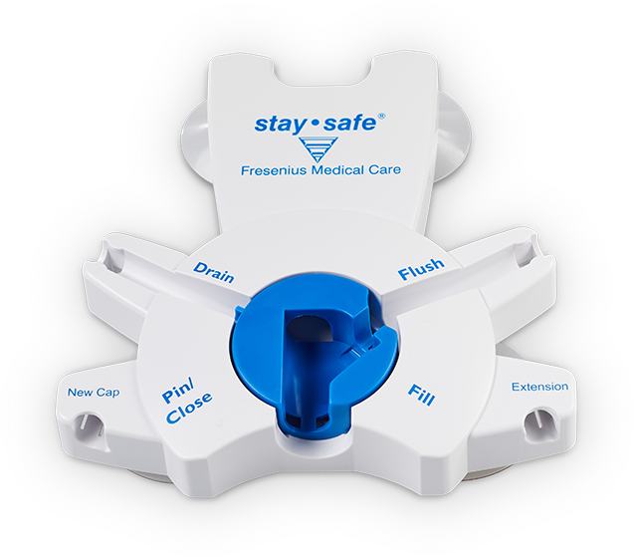
Barriers to Innovation
Need to learn CAD for prototyping
Finding the correct measurement parameters
Acquiring accurate measurements for early detection of infection
Acquiring good test cases (HIPAA)
Work around proprietary systems such as the Fresenius stay-safe
Easy to use by patients with poor vision and dexterity
Easy for clinics to implement and train
Easy to use at home
Notes:
The last 5-7 minutes should be where you think the greatest barriers to your innovation you think will need to be overcome to bring your concept to fruition. Again, it could be technical, economic, political, educational, competitive, or any number of other things that will likely keep you up at night!

