Slide 1
Renal Continuum of Care Update
Lisa Chen & James Bonaffini

Slide 2
Problem Statement – January 14
The purpose of this project is to reduce admission to the UVA Hospital for peritonitis for peritoneal dialysis (PD) patients by identifying infection in its early stages and lowering patient-caused home infection rates.
Problem Statement - Revised
The purpose of this project is to decrease the incidence of peritonitis for current and future peritoneal dialysis (PD) patients by identifying infection in its early stages and refining/replacing the mechanics of existing PD devices.

Slide 3
Why This Problem is Worth Solving
ESRD Costs Medicare over $35 Billion every year
Executive Order on Advancing American Kidney Health
Push for home dialysis – 80% of new patients by 2025 (a very large increase!)
Approximately 7% of End Stage Renal Disease (ESRD) patients use PD

Slide 4
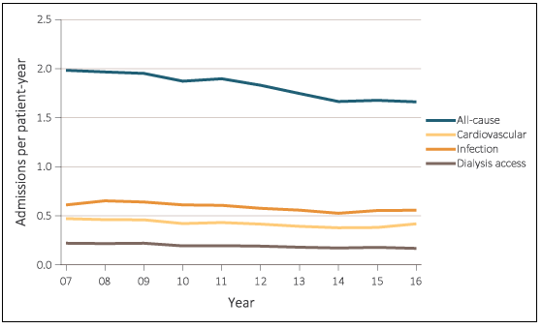
Why This Problem is Worth Solving
PD Patient Hospitalization Rates
Peritonitis Incidence rate is 0.67 per patient per year.
Admissions to the hospital for PD patients are most commonly due to infection
Heavy financial burden: peritonitis-related hospitalization average around $3,100 in the US.
Notes:
The complication imposes a heavy financial burden on the health care system with one health economics analysis estimating the average cost of peritonitis-related hospitalization to be of the order of $3100.

Slide 5
Why This Problem is Worth Solving
Demographics
Risk of first peritonitis was 26% higher in African Americans than Caucasians
Incidence of first peritonitis occurred several months earlier for African Americans
Risk for infection increases with co-morbidities that are found at a higher rate in AAs.
Asian and Caucasian patients are more likely to use PD currently
Younger patients are more likely to use PD
Notes:
Hispanic Population is 1.3x more likely
African Americans – comorbidities

Slide 6
Why This Problem is Worth Solving
PD is more easily learned and less taxing than home hemodialysis
PD better fits into work schedules than hemodialysis
Less infection will result in longer viability of the peritoneum
Less infection will result in fewer hospital admissions (lower overall cost)
Making PD more approachable will result in higher utilization of the procedure and facilitate in the transfer to home dialysis modalities
Notes:
Admission
More uncomfortable
Expensive
Reduce viability of PD
Kidney-care takes a back-seat
Identifying infection
Patients look at the bag for cloudiness – qualitative
Patients are not always able to assess correctly (diabetes/eyesight) or are not educated correctly
Checkups are only once a month
Effluent dialysate is usually discarded
Patient-caused
PD is operated by the patient
Transfer case
Sterility measures are not taken (example- lady who walked around the house with her open tube)
Dexterity is not great for some patients

