Slide 1
Renal Clinical Requirements
James Bonaffini & Lisa Chen
Notes:
jab7qw@virginia.edu

Slide 2
Contents
Problem Statement
Clinical Requirements
Testable Criteria
Engineering Specifications and Related Guidelines
Testing Timeline

Slide 3
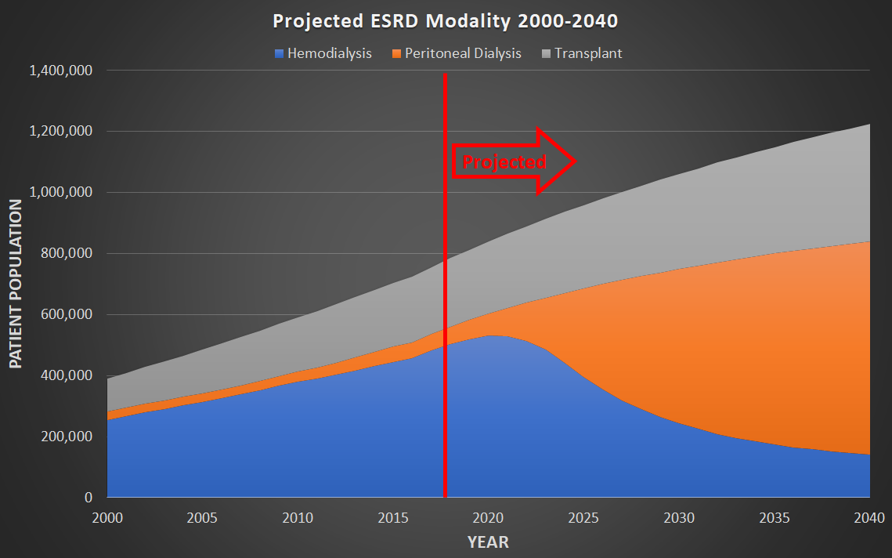
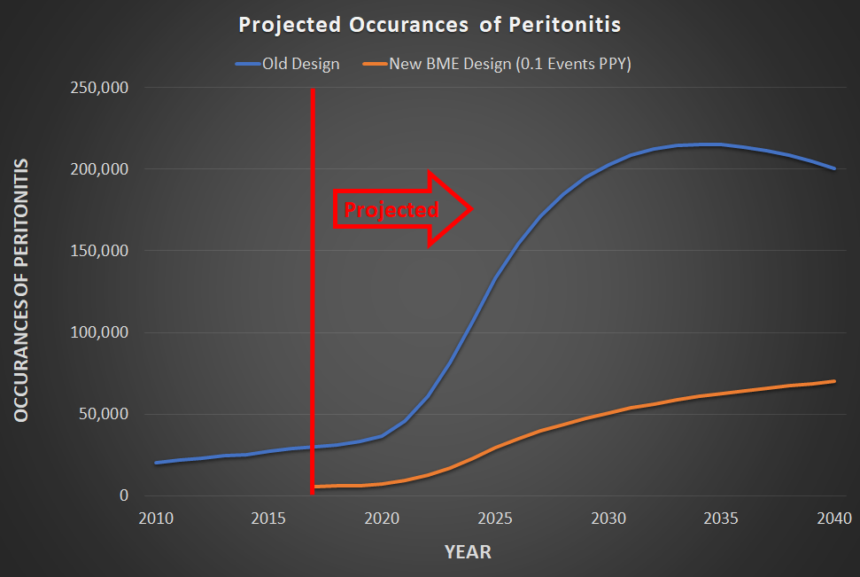
Problem Statement
The purpose of this project is to decrease the incidence of peritonitis for current and future peritoneal dialysis (PD) patients by identifying infection in its early stages and refining/replacing the mechanics of existing PD devices.

Slide 4
Clinical Requirements
Safety | Device shall enable enhanced prevention from infection
Safety | Device shall prevent the PD patient from touching the PD catheter tip during normal use.
Sterilizable | Device shall be able to be sterilized
User | Device shall be usable by a PD patient, right or left handed.
Environment | Device shall be usable at home
Use | Device shall permit tactile manipulation of the catheter tip while keeping hands away from the tip
Use | Device shall be simple to use and able to be learned within 5 demonstrated uses by a clinical professional.
Environment/Sterile | Device shall keep the catheter tip sterile even in a non-sterile environment.
Safety | Tip must remain securely on the catheter when a transfer is not occuring
Use/Safety | Device shall be durable enough to survive a 3 foot fall.
Use | Device shall be watertight and create a channel for fluid to flow
Biocompatibility | Device shall be biocompatible with fluid flowing across it and into the PD patient, not leeching any toxic chemicals
Sterility | Device shall maintain sterility of the catheter tip
Efficiency | Device shall permit fluid to flow quickly into and out of patient
Price | Device shall be cheap enough for single use, less than $5
Volume | Device shall have a tip component that is disposable and manufactured at high volume Current Market: 50k Patients * 4 times/day * 365 days/year = 73 million parts Future Market (2030): 500K Patients * 4 times/day * 365 days/year = 730 million parts
Packaging | Device shall maintain sterility and remain undamaged during shipping

Slide 5
Testable Criteria
Our criteria is based upon 2 Clinical Requirements:
Safety Device shall prevent the PD patient from touching the PD catheter tip during normal use.
Use Device shall permit tactile manipulation of the catheter tip while keeping hands away from the tip
Criteria
Keeping fingers away from the sterile catheter tip
During manipulation, the device ensures patients fingers are at least 1 inch away from the exposed tip
Methods
Take video of the interaction with the PD device
Place deformable or inprintable material around prohibited sections of the device; perform interaction and investigate whether material was perturbed
Repeat connection with large sample size and collect rate of failure/complication
Various environments that can occur in a home setting
Various Lighting
Various amounts of clutter and space to move around to manipulate the device

Slide 6
Engineering Specifications and Related Guidelines
Related Guidelines:
ISO:
ISO 6385:2016(en): Ergonomics principles in the design of work systems
https://www.iso.org/obp/ui/#iso:std:iso:6385:en
Seeking additional standards related to:
Maintaining a sterile environment on single-use devices that are operated by a patient
Guarding of hands or fingers from a sterile or protected area (example: keeping fingers away from heavy machinery)
FDA Guidance:
Applying Human Factors and Usability Engineering to Medical Devices (03 February 2016).
Subsection 5.2 Device Use Environments
Subsection 5.3 Device User Interface
https://www.fda.gov/regulatory-information/search-fda-guidance-documents/applying-human-factors-and-usability-engineering-medical-devices
Notes:
ISO 13485 Medical devices -- Quality management systems -- Requirements for regulatory purposes

Slide 7
Engineering Specifications and Related Guidelines (cont’d)
FDA 876.5630: Title 21 (Food and Drugs) Chapter I (FDA, HHS), Subchapter H (Medical Devices), Subpart 876 (Gastroenterology-Urology Devices), Subpart F (Therapeutic Devices), 5630 (Peritoneal Dialysis System and Accessories)
Identification….. (3) The disposable administration set for peritoneal dialysis consists of tubing, an optional reservoir bag, and appropriate connectors. It may include a peritoneal dialysate filter to trap and remove contaminating particles.
Classification. Class II (special controls). The following accessories are exempt from the premarket notification procedures in subpart E of part 807 of this chapter subject to the limitations in §876.9: A catheter finger grip that is non-patient contacting and intended for single use with a peritoneal catheter; a continuous ambulatory peritoneal dialysis (CAPD) belt; and a catheter stand that does not include weigh scales.
https://www.ecfr.gov/cgi-bin/text-idx?SID=277c25f2d688dc4bb5fd8041efb2bf6d&mc=true&node=se21.8.876_15630&rgn=div8
Product Code: KDJ Product Description: SET, ADMINISTRATION, FOR PERITONEAL DIALYSIS, DISPOSABLE

Slide 8
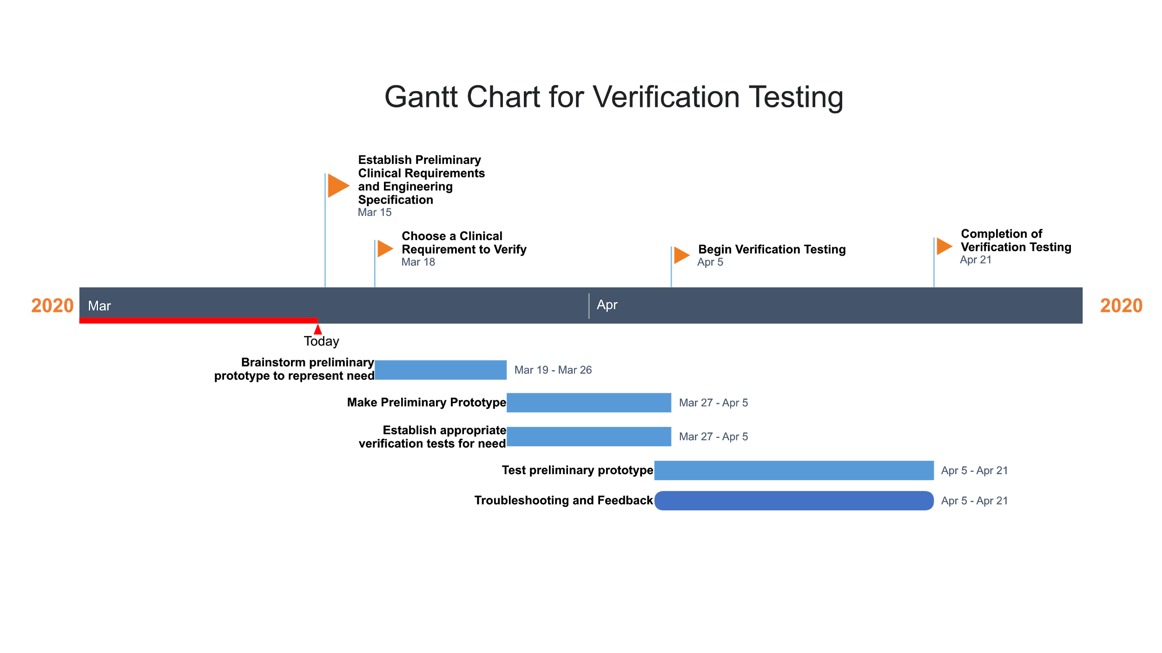
Testing Timeline: Gantt Chart

