Slide 1

Predicting Thrombin and Fibrin during Thrombosis under Flow
Jason Chen, Scott L. Diamond
James Bonaffini
Tehan Dassanayaka
Hill Johnson
Jordan Word

Slide 2
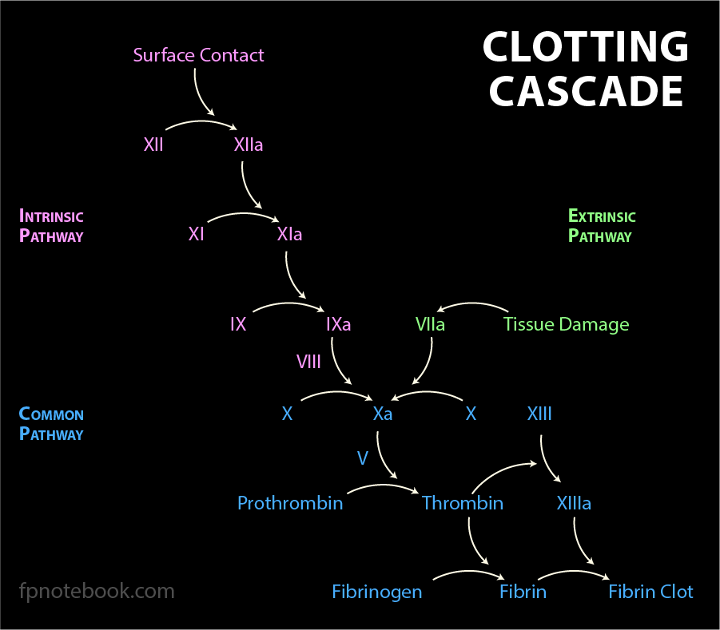
Biological Background
MOTIVATION:
Clotting mechanisms have many implications in human disease
Coagulation cascade is difficult to model and study
AIM:
Create a simplified computational model to determine coagulation factor concentrations during thrombosis under venous flow
SIGNIFICANCE:
Multiscale simulation of thrombosis in venous vasculature
Study and development of therapies that impact the coagulation cascade
Notes:
SUMMARY OF PAPER SELECTED
Motivation
Human Diseases:
Coronary Thrombosis (heart attacks)
Stroke
Genetic diseases - Hemophilia
Anticoagulation therapy for patients with mechanical heart valves
Difficulties:
Clotting is a complex biological phenomenon
Despite decades of studies - new modulators and reaction pathways are still being discovered
Model is necessary because studying in purified system can be difficult because picoMolar levels of factors formed transiently are challenging to measure experimentally
Paper Aim
Develop computational model to determine coagulation factor concentrations after clot initiation
Potential Clinical Significance
Multiscale simulation
Over vessel scale lengths of mm to cm
Study the coagulation cascade and develop therapies
Anticoagulant/Coagulant promoters
SUMMARY OF BIOLOGICAL MECHANISMS MODELED
Three pathways form the coagulation cascade
Extrinsic (Tissue Factor from tissue damage->forms activated complex with factor 7)
Intrinsic (Collagen/platelet activation)
Common (Meets at factor 10 and combines with factor 5 to create the prothrombinase complex)
Emphasize the final steps of the clotting cascade
Prothrombin->Thrombin and Fibrinogen->Fibrin
Clotting on Surface under Flow:
Mathematically complex physical phenomenon:
Platelet margination to the wall
convective/diffusive transport
Concentration boundary layers
Pressure-driven permeation
Moving boundaries
General Notes:
Fibrin appears to provide explosive but feedback inhibited thrombin generation
The large amount of fibrin-bound thrombin was predicted to take a few hours to elute into the circulation to form TAT
Generally interactions at single molecule level are considered unaffected by macroscopic flow forces

Slide 3
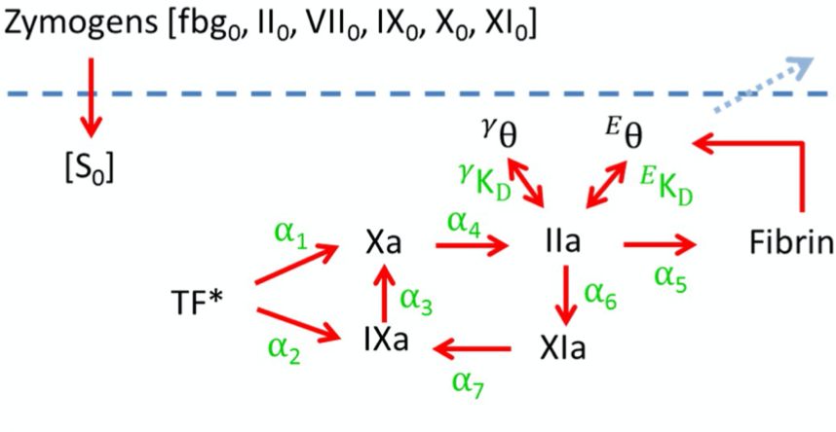
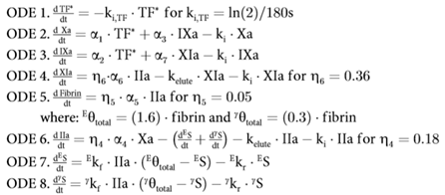
Key Equations and Parameters
k_{i}, k_{i,TF} | Half-life constants
k_{elute} | Elution constant
𝞪 | Kinetic coefficients
𝞰 | Effectiveness factors
Notes:
Graphical Model
Initial concentration of zymogens
The model is a simplified version of the clotting cascade.
TF from tissue damage initiates the clotting cascade
In the ODE equation half-life constants are used to model the change in TF concentration over time
Alpha are the kinetic coefficients determined by michaelis-menten kinetics and found in the literature
Elution coefficients are determined by experimental data
Models movement of factors out of the system
eta is the effectiveness factor. When multiplied by the corresponding alpha produces the actual kinetic rate
Way to alter the model to fit the experimental data
Important to note that thrombin provides feedback into the intrinsic pathway at factor 11
Epsilon and Gamma are low and high affinity domains located on fibrin which bind thrombin

Slide 4
Assumptions
Assumptions and Limitations
Thin film
Equal zymogen concentrations in clot and plasma
Closed System
Ignores platelet metabolism
Anionic phospholipids
Fibrinogen is strongly diffusion limited
All enzymes had a half-life of 1 min other than TF which had a half-life of 3 mins
Notes:
MODEL SETUP
7 michaelis-menten equations
TAT/F1.2 measurements were used to determine thrombin concentrations in the clot over time
Three modified parameters = three effectiveness factors (n4,n5,n6) which is the ratio of actual rate with limited transport/theoretical rate
ASSUMPTIONS AND LIMITATIONS
To predict intraclot fibrin - required penetration to be strongly diffusion limited

Slide 5
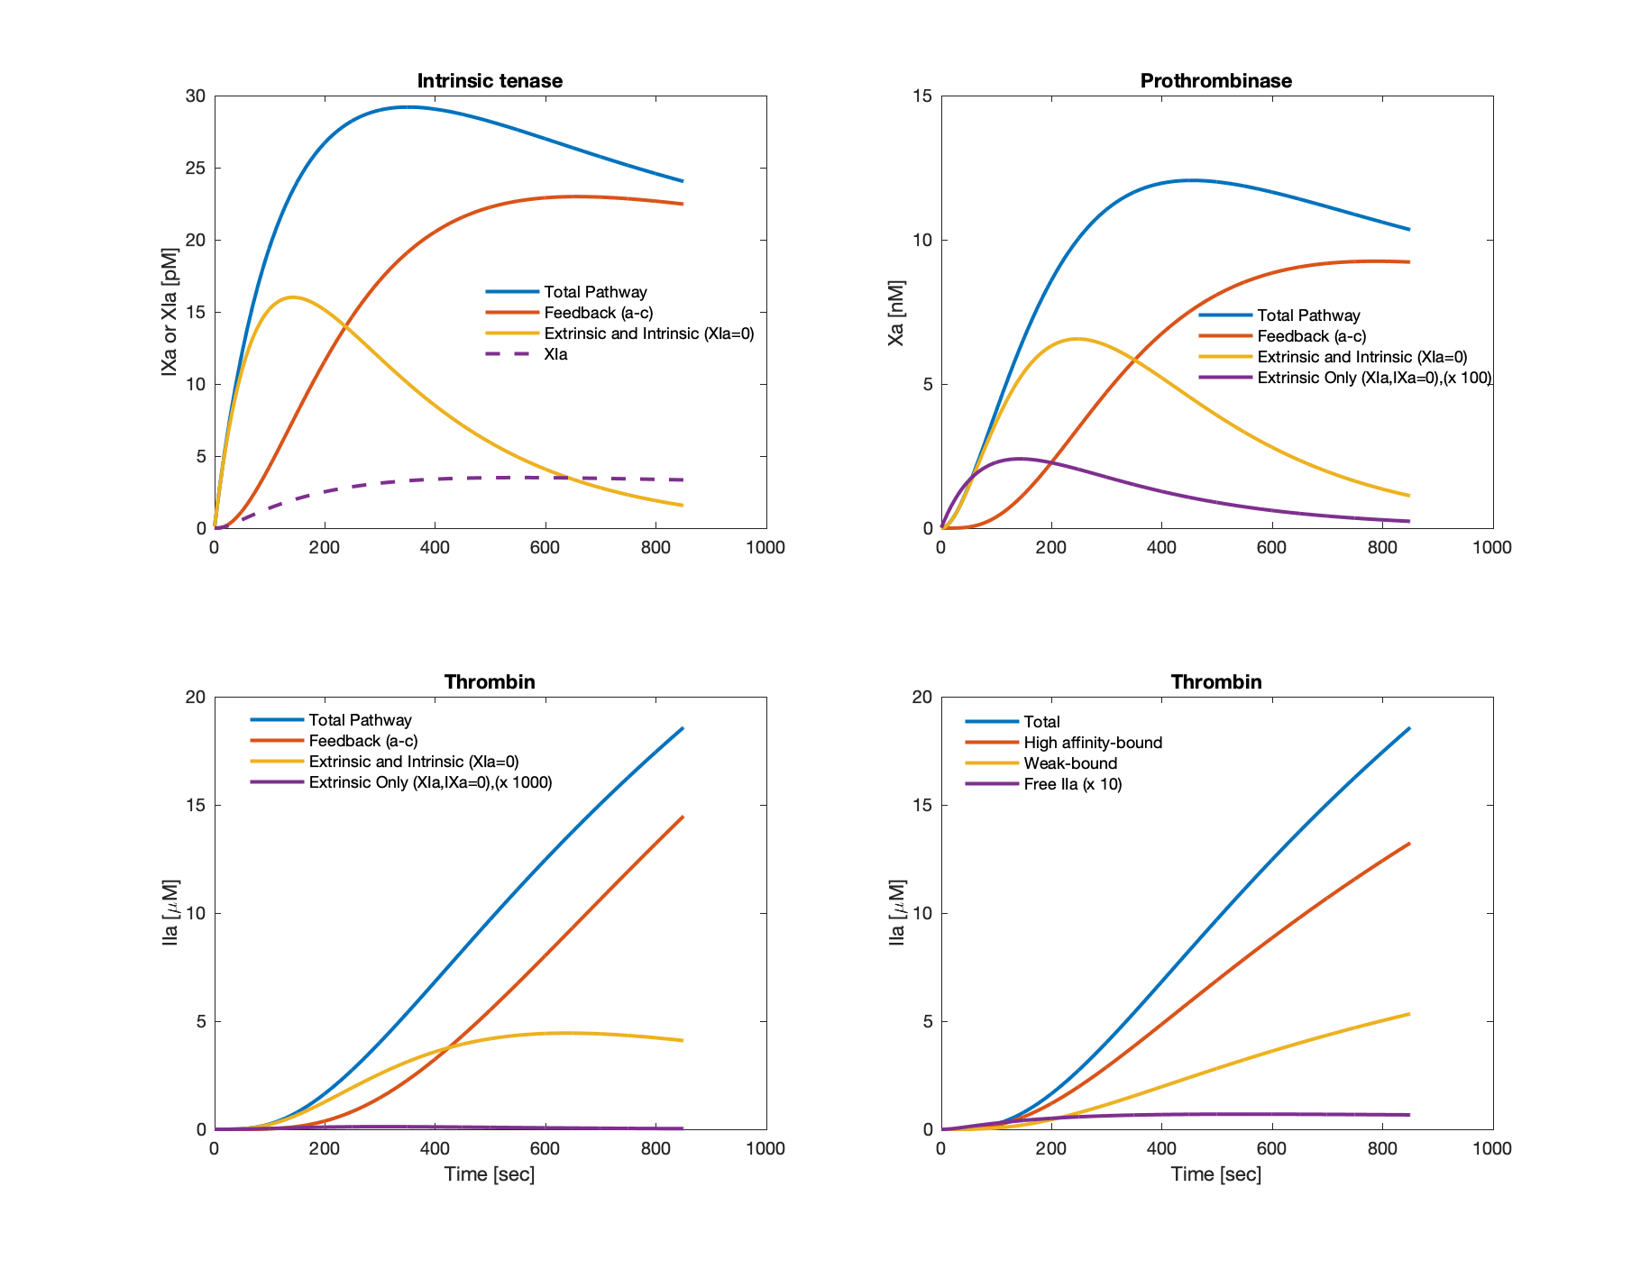
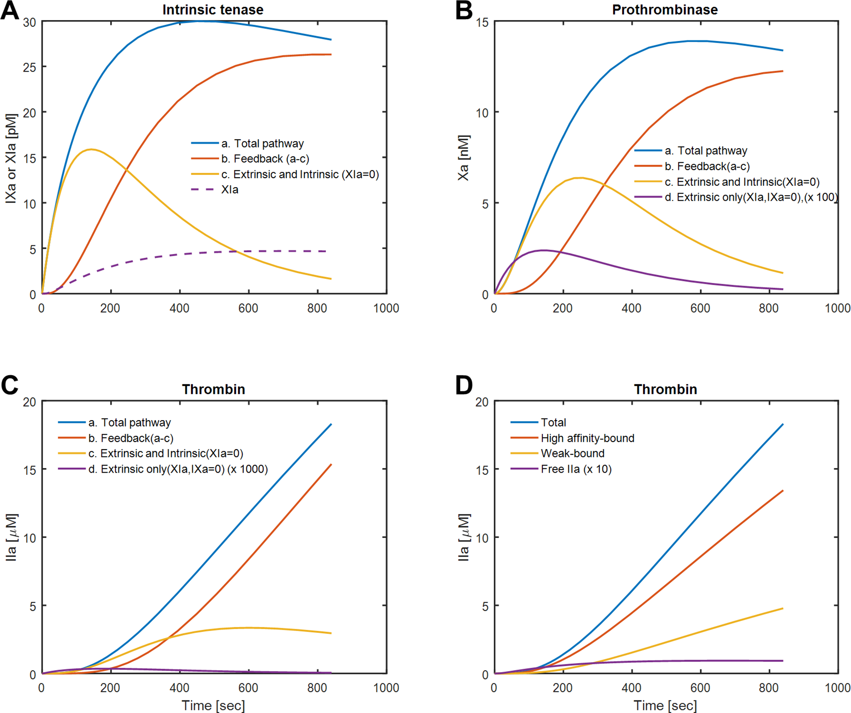
Figure Reproduction
Original
Reproduction
Notes:
Methods:
ODE15s
Difficulties:
Determining initial parameters (Reached out to the authors but they did not respond)
Rate constants for fibrin binding sites were not explicitly stated
Some conflicts between effectiveness factors in the paper and what was found in the cited literature - the author picked and chose the parameters he wanted

Slide 6
Novel Analysis:
Effect of factor deficiency on clotting cascade under flow
Hemophilia A is characterized by FVIIIa deficiency
Clotting disorder
Frequency and severity of bleeds dependent on plasma concentration of FVIIIa
Severity | FVIIIa (compared to normal) | FVIIIa concentration
Mild | 5-40% | 0.05-0.4 IU/mL
Moderate | 1-5 % | 0.01-0.05 IU/mL
Severe | <1 % | < 0.01 IU/mL
Notes:
Hemophilia A is characterized by Factor VIII deficiency
Look at upper end of the severity
Would have to alter the system of ODEs

Slide 7
Novel Analysis Methods
Paper assumes cofactor activation is not rate limiting
Alter parameters to represent plasma levels of FVIIIa associated with mild, moderate, and severe hemophilia
Effects ODEs 2 and 3 in the intrinsic pathway
Model thrombin concentration over time in FVIIIa deficient systems
Notes:
Paper assumes non rate limited cofactor activation
Analyzes dynamics of intrinsic tenase generation, prothrombinase production and thrombin binding to fibrin when intrinsic tenase is set to 0 (to model the most extreme hemophilia) → does not analyze the intermediate cases
Determine rate limitation of cofactor activation
Alter ODEs 2 and 3, representing X → Xa, to represent the rate limitation associated with cofactor activation

Slide 8
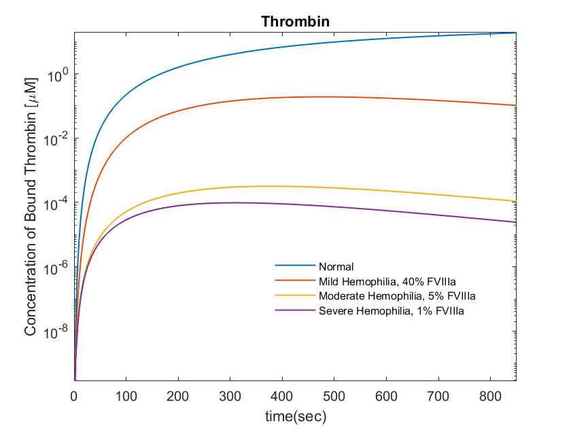
Results
Model thrombin concentration over time in FVIIIa deficient systems
FVIIIa is not explicitly modeled but rather grouped into the effectiveness parameters
Despite model’s simplicity, complexities of the wound healing cascade can still be factored into the model
Clinical implication
Model can guide therapy
Notes:
Normal to mild (2.5 fold decrease in factor 8, 18.7 fold decrease in thrombin )
Mild to moderate (8 fold decrease in factor 8, 955 fold decrease in thrombin )
Moderate to severe (5 fold decrease in factor 8, 4.5 fold decrease in thrombin )
Big takeaway,
Mild to moderate greatest fold change

Slide 9
Questions?

Slide 10
Citations
Chen, Jason, and Scott L. Diamond. “Reduced Model to Predict Thrombin and Fibrin during Thrombosis on Collagen/Tissue Factor under Venous Flow: Roles of γ’-Fibrin and Factor XIa.” Edited by Jeffrey J. Saucerman. PLOS Computational Biology 15, no. 8 (August 5, 2019): e1007266. https://doi.org/10.1371/journal.pcbi.1007266.
Preston, F. E., S. Kitchen, I. Jennings, T. a. L. Woods, and M. Makris. “SSC/ISTH Classification of Hemophilia A: Can Hemophilia Center Laboratories Achieve the New Criteria?” Journal of Thrombosis and Haemostasis 2, no. 2 (2004): 271–74. https://doi.org/10.1046/j.1538-7836.2003.00447.x.
“Bleeding Disorders | National Heart, Lung, and Blood Institute (NHLBI).” Accessed December 1, 2019. https://www.nhlbi.nih.gov/health-topics/bleeding-disorders.
Notes:
https://onlinelibrary.wiley.com/doi/10.1046/j.1538-7836.2003.00447.x
https://www.nhlbi.nih.gov/health-topics/bleeding-disorders

Slide 11
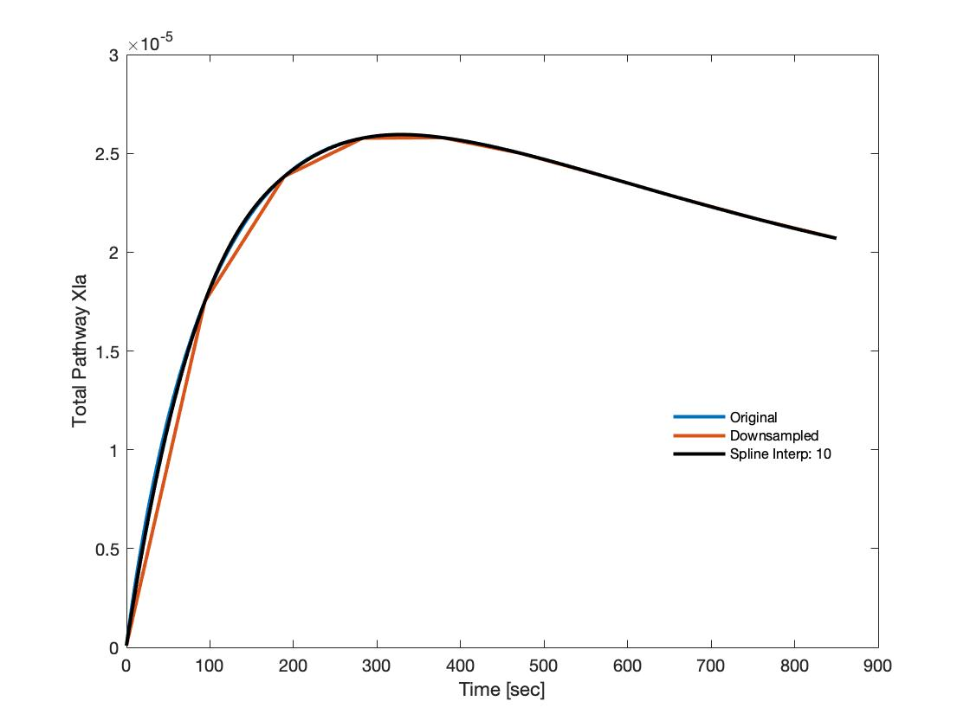
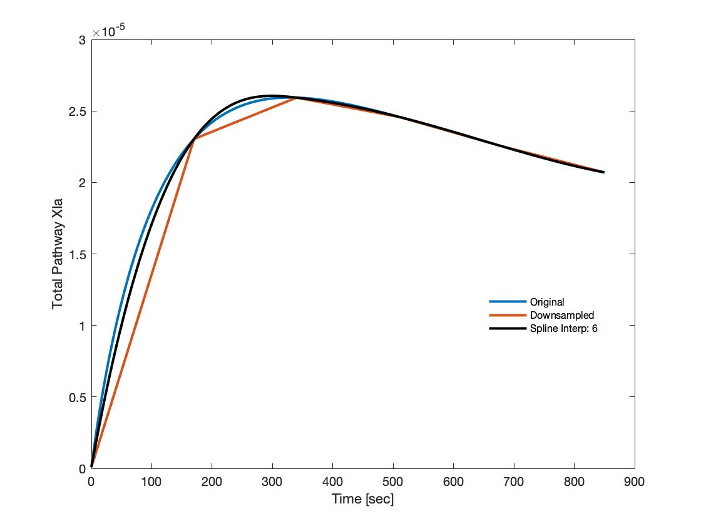
Spline Interpolation
Notes:
Spline interpolation:
Used 10,6,5,4 points to accurately recreate concentration of factor 11a over the 850s time frame.
ODE curves can be recreated using samples from experimental data

Slide 12
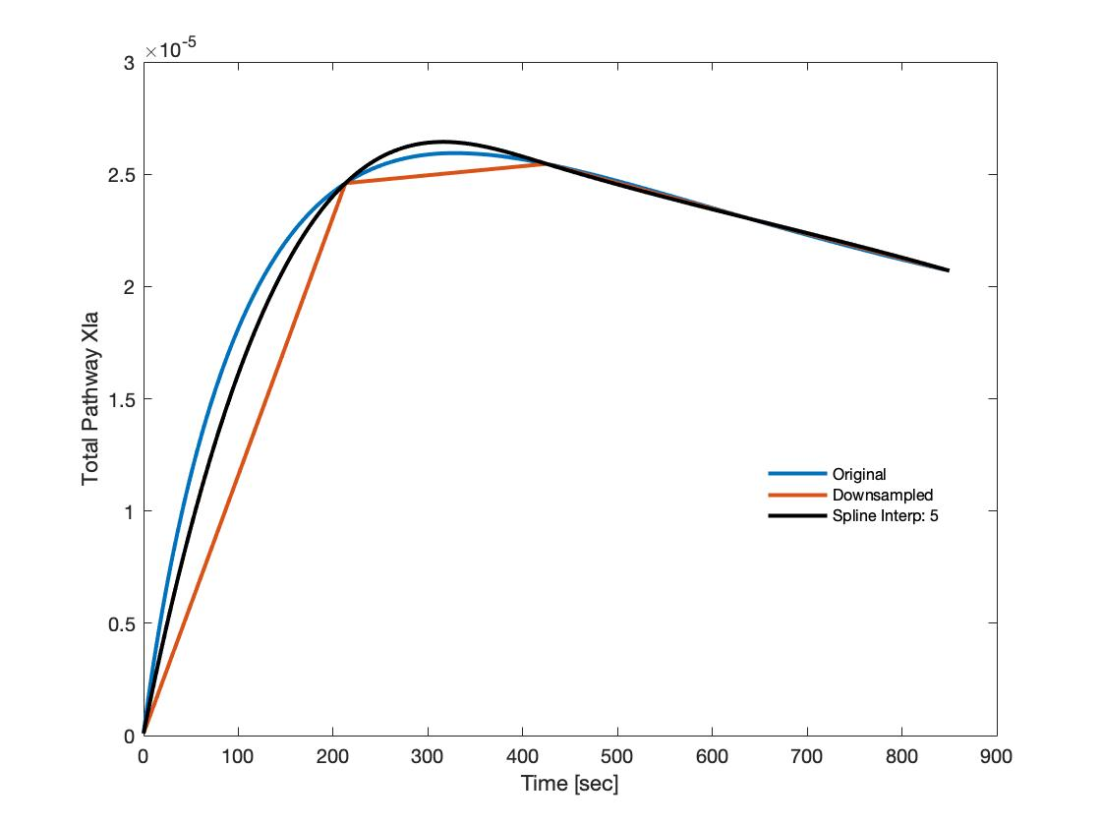
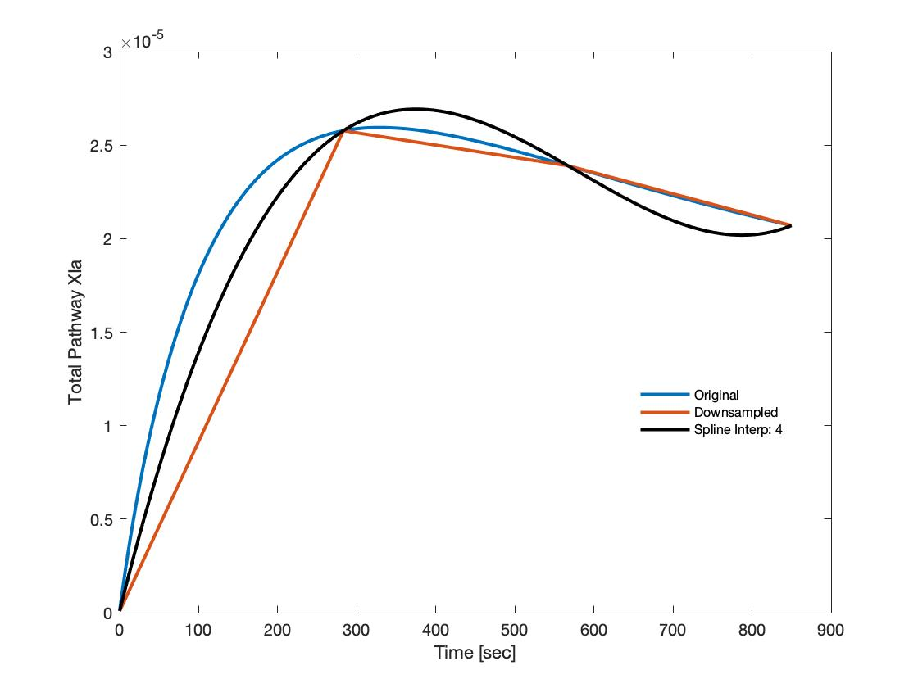

Slide 13
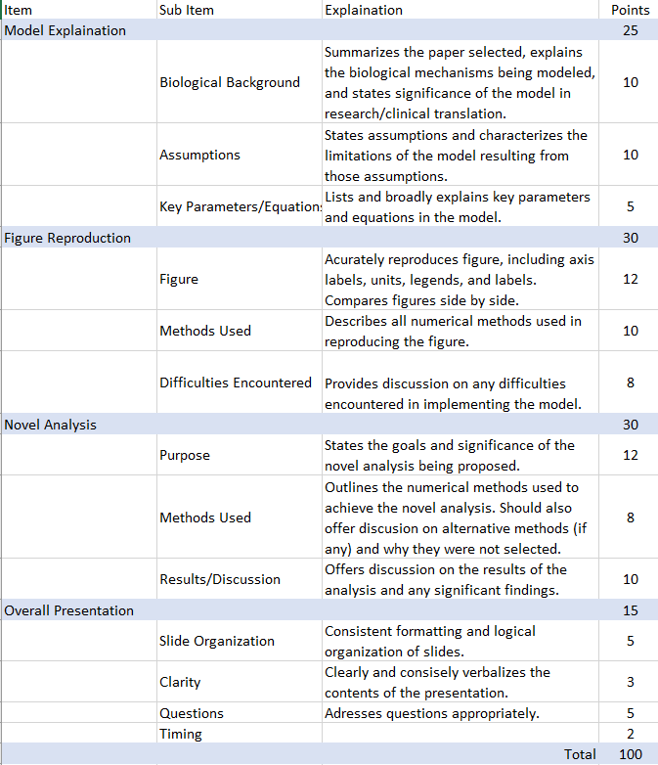
Resources
Our Previous Presentation:
https://docs.google.com/presentation/d/1fura69Lllvz_mkbHlCeZBSAx9Tm_pFQY4ch9zQ2Vc-M/edit?usp=sharing

