Slide 1




Slide 2

Salesforce.com Mobile SDK SmartStore
SQLite ORM wrapper for Native and Hybrid apps built on the SFDC Mobile SDK
This Presentation: http://bit.ly/I1epls
MobileSDK: http://wiki.developerforce.com/page/Mobile_SDK
My Demo Hybrid App: https://github.com/tomgersic/SmartStoreDemo
Sandeep’s blog post: http://bit.ly/xb8H6l
Mobile SDK Workbook: http://bit.ly/xb8H6l

Slide 3
Why use SmartStore in a Hybrid app?

Slide 4
WebSQL
Implemented in WebKit using SQLite
Available on both iOS and Android
But…

Slide 5

WebSQL
http://www.w3.org/TR/webdatabase/

Slide 6
Next up from the W3C? IndexedDB
W3C Spec: http://www.w3.org/TR/IndexedDB/
Key-Value Database System
Asynchronous or Synchronous
Adheres to Same Origin Policy
But…

Slide 7
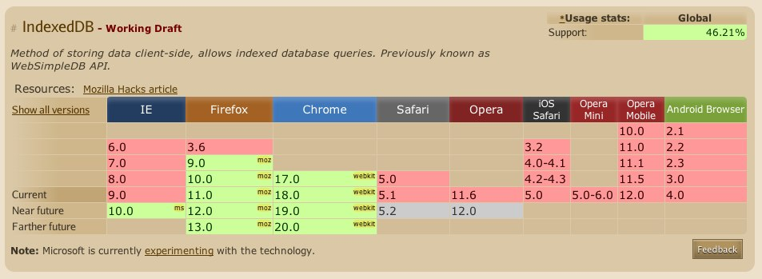
IndexedDB
http://caniuse.com/#search=indexeddb

Slide 8
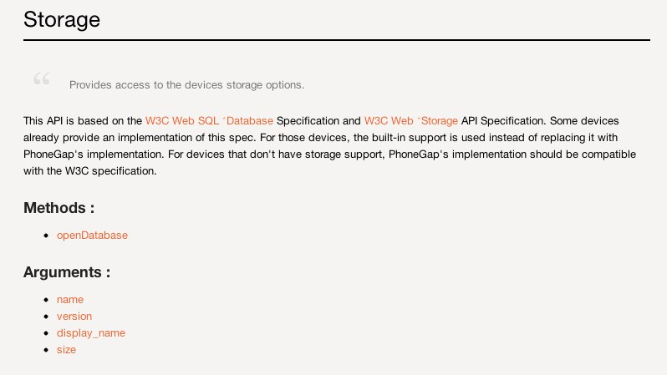
PhoneGap?
Storage Class: http://docs.phonegap.com/en/1.5.0/phonegap_storage_storage.md.html

Slide 9


PhoneGap Storage?

Slide 10


Lawnchair simple JSON storage
“is sorta like a couch except smaller and outside”

Slide 11
lawnchair
Can use localStorage or WebSQL as an underlying architecture
So, lawnchair with localStorage?
Comparing the speed of using a local SQLite database versus window.localStorage to store key/value pairs using Lawnchair.
http://jsperf.com/lawnchair-webkitsqlite-vs-domstorage/3

Slide 12
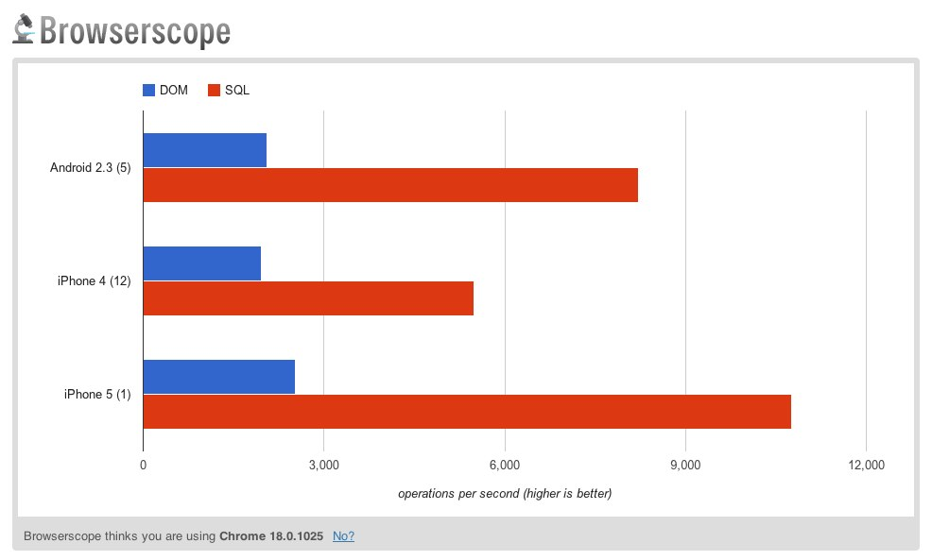
lawnchair

Slide 13
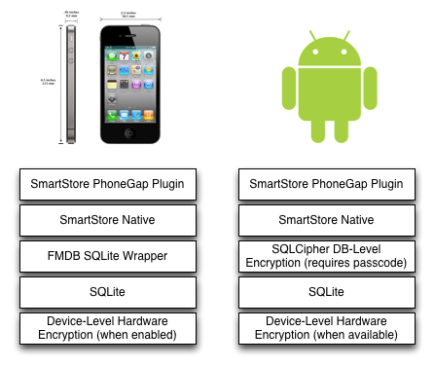
SmartStore

Slide 14
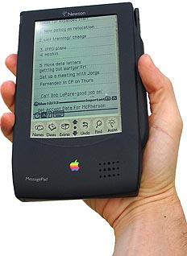
SmartStore Terminology
“Soup” – is basically just a database table used to store JSON documents with index columns.
Soups are held in “Stores”, which are SQLite database files.
Apple Newton terminology – had no real filesystem, so data was stored in database entries called “soups”
http://en.wikipedia.org/wiki/Soup_(Apple)
http://www.canicula.com/newton/prog/soups.htm

Slide 15

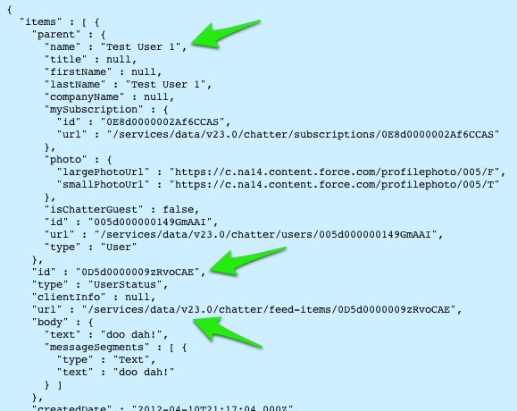
SmartStore – Register a Soup
navigator.smartstore.registerSoup(soupName,indexes,success,error);
soupName is whatever you want it to be.
Indexes are defined as arrays of objects, and are needed if you want to search or sort by that field.
Indexes have a Path, which should be a field in the JSON object, and a Type, which is either “string” or “integer”
success and error are callbacks
Example:
[
{“id”,”string”},
{“url”,”string”},
{”parent.name”,”string”}
]

Slide 16

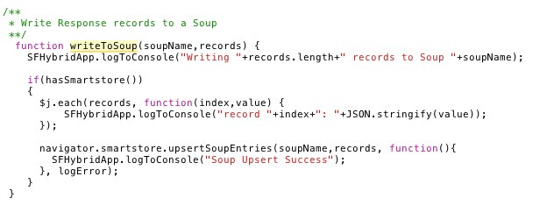
SmartStore – Upsert Soup Record
navigator.smartstore.upsertSoupEntries(soupName,records, success, error);
soupName identifies the soup you registered earlier
records is an array of JSON objects
If you’re using ForceTK, this is response.items.

Slide 17

SmartStore – Query the Soup
Step 1: Define a querySpec:
buildAllQuerySpec(path,order,pageSize)
Query all records from the object in the given sort order (or null order)
var querySpec = navigator.smartstore.buildAllQuerySpec("id", null, 20);
buildExactQuerySpec(path,matchKey,pageSize)
Search for records with index path values matching the key.
buildRangeQuerySpec(path,beginKey,endKey,pageSize)
Return all records with an index path value between the two range values
buildLikeQuerySpec(path,likeKey,order,pageSize)
Basically “select * from [table] LIKE ‘%[likeKey]%’”

Slide 18
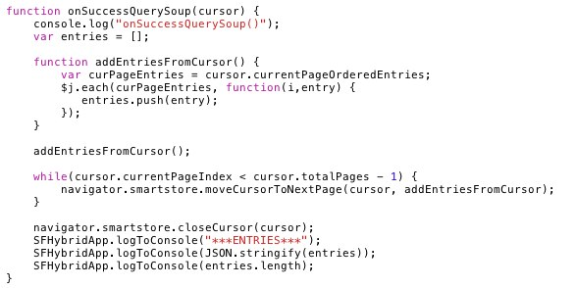

SmartStore – Query the Soup
Step 2: Use the QuerySpec to query the Soup
navigator.smartstore.querySoup(soupName,querySpec, success(cursor),logError);
Use the query cursor to navigate response pages

Slide 19

SmartStore – Remove the Soup
Remove Soups easily with:
SmartStore.prototype.removeSoup = function (soupName, successCB, errorCB)

Slide 20
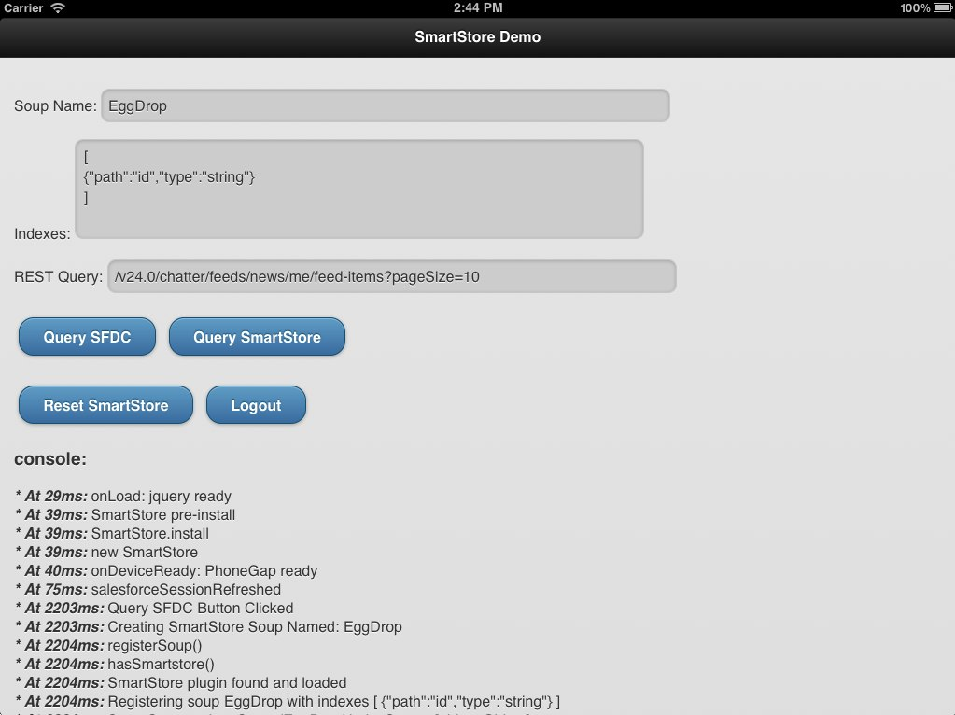

Slide 21
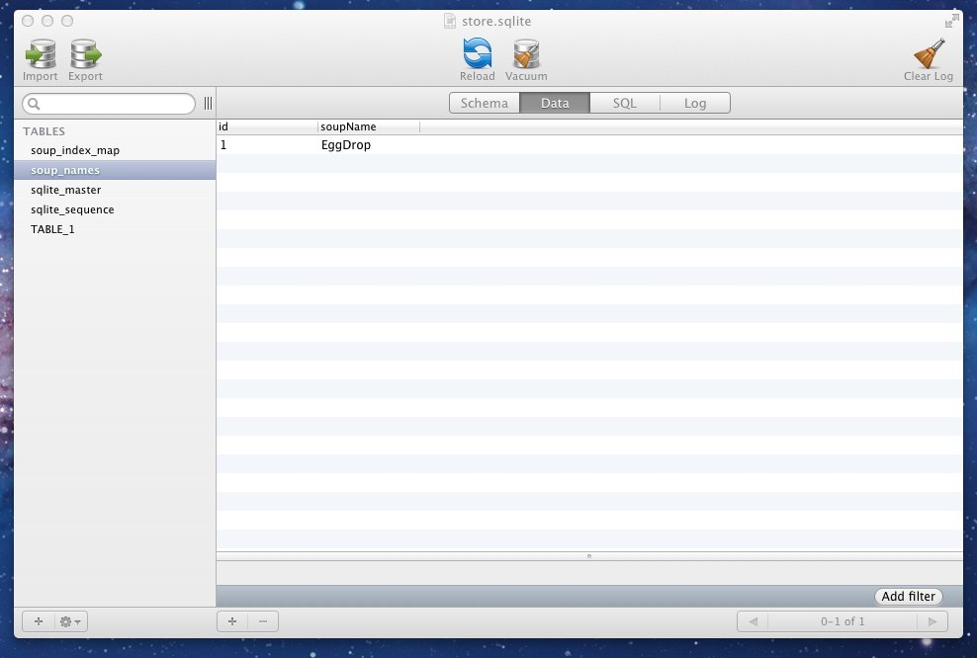
SmartStore Behind the Scenes
soup_names keeps a list of the Soups I’ve created.

Slide 22
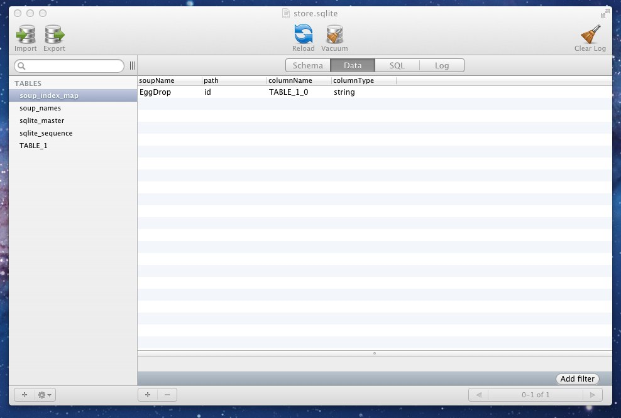
SmartStore Behind the Scenes
soup_index_map keeps track of the indexes for each Soup.

Slide 23
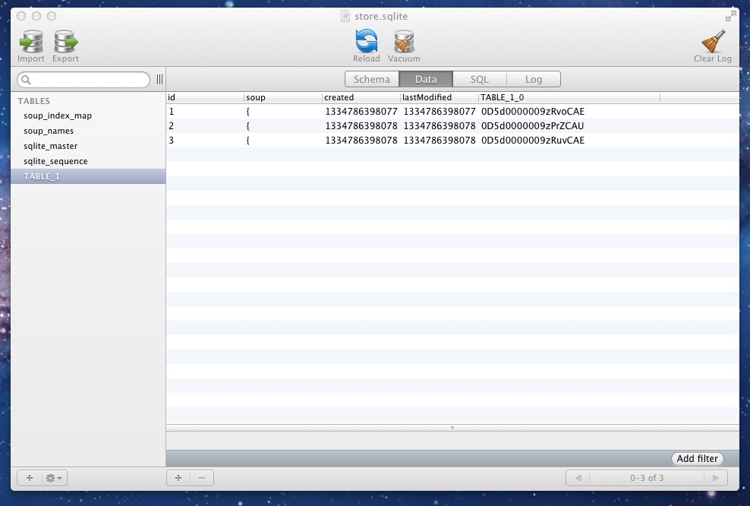
SmartStore Behind the Scenes
TABLE_1 is a generically named table that contains my JSON data and Index values. The TABLE_1_0 field here is the “id” index we specified when we created the Soup. If I had created more indexes, like a “name” index, another column would be shown here.

Slide 24
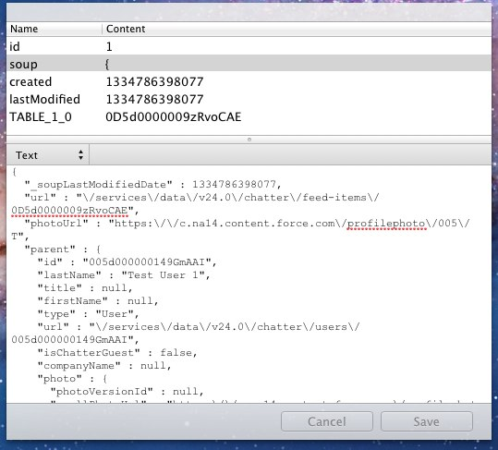
SmartStore Behind the Scenes
The Soup field contains the full JSON response for that record so you can reuse whatever code you wrote to deal with the JSON record from the REST API once you’ve pulled it from the Soup.

