Slide 1
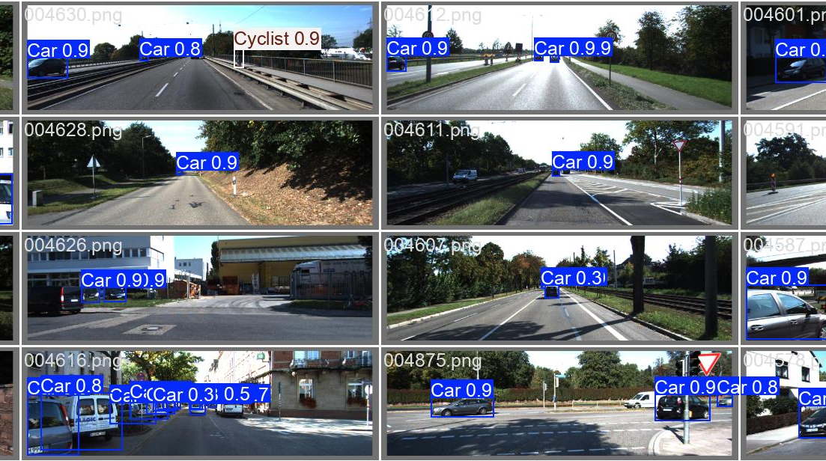
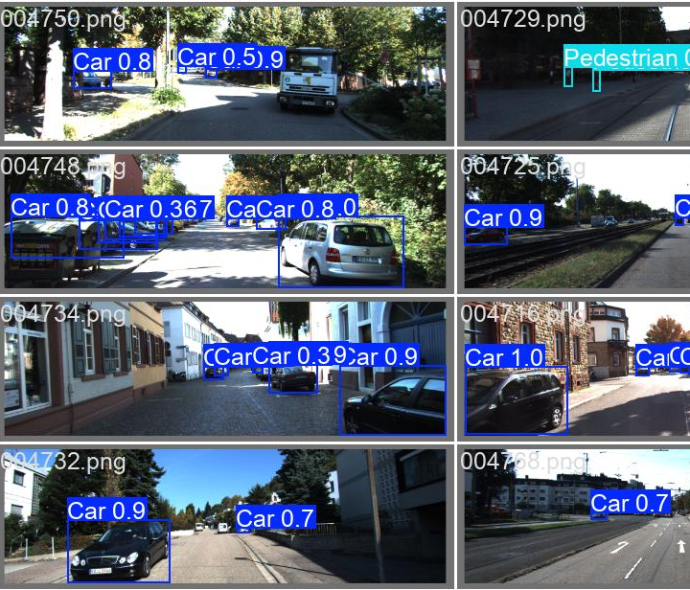
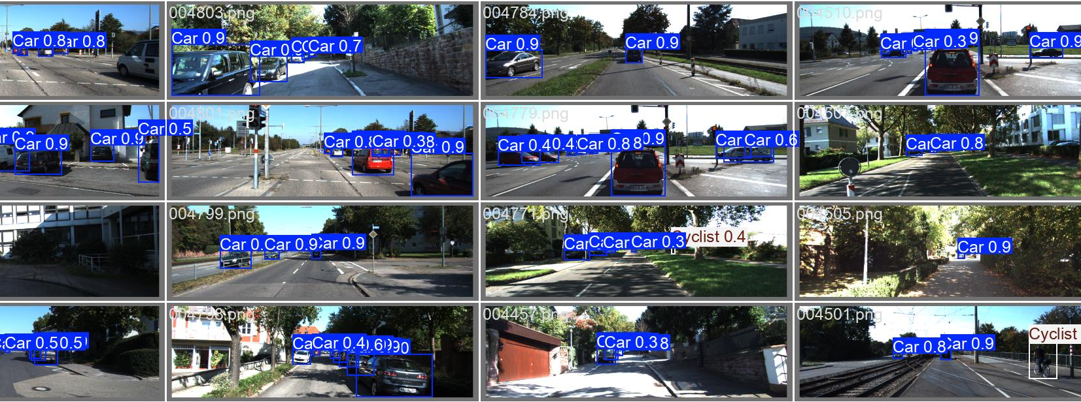
Road Detection Final Presentation
Jason Bone

Slide 2
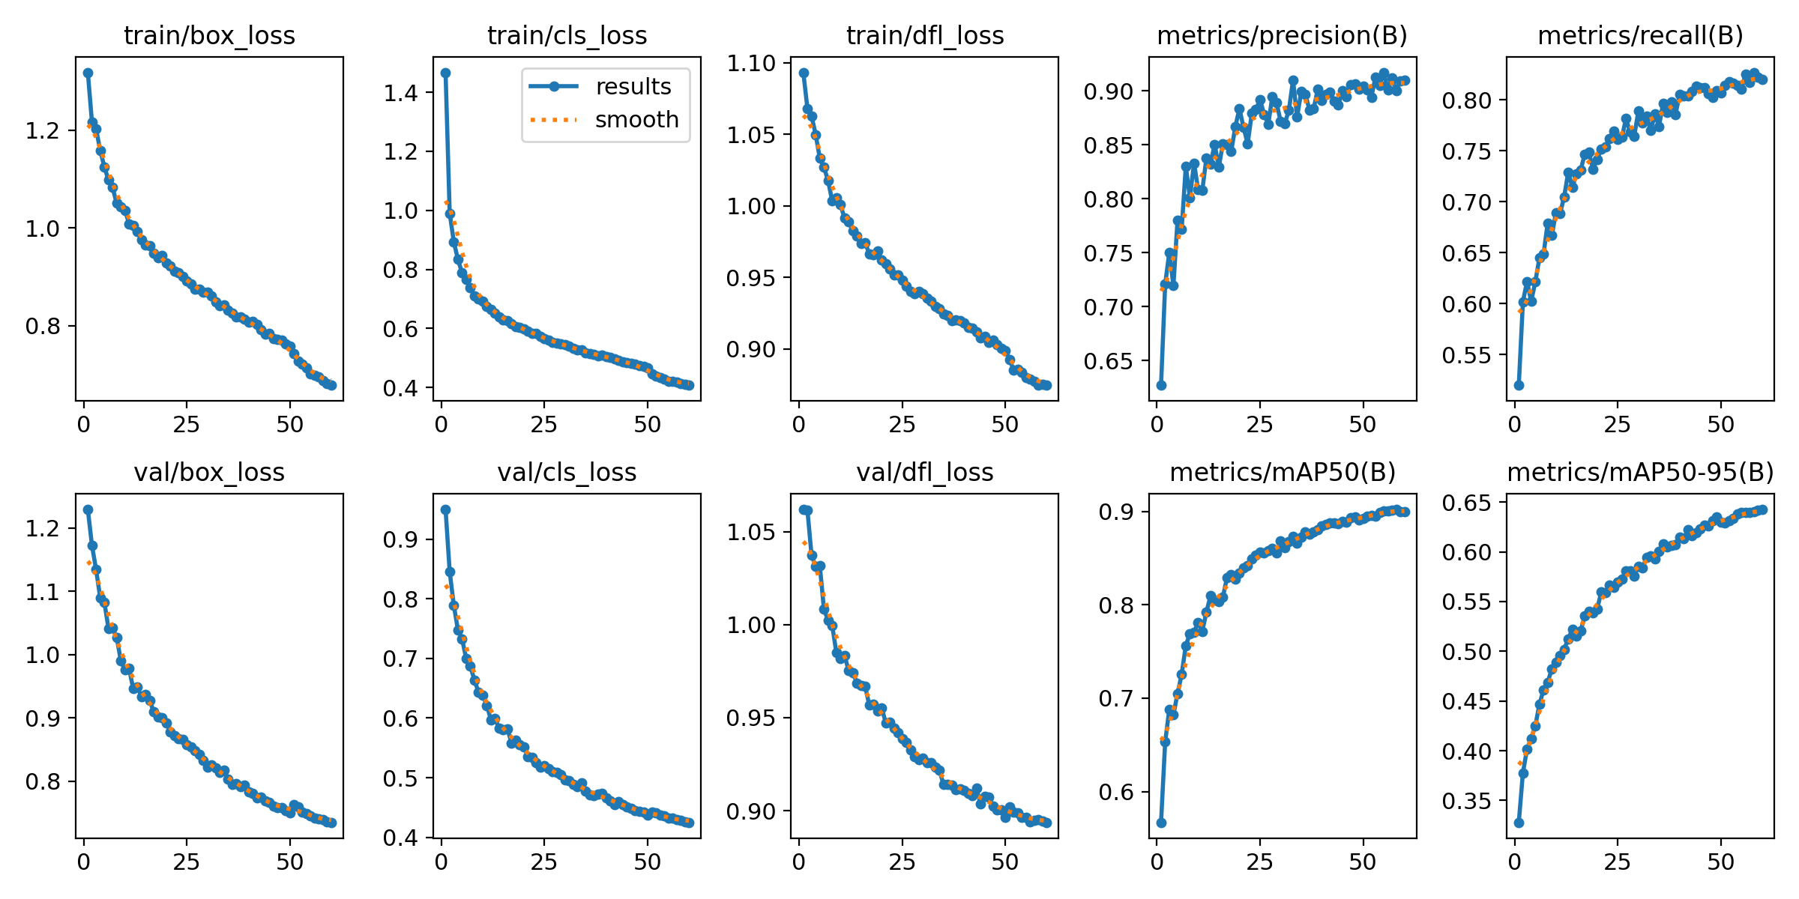
Final Methodology
Due to time constrains and issues with Faster R-CNN and Google Colab, used only YOLOv8 model compared to results reported for other models.
While comparisons are not one-to-one still provides valuable insight.
15k COCO Images for 30 epochs ~7500 KITTI Images at 80/20 split for 60 epochs
YOLO: class_id x_center y_center width height
KITTI: type truncated occluded alpha bbox_left bbox_top bbox_right bbox_bottom dimensions_height dimensions_width dimensions_length location_x location_y location_z rotation_y
COCO: JSON format

Slide 3
Metric Comparisons
Key metrics comparison for reported KITTI results from community benchmarks and leaderboard submissions.
Model | mAP@0.5 | mAP@0.5:0.95 | Dataset
YOLOv8 (Ours) | 90.0% | 64.3% | KITTI-val
Faster R-CNN | 78.1% | 57.6% | KITTI-test
SSD | 75.3% | 54.2% | KITTI-test
YOLOv3 | 72.1% | 51.8% | KITTI-test

Slide 4
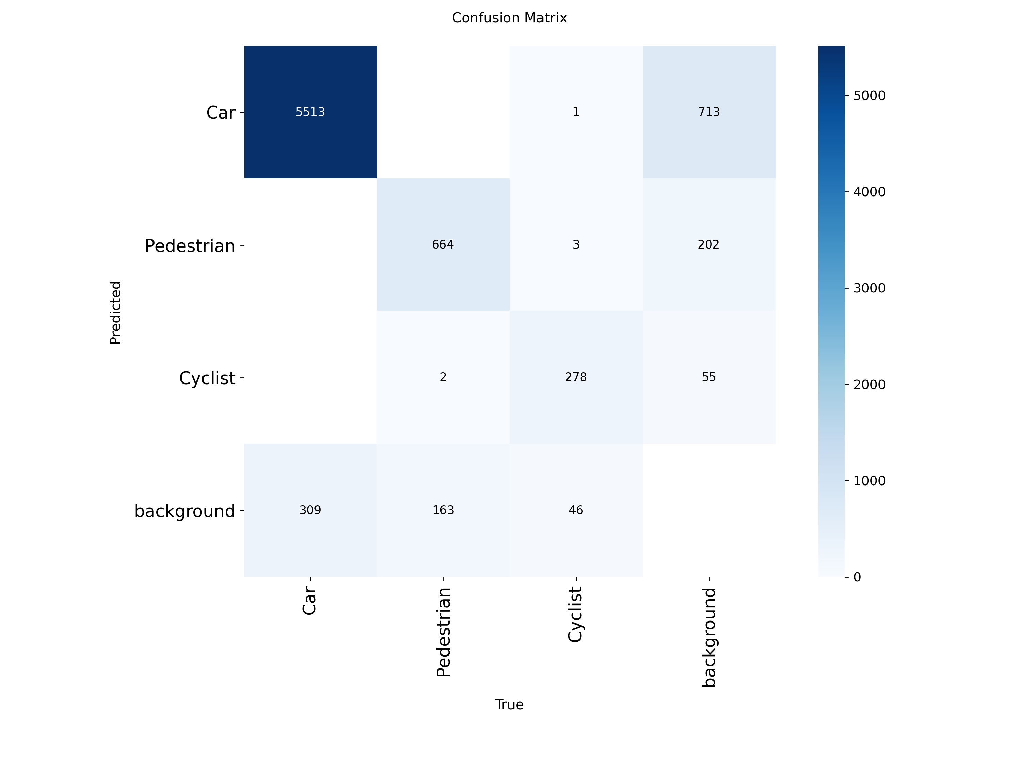
Conclusions
YOLOv8 and more advanced single-stage object detection models outperform two-stage models overall by having much faster speeds while still competing in accuracy.
YOLO gets better with every iteration and continued advancements in the single-stage models will help push autonomous driving forward.
Even though KITTI is a great test set only roads from one environment is still far too general for a real-world object detector for a vehicle
Even at mAP of 90% further improvements would be required if our model were to ever be applied.

