Slide 1
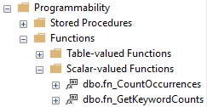
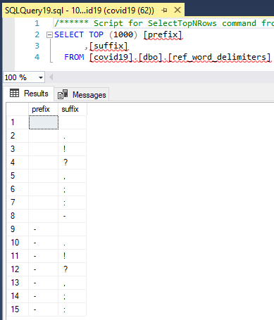
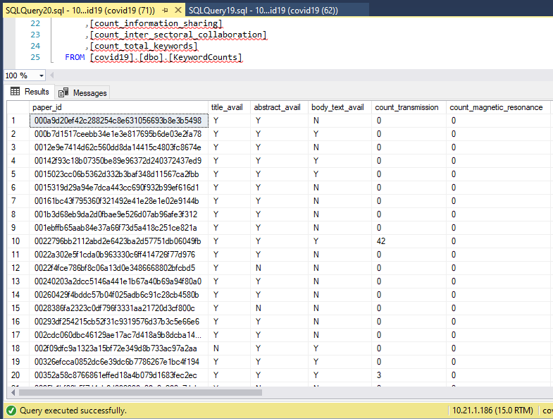

The ref_word_delimiters table is a reference table that allows us to dynamically define the leading (prefix)/trailing (suffix) character(s) that determine a whole-word instance. Adding another permutation simply requires inserting a new record with the prefix/suffix desired. Removing a permutation simply requires deletion of a record.
fn_CountOccurences counts the number of times a specific string (word or phrase) occurs in a corpus.
fn_GetKeywordCounts loops through all the permutations from ref_word_delimiters with the word (or phrase) of interest to see how many times it occurs in total. The loop occurs once for each record in ref_word_delimiters to tally total occurrences.
Kaggle COVID-19 Keyword Counts Technical Approach
A SQL SELECT INTO AS… was used to create the KeywordCounts table so keyword counts are quickly accessible. Some useful facts about this table are:
It is keyed on the PK from AllPapers (paper_id).
Each paper has a record and keyword counts are shown for each paper.
Y/N flags are used to indicate if a paper has a title, abstract, and body_text available or not.
A total keyword count sums all of the counts to give some sense of total matches.
ScrumMaster: Jim Eselgroth
Lead Scientist: John Bonfardeci
Keyword Developer: Mark DeRosa

