Slide 1
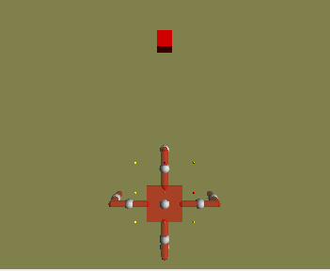
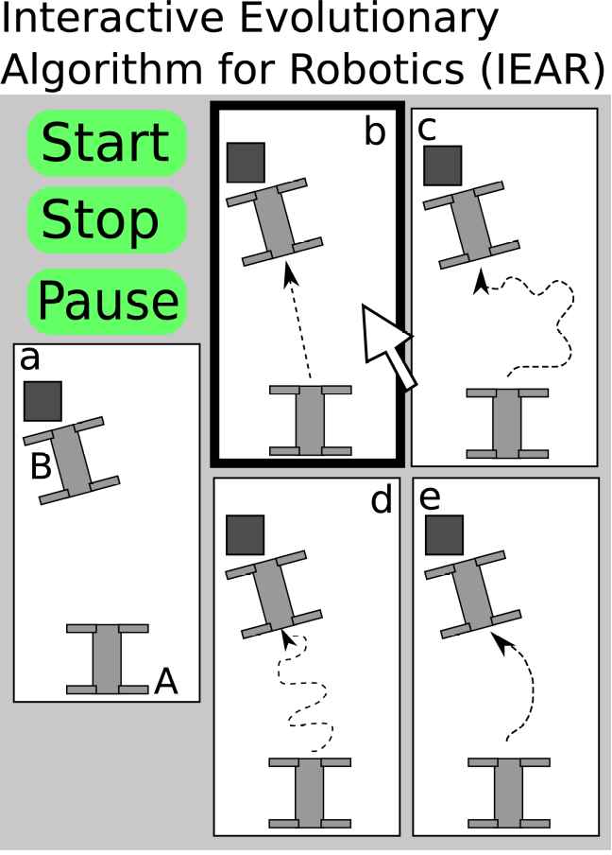
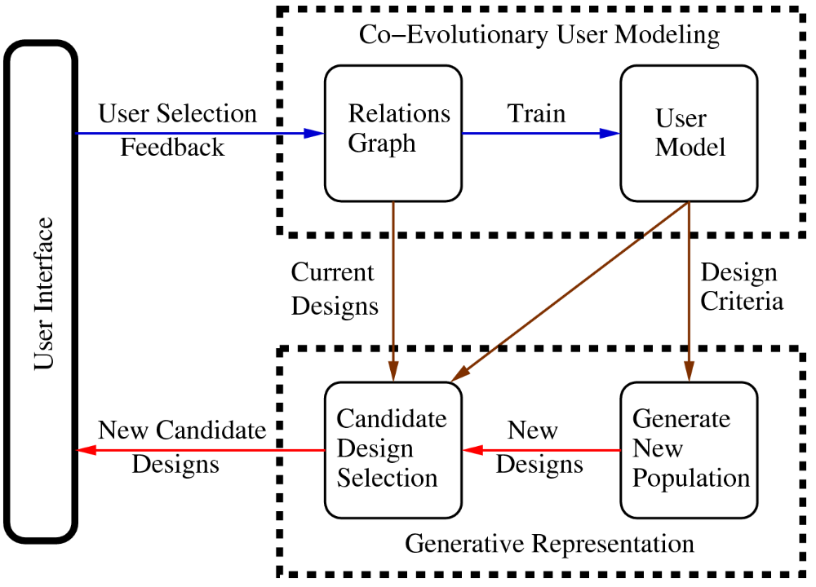
Task 1: Locomotion
Step 1
The user is initially presented with a physics-based simulation containing a single robot and a target object.

Slide 2
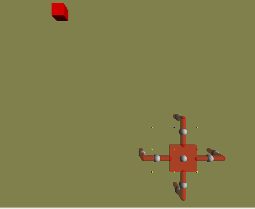
Task 1: Locomotion
Step 2
The user moves the target object to the robot’s front and left, thus altering the kind of gaits that will be selected for.

Slide 3
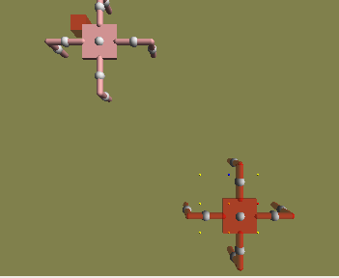
Task 1: Locomotion
Step 3
The user makes a copy of the robot (shown in pink) and drags it to the target object. This indicates the user wants to optimize controllers that exhibit phototaxis (the target object emits a light; the robot is equipped with photosensors; the robot is rewarded for moving toward the light source).

Slide 4
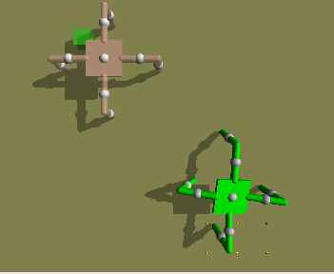
Task 1: Locomotion
Step 4
After ~4 mins of optimization, a controller is found that allows the robot to locomote from its start position to near the desired end position.

Slide 5
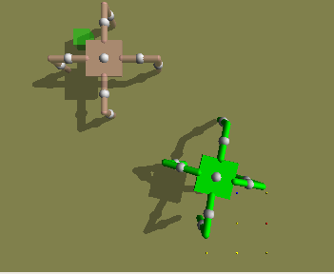
Task 1: Locomotion
Step 4
After ~4 mins of optimization, a controller is found that allows the robot to locomote from its start position to near the desired end position.

Slide 6
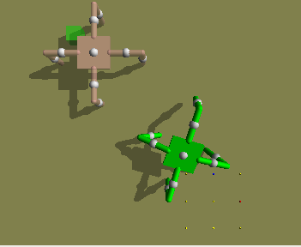
Task 1: Locomotion
Step 4
After ~4 mins of optimization, a controller is found that allows the robot to locomote from its start position to near the desired end position.

Slide 7
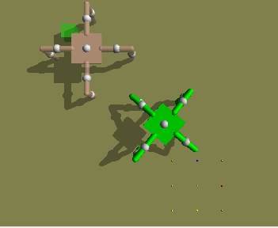
Task 1: Locomotion
Step 4
After ~4 mins of optimization, a controller is found that allows the robot to locomote from its start position to near the desired end position.

Slide 8
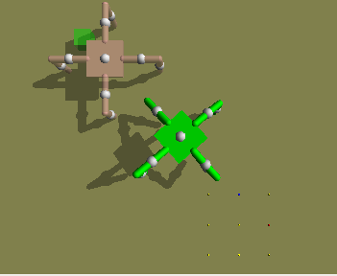
Task 1: Locomotion
Step 4
After ~4 mins of optimization, a controller is found that allows the robot to locomote from its start position to near the desired end position.

Slide 9
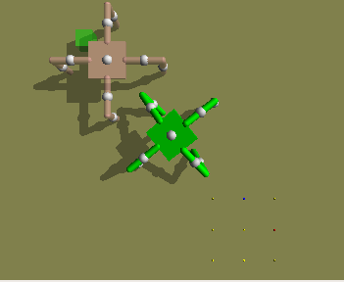
Task 1: Locomotion
Step 4
After ~4 mins of optimization, a controller is found that allows the robot to locomote from its start position to near the desired end position.

Slide 10
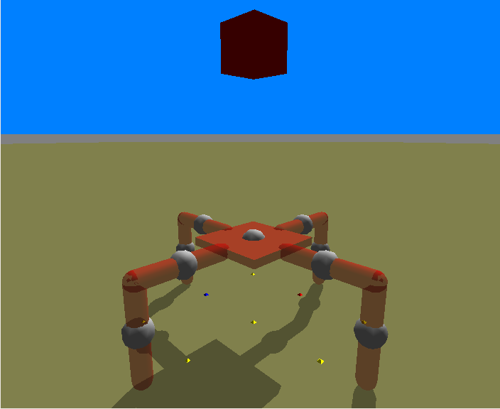
Task 2: Jumping
Step 1
Using the same system, the user now drags the target object above the robot.

Slide 11
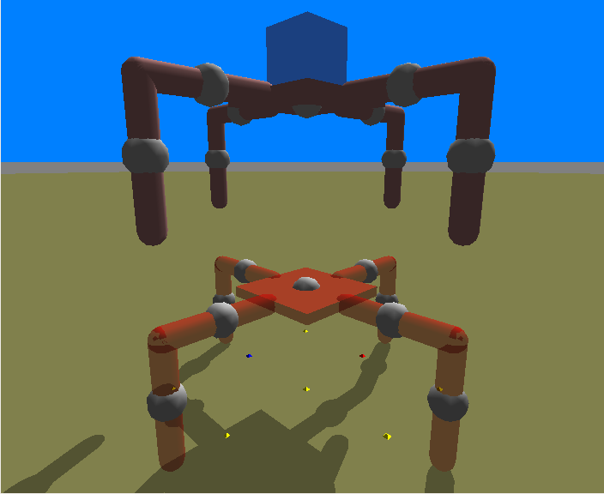
Task 2: Jumping
Step 2
A copy of the robot is again made, and placed just below the target object. This exerts optimization pressure toward controllers that cause the robot to jump in place.

Slide 12
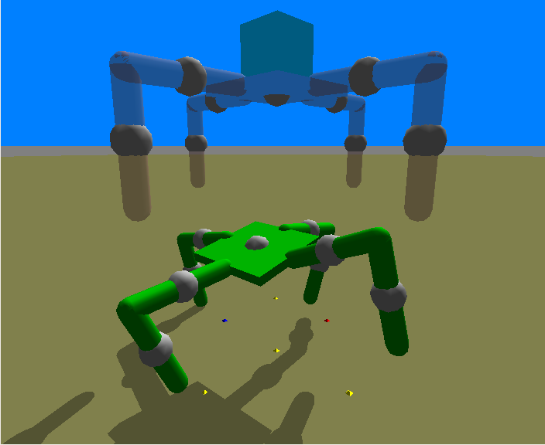
Task 2: Jumping
Step 3
After ~ 2 mins of optimization, a controller is discovered that enables the robot to jump in place.

Slide 13
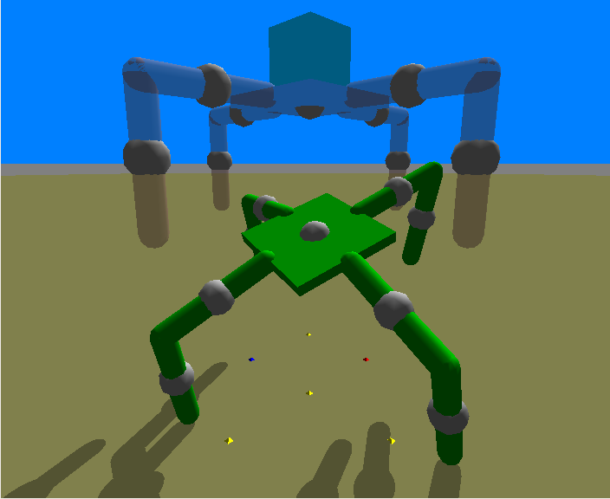
Task 2: Jumping
Step 3
After ~ 2 mins of optimization, a controller is discovered that enables the robot to jump in place.

Slide 14
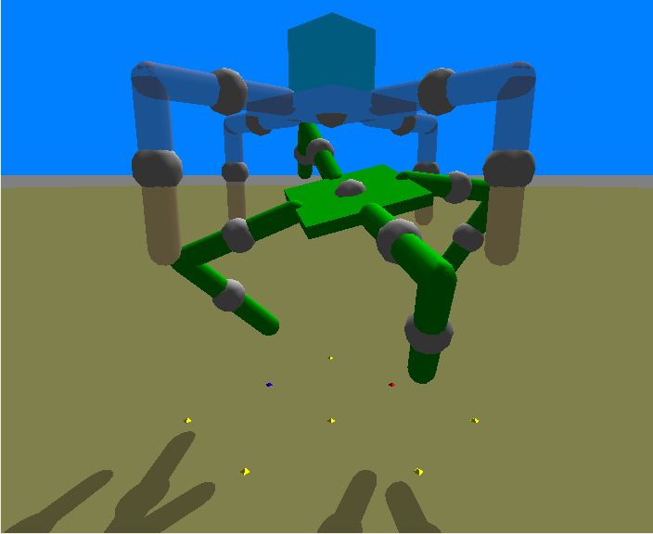
Task 2: Jumping
Step 3
After ~ 2 mins of optimization, a controller is discovered that enables the robot to jump in place.

