Slide 1
MaristAir Cloud App
Final Project for MSCS 621
By: Jason Boniello

Slide 2
Overview
Objective
What is MaristAir
Why Convert to Cloud
Database Defined
Code Overview
Webpage Examples
Architecture
Local Deployment
IBM
AWS
AWS RDS
Conclusion

Slide 3
Project Objective
To learn how the native cloud applications can be developed and deployed into the hybrid cloud environment.
Goals
Develop a cloud application in local environment, containerize, and post to Dockerhub
Create a webpage for users to interact with (on local and cloud provider)
Connect with services provided by IBM Cloud and AWS and deploy the containers

Slide 4
What is MaristAir?
MaristAir was originally a local database application created for MSCS 542 to showcase database calls to an airline reservation system. This was created using a combination of MySQL tables and python-flask interface to mimic managing a real airline system over the web. The major functions include adding new flights, creating user accounts, and taking user reservations.
The initial setup is done by a database admin using MySQL CLI connections, including creating the Tables and default database access permissions.
The application admin and general users would then access through the web interface hosted by python-flask.

Slide 5
Why Convert to CLOUD
An airline reservation system is a natural showcase of hybrid cloud capabilities for many reasons:
Using the same code, many different airports can deploy the application
Since each instance is configurable, the airport can customize their own database
For large airports, the system can be deployed to multiple containers and target a single private on-premises database, boosting data security.
Large scale deployments can deploy multiple instances and target multiple databases.
Example: A company operating in two countries wants to show both domestic and international flights on separate clusters based on user geographic region. They can configure multiple instances and have those instances target either a domestic or international database accordingly.

Slide 6
Database Defined
The Database used by the application consists of the following tables. ERD shown next slide:
Reservation – contains the info about a user’s booking
User – the ID through which a person interacts with the site
Billing – credit card information tied to a User
Options – list of available options, such as extra legroom or in-flight purchase
Option_List – associated selections from Options tied to a reservation
City – details about a given city, such as New York
Flight – details regarding a specific flight from one city to another
Plane – contains list of different available planes, such as Boeing 747
Airline – list of airlines the airport uses, such as United or JetBlue

Slide 7
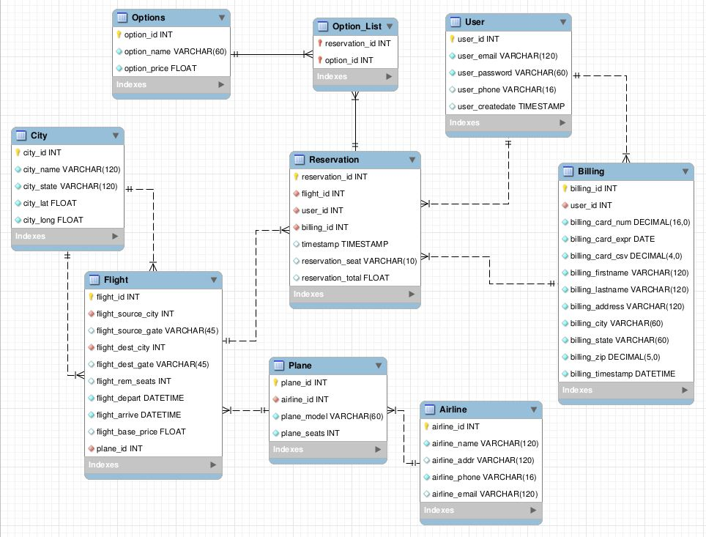

Slide 8
Code Overview
The Code uses python-flask to achieve a web interface. The following are the relevant files:
app.py – the main program containing the web page APIs
Classes.py – a python representation of the database tables as well as the methods to interact with them, including the SQL commands.
db folder – contains initial database setup commands to be used by DB admin
static folder – contains javascript and css files used on the webpages
templates – contains the HTML files for each webpage

Slide 9
Code Overview – app.py
This page contains an @app.route for every method in the API
The code imports the relevant classes (representing database tables) as needed
Ex: ‘createAccount’ imports the User class to interact with the database and create session credentials
The main API functions are self evident (full definition in Github):
index.html , createAccount, login, logout, addFlight, reservation, listing, and changeDatabase
dbHost and dbPort are defined during runtime, and changed by ‘changeDatabase’
Interactions with the database are done by passing in dbHost and dbPort on the User class instantiation, where the connection code lies

Slide 10
Code Overview – Classes.py
Contains classes where the fields represent database columns, and methods are for interacting with them
Most SQL commands are defined in the methods, and arguments are passed in during the calls by app.py
The most important class is User, as this is where user session data lies as well as the connectivity code for the database.
Every other class that uses SQL to interact with the database is passed in the User as well to use this connection

Slide 11
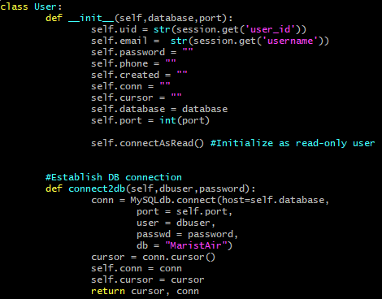
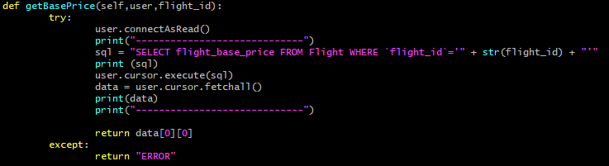
Code Overview – User Class
Shown here is the code for connecting to the database from the application. The app would define an instance of this as follows:
user = User(dbHost,dbPort)
where the host and port are specific to the running container.
The ‘connect2db’ takes the arguments for a database user and password, and connects the self.conn and self.cursor to the defined IP and port from above.
Example of a SQL query in the ‘Flight’ class. Note the user.cursor.execute is implementing the DB connection.
Note – this is just the constructor and main ‘connect2db’ function of the User class.

Slide 12
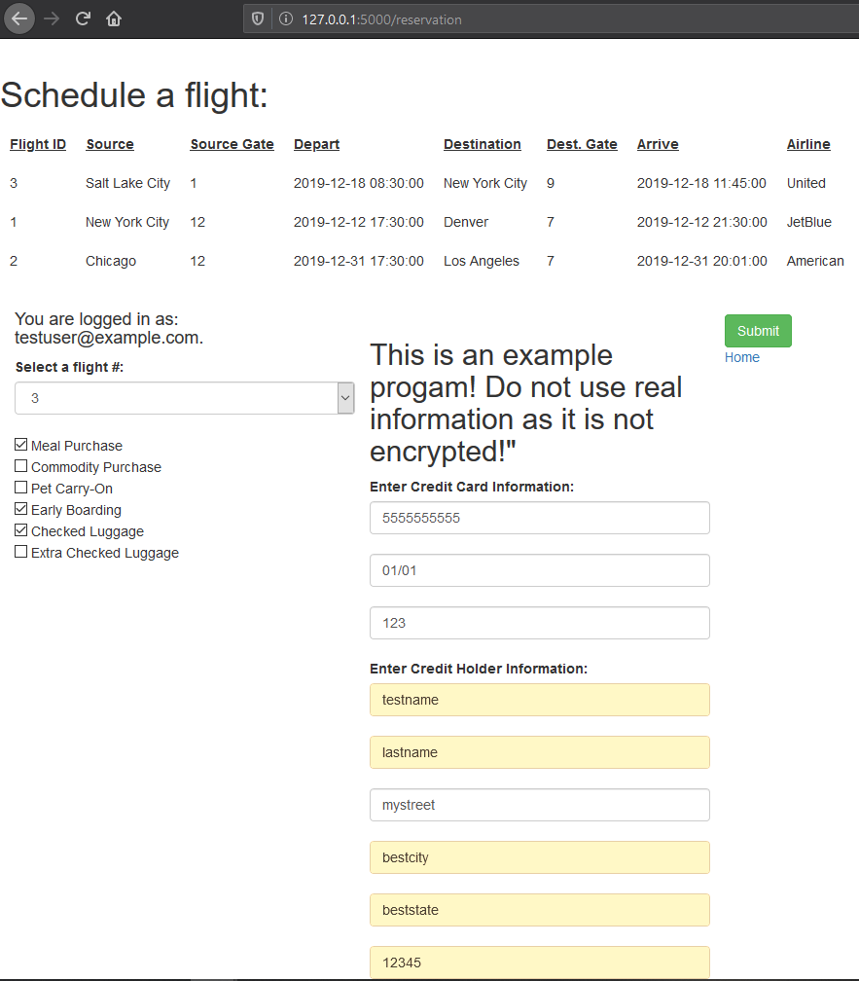
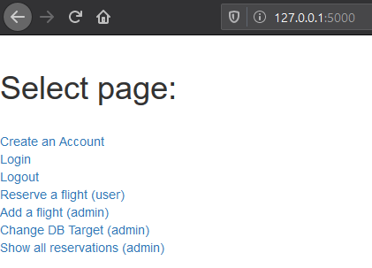
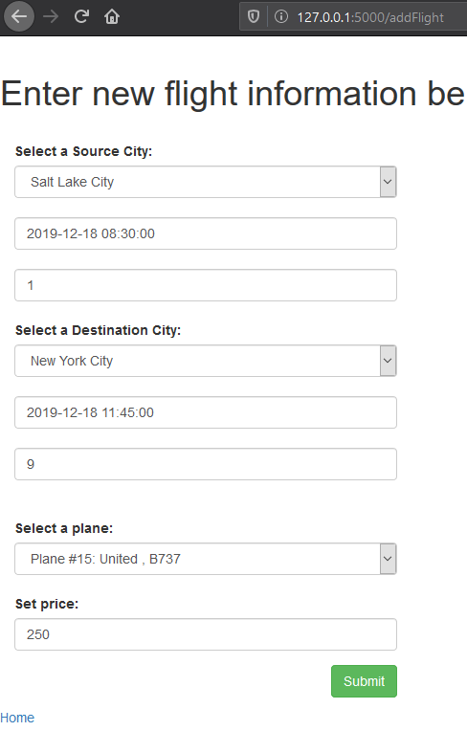
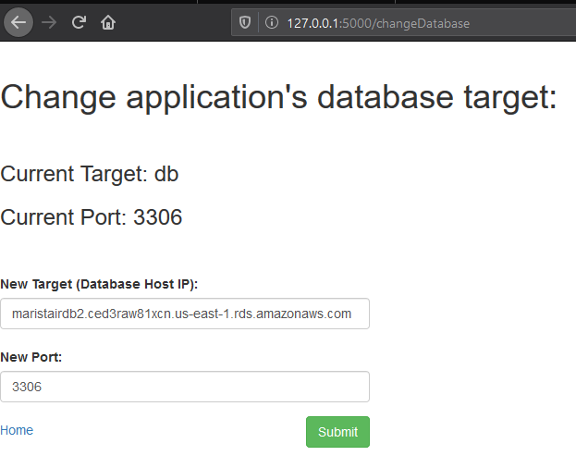
Web Page Examples
Screenshots of each webpage are located at:
https://github.com/jboniello/marist-mscs621-2019-boniello/tree/master/docs/Application

Slide 13
Architecture
As mentioned in the introduction, the same MaristAir docker image can be deployed across many clouds. For this project, the goal was deploy across the local cloud, IBM Cloud, and AWS. On the next slide, the architecture overview will be shown, and will be followed up in-depth for each deployment.
Note - each application instance can target any configured database
The dashed lines on the next slide show that multiple containers can be deployed from the single docker image, as well as multiple DBs are selectable by each instance.

Slide 14
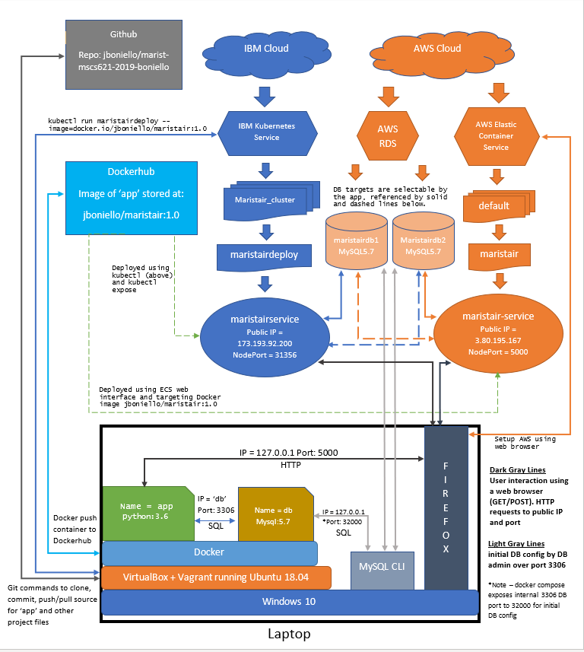

Slide 15
Local Cloud Deployment
The local environment was setup using:
VirtualBox + Vagrant using Ubuntu VM on a Win10 laptop
Docker to run the app.py using a python:3.6 image (Dockerfile)
docker-compose.yml to start the app and a local DB instance of Docker MySQL:5.7 image
‘Docker ps’ showing both running
9adf41ce8c01 final_project_dev_app "python app.py" 2 days ago Up 27 hours 0.0.0.0:5000->5000/tcp final_project_dev_app_1
b8993cabb27b mysql:5.7 "docker-entrypoint.s…" 2 days ago Up 27 hours 33060/tcp, 0.0.0.0:32000->3306/tcp final_project_dev_db_1
Connection Details:
Local webpage is located at 127.0.0.1:5000, as exposed by 0.0.0.0:5000 in the final_project_dev_app_1 instance
Local webpage internally interacted with the database using ‘db’ and port 3306 as part of the same namespace
Database is exposed on port 32000 for external use. This database configure commands using a CLI mysql client were:
mysql --host='127.0.0.1' --port=32000 -u root -p < MaristAirDBSQL.sql
mysql --host='127.0.0.1' --port=32000 -u root -p < MaristAir_Inserts.sql

Slide 16
Local to Cloud
Using docker to build the image from the Dockerfile, and then push it to a public Dockerhub to be called on by IBM and AWS cloud.
docker build -t maristair:latest .
docker tag maristair jboniello/maristair:1.0
docker push jboniello/maristair:1.0
Dockerhub:
https://hub.docker.com/repository/docker/jboniello/maristair
Github
https://github.com/jboniello/marist-mscs621-2019-boniello

Slide 17
IBM Cloud
A container of MaristAir was deployed using the IBM Kubernetes service.
Screenshots of IBM web page setup are located: https://github.com/jboniello/marist-mscs621-2019-boniello/tree/master/docs/IBM
Deployment Steps:
ibmcloud login -a cloud.ibm.com -r us-south -g Default
ibmcloud ks cluster config --cluster bnnrbbnd0cm3ttj81ivg (Create this cluster on IBM's webpage)
export KUBECONFIG=/root/.bluemix/plugins/container-service/clusters/bnnrbbnd0cm3ttj81ivg/kube-config-hou02-maristair_cluster.yml
kubectl run maristairdeploy --image=docker.io/jboniello/maristair:1.0
kubectl expose deployment/maristairdeploy --type=NodePort --name=maristairservice --port=80 --target-port=5000

Slide 18
IBM Cloud – Cont.
kubectl describe service maristairdeploy
Name: maristairdeploy
Namespace: default
Labels: run=maristairdeploy
Annotations: <none>
Selector: run=maristairdeploy
Type: NodePort
IP: 172.21.149.0
Port: <unset> 5000/TCP
TargetPort: 5000/TCP
NodePort: <unset> 31356/TCP
Endpoints: 172.30.109.135:5000
Session Affinity: None
External Traffic Policy: Cluster
Events: <none>
kubectl get services
NAME TYPE CLUSTER-IP EXTERNAL-IP PORT(S) AGE
kubernetes ClusterIP 172.21.0.1 <none> 443/TCP 4d10h
maristairdeploy NodePort 172.21.149.0 <none> 5000:31356/TCP 4d9h
maristairservice NodePort 172.21.119.11 <none> 80:31645/TCP 4d9h
External IP is accessed by the nodeport: http://173.193.92.200:31356
By default, the application is setup to use the database found on maristairdb1.ced3raw81xcn.us-east-1.rds.amazonaws.com:3306

Slide 19
AWS ECS
To show that the application is portable to multiple clouds, Amazon’s Elastic Container Services were used to deploy an instance. Since Amazon’s process is fairly easy through the web, the following slides will contain screenshots of this process.
Important notes:
Give the container a name, enter the dockerhub image 'jboniello/maristair:1.0" , make it public accessible, and set port to 5000
Give the container a VPC and configure network rules to allow all Inbound/OutBound connections (0.0.0.0/0)
Run a task using the container, and get the public IP and port that will be used

Slide 20
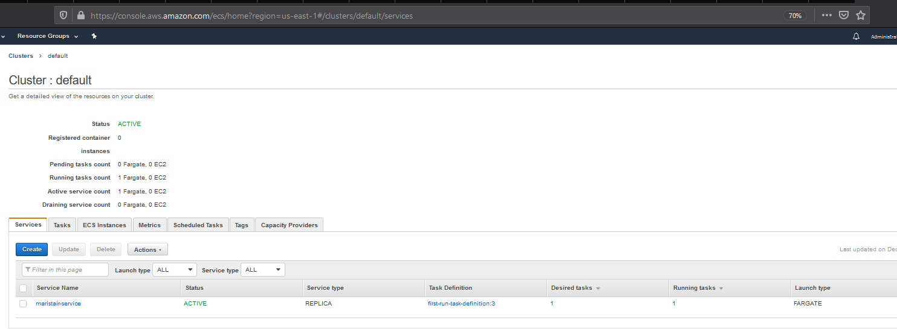
AWS Cluster

Slide 21
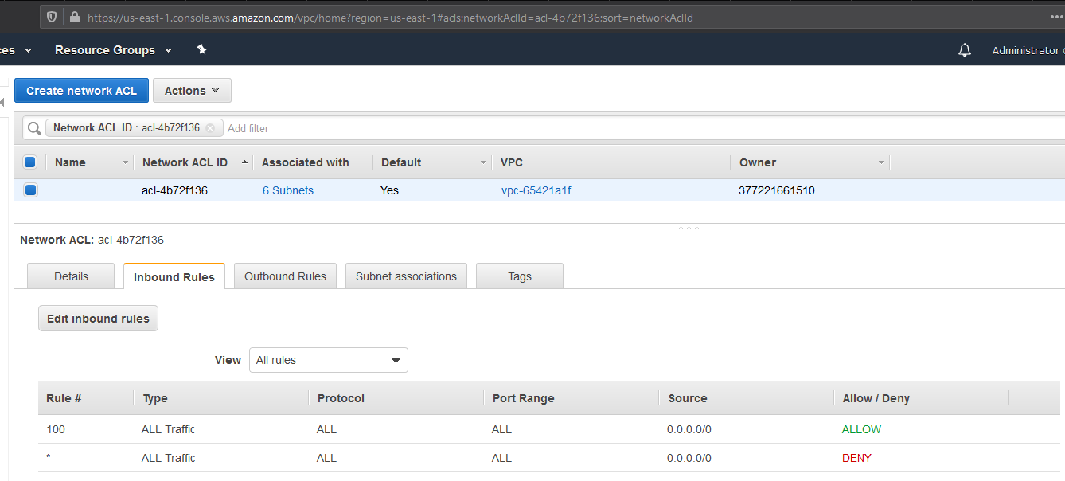
AWS VPC Network Rules

Slide 22
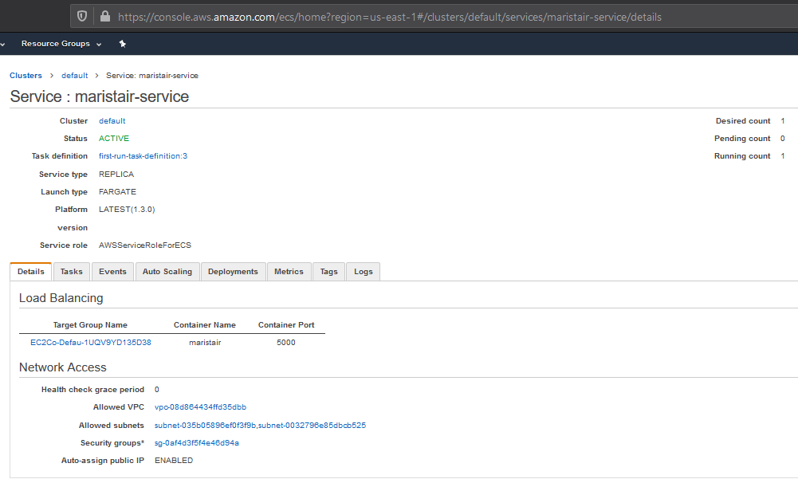
AWS MaristAir-Service

Slide 23
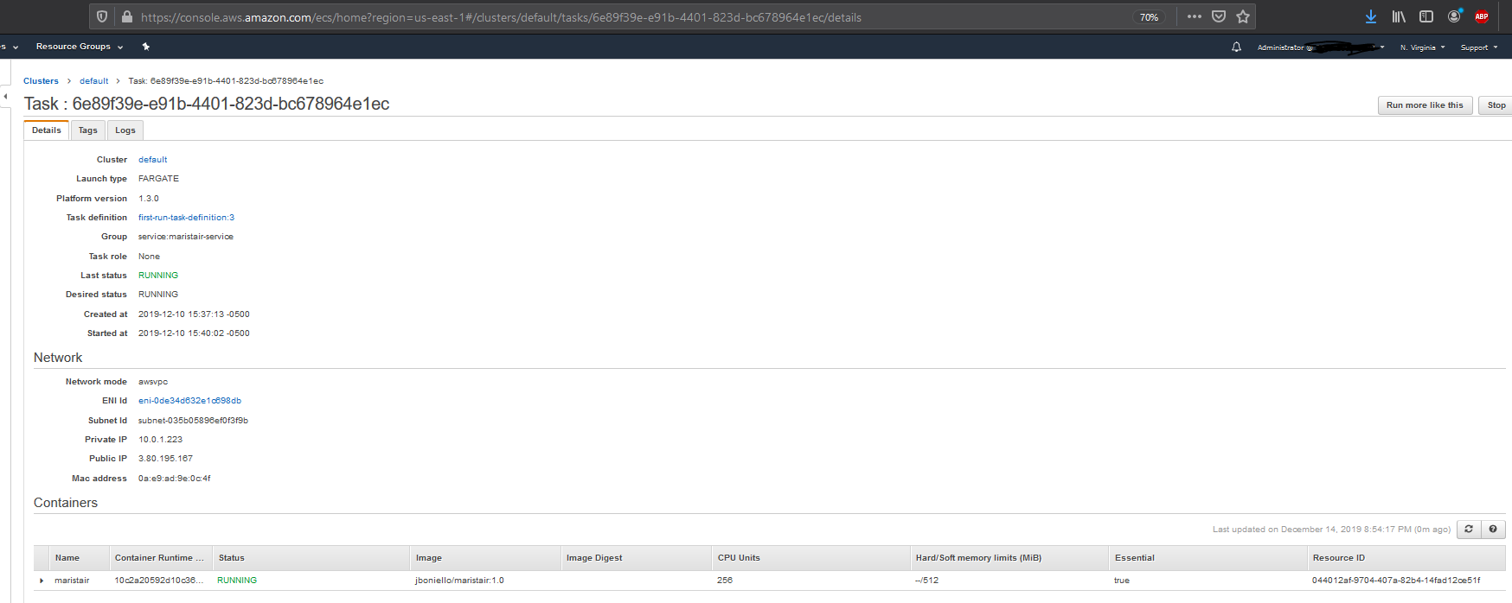
AWS Running Task
Public IP is shown here = http://3.80.195.167:5000
Also by default, the application is setup to use the database found on maristairdb1.ced3raw81xcn.us-east-1.rds.amazonaws.com:3306

Slide 24
AWS Relational Database Service (RDS)
Due to the need of having persistent connections for demoing the application, Amazon’s RDS was used to create 2 instances of MySQL 5.7 databases. This is another cloud service provided by AWS, and is similar to the docker database deployment in the local environment (sourcing a container of the MySQL image)
The connections are valid over port 3306:
maristairdb1.ced3raw81xcn.us-east-1.rds.amazonaws.com
maristairdb2.ced3raw81xcn.us-east-1.rds.amazonaws.com
Configuration from any MySQL CLI using files found in final_project_dev/db/ folder:
mysql -u admin -p -h maristairdb1.ced3raw81xcn.us-east-1.rds.amazonaws.com -P 3306 < MaristAirDBSQL.sql
mysql -u admin -p -h maristairdb1.ced3raw81xcn.us-east-1.rds.amazonaws.com -P 3306 < MaristAir_Inserts.sql
mysql -u admin -p -h maristairdb2.ced3raw81xcn.us-east-1.rds.amazonaws.com -P 3306 < MaristAirDBSQL.sql
mysql -u admin -p -h maristairdb2.ced3raw81xcn.us-east-1.rds.amazonaws.com -P 3306 < MaristAir_Inserts.sql

Slide 25
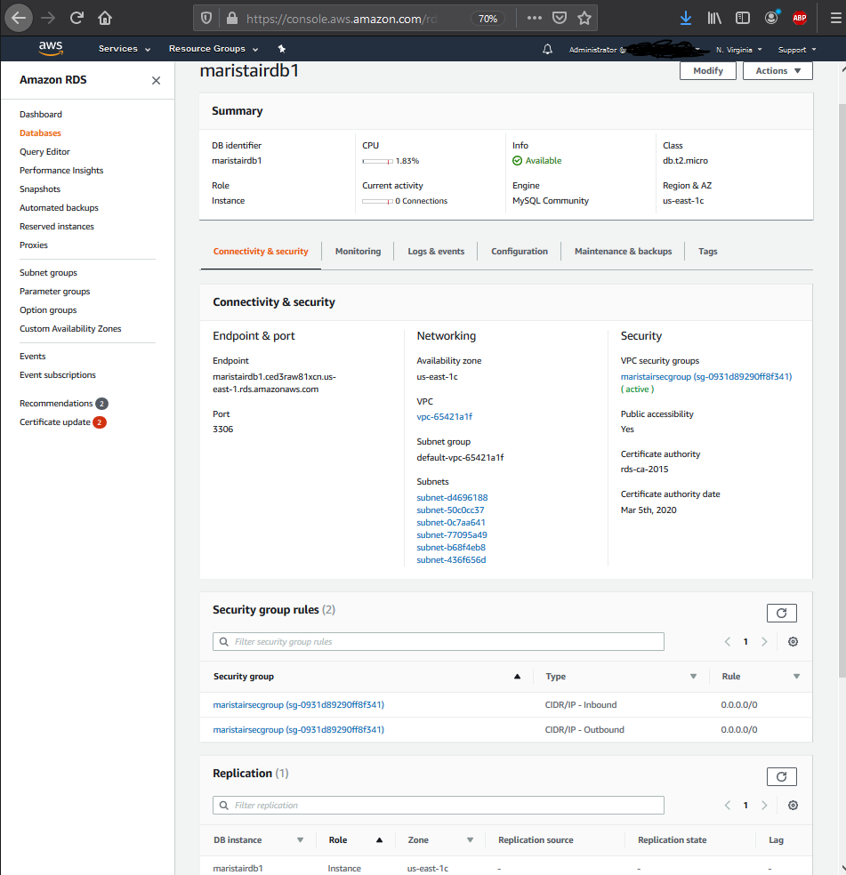
AWS RDS – Cont.
Screenshots of AWS RDS can be found: https://github.com/jboniello/marist-mscs621-2019-boniello/tree/master/docs/Database
Example of maristairdb1 instance

Slide 26
Testing Connections
If testing the application, one should at least check out these functions:
Flight listings for each database under /reservation , before and after changing DB target
Change the database targets under /changeDatabase
maristairdb1.ced3raw81xcn.us-east-1.rds.amazonaws.com , port = 3306
maristairdb2.ced3raw81xcn.us-east-1.rds.amazonaws.com , port = 3306
*Note – setting an invalid target will cause the other pages to have internal server errors. If that happens, navigate back to /changeDatabase and reset the target
Look at listings under /listings
Try and make a reservation in /reservation, and check for the new reservation ID under /listings
The example user should already be signed in using: email=testuser@example.com, pw=testuser1
If not, either login with that account, or create a new one!

Slide 27
Conclusion
The MaristAir app is a airline reservation tool meant to show off hybridity within cloud environments. Whether the application is run locally, or within different cloud service providers, the tools are available to target any configured database.
Since the app is containerized, it can be deployed from Docker many times for a single airport for load-balancing, by many different airports for independent data sets, or both cases when needs arise.
Using Docker, IBM Cloud Kubernetes, AWS ECS, and AWS RDS, the application was tested and deployed successfully as a hybrid cloud environment.

