Slide 1



Arya:
Nearly Linear-Time
Zero-Knowledge Proofs for Correct Program Execution
Jonathan Bootle, Andrea Cerulli, Jens Groth, Sune Jakobsen, Mary Maller

Slide 2
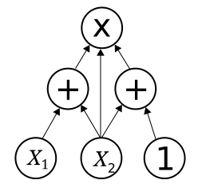



Zero-Knowledge Proofs for
Correct Program Execution
Statement
Witness
Prover
Verifier

Slide 3

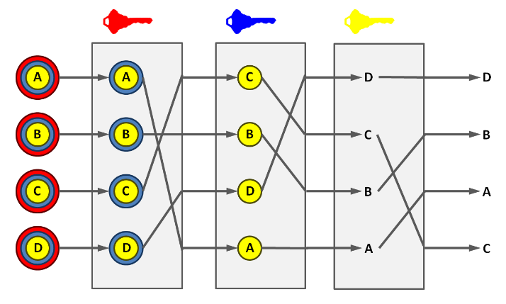



Zero-Knowledge Proofs for
Correct Program Execution
Statement
Witness
Prover
Verifier

Slide 4
Zero-Knowledge Proofs for
Correct Program Execution
Statement
Completeness:
An honest prover convinces the verifier.
Prover
Verifier

Slide 5
Zero-Knowledge Proofs for
Correct Program Execution
Statement
Soundness:
A dishonest prover never convinces the verifier.
Computational guarantee
-> argument
Completeness:
An honest prover convinces the verifier.
Prover
Verifier

Slide 6
Zero-Knowledge Proofs for
Correct Program Execution
Statement
Witness
Soundness:
A dishonest prover never convinces the verifier.
Computational guarantee
-> argument
Completeness:
An honest prover convinces the verifier.
Prover
Verifier
Zero-knowledge:
Nothing but the truth of the statement is revealed.

Slide 7
Zero-Knowledge Proofs for
Correct Program Execution
Statement
Interaction
Prover Computation
Verifier Computation
Communication
Prover
Verifier
Cryptographic Assumption

Slide 8
Zero-Knowledge Proofs for
Correct Program Execution
Registers
Memory
pc | r1 | r2 | r3 | … | … | … | … | … | flag
Primary Input
instruction1
instruction2
Instruction3
…
…
…
Input Tapes
Random
Access
Auxiliary Input
TinyRAM
Program
TinyRAM
Instructions include ADD, MULT, XOR, AND,…

Slide 9
Zero-Knowledge Proofs for
Correct Program Execution
Registers
Memory
pc | r1 | r2 | r3 | … | … | … | … | … | flag
Primary Input
instruction1
instruction2
Instruction3
…
…
…
Input Tapes
Random
Access
Auxiliary Input
TinyRAM
Program
TinyRAM
Public Values <-> Statement

Slide 10
Zero-Knowledge Proofs for
Correct Program Execution
Registers
Memory
pc | r1 | r2 | r3 | … | … | … | … | … | flag
Primary Input
instruction1
instruction2
Instruction3
…
…
…
Input Tapes
Random
Access
Auxiliary Input
TinyRAM
Program
TinyRAM
Private Values <-> Prover’s Witness

Slide 11
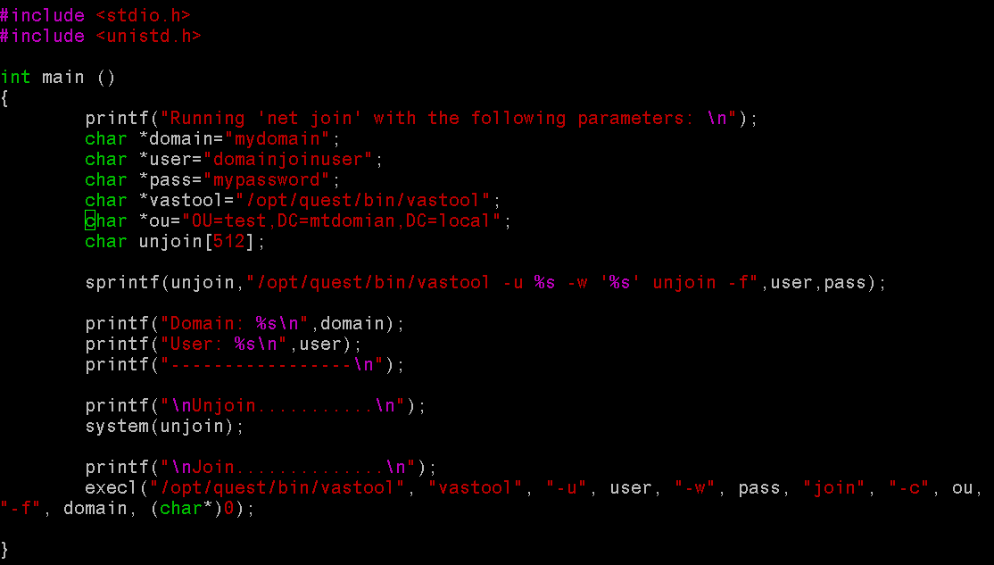
Zero-Knowledge Proofs for
Correct Program Execution
Goal:
Zero-knowledge proof for
correct TinyRAM execution
with low prover overhead
Why TinyRAM?
Closer to real world statements
Compilers from restricted C to TinyRAM

Slide 12
Execution Trace
List of
Memory
Changes
Memory
Extra Information
Time
0
pc | r1 | r2 | r3 | … | … | … | … | … | flag
pc | r1 | r2 | r3
1
pc | r1 | r2 | r3 | … | … | … | … | … | flag
pc | r1 | r2 | r3
2
pc | r1 | r2 | r3 | … | … | … | … | … | flag
pc | r1 | r2 | r3
3
pc | r1 | r2 | r3 | … | … | … | … | … | flag
pc | r1 | r2 | r3
…
…
instruction1
instruction2
Instruction3
…
…
…
T
pc | r1 | r2 | r3 | … | … | … | … | … | flag
pc | r1 | r2 | r3
TinyRAM
Program
Primary Input
Input Tapes
Auxiliary Input

Slide 13
Checks
List of
Memory
Changes
Memory
Extra Information
Time
0
pc | r1 | r2 | r3 | … | … | … | … | … | flag
pc | r1 | r2 | r3
1
pc | r1 | r2 | r3 | … | … | … | … | … | flag
pc | r1 | r2 | r3
2
pc | r1 | r2 | r3 | … | … | … | … | … | flag
pc | r1 | r2 | r3
3
pc | r1 | r2 | r3 | … | … | … | … | … | flag
pc | r1 | r2 | r3
…
…
instruction1
instruction2
Instruction3
…
…
…
Memory
Consistency
T
pc | r1 | r2 | r3 | … | … | … | … | … | flag
pc | r1 | r2 | r3
TinyRAM
Program
Primary Input
Input Tapes
Auxiliary Input

Slide 14
Checks
List of
Memory
Changes
Memory
Extra Information
Time
0
pc | r1 | r2 | r3 | … | … | … | … | … | flag
pc | r1 | r2 | r3
1
pc | r1 | r2 | r3 | … | … | … | … | … | flag
pc | r1 | r2 | r3
Correct Instruction
Execution
2
pc | r1 | r2 | r3 | … | … | … | … | … | flag
pc | r1 | r2 | r3
3
pc | r1 | r2 | r3 | … | … | … | … | … | flag
pc | r1 | r2 | r3
…
…
instruction1
instruction2
Instruction3
…
…
…
T
pc | r1 | r2 | r3 | … | … | … | … | … | flag
pc | r1 | r2 | r3
TinyRAM
Program
Primary Input
Input Tapes
Auxiliary Input

Slide 15
Checks
List of
Memory
Changes
Memory
Extra Information
Time
0
pc | r1 | r2 | r3 | … | … | … | … | … | flag
pc | r1 | r2 | r3
1
pc | r1 | r2 | r3 | … | … | … | … | … | flag
pc | r1 | r2 | r3
2
pc | r1 | r2 | r3 | … | … | … | … | … | flag
pc | r1 | r2 | r3
3
pc | r1 | r2 | r3 | … | … | … | … | … | flag
pc | r1 | r2 | r3
…
…
instruction1
instruction2
Instruction3
…
…
…
Word
Decompositions
T
pc | r1 | r2 | r3 | … | … | … | … | … | flag
pc | r1 | r2 | r3
TinyRAM
Program
Primary Input
Input Tapes
Auxiliary Input

Slide 16
Proving Correct Program Execution
Sources of Overhead
Our Solutions
Large fields and large cyclic groups
Permutation networks for checking memory
Large circuits for bitwise operations
Use hash-based proof system over any field
Alternative approach to checking permutations
Word decomposition technique gives constant-size circuits

Slide 17

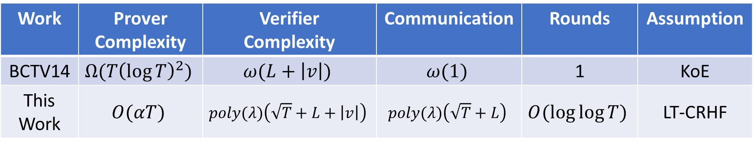
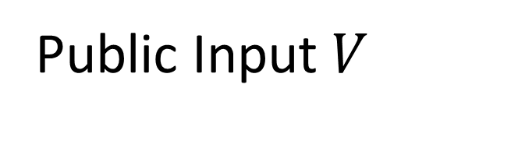
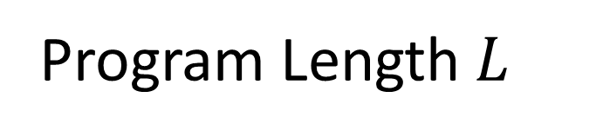
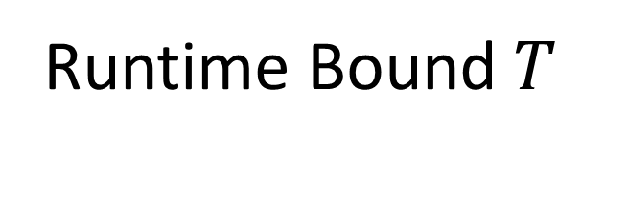
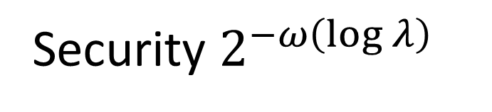
Results
Work | Prover Complexity | Verifier Complexity | Communication | Rounds | Assumption
BCTV14 | $$Ω(T{\left(\log{T}\right)}^{2})$$ | $$ω(L+\left|v\right|)$$ | $$ω(1)$$ | 1 | KoE
This Work | $$O(αT)$$ | $$poly(λ)\left(\sqrt{T}+L+\left|v\right|\right)$$ | $$poly(λ)\left(\sqrt{T}+L\right)$$ | $$O(\log{\log{T}})$$ | LT-CRHF
But what is $α$?
Security $2^{−ω\left(\log{λ}\right)}$
Program Length $L$
Runtime Bound $T$
Public Input $V$

Slide 18
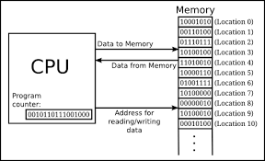
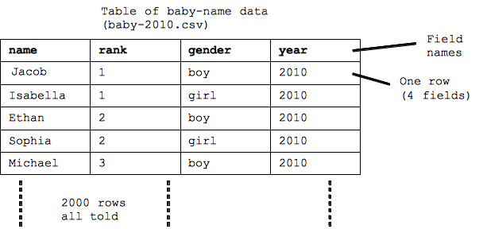
Overview
Arithmetising TinyRAM
TinyRAM Execution Trace
Algebraic Constraints
Main Contributions
Polynomials
Prior work: Linear-Time
Zero-Knowledge Proofs
Ideal Protocols
Zero-Knowledge Look-Up Arguments and More
Standard Protocols

Slide 19




Ideal Linear Commitment Protocols
Commit to vectors
P
V
$x←$C
Commit to vectors
Send random challenges
$y←$C
…
…
Check linear combinations against commitments
$z←$C
Compute linear combinations
Linear combinations

Slide 20
Ideal Linear Commitment Protocols
Commit to execution trace
P
V
$x←$C
Commit to vectors
Send random challenges
$y←$C
…
…
Coefficients of linear combinations embed useful conditions
$z←$C
Compute linear combinations
Linear combinations

Slide 21
Committing
Encode
2 | 6 | 6 | 2 | 0
2 | 3 | 7 | 2 | 5 | 7 | 3 | 1 | 7 | 4
3 | 7 | 2 | 8 | 4
8 | 4 | 5 | 7 | 4 | 6 | 8 | 9 | 3 | 5
4 | 2 | 8 | 4 | 6
7 | 2 | 3 | 4 | 6 | 2 | 1 | 5 | 6 | 3
3 | 7 | 4 | 3 | 9
8 | 4 | 7 | 2 | 4 | 5 | 2 | 5 | 3 | 9
Prover computes linear combination
Hash
5 | 9 | 3 | 2 | 4

Slide 22

Checking Commitments
Encode
2 | 6 | 6 | 2 | 0
2 | 3 | 7 | 2 | 5 | 7 | 3 | 1 | 7 | 4
3 | 7 | 2 | 8 | 4
8 | 4 | 5 | 7 | 4 | 6 | 8 | 9 | 3 | 5
4 | 2 | 8 | 4 | 6
7 | 2 | 3 | 4 | 6 | 2 | 1 | 5 | 6 | 3
3 | 7 | 4 | 3 | 9
8 | 4 | 7 | 2 | 4 | 5 | 2 | 5 | 3 | 9
Prover computes linear combination
Hash
Encode
5 | 9 | 3 | 2 | 4
2 | 3 | 7 | 2 | 5 | 7 | 3 | 1 | 7 | 4
Verifier encodes and spot-checks columns
High minimum distance catches cheating

Slide 23























































Slide 24
Correct Instruction Execution
pc | r1 | r2 | r3 | … | … | … | … | … | flag
pc | r1 | r2 | r3
Transition Circuit
Covers all TinyRAM instructions
Check consistency of values across each time step
pc | r1 | r2 | r3 | … | … | … | … | … | flag
pc | r1 | r2 | r3
Transition Circuit
Constant size circuit
pc | r1 | r2 | r3 | … | … | … | … | … | flag
pc | r1 | r2 | r3
Give batch argument that each copy of circuit is satisfied

Slide 25
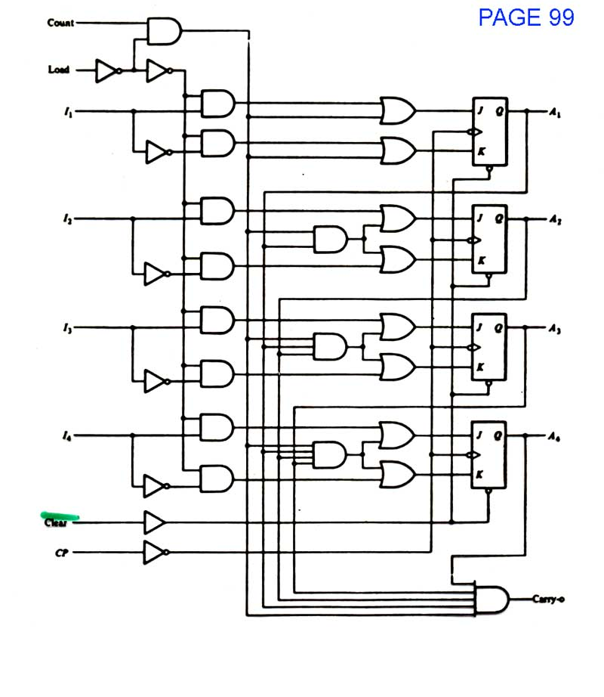
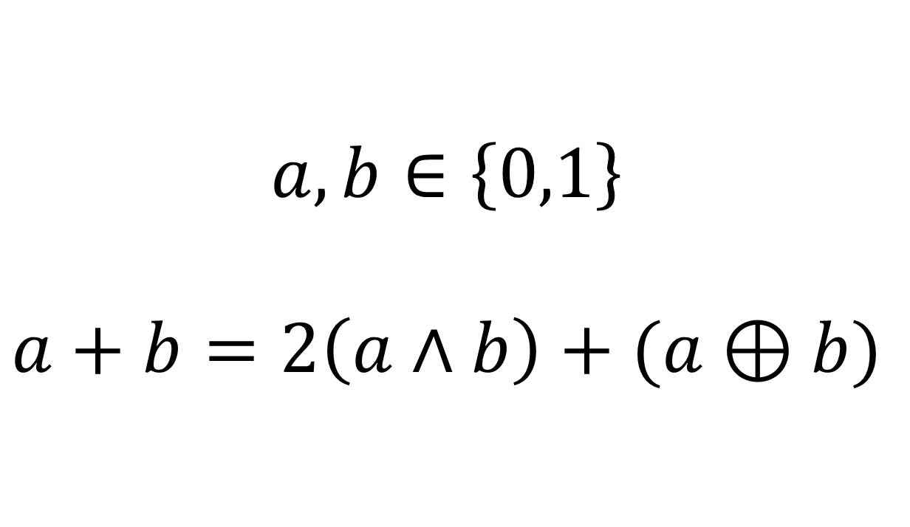
Word Decomposition
Avoid binary circuits when checking bitwise operations on non-binary field elements!
$$a,b∈\left\{0,1\right\}$$
$$a+b=2\left(a∧b\right)+(a⊕b)$$

Slide 26




Word Decomposition
Register value
Binary Decomposition
$$a$$
$$a_{0}$$ | $$a_{1}$$ | $$a_{2}$$ | $$a_{3}$$ | … | … | … | … | $$a_{W−2}$$ | $$a_{W−1}$$
$$a_{O}$$
$$a_{1}$$ | $$0$$ | $$a_{3}$$ | $$0$$ | … | … | … | … | $$a_{W−1}$$ | $$0$$
Odd bits
$$a_{E}$$
$$a_{0}$$ | $$0$$ | $$a_{2}$$ | $$0$$ | … | … | … | … | $$a_{W−2}$$ | $$0$$
Even bits
$$a=2a_{O}+a_{E}$$

Slide 27









Word Decomposition
$$a$$
$$a_{0}$$ | $$a_{1}$$ | $$a_{2}$$ | $$a_{3}$$ | … | … | … | … | $$a_{W−2}$$ | $$a_{W−1}$$
$$b$$
$$a_{0}$$ | $$a_{1}$$ | $$a_{2}$$ | $$a_{3}$$ | … | … | … | … | $$a_{W−2}$$ | $$a_{W−1}$$
$$a_{O}$$
$$a_{1}$$ | $$0$$ | $$a_{3}$$ | $$0$$ | … | … | … | … | $$a_{W−1}$$ | $$0$$
$$b_{O}$$
$$a_{1}$$ | $$0$$ | $$a_{3}$$ | $$0$$ | … | … | … | … | $$a_{W−1}$$ | $$0$$
$$a_{E}$$
$$a_{0}$$ | $$0$$ | $$a_{2}$$ | $$0$$ | … | … | … | … | $$a_{W−2}$$ | $$0$$
$$b_{E}$$
$$a_{0}$$ | $$0$$ | $$a_{2}$$ | $$0$$ | … | … | … | … | $$a_{W−2}$$ | $$0$$
$$a=2a_{O}+a_{E}$$
$$b=2b_{O}+b_{E}$$
XORs in even bits
$$a_{0}⊕b_{0}$$ | $$a_{0}∧b_{0}$$ | $$a_{2}⊕b_{2}$$ | $$a_{2}∧b_{2}$$ | … | … | … | … | $$a_{W−2}⊕b_{W−2}$$ | $$a_{W−2}∧b_{W−2}$$
ANDs in odd bits
$${a_{E}+b}_{E}$$

Slide 28
Look-up Argument
Register Value
Even
Bits
Odd
Bits
Decomposition Look-Up Table
Register Values | Even Bits | Odd Bits
All possible register values
Use zero-knowledge look-up argument to show all decompositions correct

Slide 29
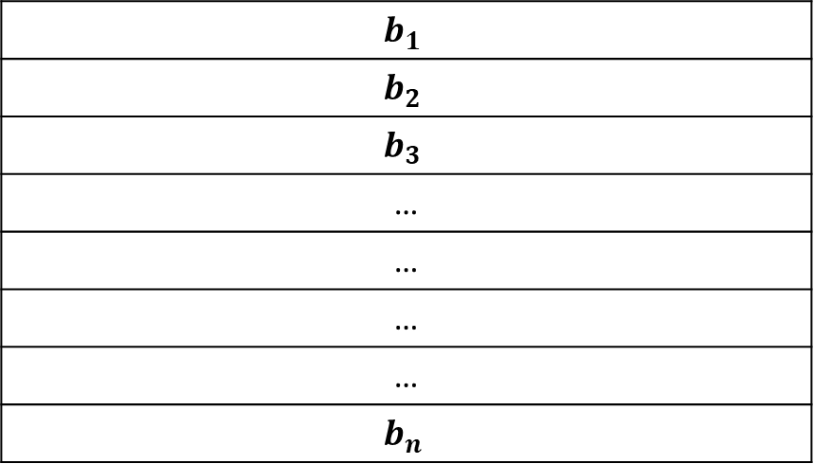

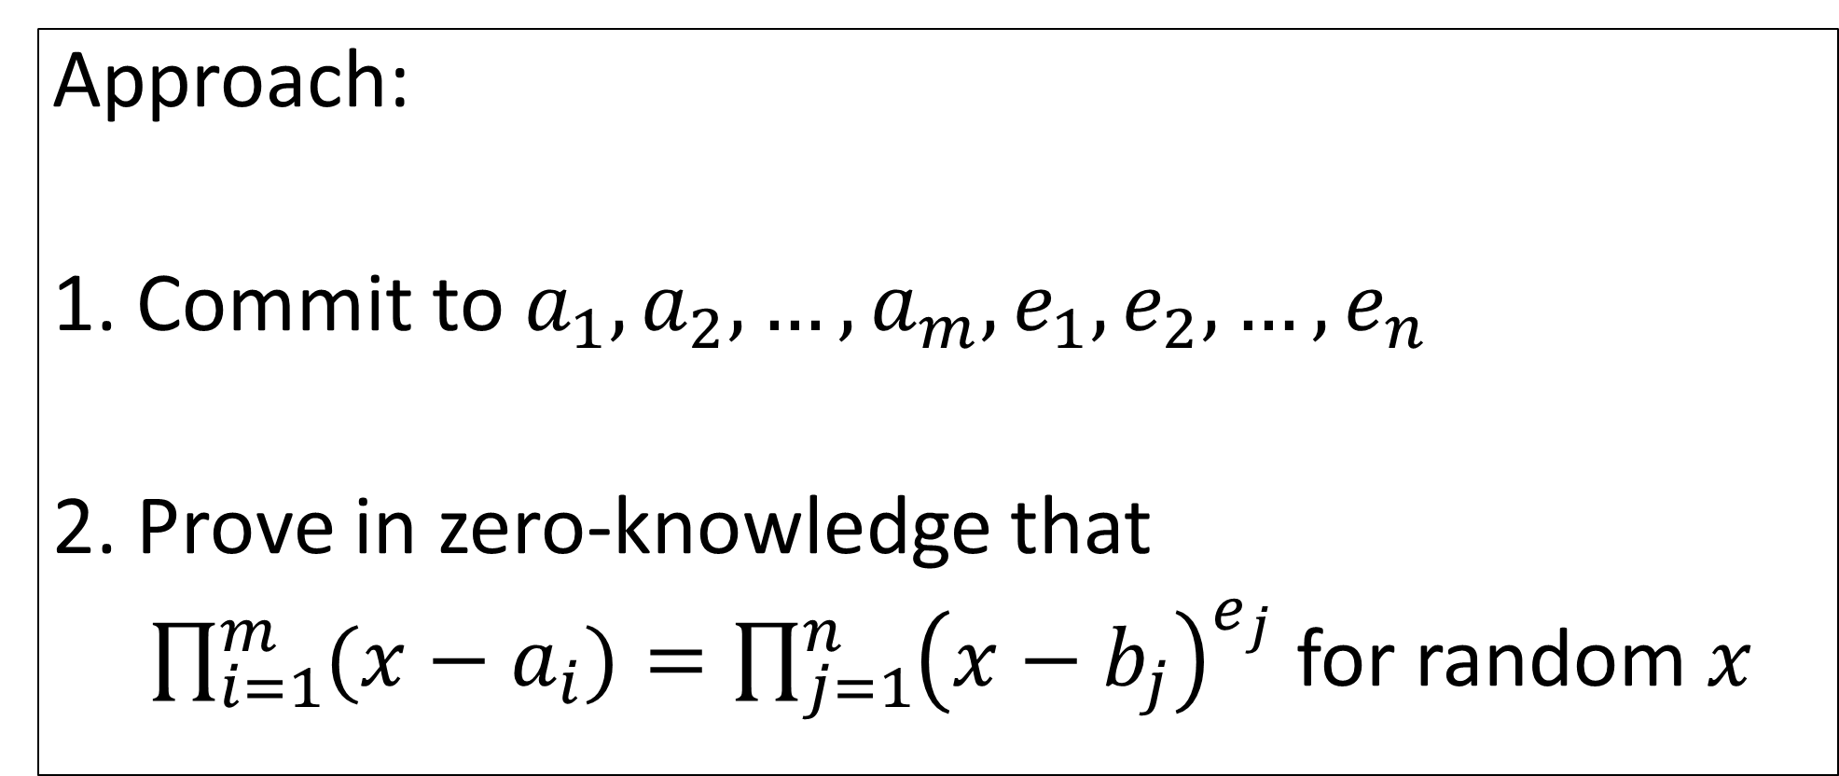

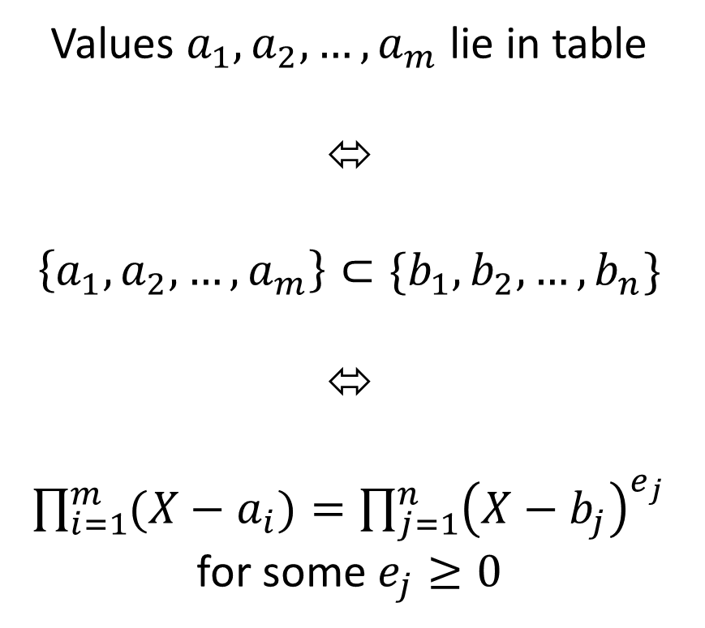
Look-up Argument
Approach:
1. Commit to $a_{1},a_{2},…,a_{m},e_{1},e_{2},…,e_{n}$
2. Prove in zero-knowledge that
$\prod_{i=1}^{m}{(x−a_{i})}=\prod_{j=1}^{n}{{\left(x−b_{j}\right)}^{e_{j}}}$ for random $x$
Values $a_{1},a_{2},…,a_{m}$ lie in table
⬄
$$\left\{a_{1},a_{2},…,a_{m}\right\}⊂\{b_{1},b_{2},…,b_{n}\}$$
⬄
$\prod_{i=1}^{m}{(X−a_{i})}=\prod_{j=1}^{n}{{\left(X−b_{j}\right)}^{e_{j}}}$ for some $e_{j}≥0$
Look-Up Table
 | $$b_{1}$$
 | $$b_{2}$$
 | $$b_{3}$$
 | …
 | …
 | …
 | …
 | $$b_{n}$$
$b_{1},b_{2},…,b_{n}$ already public
Verify a ‘square and multiply’ algorithm in zero-knowledge
Think of $m≫n$

Slide 30
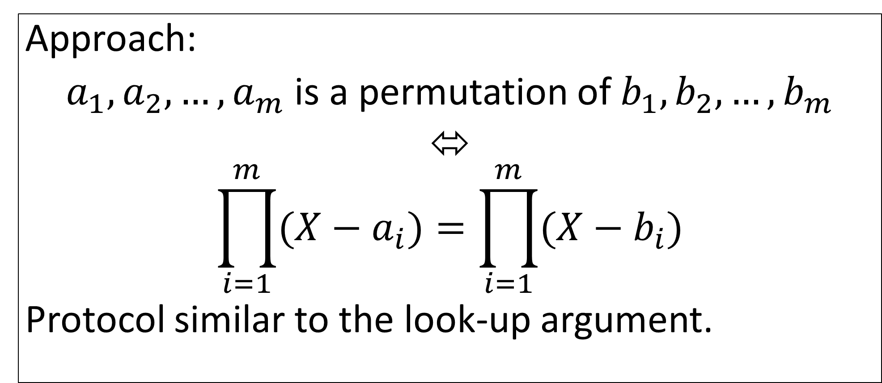
Memory Consistency
Approach:
$a_{1},a_{2},…,a_{m}$ is a permutation of $b_{1},b_{2},…,b_{m}$
⬄
$$\prod_{i=1}^{m}{(X−a_{i})}=\prod_{i=1}^{m}{(X−b_{i})}$$
Protocol similar to the look-up argument.
Memory Location
Access
Time
Current
Value
Previous Access
Time
Previous
Value
First Access
1
Set equal
Should be equal
Next Access
1
Should be equal
Last Access
1
One memory location -> Cycle
All locations -> permutation

Slide 31
Summary
Nearly-linear proving time
Sublinear verification time
New word decomposition technique for verifying binary operations over non-binary fields
New look-up argument

Slide 32
Thanks!
Work | Prover Complexity | Verifier Complexity | Communication | Rounds | Assumption
BCTV14 | $$Ω(T{\left(\log{T}\right)}^{2})$$ | $$ω(L+\left|v\right|)$$ | $$ω(1)$$ | 1 | KoE
This Work | $$O(αT)$$ | $$poly(λ)\left(\sqrt{T}+L+\left|v\right|\right)$$ | $$poly(λ)\left(\sqrt{T}+L\right)$$ | $$O(\log{\log{T}})$$ | LT-CRHF
Security $2^{−ω\left(\log{λ}\right)}$
Program Length $L$
Runtime Bound $T$
Public Input $V$

