Slide 1
Linear-Time Arguments with Sublinear Verification from Tensor Codes
Jonathan Bootle (IBM Research – Zurich)
Joint work with Alessandro Chiesa (UC Berkeley) and Jens Groth (Dfinity)

Slide 2
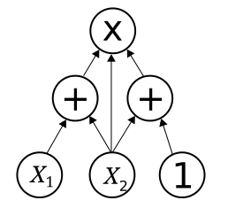



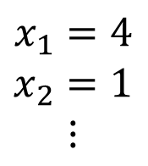
The holy grail for efficient arguments for NP
10
$$x_{1}=4$$
$$x_{2}=1$$
$$⋮$$
P
V
Prover
Verifier

Slide 3
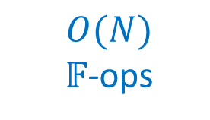
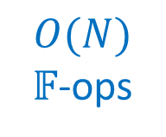

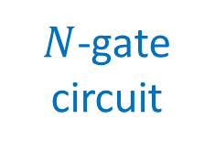
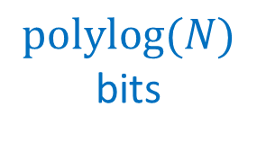
The holy grail for efficient arguments for NP
Any field $𝔽$
10
$N$-gate
circuit
$$x_{1}=4$$
$$x_{2}=1$$
$$⋮$$
P
V
$O(N)$ $𝔽$-ops
$$O(N)$$
$𝔽$-ops
$$\text{polylog}(N)$$
bits
Prover
Verifier

Slide 4
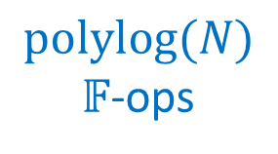
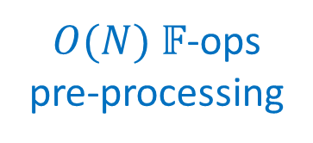
The holy grail for efficient arguments for NP
Any field $𝔽$
10
I
$O(N)$ $𝔽$-ops
pre-processing
$N$-gate
circuit
$$x_{1}=4$$
$$x_{2}=1$$
$$⋮$$
Indexer
P
V
$O(N)$ $𝔽$-ops
$\text{polylog}(N)$ $𝔽$-ops
$$\text{polylog}(N)$$
bits
Prover
Verifier

Slide 5
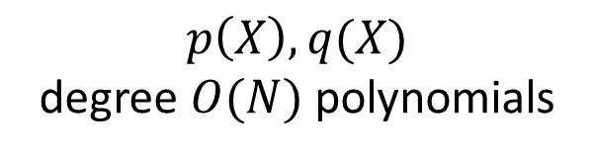
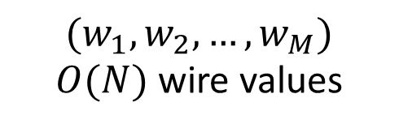
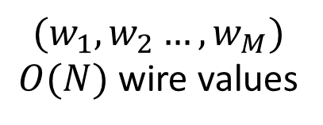
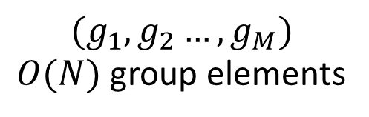
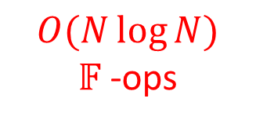
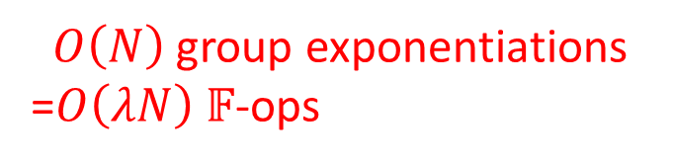
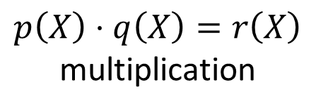
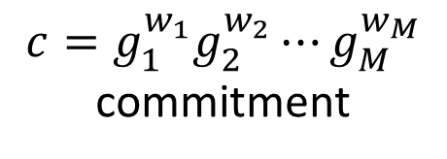
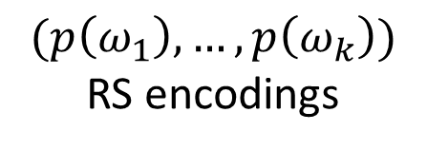
Obstacles
Fast Fourier transforms
Algebraic commitments
$$(w_{1},w_{2}…,w_{M})$$
$O(N)$ wire values
$$(w_{1},w_{2},…,w_{M})$$
$O(N)$ wire values
$$(g_{1},g_{2}…,g_{M})$$
$O(N)$ group elements
$$p\left(X\right),q(X)$$
degree $O(N)$ polynomials
$O\left(N\right)$group exponentiations
=$O\left(λN\right) 𝔽$-ops
$O(N\log{N})$
$𝔽$-ops
$$(p\left(ω_{1}\right),…,p\left(ω_{k}\right))$$
RS encodings
$$p\left(X\right)⋅q\left(X\right)=r\left(X\right)$$
multiplication
$$c=g_{1}^{w_{1}}g_{2}^{w_{2}}⋯g_{M}^{w_{M}}$$
commitment

Slide 6
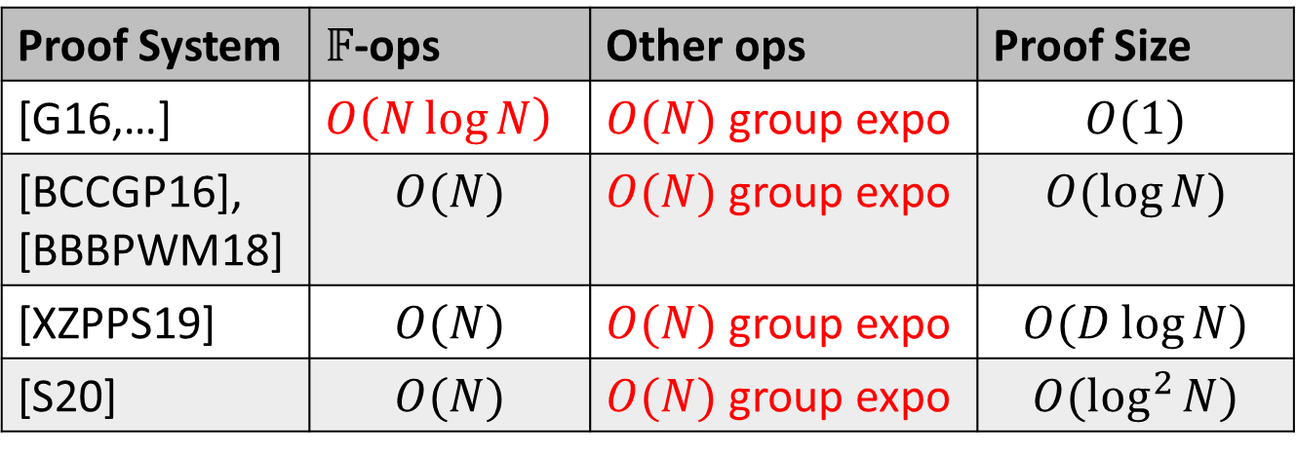

Exciting progress on provers without FFTs
Close to the holy grail, but not quite linear-time…
Excellent concrete efficiency!
Proof System | $𝔽$-ops | Other ops | Proof Size
[G16,…] | $O\left(N\log{N}\right)$ | $O(N)$ group expo | $$O(1)$$
[BCCGP16], [BBBPWM18] | $$O(N)$$ | $O(N)$ group expo | $$O(\log{N})$$
[XZPPS19] | $$O(N)$$ | $O(N)$ group expo | $$O(D\log{N})$$
[S20] | $$O(N)$$ | $O(N)$ group expo | $$O(\log^{2}{N})$$
$N$-gate arithmetic circuits over $𝔽$

Slide 7

The holy grail requires:
algebraic
commitments
FFTs

Slide 8
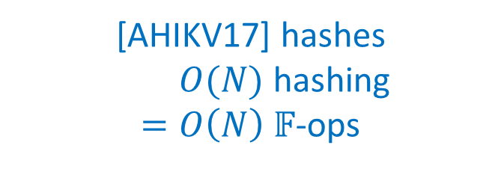
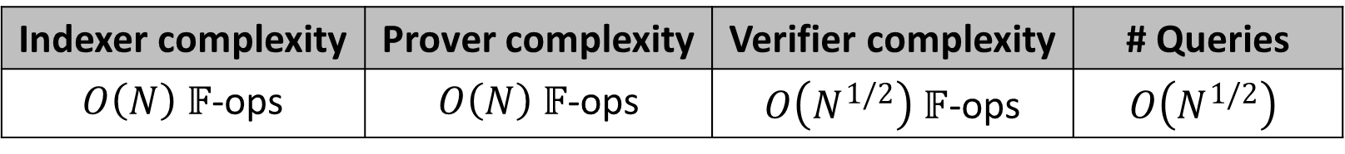
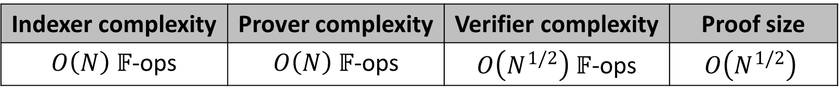
A ray of hope
[BCGGHJ17] cryptographic argument:
[BCGGHJ17] interactive oracle proof:
Indexer complexity | Prover complexity | Verifier complexity | Proof size
$O\left(N\right) 𝔽$-ops | $O\left(N\right) 𝔽$-ops | $O\left(N^{1/2}\right) 𝔽$-ops | $$O\left(N^{1/2}\right)$$
[AHIKV17] hashes
$O(N)$ hashing
$=O\left(N\right) 𝔽$-ops
Indexer complexity | Prover complexity | Verifier complexity | # Queries
$O\left(N\right) 𝔽$-ops | $O\left(N\right) 𝔽$-ops | $O\left(N^{1/2}\right) 𝔽$-ops | $$O\left(N^{1/2}\right)$$
Information theoretic

Slide 9
Challenge: can we construct linear-time IOPs with better query complexity?

Slide 10
Results

Slide 11
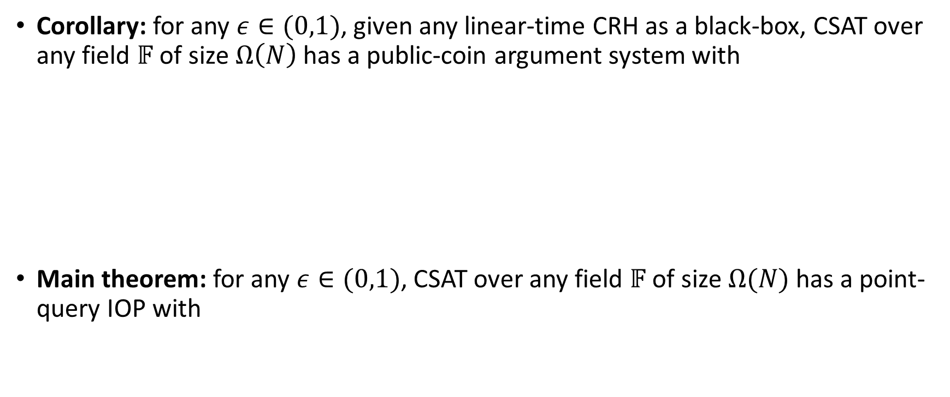
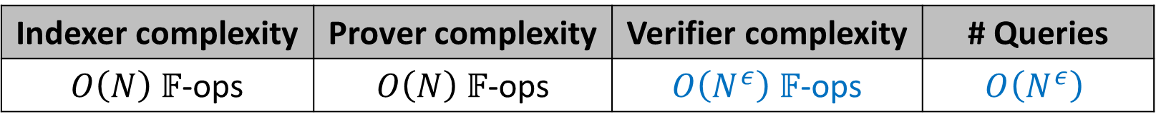

Our results
Corollary: for any $ε∈(0,1)$, given any linear-time CRH as a black-box, CSAT over any field $𝔽$ of size $Ω\left(N\right)$ has a public-coin argument system with
Main theorem: for any $ε∈(0,1)$, CSAT over any field $𝔽$ of size $Ω(N)$ has a point-query IOP with
Indexer complexity | Prover complexity | Verifier complexity | Proof size
$O\left(N\right) 𝔽$-ops | $O\left(N\right) 𝔽$-ops | $O\left(N^{ε}\right) 𝔽$-ops | $$O\left(N^{ε}\right)$$
Indexer complexity | Prover complexity | Verifier complexity | # Queries
$O\left(N\right) 𝔽$-ops | $O\left(N\right) 𝔽$-ops | $O\left(N^{ε}\right) 𝔽$-ops | $$O\left(N^{ε}\right)$$

Slide 12
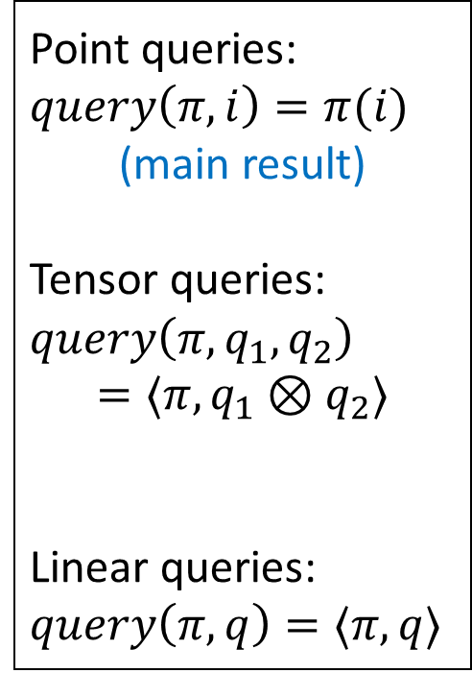

Interactive oracle proofs
query
access
P
V
Point queries:
$$query\left(π,i\right)=π(i)$$
(main result)
Tensor queries:
$$query\left(π,q_{1},q_{2}\right)$$
$$=⟨π,q_{1}⊗q_{2}⟩$$
Linear queries:
$$query\left(π,q\right)=⟨π,q⟩$$
proof oracle
$$…$$

Slide 13
Our approach to the main theorem
linear error-correcting code
Lemma 1:
tensor-query IOP
Lemma 2:
code-based compiler
Main theorem:
point-query IOP

Slide 14
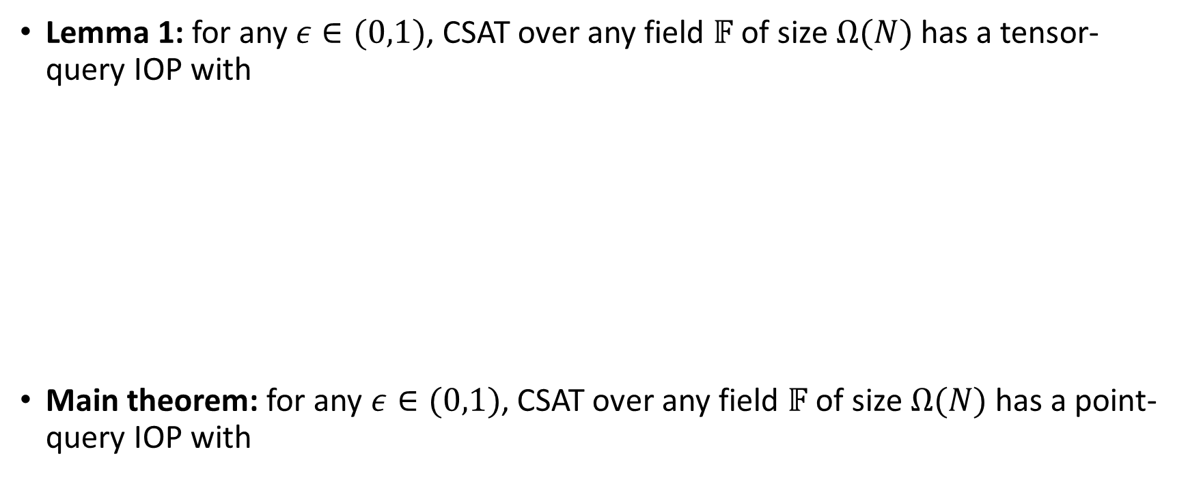
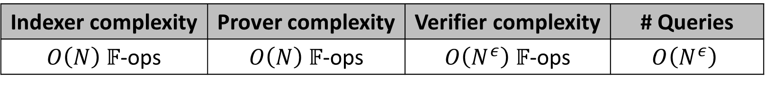

Our approach in more detail
Lemma 1: for any $ε∈(0,1)$, CSAT over any field $𝔽$ of size $Ω(N)$ has a tensor-query IOP with
Main theorem: for any $ε∈(0,1)$, CSAT over any field $𝔽$ of size $Ω(N)$ has a point-query IOP with
Indexer complexity | Prover complexity | Verifier complexity | # Queries
$O\left(N\right) 𝔽$-ops | $O\left(N\right) 𝔽$-ops | $O\left(N^{ε}\right) 𝔽$-ops | $$O(1)$$
Lemma 2:
code-based compiler
Indexer complexity | Prover complexity | Verifier complexity | # Queries
$O\left(N\right) 𝔽$-ops | $O\left(N\right) 𝔽$-ops | $O\left(N^{ε}\right) 𝔽$-ops | $$O\left(N^{ε}\right)$$

Slide 15
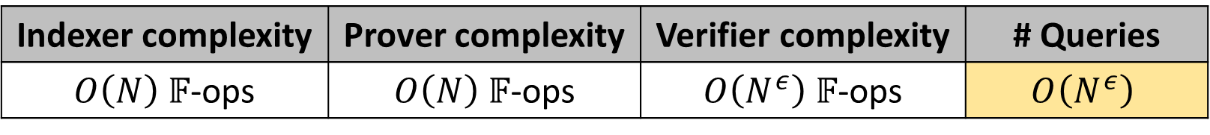
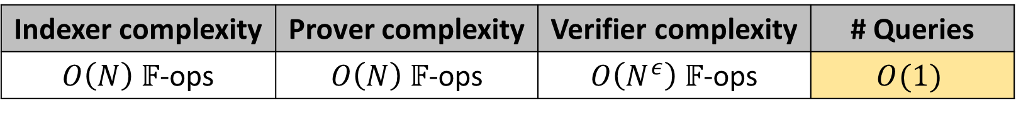
Our approach in more detail
Lemma 1: for any $ε∈(0,1)$, CSAT over any field $𝔽$ of size $Ω(N)$ has a tensor-query IOP with
Main theorem: for any $ε∈(0,1)$, CSAT over any field $𝔽$ of size $Ω(N)$ has a point-query IOP with
Indexer complexity | Prover complexity | Verifier complexity | # Queries
$O\left(N\right) 𝔽$-ops | $O\left(N\right) 𝔽$-ops | $O\left(N^{ε}\right) 𝔽$-ops | $$O(1)$$
Lemma 2:
code-based compiler
Indexer complexity | Prover complexity | Verifier complexity | # Queries
$O\left(N\right) 𝔽$-ops | $O\left(N\right) 𝔽$-ops | $O\left(N^{ε}\right) 𝔽$-ops | $$O\left(N^{ε}\right)$$

Slide 16
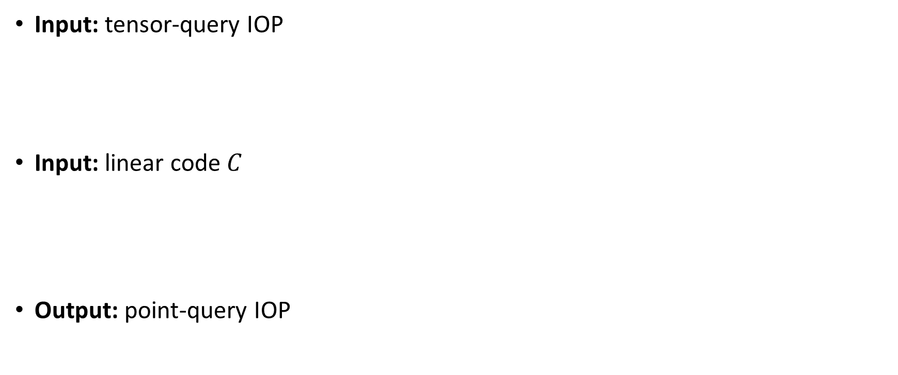
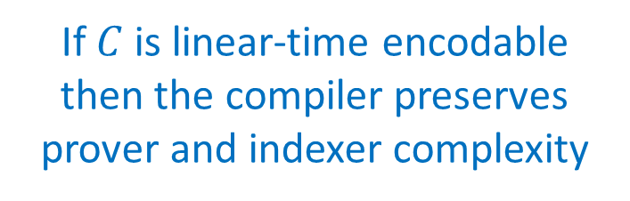
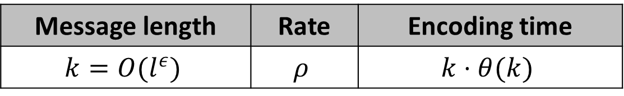
Lemma 2: the code-based compiler
Input: tensor-query IOP
Input: linear code $C$
Output: point-query IOP
Indexer complexity | Prover complexity | Verifier complexity | Proof length | # Queries
$$T_{I}$$ | $$T_{P}$$ | $$T_{V}$$ | $$l$$ | $$q$$
If $C$ is linear-time encodable then the compiler preserves prover and indexer complexity
Message length | Rate | Encoding time
$$k=O(l^{ε})$$ | $$ρ$$ | $$k⋅θ(k)$$
Indexer complexity | Prover complexity | Verifier complexity | Proof length | # Queries
$$T_{I}+O_{ρ}\left(l\right)⋅θ(k)$$ | $$T_{I}+O_{ρ}\left(l\right)⋅θ(k)$$ | $$T_{V}+O(q⋅k)⋅θ(k)$$ | $$O_{ρ}(q⋅l)$$ | $$O(q⋅k)$$

Slide 17
Related techniques
[GKR08]
Linear-time
interactive proofs
Holographic
arguments
[T13]
[COS20]
[XZPPS19]
[S20]
This
work
[BCGGHJ17]
‘FRI’ [BBHR18]
Code-based
IOPs
[RR20]

Slide 18
Code-based compiler techniques

Slide 19

The input tensor-query IOP
P
tensor
queries
V
tensor IOP proof oracle
$$…$$

Slide 20
The compiled point-query IOP
P
tensor IOP simulation phase
point
queries
V
encoded tensor IOP oracle
tensor queries
tensor query answers
$$…$$

Slide 21
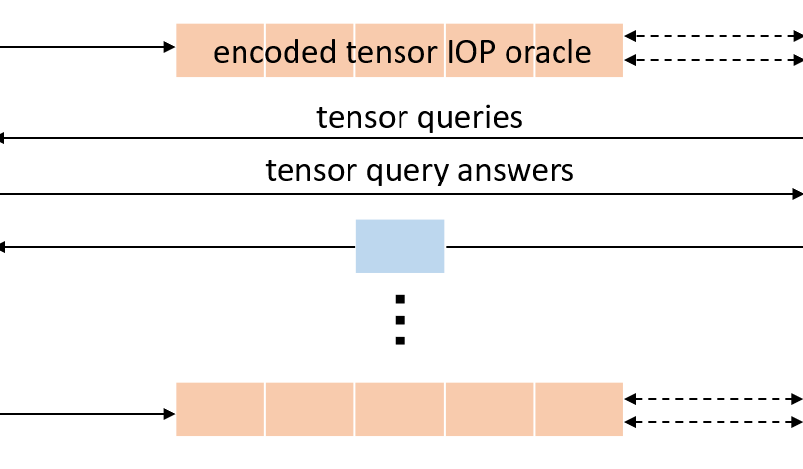
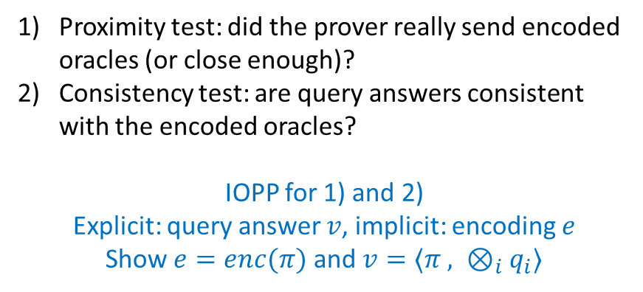
The compiled point-query IOP
P
tensor IOP simulation phase
V
tensor query consistency phase
Proximity test: did the prover really send encoded oracles (or close enough)?
Consistency test: are query answers consistent with the encoded oracles?
IOPP for 1) and 2)
Explicit: query answer $v$, implicit: encoding $e$
Show $e=enc(π)$ and $v=⟨π , ⊗_{i}q_{i}⟩$
Which encodings preserve linear time and admit proximity and consistency IOPPs?

Slide 22

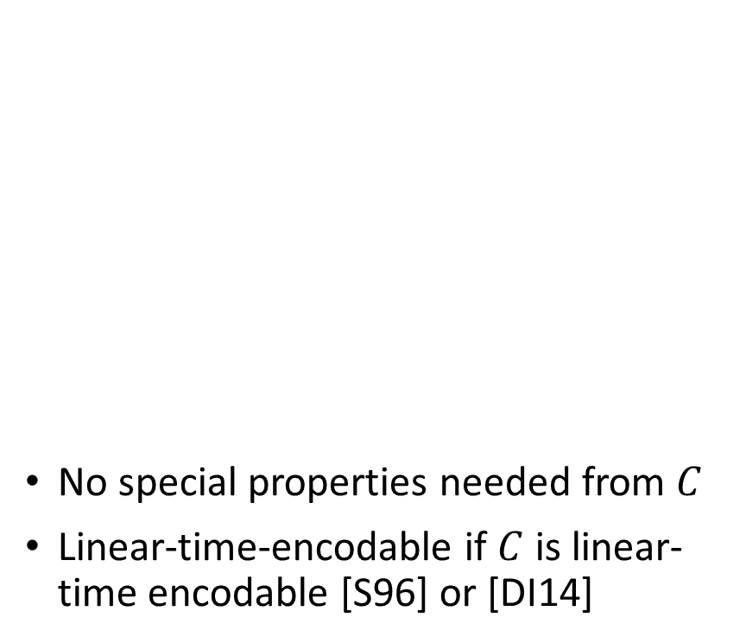




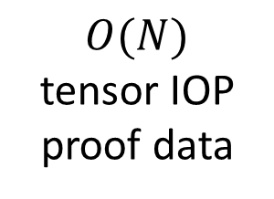
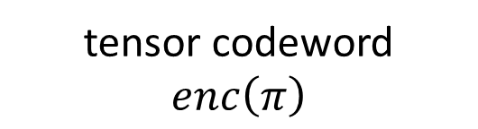
Encodings using the tensor code $C^{⊗t}$
$$O\left(N^{1/3}\right)$$
No special properties needed from $C$
Linear-time-encodable if $C$ is linear-time encodable [S96] or [DI14]
$$O\left(N^{1/3}\right)$$
$$O\left(N^{1/3}\right)$$
tensor codeword $enc\left(π\right)$
$O(N)$
tensor IOP proof data
$$t=3$$

Slide 23
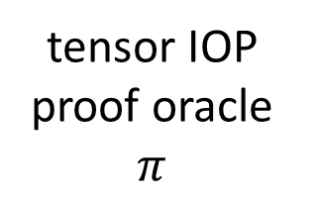
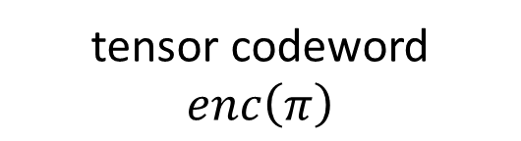
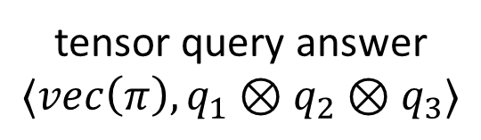
How does the consistency test work?
tensor IOP proof oracle $π$
tensor codeword $enc\left(π\right)$
How are these connected?
tensor query answer $⟨vec\left(π\right),q_{1}⊗q_{2}⊗q_{3}⟩$

Slide 24
How does the consistency test work?
tensor IOP proof oracle $π$
tensor codeword $enc\left(π\right)$
How are tensor queries computed?
tensor query answer $⟨vec\left(π\right),q_{1}⊗q_{2}⊗q_{3}⟩$

Slide 25



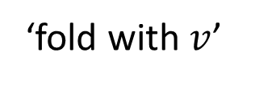




A folding operation
$$a_{1}$$
$$a_{2}$$
$$a_{3}$$
$$v=(v_{1},v_{2},v_{3})$$
‘fold with $v$’
$$v_{1} + v_{2} +v_{3}$$
$$a_{1}$$
$$a_{2}$$
$$a_{3}$$

Slide 26
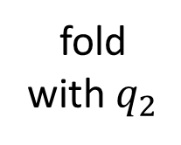
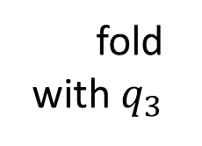
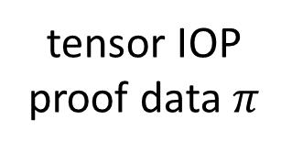
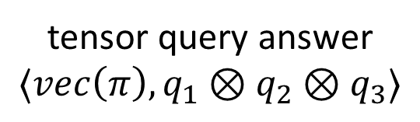
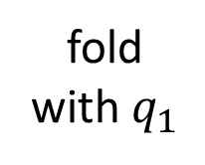
Computing query answers by folding
fold with $q_{1}$
fold with $q_{2}$
fold with $q_{3}$
tensor IOP proof data $π$
tensor query answer $⟨vec\left(π\right),q_{1}⊗q_{2}⊗q_{3}⟩$

Slide 27
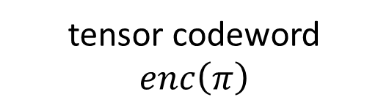
Computing query answers by folding
tensor IOP proof oracle $π$
How are tensor encodings computed?
fold
tensor codeword $enc\left(π\right)$
fold
fold
tensor query answer $⟨vec\left(π\right),q_{1}⊗q_{2}⊗q_{3}⟩$

Slide 28
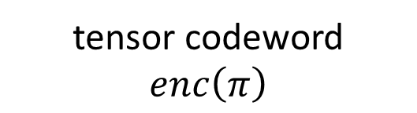
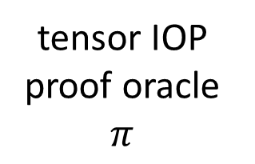
Partial tensor encodings
encode horizontally
encode vertically
tensor IOP proof oracle $π$
tensor codeword $enc\left(π\right)$
$$t=3$$

Slide 29
Partially encoding tensor IOP proofs
tensor IOP proof oracle $π$
encode
encode
tensor codeword $enc\left(π\right)$
tensor query answer $⟨vec\left(π\right),q_{1}⊗q_{2}⊗q_{3}⟩$

Slide 30
How do we check consistency?
tensor IOP proof oracle $π$
fold
tensor codeword $enc\left(π\right)$
encode
tensor query answer $⟨vec\left(π\right),q_{1}⊗q_{2}⊗q_{3}⟩$

Slide 31
How do we check consistency?
tensor IOP proof oracle $π$
tensor codeword $enc\left(π\right)$
Check consistency at each step?
tensor query answer $⟨vec\left(π\right),q_{1}⊗q_{2}⊗q_{3}⟩$

Slide 32
How the IOPP checks consistency
fold
encode
equal
fold
encode
equal
fold
Folding and partial encodings commute

Slide 33
The consistency check IOPP
tensor IOP proof oracle $π$
P
tensor codeword $enc\left(π\right)$
P
P
prover messages
tensor query answer $⟨vec\left(π\right),q_{1}⊗q_{2}⊗q_{3}⟩$
P

Slide 34
What the verifier wants to check
fold
encode
V
equal?
fold
encode
V
V
fold
equal?
equal?
Want to check using a small number of queries

Slide 35
Spot-checks using few queries
query
query
fold
encode
V
equal?
Distance properties of the code guarantee inconsistencies are caught

Slide 36
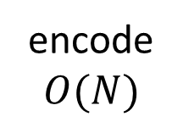
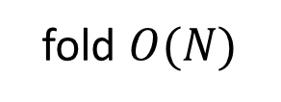






Analysis: prover complexity
encode
$$O(N)$$
encode
$$O(N)$$
size $O(N)$
fold $O(N)$
encode
$$o(N)$$
fold $o(N)$
size $o(N)$
Use [S96] or [DI14] codes
fold $o(N)$

Slide 37

Analysis: proof size and verifier complexity
V
Only touches 1-dimensional stripes of size $O\left(N^{1/3}\right)$

Slide 38
Conclusion

Slide 39
Our approach
Tensor IOP
Point IOP
Argument
Code-based compiler
Hash-based compiler
Any tensor IOP
Sub-linear proof size
Any linear code
Any hash function

Slide 40


Our approach
Tensor IOP
Point IOP
Argument
Code-based compiler
Hash-based compiler
$O\left(N\right)$-time tensor IOP
$O\left(N\right)$-time argument
[S96] or [DI14] codes
[AHIKV17] hashes

Slide 41
Thanks!
Corollary: for any $ε∈(0,1)$, given any linear-time CRH as a black-box, CSAT over any field $𝔽$ of size $Ω\left(N\right)$ has a public-coin argument system with
Main theorem: for any $ε∈(0,1)$, CSAT over any field $𝔽$ of size $Ω(N)$ has a point-query IOP with
Indexer complexity | Prover complexity | Verifier complexity | Proof size
$O\left(N\right) 𝔽$-ops | $O\left(N\right) 𝔽$-ops | $O\left(N^{ε}\right) 𝔽$-ops | $$O\left(N^{ε}\right)$$
Indexer complexity | Prover complexity | Verifier complexity | # Queries
$O\left(N\right) 𝔽$-ops | $O\left(N\right) 𝔽$-ops | $O\left(N^{ε}\right) 𝔽$-ops | $$O\left(N^{ε}\right)$$

