Slide 1
Next Up:
Jordan Borean

Slide 2
3
3

Slide 3
2

Slide 4
1

Slide 5
Slaying the assembly conflict dragon with Assembly Load Contexts
Jordan Borean

Slide 6

Many thanks to our sponsors:

Slide 7

Jordan Borean
Software Engineer for Red Hat
Works on Ansible, specializes in Windows integrations
Enjoys working with Python, PowerShell, and C#
Proud father (sleep notwithstanding) of 1

Slide 8
Problem
Modules can have dependencies on .NET packages
PowerShell loads modules in the one process
A process can only load 1 version of an assembly
Modules that use the same assembly but at different versions cause a conflict

Slide 9
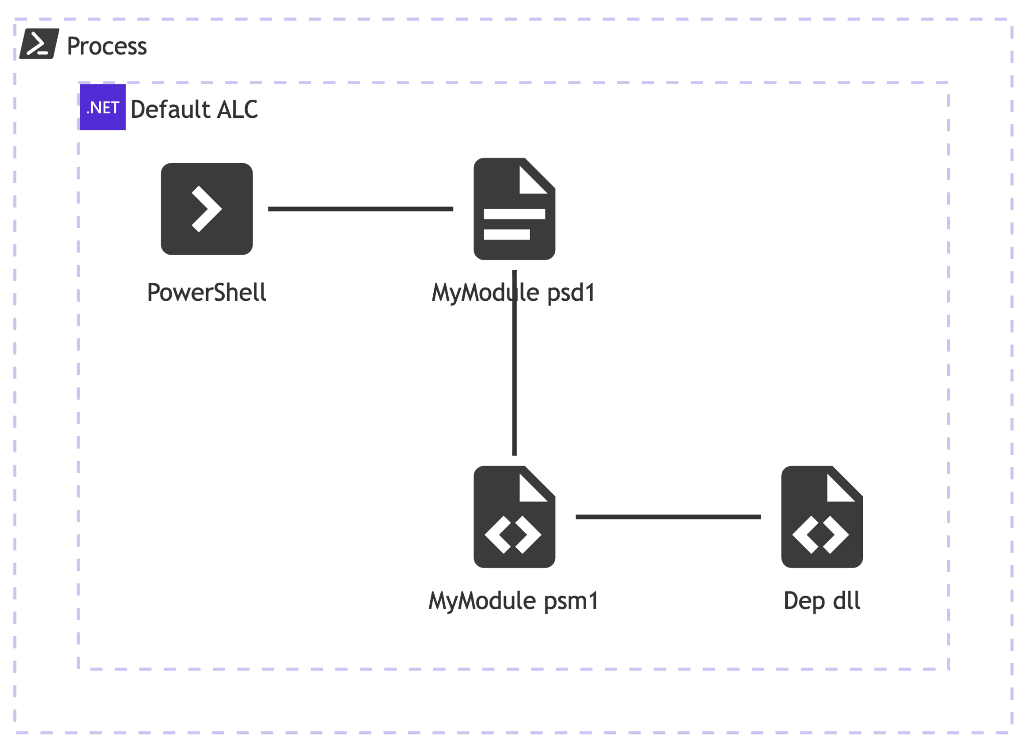
Assembly Load Resolver

Slide 10
Assembly Load Resolver
PROS
CONS
1
No UX Changes Needed
So Many Edge Cases
1
2
Can be used with WinPS
Expands Test Matrix
2
Band Aid not a Fix
3

Slide 11
Fai
1

Slide 12
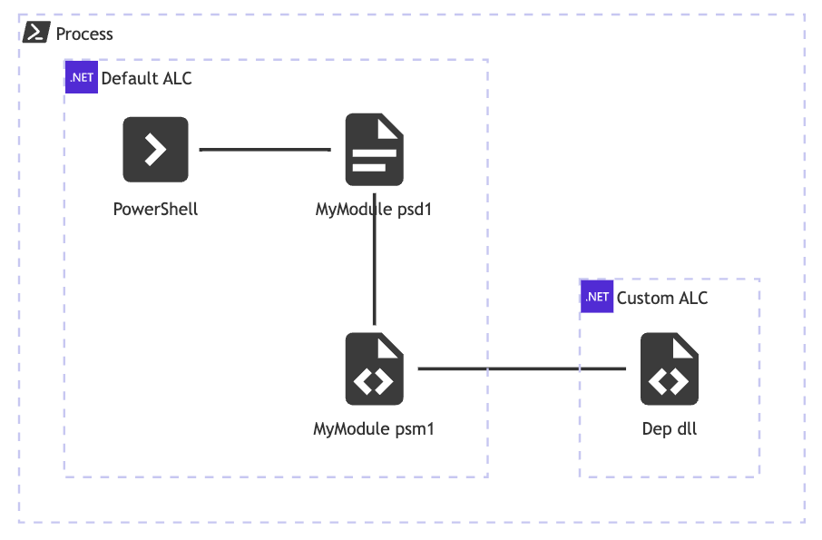
Script Based ALC

Slide 13
Script Based ALC
PROS
CONS
1
No C# Needed
Needs rethink of function Input/Outputs
1
Types cannot be exposed in pwsh/parameters
2
Complex to write
3

Slide 14
3

Slide 15
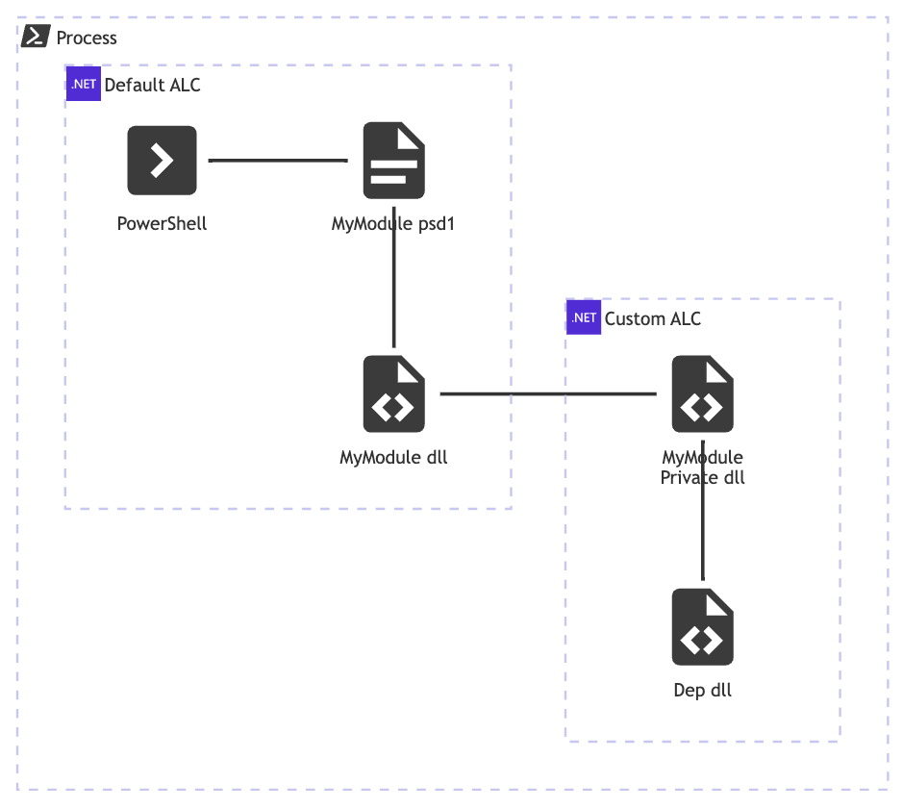
ALC Resolver

Slide 16
ALC Resolver
PROS
CONS
1
No need for .psm1
Needs rethink of function Inputs/Outputs
1
2
Structure similar to simple C# module
Needs to wrap deps in separate assembly
2
3
Simpler in how it works
Risk of inadvertently exposing to default ALC
3

Slide 17
7

Slide 18
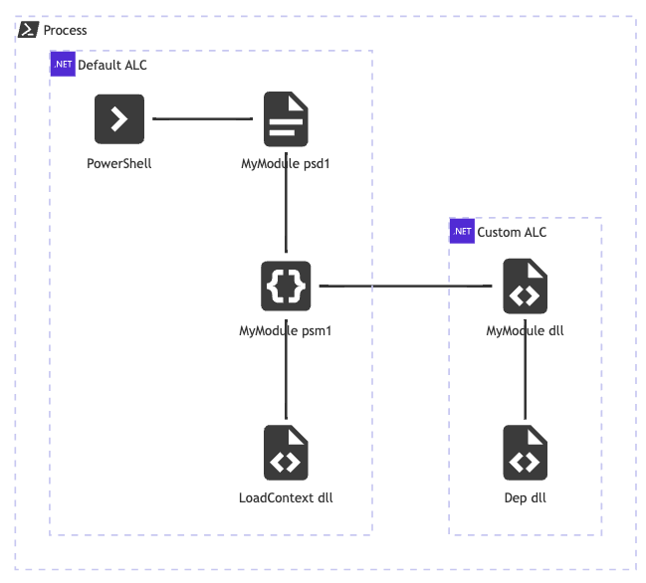
ALC Loader

Slide 19
ALC Loader
PROS
CONS
1
Fully isolates module and deps
Needs rethink of function Inputs/Outputs
1
2
Cmdlets can use deps directly
Hard to understand
2
3
Cmdlets and immediate types accessible in pwsh
Requires psm1
3

Slide 20
9

Slide 21
Key Takeaways
An ALC is the only way to fully isolate your .NET assemblies from other modules
Requires a re-think of how you expose types/it is hard to add to existing modules
Use the ALC Loader approach
Pester the PowerShell team to add better support for ALC, e.g. type lookups like [MyAlc, Namespace.Type]

Slide 22

Q&A
15 minutes

