Slide 1
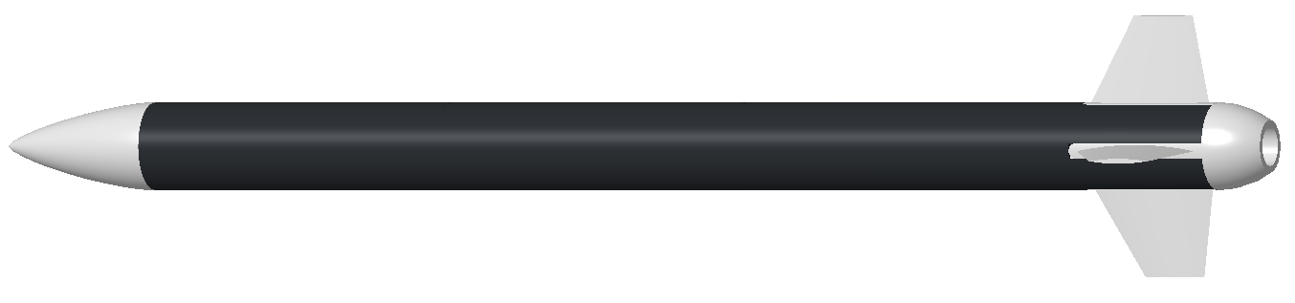






$$z_{b}$$
$$z_{g}$$
$$y_{b}$$
$$x_{b}$$
$$y_{g}$$
$$x_{g}$$

Slide 2


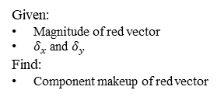




$$z$$
Given:
Magnitude of red vector
$δ_{x}$ and $δ_{y}$
Find:
Component makeup of red vector
$$δ_{x}$$
$$δ_{y}$$
$$V={\left[\begin{matrix}v_{x} & v_{y} & v_{z}\end{matrix}\right]}^{T}, δ_{x}=\tan^{−1}\left(\frac{v_{x}}{v_{z}}\right), δ_{y}=\tan^{−1}\left(\frac{v_{y}}{v_{z}}\right)$$
$$x$$
$$y$$

