Slide 1
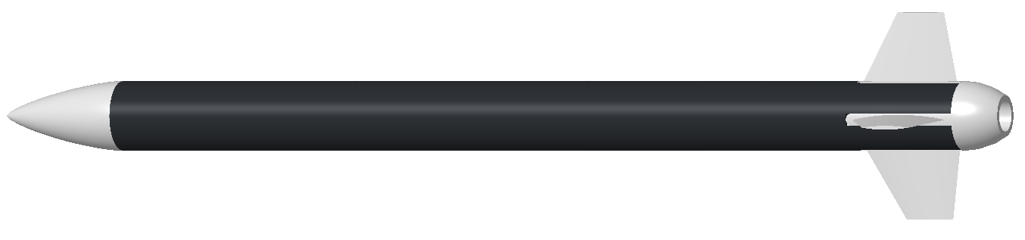









$$z_{b}$$
$$z_{g}$$
$$y_{b}$$
$${\vec{F}}_{a}$$
$$x_{b}$$
$$y_{g}$$
$${\vec{F}}_{g}$$
$${\vec{F}}_{th}$$
$$x_{g}$$

Slide 2




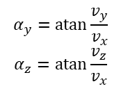











$$α$$
$$z_{b}$$
$${\vec{V}}_{b}$$
$$y_{b}$$
$$α_{y}$$
$$α_{z}$$
$$x_{b}$$
$$z_{g}$$
$$α_{y}=\operatorname{atan}{\frac{v_{y}}{v_{x}}}$$
$$α_{z}=\operatorname{atan}{\frac{v_{z}}{v_{x}}}$$
$$z_{b}$$
$$y_{g}$$
$$v_{x}$$
$$y_{b}$$
$${\vec{V}}_{b}$$
$$v_{z}$$
$$v_{y}$$
$$x_{b}$$
$$x_{g}$$

Slide 3






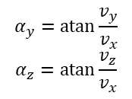
$$α_{y}=\operatorname{atan}{\frac{v_{y}}{v_{x}}}$$
$$α_{z}=\operatorname{atan}{\frac{v_{z}}{v_{x}}}$$
$$z_{b}$$
$$v_{x}$$
$$y_{b}$$
$${\vec{V}}_{b}$$
$$v_{z}$$
$$v_{y}$$
$$x_{b}$$

Slide 4


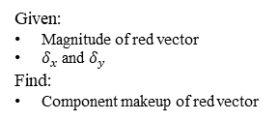




$$z$$
Given:
Magnitude of red vector
$δ_{x}$ and $δ_{y}$
Find:
Component makeup of red vector
$$δ_{x}$$
$$δ_{y}$$
$$V={\left[\begin{matrix}v_{x} & v_{y} & v_{z}\end{matrix}\right]}^{T}, δ_{x}=\tan^{−1}\left(\frac{v_{x}}{v_{z}}\right), δ_{y}=\tan^{−1}\left(\frac{v_{y}}{v_{z}}\right)$$
$$x$$
$$y$$

Slide 5
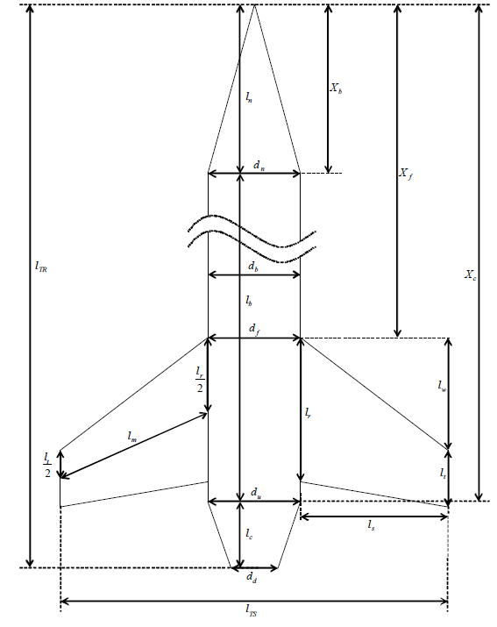





$$L$$
$$θ$$
$$\left[L,\frac{L}{\cos{θ}}\sin{θ}\right]$$
$$\left[L,\frac{L}{\cos{θ}}\sin{θ}+\frac{L_{t}}{2}\right]$$
$$\left[0,\frac{L_{r}}{2}\right]$$

