Slide 1
Lab 3
Run-Time Governance

Slide 2
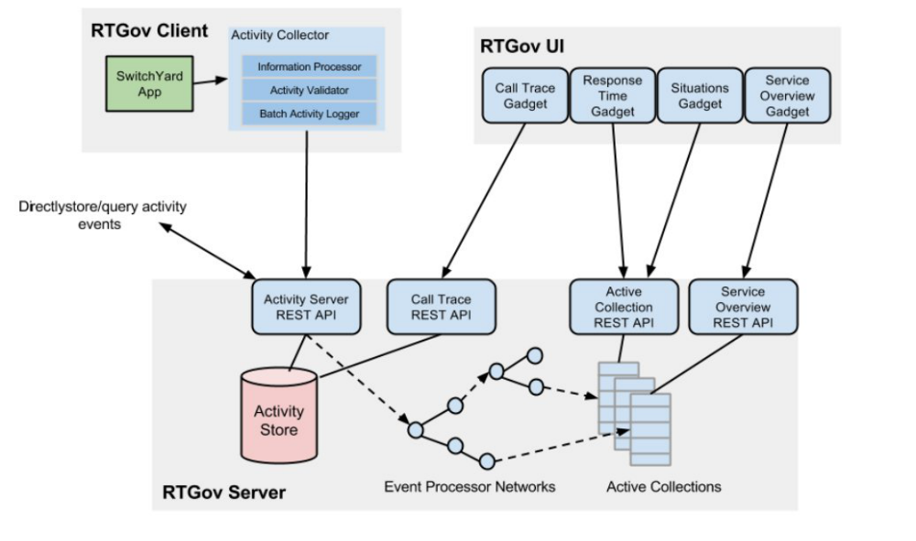

FYI
Activity Collector: Used to collect activity events.
Activity Server and Store: Used for central activity event storage and querying.
Event Processor Network: Used for generic event analysis to process the activity events.
Active Collections: Used for active information management to post-process and cache information for end-user applications.

Slide 3
FYI
Note: The Policy Enforcement and Report Generation for the Home Loan application code is in process so we will review part of the code, concepts and Run Monitoring. The quickstart/overlord/rtgov quickstart with FSW walks through the Order Management Demo.
A deeper dive can be found in the RTGov section in https://access.redhat.com/site/documentation/en-US/Red_Hat_JBoss_Fuse_Service_Works/6/pdf/Development_Guide_Volume_3_Governance/Red_Hat_JBoss_Fuse_Service_Works-6-Development_Guide_Volume_3_Governance-en-US.pdf
Home Loan Interceptors:
Exchange Validator - This class is derived from an abstract base
class that provides most of the required functionality for converting an Exchange message into an activity event.
PolicyEnforcer – The policy enforcement is provided by a specific Switchyard Auditor implementation (PolicyEnforcer) that is
included with the Home Loan application.

Slide 4
Lab Steps
Step 0: Getting Started
Step 1 : Configure RTGov
Step 2 : Monitor a SLA
Step 3 : Generate a SLA Report
Step 4 : Review Synchronous Policy
Step 5 : Review Asynchronous Policy

Slide 5

Step 0
Goals
Getting Started
Start Fuse Service Works

Slide 6

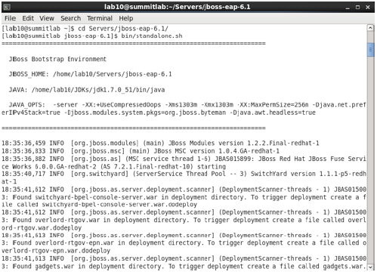
Getting Started
TODO
NOTE: Ignore this step if you already started the server.
1. Open a Terminal window
2. Navigate to the Server directory and start the server:
cd Servers/jboss-eap-6.1bin/standalone.sh

Slide 7
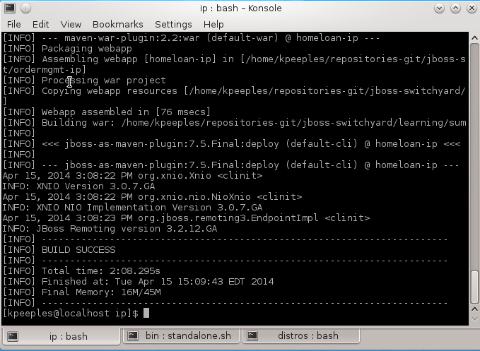

Getting Started
TODO
Open terminal
Change to lab3 folder
Change to the Information Processor folder
Run mvn jboss-as:deploy
FYI
For integrating an Activity Collector inside the execution environment, you can use Information
processors to extract relevant context and property values from activity events.

Slide 8
Step 1
Goals
Configure RTGov
Enable Activity Collection

Slide 9
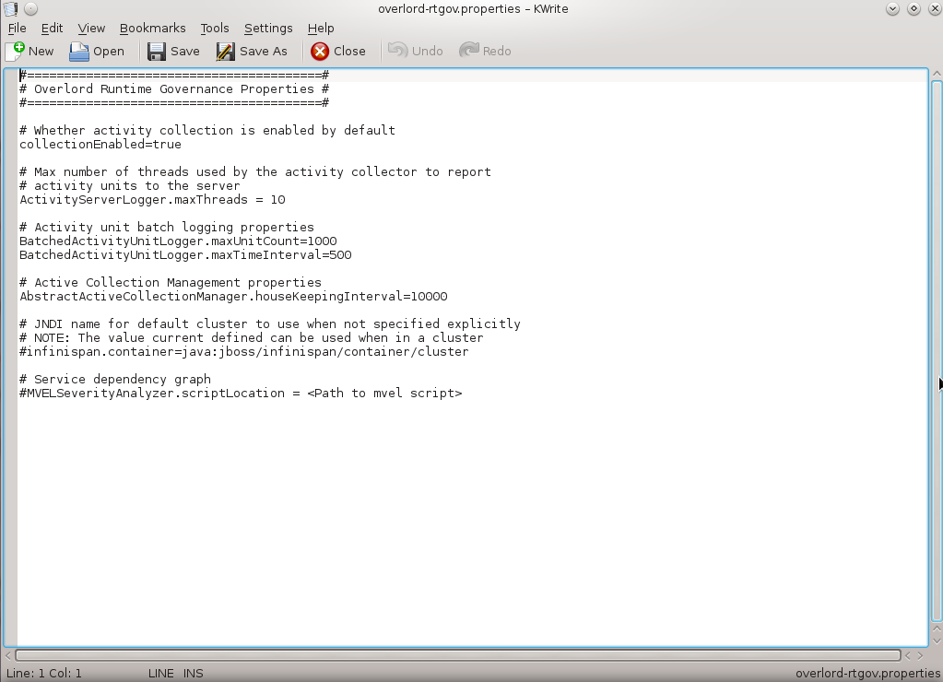
Configure RTGov
TODO
Open your preferred text editor, ie Write or Kwrite
Browse to /home/lab10/Servers/jboss-eap-6.1/standalone/configuration and open overlord-rtgov.properties
Change the collectionEnabled property to true
Save your changes

Slide 10
Step 2
Goals
Configure JBDS to deploy workflow
Sign onto S-RAMP
Check for deployment of workflow
Monitor a SLA

Slide 11
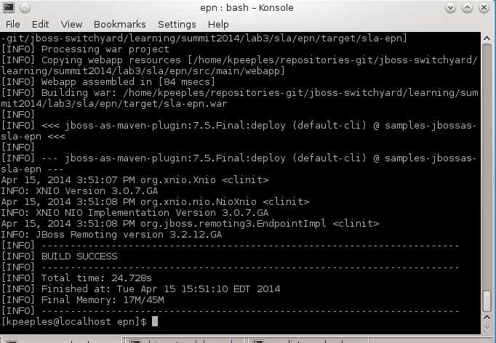

Monitor a SLA
FYI
An EPN (Event Processor Network) processes a stream of events through a network of linked nodes established to perform specific filtering, transformation or analysis tasks. You can define this network as an object model or specify it as a JSON representation for packaging in a suitable form, and subsequently de-serialized when deployed to the Run-Time Governance server.
Open a terminal
browse to lab3/sla/epn
deploy epn with mvn jboss-as:deploy
TODO

Slide 12
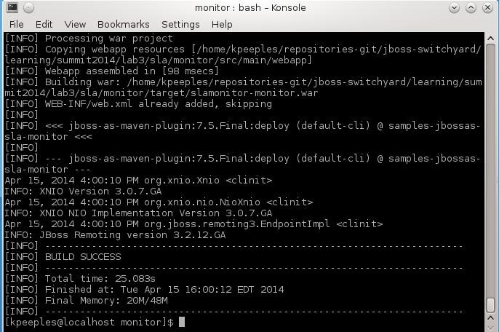
Monitor a SLA
FYI
Service Level Agreements can be policed using rules defined in an Event Processor Network, and reporting to end users using the pre-configured "Situations" active collection. T he rule used in this example is detecting whether the response time associated with an operation on a service exceeds a particular level. However more complex temporal rules could be defined to identify the latency between any two points in a business transaction flow.
TODO
Open a terminal
browse to lab3/sla/monitor
deploy monitor with mvn jboss-as:deploy

Slide 13
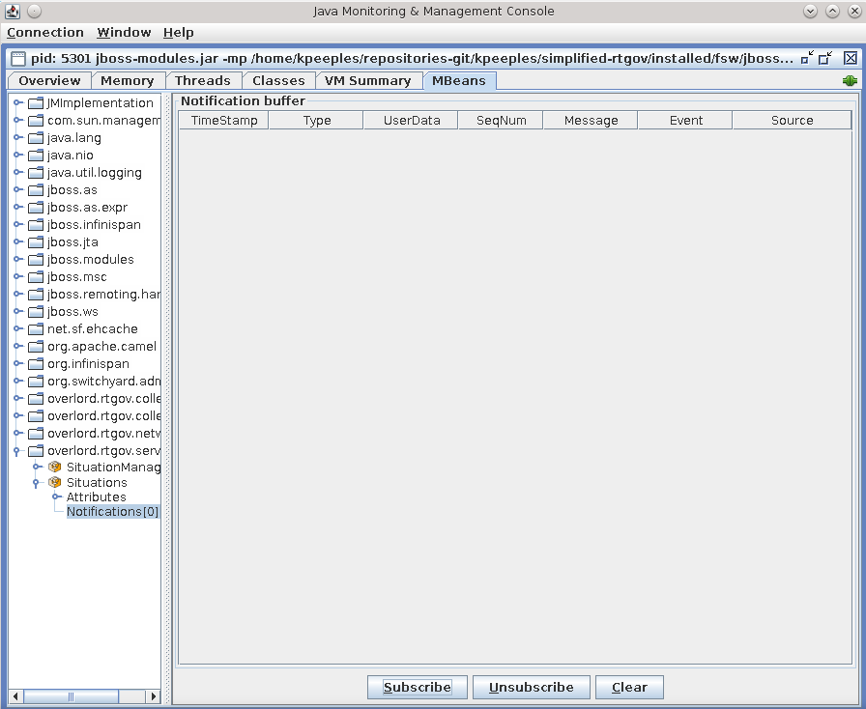
Monitor a SLA
Open a terminal
Open jconsole
Choose jboss-modules process
Choose insecure
Click mbeans tab
Browse to the notifications in overlord.rtgov.services in Situations
Click subscribe
Send a home loan soap message with mvn –Psoap from lab2
Notice the server console
Notice the Violation in the JConsole
FYI
TODO
The "out of the box" active collection configuration is pre-initialized with a collection for the org.overlord.rtgov.analytics.situation.Situation objects, subscribing to the "Situations“ subject from the Event Processor Network. Therefore any detected SLA violations will automatically be stored in this collection (accessible via a REST ful service), and reported to the associated JMX notifier.

Slide 14
Monitor a SLA
FYI
You can also request the list of response time information from the same custom service, using the URL
http://localhost:8080/slamonitor-monitor/monitor/responseTimes?operation=intake
TODO
Open a browser
Browse to response time for operations
http://localhost:8080/slamonitor-monitor/monitor/responseTimes?operation=intake

Slide 15
Step 3
Goals
Generate A Report
Generate a Report

Slide 16
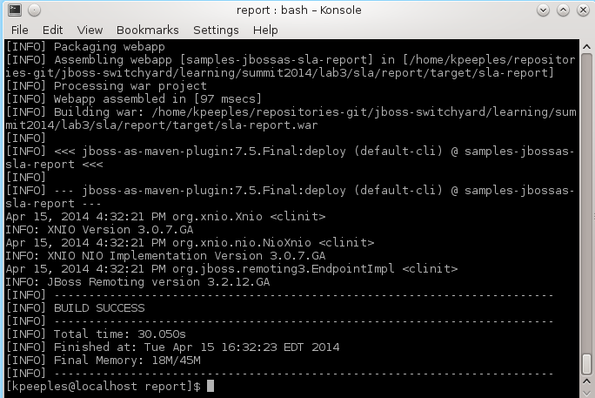

Generate a Report
FYI
The report can be accessed via the REST interface
TODO
Open a terminal
Change to lab3/sla/report
Deploy to jboss with mvn jboss-as:deploy

Slide 17
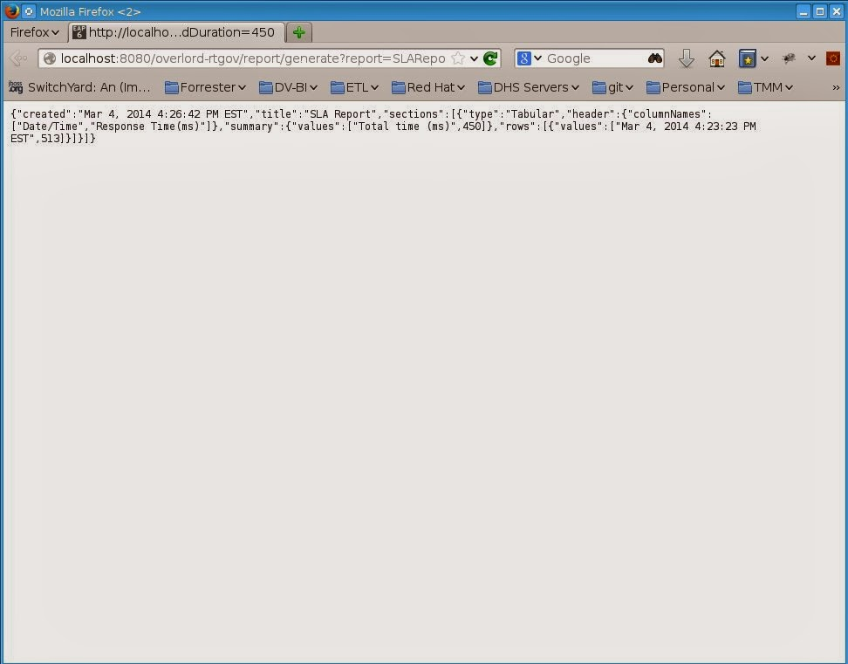
Generate a Report
FYI
This is the example from the Orders Demo. The Home Loan generate will show empty at the moment.
TODO
Open a terminal and change to lab3//homeloan
Send multiple soap messages with mvn –Psoap from lab2
Open a browser
Browse to http://localhost:8080overlordrtgovreportgeneratereport=SLAReport&startDay=1&startMonth=1&startYear=2013&endDay=31&endMonth=12&endYear=2013&maxResponseTime=400&averagedDuration=450

Slide 18
Step 4
Goals
Review the concept of Synchronous Policy
Review Synchronous Policy

Slide 19
Review a Synchronous Policy
FYI
The Synchronous Enforcement approach shows how a business policy can be implemented in a synchronous (or inline) manner, where the decision is taken immediate, and can therefore be used to influence the current business transaction. A policy enforcement mechanism can be used with the Activity Validator mechanism, to immediately evaluate the business policy and (if appropriate) block the business transaction.
For Example, if two requests are received within two seconds of each other then the ones after the first are blocked.

Slide 20
Step 5
Goals
Review the concept of Asynchronous Policy
Review Asynchronous Policy

Slide 21
Review a Asynchronous Policy
FYI
The Asynchronous Enforcement approach shows how a business policy can be implemented in an asynchronous (or out-of-band) manner, where the decision is taken after the fact, and can therefore only be used to influence future business transactions.
For Example, A customer has a debt threshold of 150. If requests have totaled more than the threshold any subsequent request we will receive a SOAP fault from the server. T his is due to the fact that the PolicyEnforcer auditor has intercepted the request, and detected that the customer is now suspended.

Slide 22
Lab 3 Complete!

