Slide 1
Demo Highlights
Business Process w/ Web Service Integration
Decision Table – Web
Decision Table - Spreadsheet
Domain Specific Language (DSL)
Business Activity Monitoring (BAM)

Slide 2
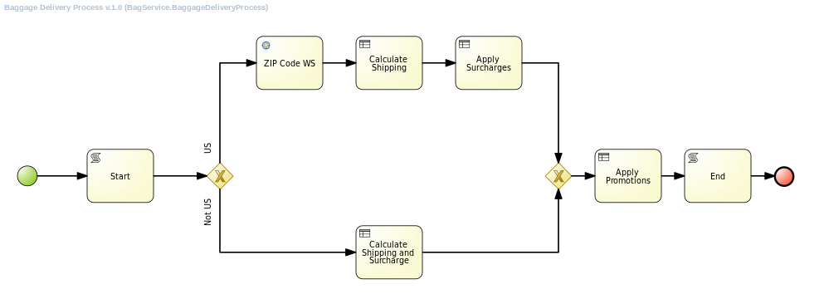
Demo Overview – Baggage Delivery Service

