Slide 1
Architecture for Real-Time ETL
Nashville BI User Group
3 October 2017

Slide 2

Jon Boulineau Delivery Lead, HCA
I lead data integration and data warehouse teams for HCA. My current project is the implementation of a streaming ETL pipeline using Hadoop ecosystem tools and SQL Server.
Nashville PASS Leader
jonboulineau
@jboulineau
jboulineau@gmail.com
Rivulet.io
ETL Architecture for Real-Time BI

Slide 3
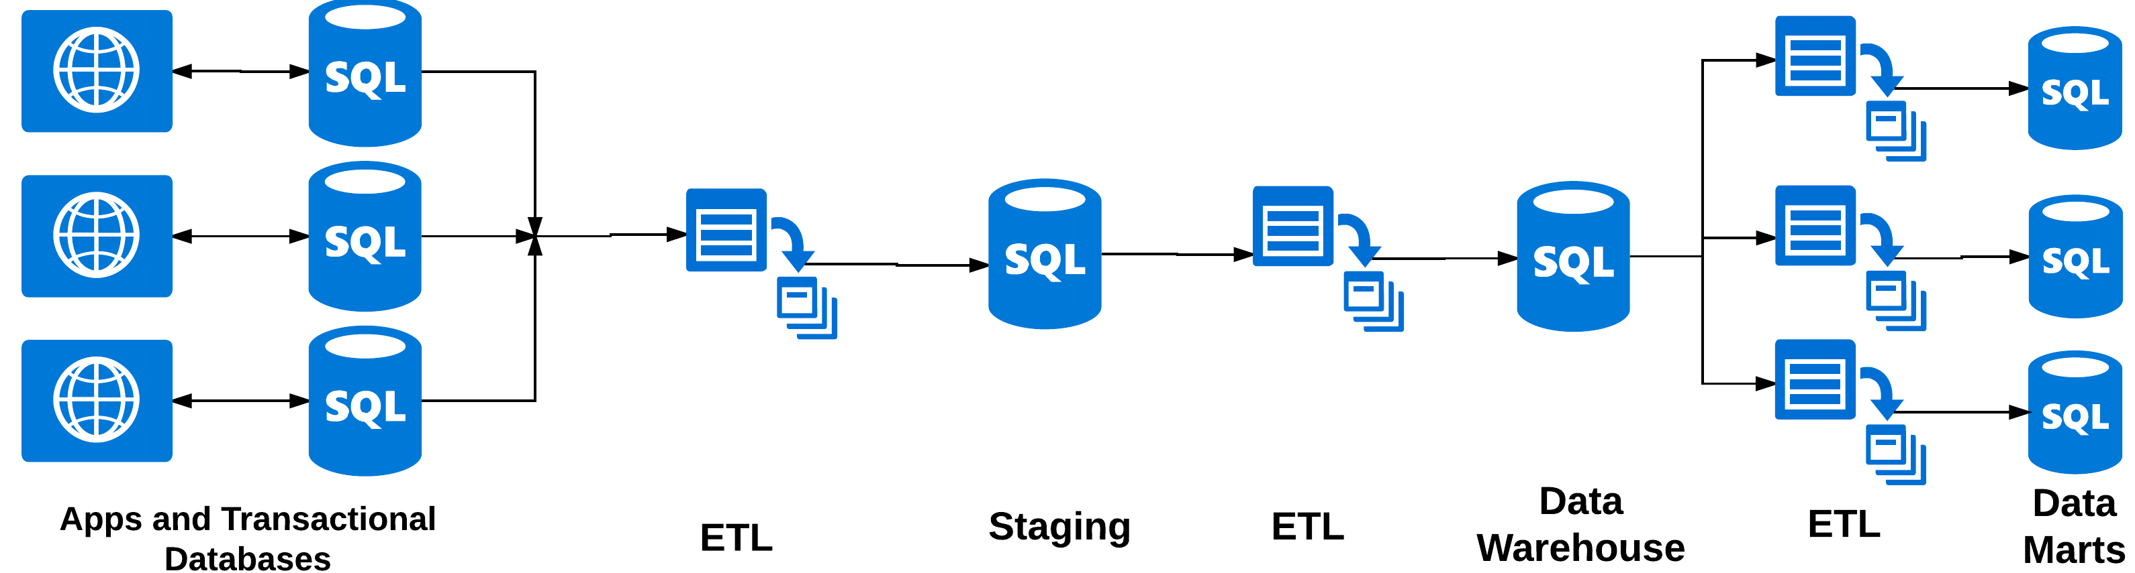
3 |
ETL Architecture for Real-Time BI

Slide 4
Monolithic
Localized
RDBMS persistency
Mutable databases with spotty audit logs
Vertically scaled
Applications
4 |
ETL Architecture for Real-Time BI

Slide 5
Significant overhead to make up for mutability of Application databases (e.g. Delta detection)
Forced into (shrinking) batch windows due to overhead
‘Lossy’ snapshots
Inaccurate in processing time, inaccurate in event time
Brittle: failures tend to be catastrophic, partition intolerant, low availability
Fault intolerant
Expensive / difficult to scale
Many points of failure
How well is your ETL logic managed?
ETL / Staging /
Data Warehouse
5 |
ETL Architecture for Real-Time BI

Slide 6
Forced into (shrinking) batch windows due to overhead
‘Lossy’ snapshots
Inaccurate in processing time, inaccurate in event time
Brittle: failures tend to be catastrophic, partition intolerant, low availability
Fault intolerant
Expensive / difficult to scale
Many points of failure
Data accuracy skew due to divergent logic
ETL and Data Marts
6 |
ETL Architecture for Real-Time BI

Slide 7
Change Drivers
Batch Inadequacy
Catastrophic Failure
‘Lossy’
Time-based inaccuracies
Scale
Fault Intolerance
Complexity (Tool / Pattern Specific)
7 |
ETL Architecture for Real-Time BI

Slide 8
Change Drivers
BI Use Cases
Machine Learning
Hybrid Applications
Industry Specific Competition
Batch Inadequacy
Catastrophic Failure
‘Lossy’
Time-based inaccuracies
Scale
Fault Intolerance
Complexity (Tool / Pattern Specific)
8 |
ETL Architecture for Real-Time BI

Slide 9
Change Drivers
Application Architecture
Polyglot Persistence
Event-Driven Architecture
BI Use Cases
Machine Learning
Batch Inadequacy
Catastrophic Failure
‘Lossy’
Hybrid Applications
Industry Specific Competition
Time-based inaccuracies
Scale
Fault Intolerance
Complexity (Tool / Pattern Specific)
Distributed Microservices
Real-time ETL is as much about overcoming limitations of batch processing and adapting to changes in application architecture as it is about enabling BI use cases
9 |
ETL Architecture for Real-Time BI

Slide 10
Patterns for Real-Time ETL

Slide 11
Application Architecture
Polyglot Persistence
Event-Driven Architecture
BI Use Cases
Machine Learning
Batch Inadequacy
Catastrophic Failure
‘Lossy’
Hybrid Applications
Industry Specific Competition
Time-based inaccuracies
Scale
Fault Intolerance
Complexity (Tool / Pattern Specific)
Distributed Microservices
11 |
ETL Architecture for Real-Time BI

Slide 12
Microbatch
Application Architecture
Polyglot Persistence
Event-Driven Architecture
BI Use Cases
Machine Learning
Batch Inadequacy
Catastrophic Failure
‘Lossy’
Hybrid Applications
Industry Specific Competition
Time-based inaccuracies
Fault Intolerance
Complexity (Tool / Pattern Specific)
Scale
Distributed Microservices
12 |
ETL Architecture for Real-Time BI

Slide 13
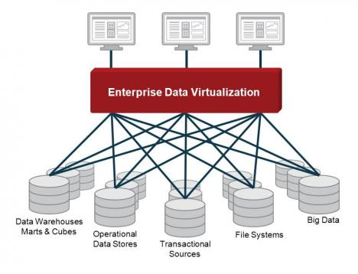
Data Virtualization
Image source: http://virtualization.sys-con.com/node/1849158

Slide 14
Data Virtualization
Application Architecture
Polyglot Persistence
Event-Driven Architecture
BI Use Cases
Machine Learning
Batch Inadequacy
Catastrophic Failure
‘Lossy’
Hybrid Applications
Industry Specific Competition
Time-based inaccuracies
Fault Intolerance
Complexity (Tool / Pattern Specific)
Scale
Distributed Microservices
14 |
ETL Architecture for Real-Time BI

Slide 15
Is it possible?
Application Architecture
Polyglot Persistence
Event-Driven Architecture
BI Use Cases
Machine Learning
Batch Inadequacy
Catastrophic Failure
‘Lossy’
Hybrid Applications
Industry Specific Competition
Time-based inaccuracies
Fault Intolerance
Complexity (Tool / Pattern Specific)
Scale
Distributed Microservices
15 |
ETL Architecture for Real-Time BI

Slide 16
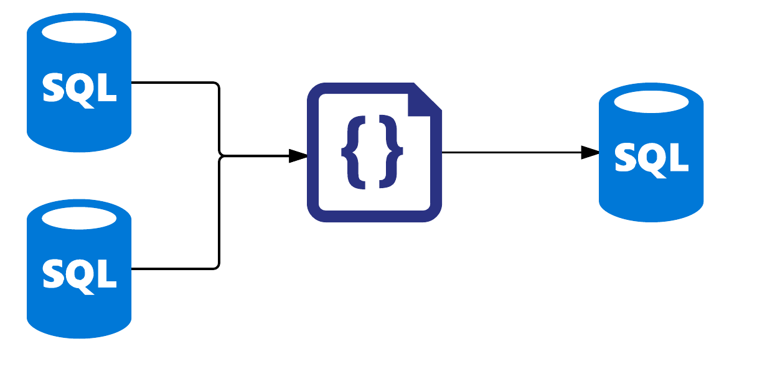
Catastrophic Failure
Tool Specific Complexity *
Hybrid Applications
Industry Specific Competition
Event Driven Architecture
Time-Based Inaccuracies
Lossy
Polyglot Persistence
Event Driven Architecture
Distributed Microservices
Scale
Fault Tolerance
Machine Learning *
Reprocessing
Statefull Algorithms
Processing inefficiencies
16 |
ETL Architecture for Real-Time BI

Slide 17
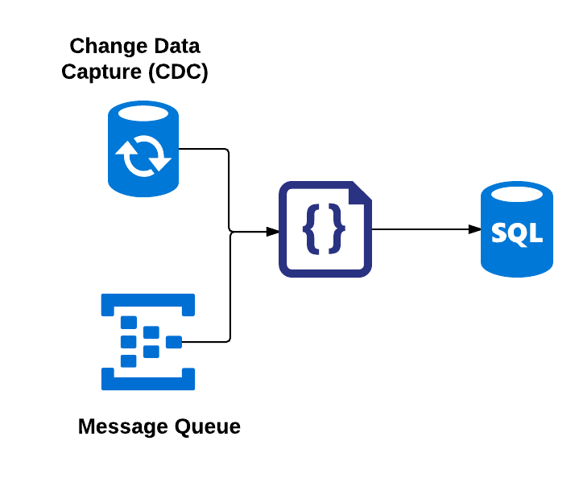
Catastrophic Failure
Tool Specific Complexity *
Hybrid Applications
Industry Specific Competition
Event Driven Architecture
Lossy
Polyglot Persistence
Event Driven Architecture
Distributed Microservices *
Reprocessing
Time-Based Inaccuracies
Scale
Fault Tolerance
Machine Learning
Statefull Algorithms
Processing inefficiencies
17 |
ETL Architecture for Real-Time BI

Slide 18
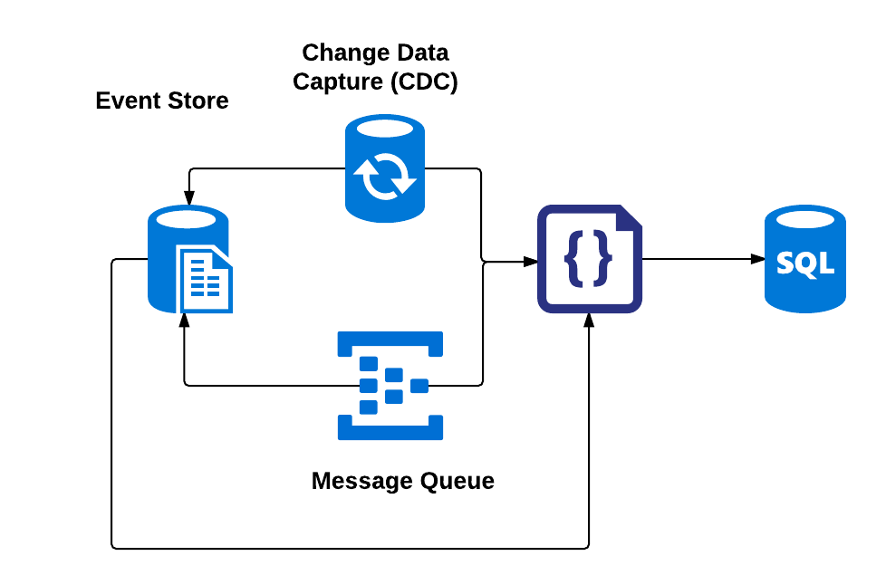
Catastrophic Failure
Tool Specific Complexity *
Hybrid Applications
Industry Specific Competition
Event Driven Architecture
Lossy
Polyglot Persistence
Event Driven Architecture
Distributed Microservices *
Reprocessing
Statefull Algorithms
Machine Learning
Time-Based Inaccuracies
Scale
Fault Tolerance
Processing inefficiencies
18 |
ETL Architecture for Real-Time BI

Slide 19
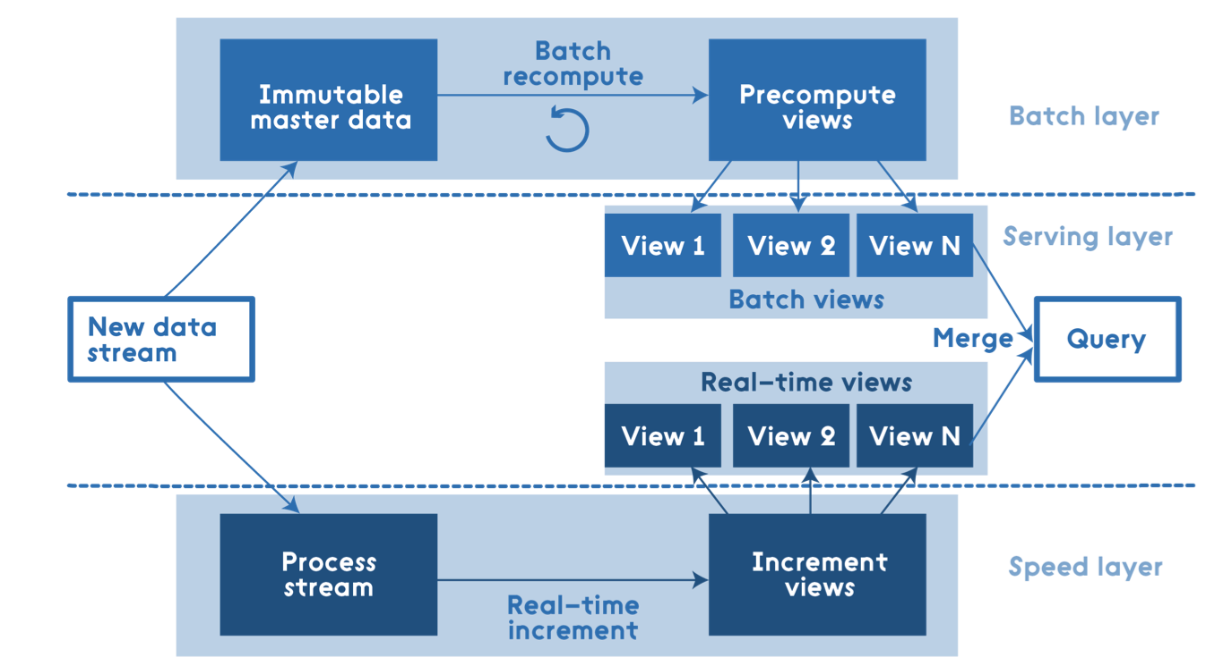
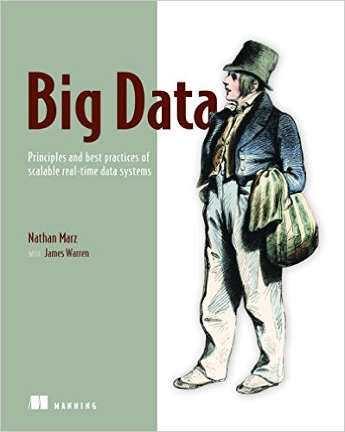
Lambda Architecture
http://nathanmarz.com/blog/how-to-beat-the-cap-theorem.html
http://radar.oreilly.com/2014/07/questioning-the-lambda-architecture.html

Slide 20
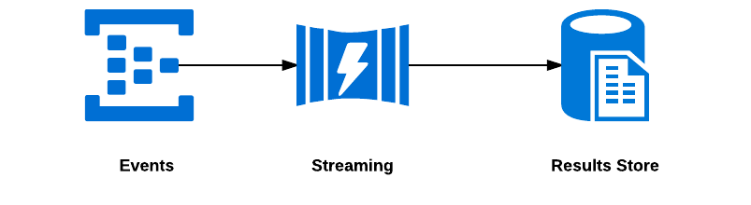
Streaming

Slide 21
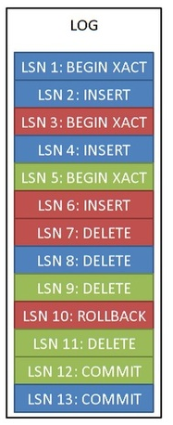
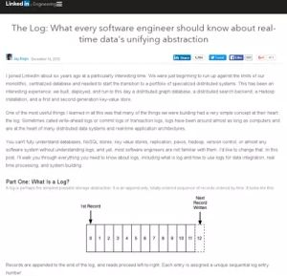
Events
The Log: What every software engineer should know about real-time data's unifying abstraction
https://goo.gl/j6mqP6

Slide 22
Events
Image source: https://dzone.com/articles/how-use-sql-server-transaction

Slide 23
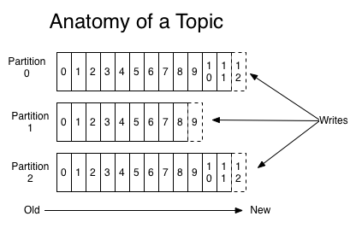
Events
Image source: https://kafka.apache.org/documentation/

Slide 24

Stream Processing

Slide 25
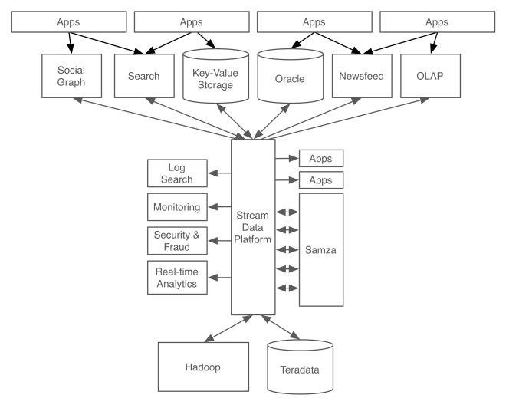
Catastrophic Failure
Tool Specific Complexity
Hybrid Applications
Industry Specific Competition
Event Driven Architecture
Lossy
Polyglot Persistence
Event Driven Architecture
Distributed Microservices
Reprocessing
Statefull Algorithms
Machine Learning
Time-Based Inaccuracies
Scale
Fault Tolerance
Processing inefficiencies
https://www.confluent.io/blog/stream-data-platform-1/

Slide 26



Volt DB
Apache Kafka (Confluent)
Amazon Kinesis
Google Cloud Pub/Sub
Microsoft Event Hub
Spark Streaming, Flink, Beam, Storm, Samza, +1M Hadoop ecosystem projects
Amazon Kinesis Analytics
Google Dataflow
Microsoft Stream Analytics
Azure Data Warehouse
Teradata
SQL Server
Amazon Redshift
Etc. etc. etc. etc.

Slide 27
Advanced Topics in Steaming
Distributed Systems
CAP / PACELC
Correctness Semantics
Exactly-once, at-least once, at-most once
Serial / Parallel algorithms
Reasoning About Time
Windowing
Event Time / Processing Time
Persistency Layer

Slide 28
https://www.oreilly.com/ideas/the-world-beyond-batch-streaming-101

