Slide 1
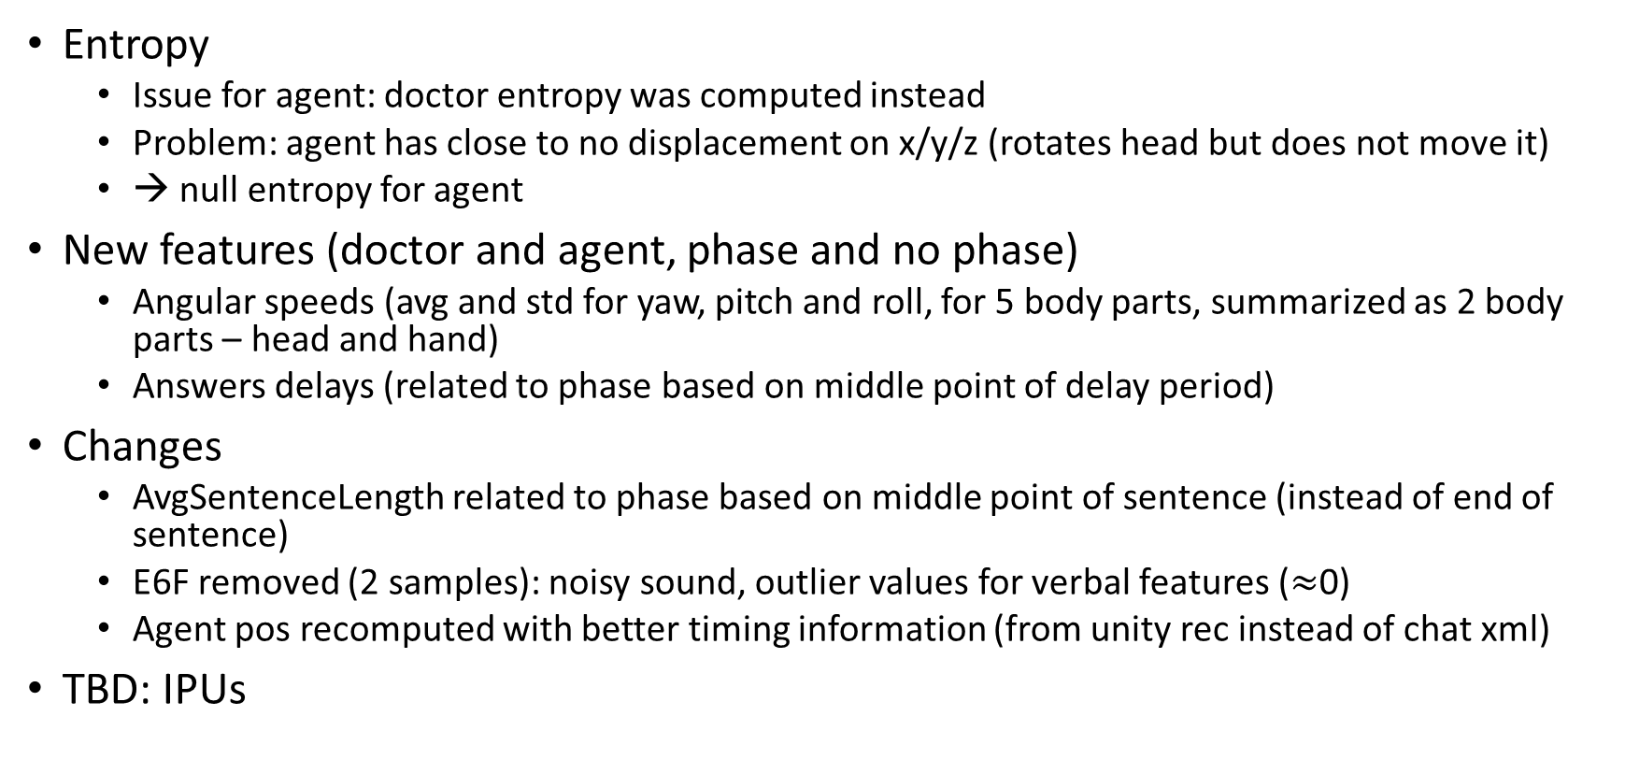
Data
Entropy
Issue for agent: doctor entropy was computed instead
Problem: agent has close to no displacement on x/y/z (rotates head but does not move it)
→ null entropy for agent
New features (doctor and agent, phase and no phase)
Angular speeds (avg and std for yaw, pitch and roll, for 5 body parts, summarized as 2 body parts – head and hand)
Answers delays (related to phase based on middle point of delay period)
Changes
AvgSentenceLength related to phase based on middle point of sentence (instead of end of sentence)
E6F removed (2 samples): noisy sound, outlier values for verbal features ($≈$0)
Agent pos recomputed with better timing information (from unity rec instead of chat xml)
TBD: IPUs

Slide 2
Method
Improvements
Use of test set (10%) for prediction scores
100 randomly stratified test/train splits (mean and standard error on scores)
Gridsearch performed for each test/train split instead of only for 1st
Avoid to ‘hide’ under/over-fitting, better evaluation of classifier
Much slower
Evaluated best discretization method for (co)presence (see next)
“Random” score: keep random strategy leading to best f1 score for comparison (uniform, stratified, most frequent)
Code review/fixes
Gridsearch was performed only on presence prediction task

Slide 3
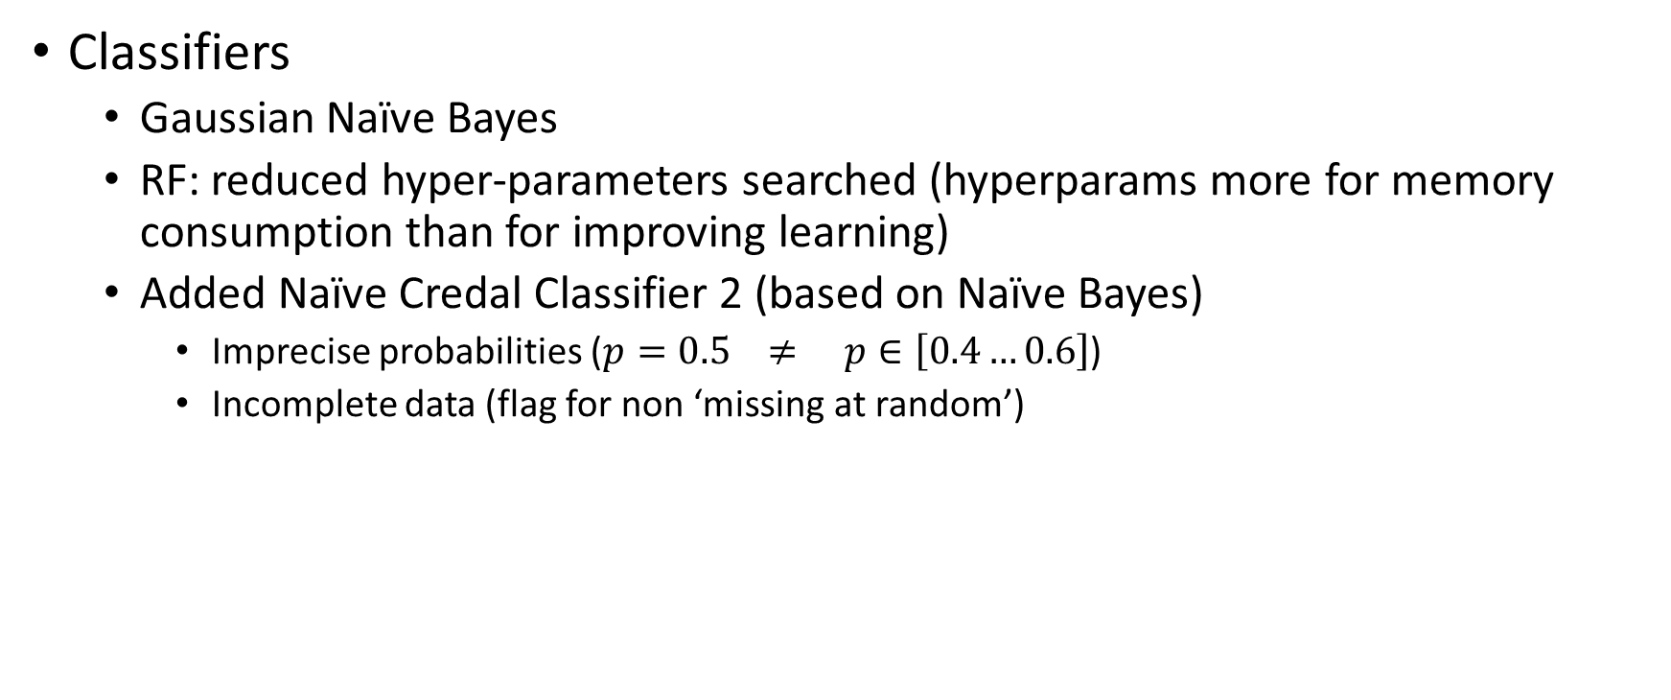
Method
Classifiers
Gaussian Naïve Bayes
RF: reduced hyper-parameters searched (hyperparams more for memory consumption than for improving learning)
Added Naïve Credal Classifier 2 (based on Naïve Bayes)
Imprecise probabilities ($p=0.5 ≠ p∈\left[0.4…0.6\right]$)
Incomplete data (flag for non ‘missing at random’)

Slide 4
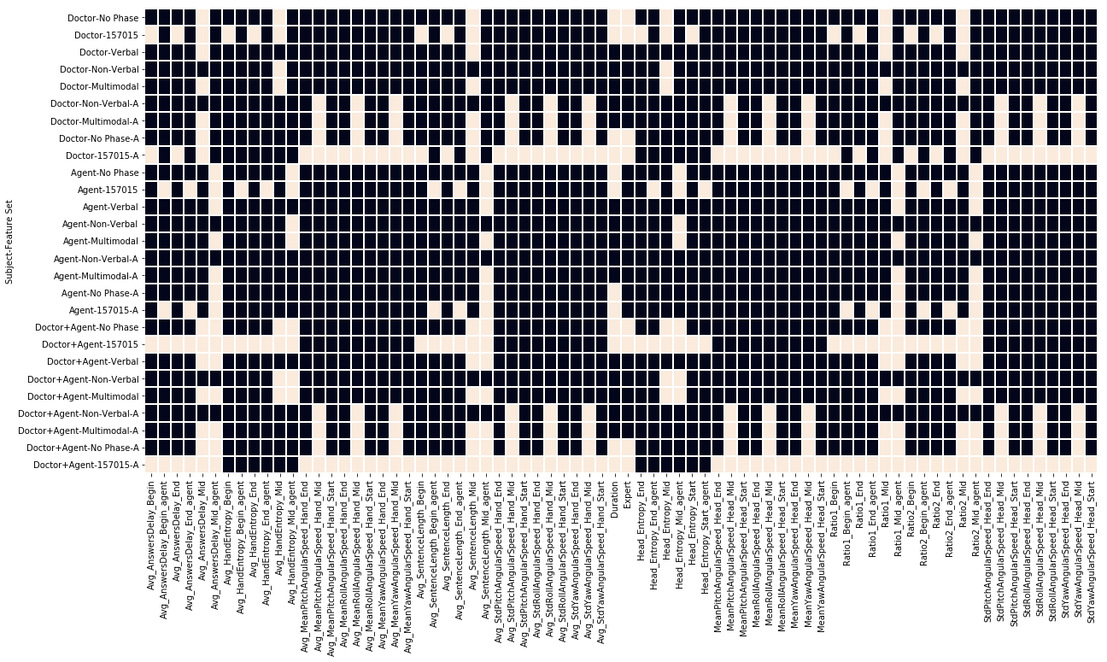
Features

Slide 5
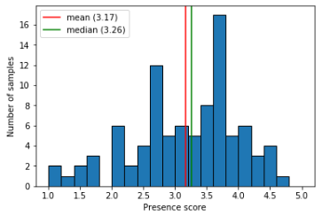
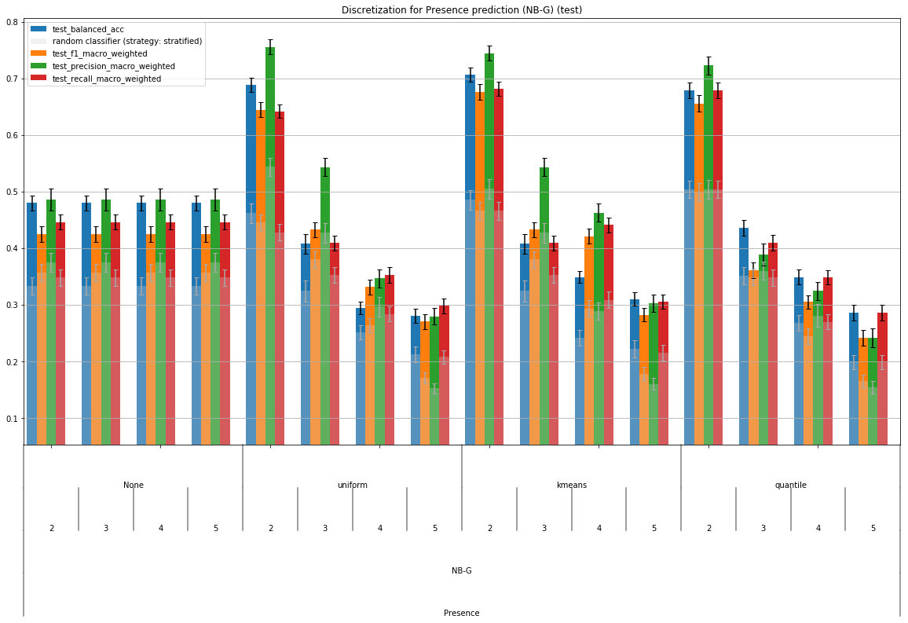
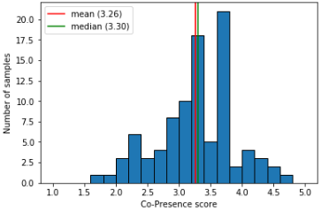
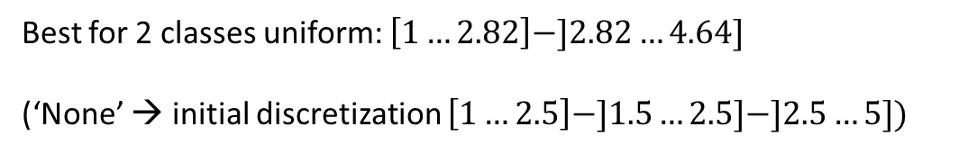
Discretization (classification task)
Best for 2 classes uniform: $\left[1…2.82\right]−]2.82…4.64]$
(‘None’ → initial discretization $\left[1…2.5\right]−]1.5…2.5]−]2.5…5])$

Slide 6
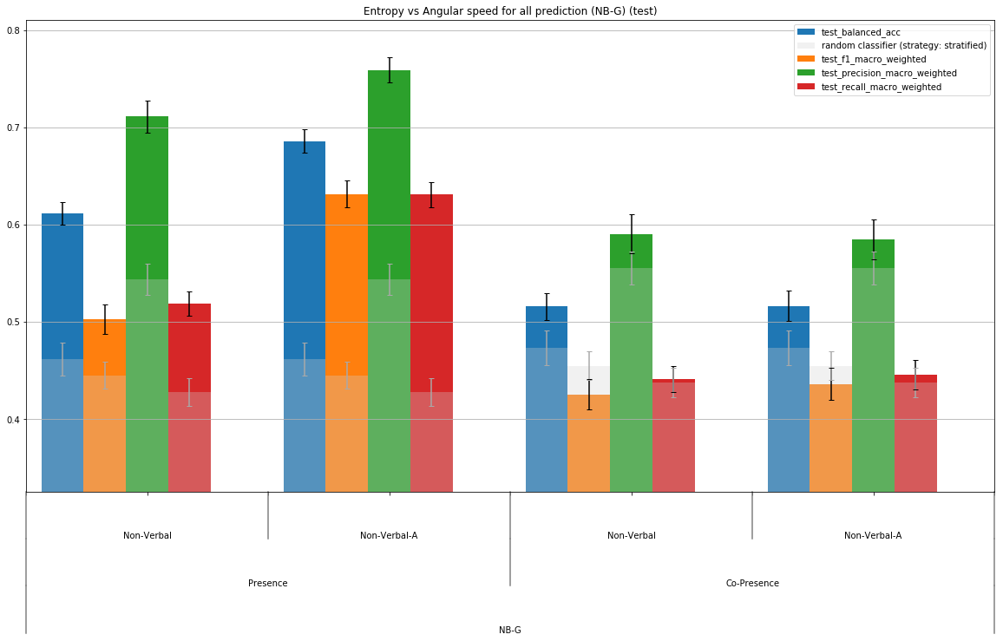
Entropy versus Angular speed
(only doctor – no entropy data for agent)

Slide 7
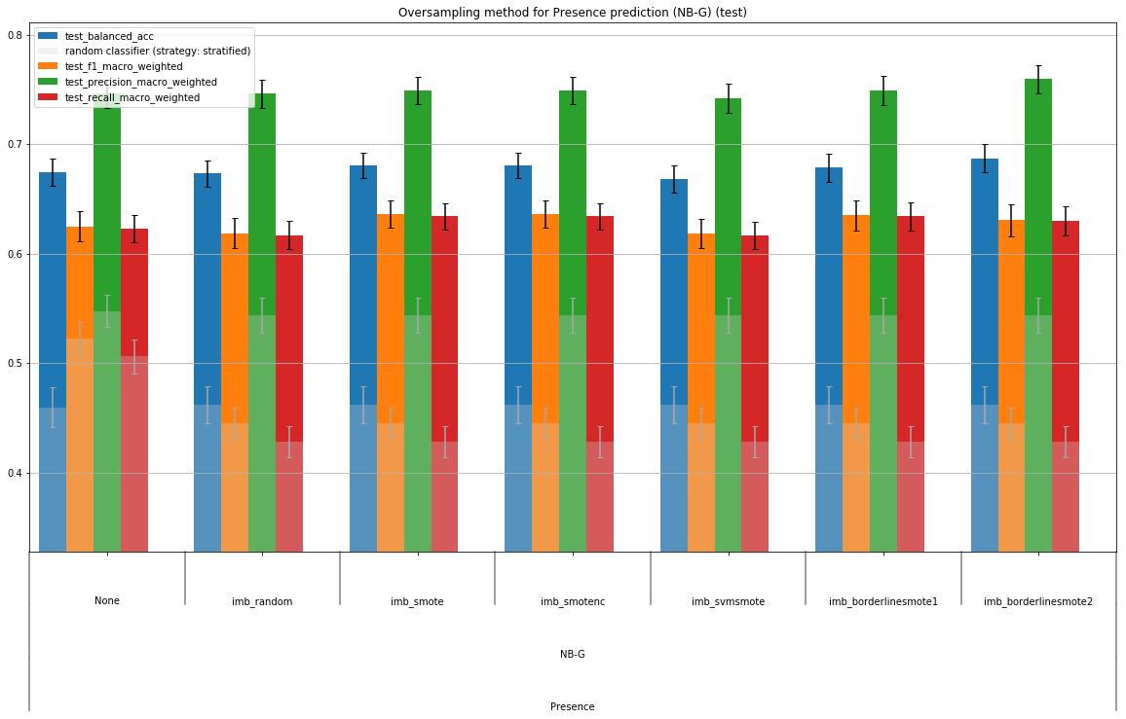
Oversampling methods
Little to no effect… as long as scores take imbalance into account (weighted)
Prediction of presence, doctor+agent, multimodal (angular speeds not entropy)

Slide 8
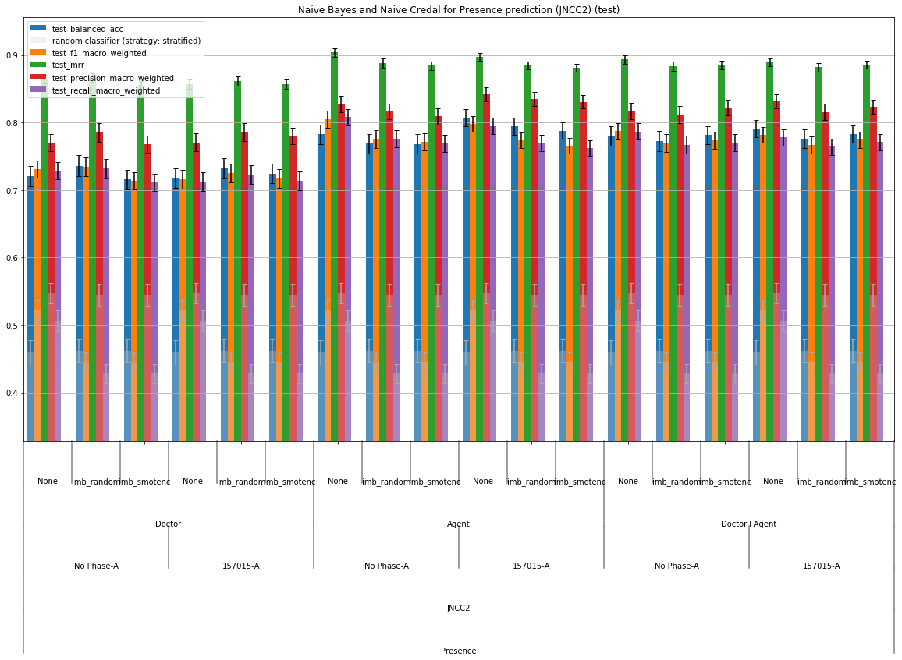
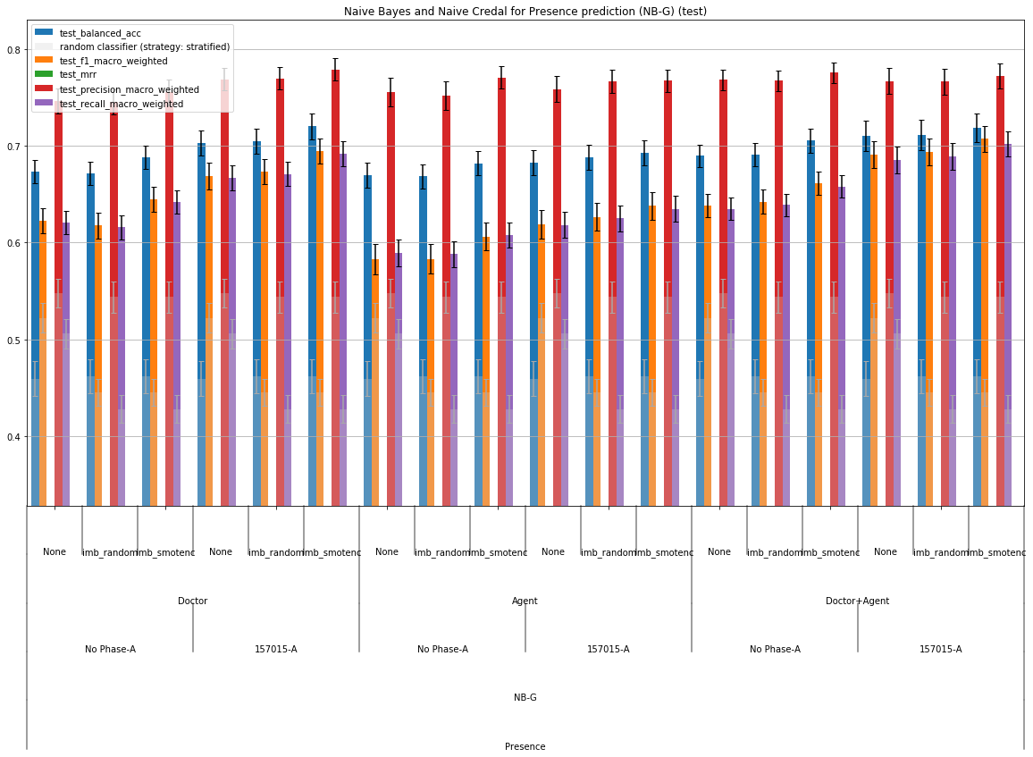
Naïve Credal Classifier

Slide 9
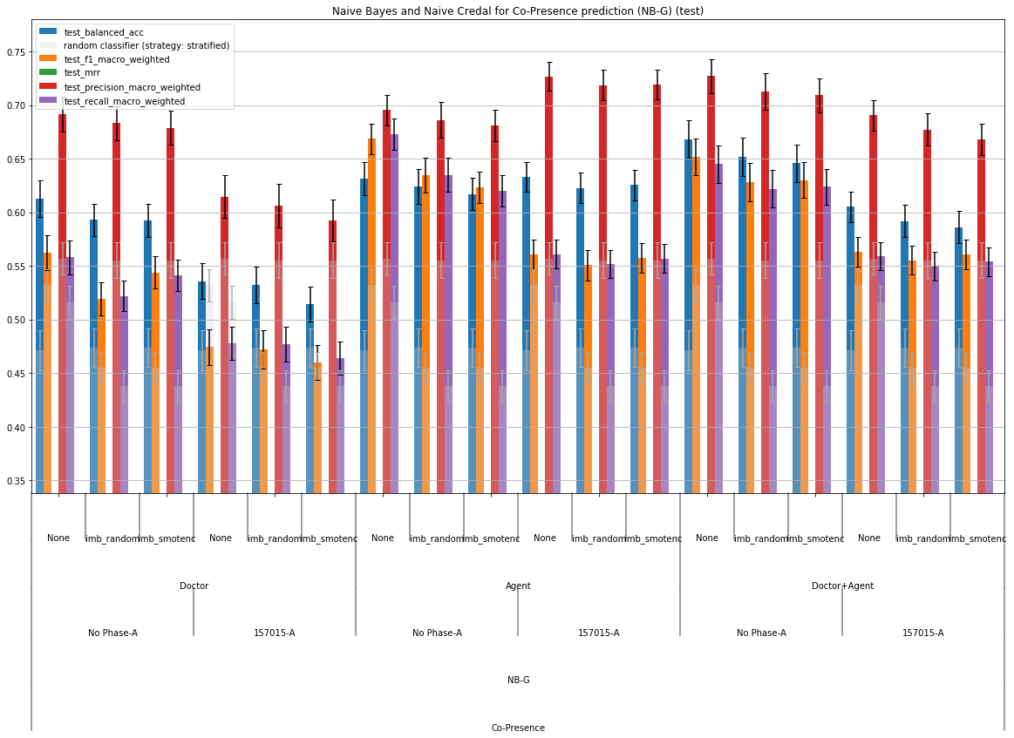
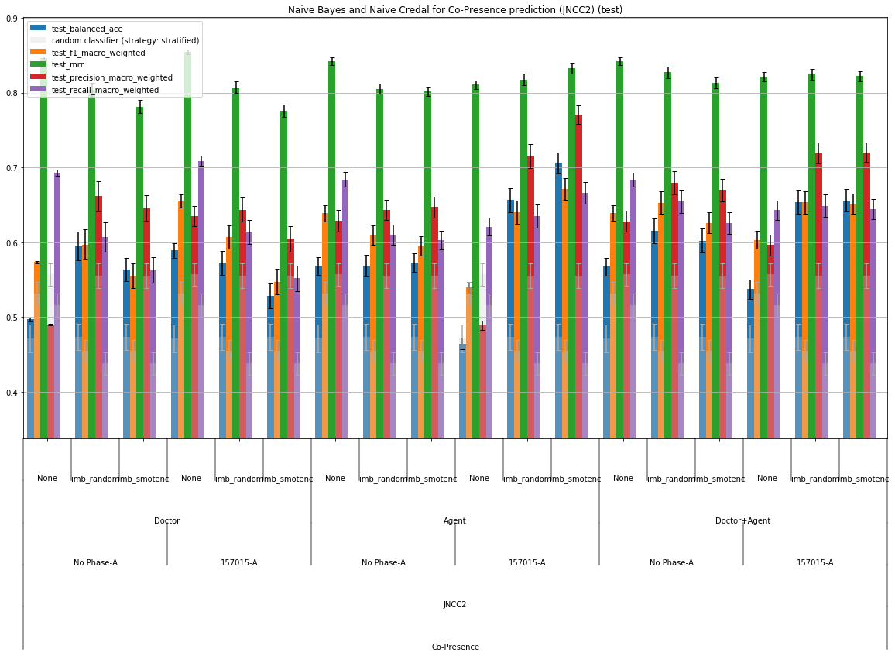

Slide 10
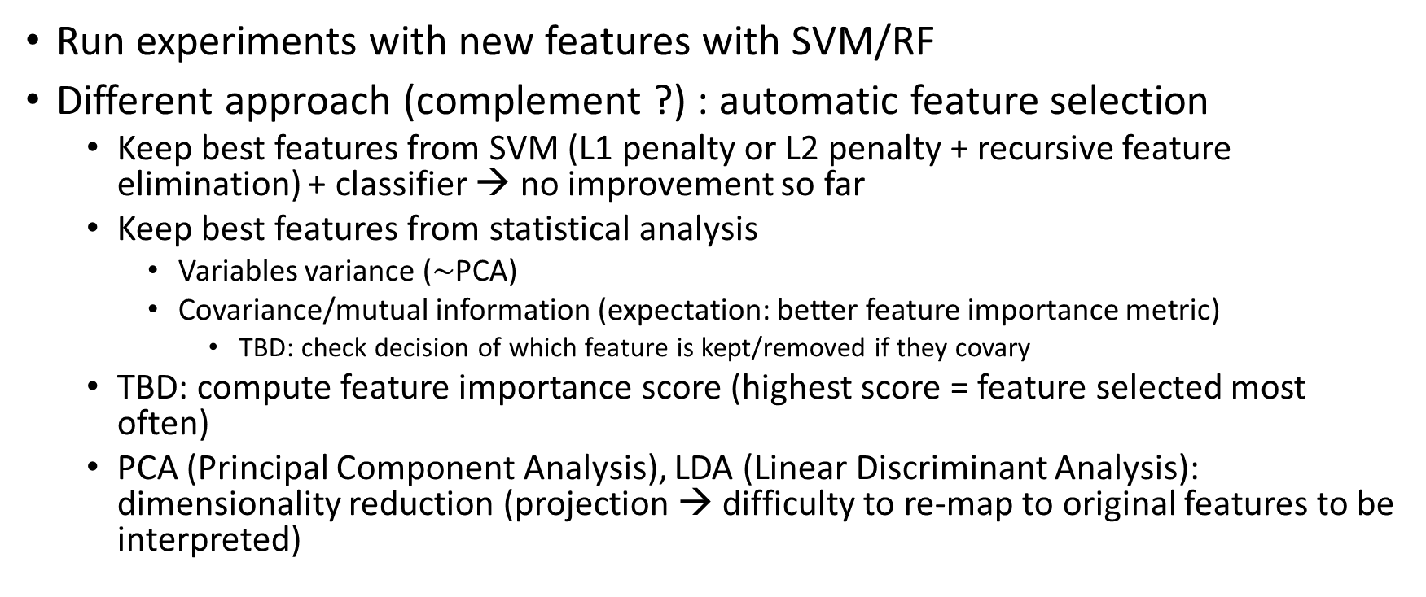
Next
Run experiments with new features with SVM/RF
Different approach (complement ?) : automatic feature selection
Keep best features from SVM (L1 penalty or L2 penalty + recursive feature elimination) + classifier → no improvement so far
Keep best features from statistical analysis
Variables variance ($\sim$PCA)
Covariance/mutual information (expectation: better feature importance metric)
TBD: check decision of which feature is kept/removed if they covary
TBD: compute feature importance score (highest score = feature selected most often)
PCA (Principal Component Analysis), LDA (Linear Discriminant Analysis): dimensionality reduction (projection → difficulty to re-map to original features to be interpreted)

Slide 11
June 2019

Slide 12
Features
Yaw/Pitch/Roll features are now averaged
List of available features (doctor/no phase)
'Duration’,
'Expert’,
'Avg_AnswersDelay_Mid’,
'Avg_HandEntropy_Mid’,
'Avg_IPUlen_Mid’,
'Avg_MeanMeanAngularSpeed_Hand_Mid’, (mean of rotation speed over time, then mean over 4 body parts, then averaged over yaw/pitch/roll)
'Avg_SentenceLength_Mid’,
'Avg_StdMeanAngularSpeed_Hand_Mid’,
'Head_Entropy_Mid’,
'MeanMeanAngularSpeed_Head_Mid’,
'Ratio1_Mid’,
'Ratio2_Mid’,
'StdMeanAngularSpeed_Head_Mid’
X3 phases (start/mid/end), x2 agent (except entropy)

Slide 13
Improvements on methodology:
Gridsearch was optimizing f1_macro score instead of f1_macro_weighted
“weighted” scores are weighted means, weights taking into account class imbalance
Test loop was convoluted, redundant, not always statistically pertinent
Initially: gridsearch (only if hyperparams to search), then cross-validation, then test, repeated across 100 shuffled stratified splits, returning valid and test scores
Replaced by gridsearch (always, used as kfolds-cv if only 1 combination of hyperparams), then test, repeated across 10x10-folds CV stratified splits, returning train, valid and test scores – 2 cross-validations, imbricated
Advantages:
Train vs valid vs test scores gives evidences of over/under-fitting not only during training but also during model selection
Kfold splits instead of Shuffled splits guarantee that each sample participated iid to train/test sets (not the case with shuffled where samples could never participate, or participate more than others)
Error bars: instead of standard deviation/sqrt(N) (standard error of the mean), what is computed is confidence interval based on global variance (based on stds of gridsearch 10-folds CV)

Slide 14
All Data
Split 1
Training Data
Test Data
Outer: RepeatedStratifiedKFold
Inner: StratifiedKFold
Fold 1
Fold 2
Fold 3
Fold 4
Fold 5
Fold 6
Fold 7
Fold 8
Fold 9
Fold 10
Split 1
Fold 1
Fold 2
Fold 3
Fold 4
Fold 5
Fold 6
Fold 7
Fold 8
Fold 9
Fold 10
Split 2
Fold 1
Fold 2
Fold 3
Fold 4
Fold 5
Fold 6
Fold 7
Fold 8
Fold 9
Fold 10
Model selection
(hyper-parameters search)
Split 10
Fold 1
Fold 2
Fold 3
Fold 4
Fold 5
Fold 6
Fold 7
Fold 8
Fold 9
Fold 10
Training Data
Validation Data
Test Data
Model evaluation
Split 2
Test Data
Training Data
StratifiedKFold, parameters search, evaluation
Split 100
Test Data
Training Data
StratifiedKFold, parameters search, evaluation
Evaluate model uncertainty

Slide 15
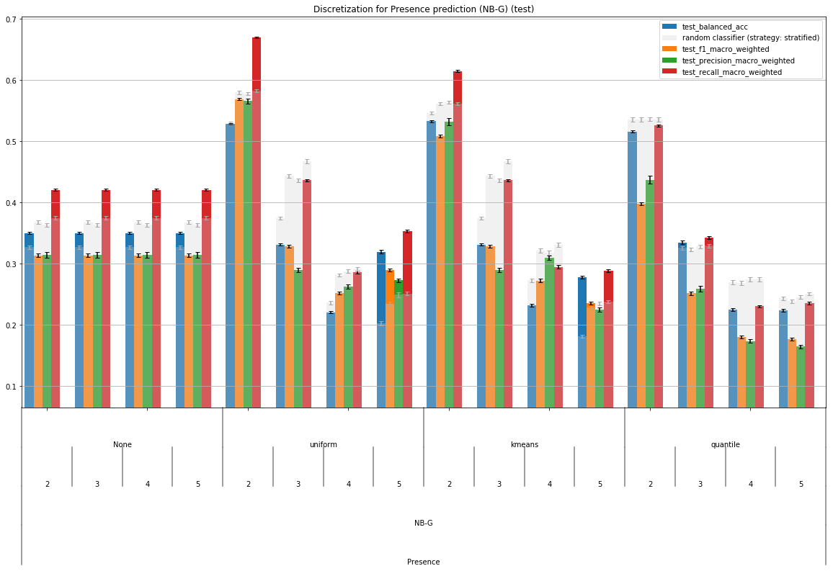
Class discretization

Slide 16
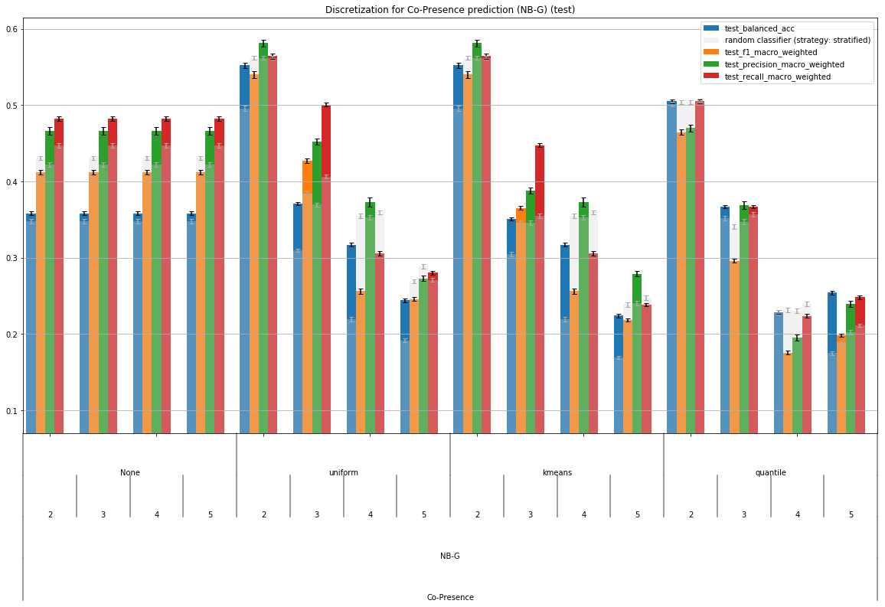
Class discretization

Slide 17
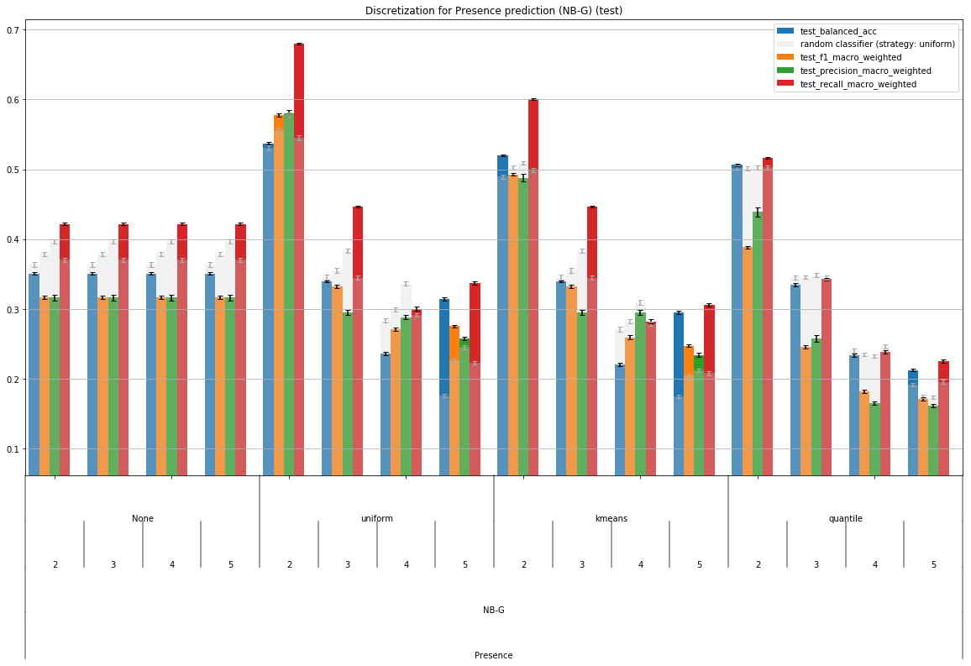
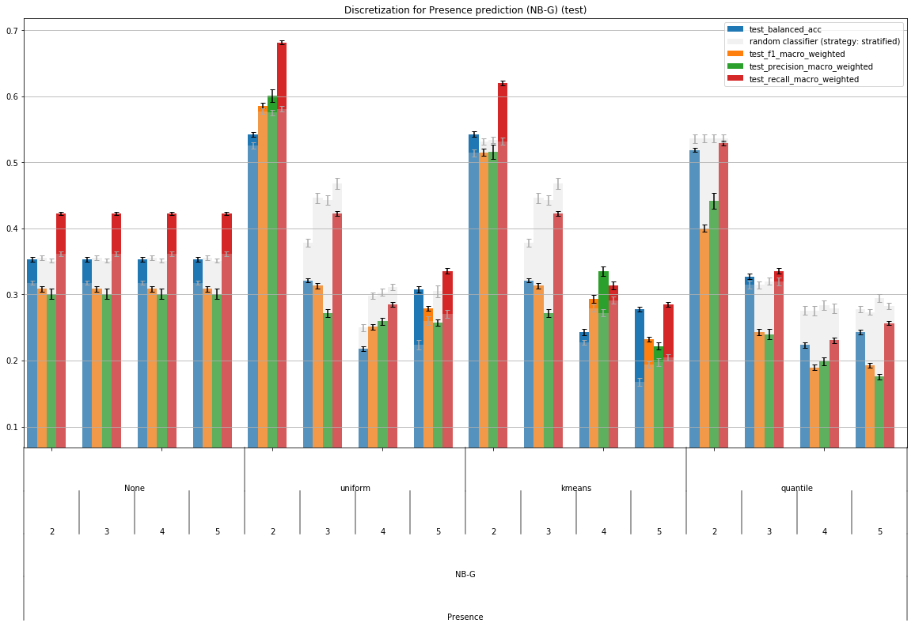
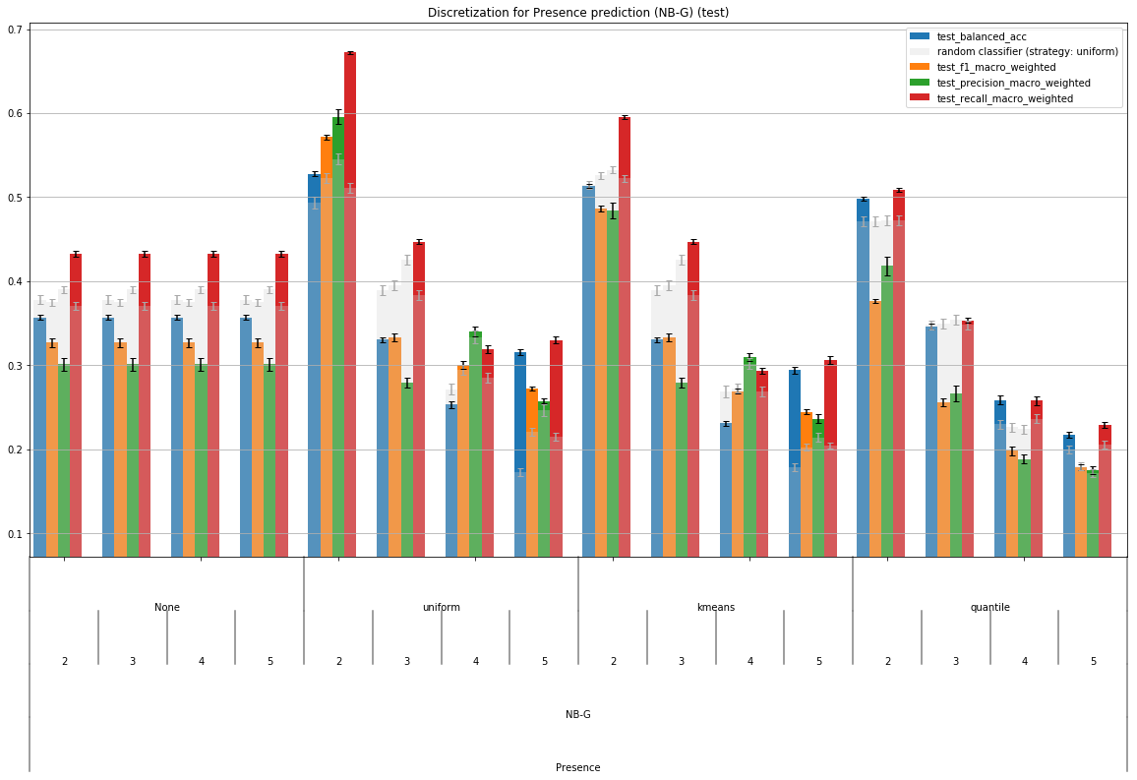
Stability of results
10x5-folds
3x5-folds
random seed 42
random seed 43

Slide 18
Stability of results
Rnd classifier strategy changing for same experiment …
“Best” random strategy is selected per classifier and task (presence/co-presence), based on best mean f1_score across results
Introduces some bias (see rnd 42 vs 43) as selected random strategy may be different and lead to very different baselines
To avoid this: keep best random strategy at each test split (same granularity as gridsearch for other classifiers)
Even more pessimistic baseline

Slide 19
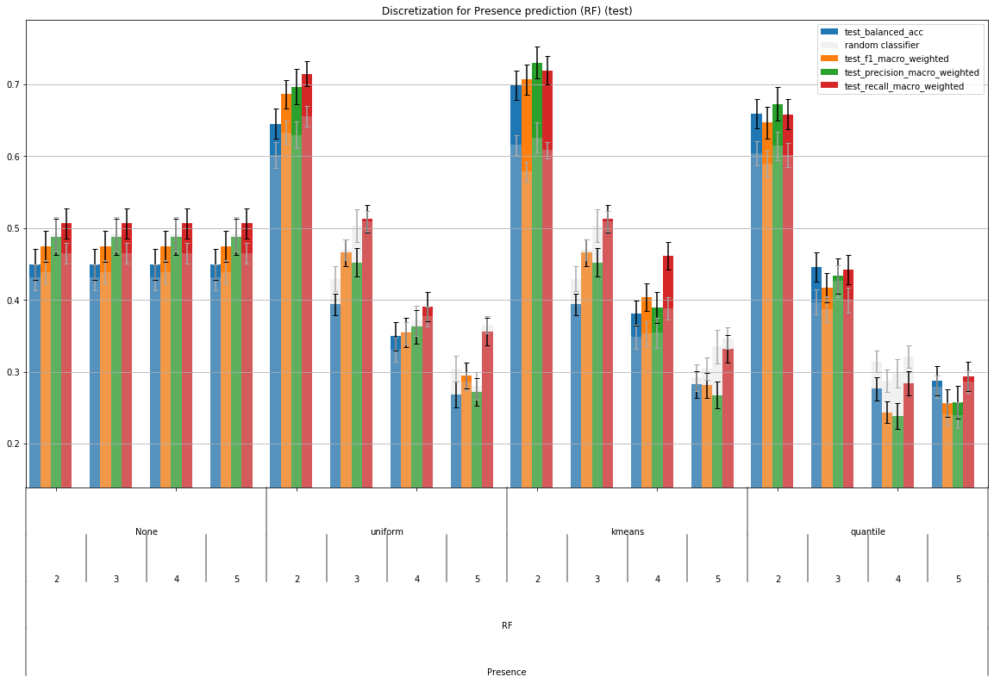
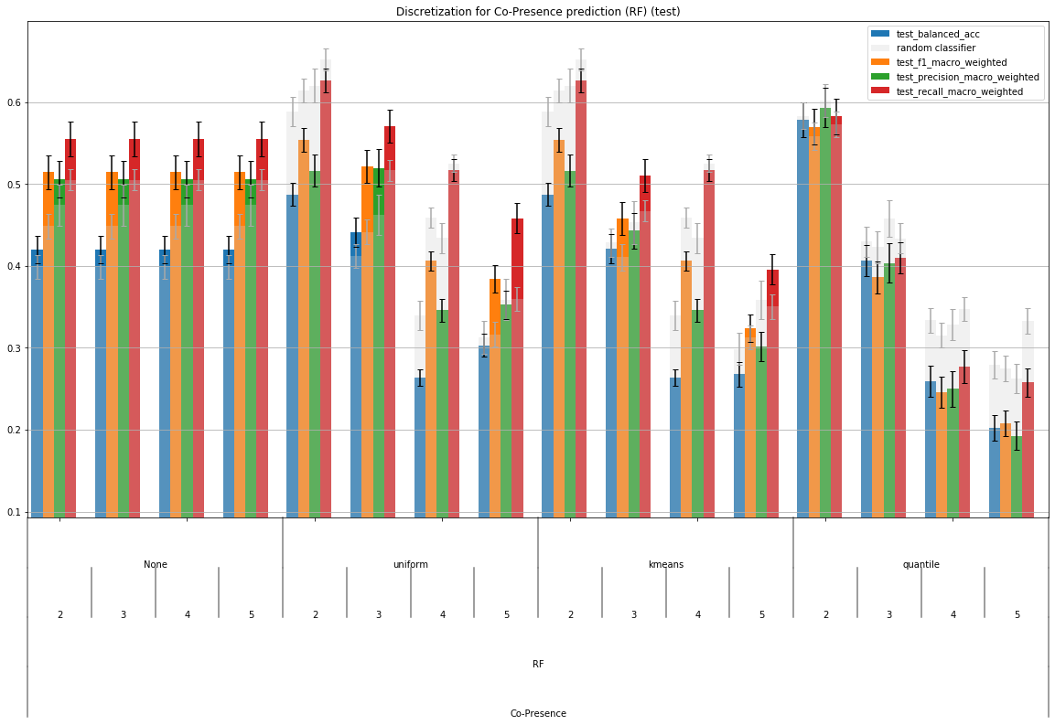
Class discretization (new rnd selection strategy)
RF best for presence prediction with 2 classes (kmeans discretization)
Notes:
Refaire ces exps mais avec doctor+agent au lieu de doctor tout seul

Slide 20
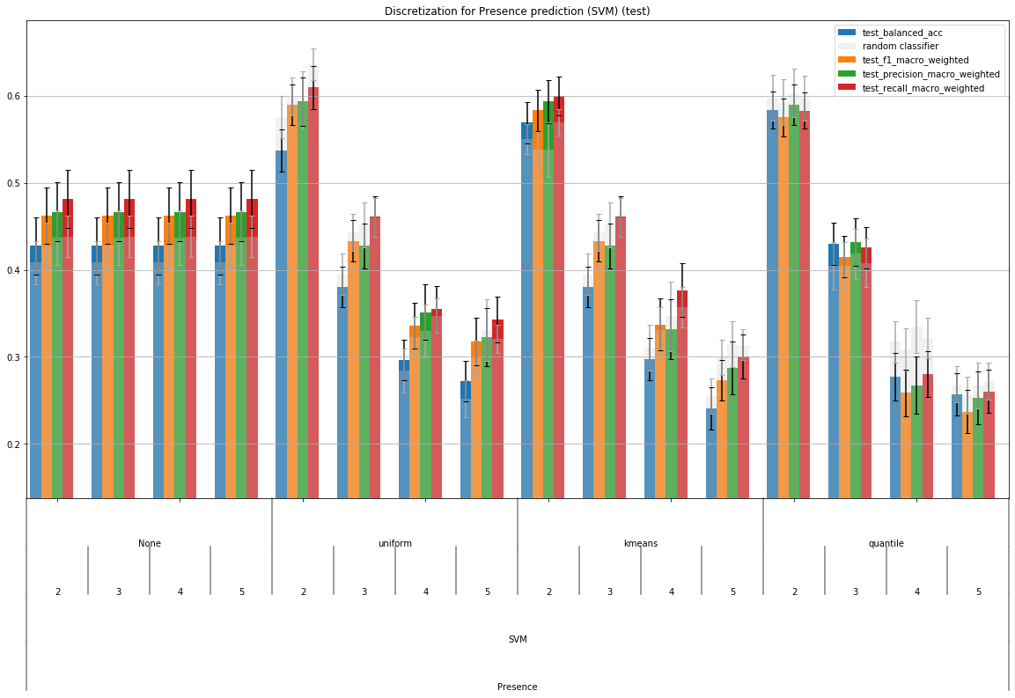
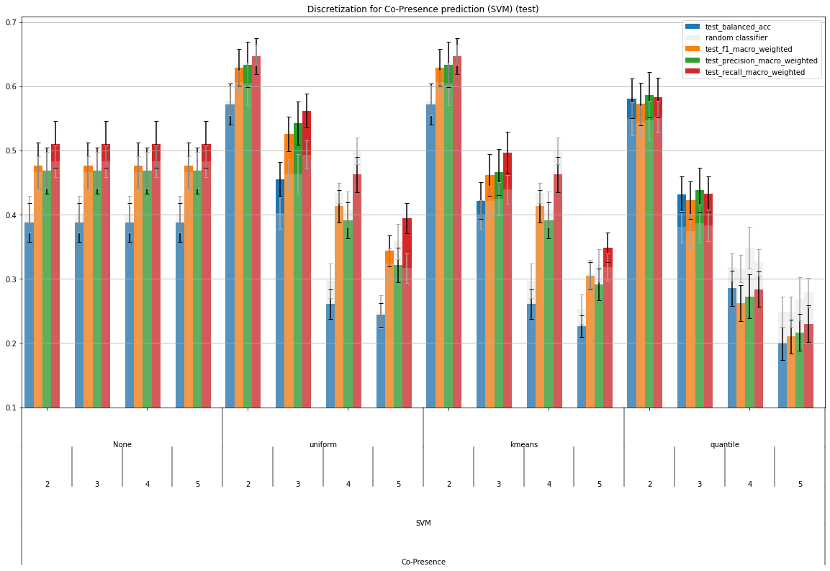
Class discretization (new rnd selection strategy)
SVM best for co-presence prediction with 3 classes (uniform strategy)
Notes:
Doctor+agent

Slide 21
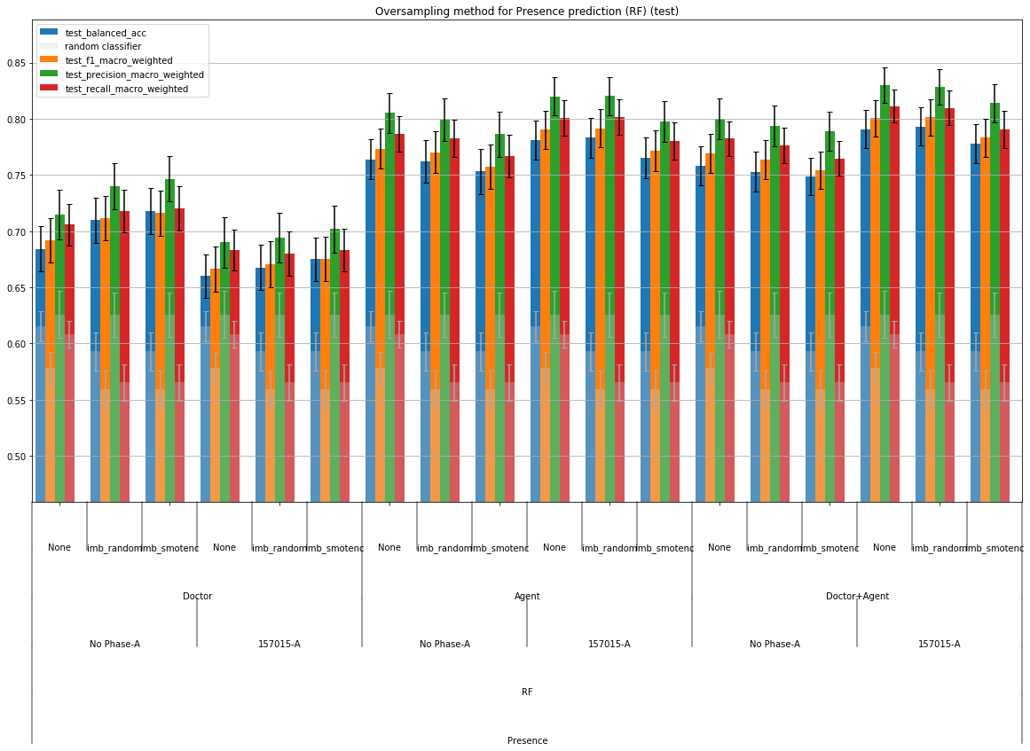
Comparison of upsampling strategies
Presence - RF with 2 classes / kmeans strategy
Impact of oversampling limited to non existant
Impact of phases not obvious (not useful for doctor-only features)
Agent and Doctor+agent better than doctor-only
Notes:
Suivant résultat des exps précédentes avec doctor+agent

Slide 22
Comparison of upsampling strategies
Co-Presence – SVM with 3 classes / uniform strategy
(in progress)

Slide 23
Ideas for feature selection
Main idea: instead of manually selecting features or groups of features and comparing results, why not selecting features automatically ?
Many techniques, supervised or not
Some classifiers provide features importances/weights: they can be used as a first step for feature selection – then a final classifier does the prediction on a subset of features
SVM with L1/L2 regularization
Random Forests
Lasso (for regression)
Other techniques based on statistics
PCA (non supervised) / LDA (supervised) : more complex because variables are changed (new features are combinations of original features, more than feature selection)
Mutual info, correlations between variables
Combinations of different techniques
Create clusters of features (kmeans) to automatically detect features groups
In each group, reject most correlated features (one vs one, or one vs all ?)
(AND/OR ?)
In each group, keep features most correlated with dependant variable (y)
Note: use continuous y for correlations analysis – but binary classification for final predictions ?
How to infer features importances ?
Idea: +1 for a feature when it is selected
… or +f1_score ? (to weight each feature importance with the score it allowed to obtain ?)
… or +f1_score * (final classifier feature importance/weight), if final classifier also provides this information ?
“Problem”: for some classifiers (SVM) weights are not constrained in a specific range – they might not be comparable – use 1/rank instead of weights directly ?

Slide 24
July 10th

Slide 25
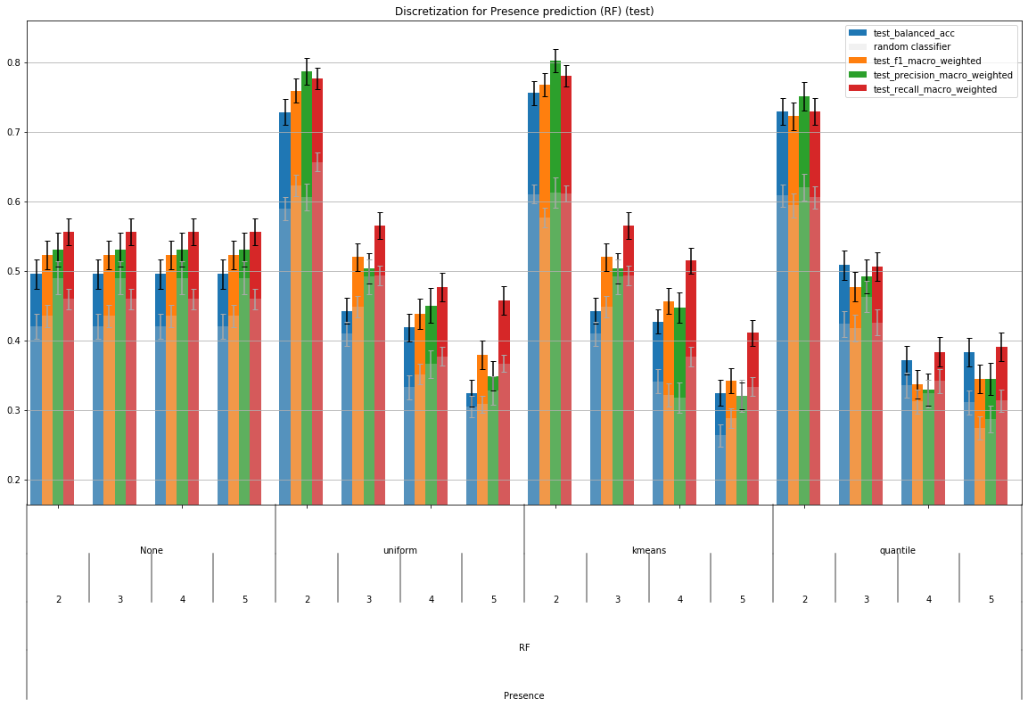
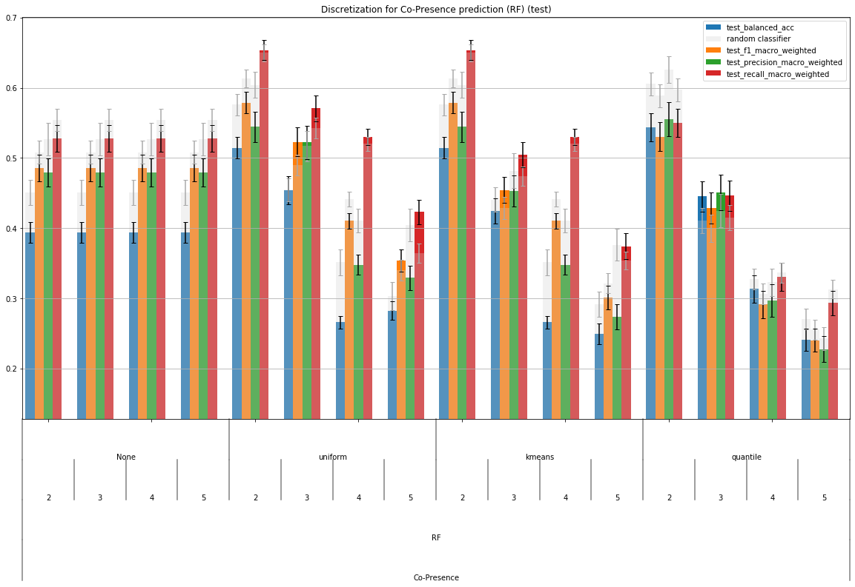
Class discretization – Random Forests
Previous experiment based on doctor/no phase features → run again with doc+agent/no phase

Slide 26
Class discretization – Random Forests
Still not better than random classifier baseline for co-presence prediction
equivalent performance for presence for binary classification (kmeans or uniform)
2 / kmeans: pivot 3.04
2 / uniform: pivot 2.82
Presence score info: min 1.0, max 4.64, mean 3.17, median 3.23
For equivalent performance, 2/kmeans closer to mean and median of presence score

Slide 27
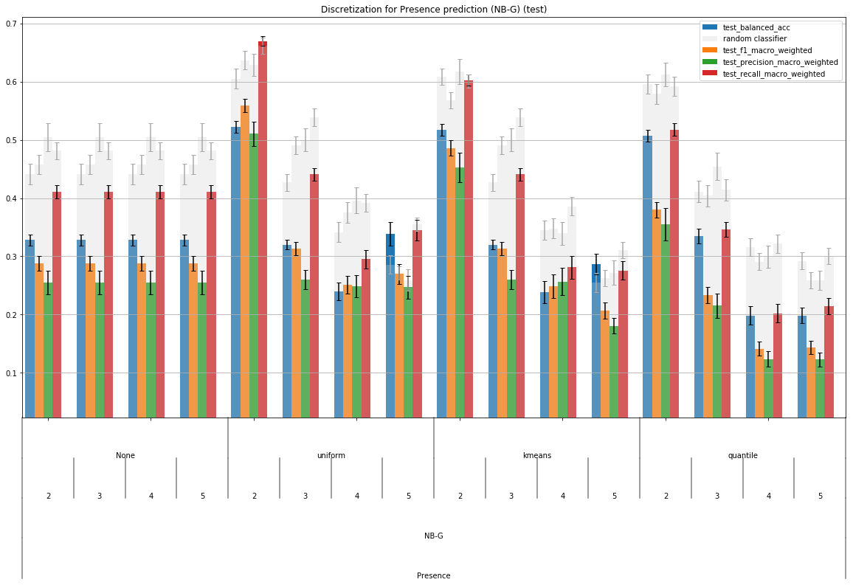
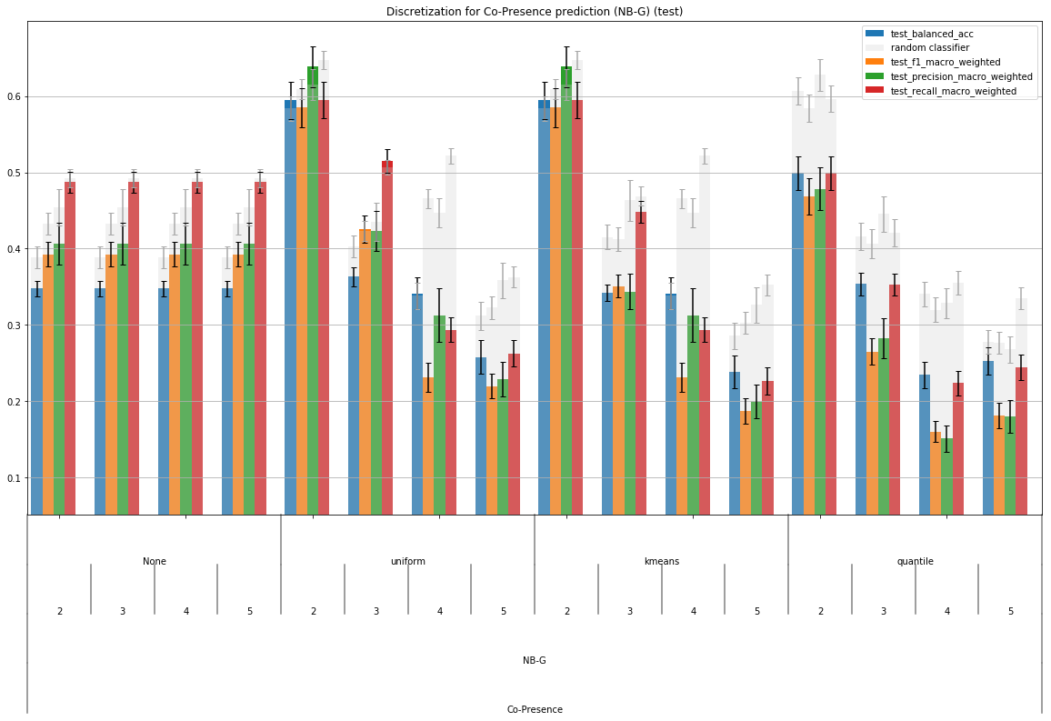
Class discretization – Naïve Bayes
fails to improve over random classifier at all.
(random classifier still a better baseline)

Slide 28
Class discretization – Naïve Credal
Naïve Credal

Slide 29
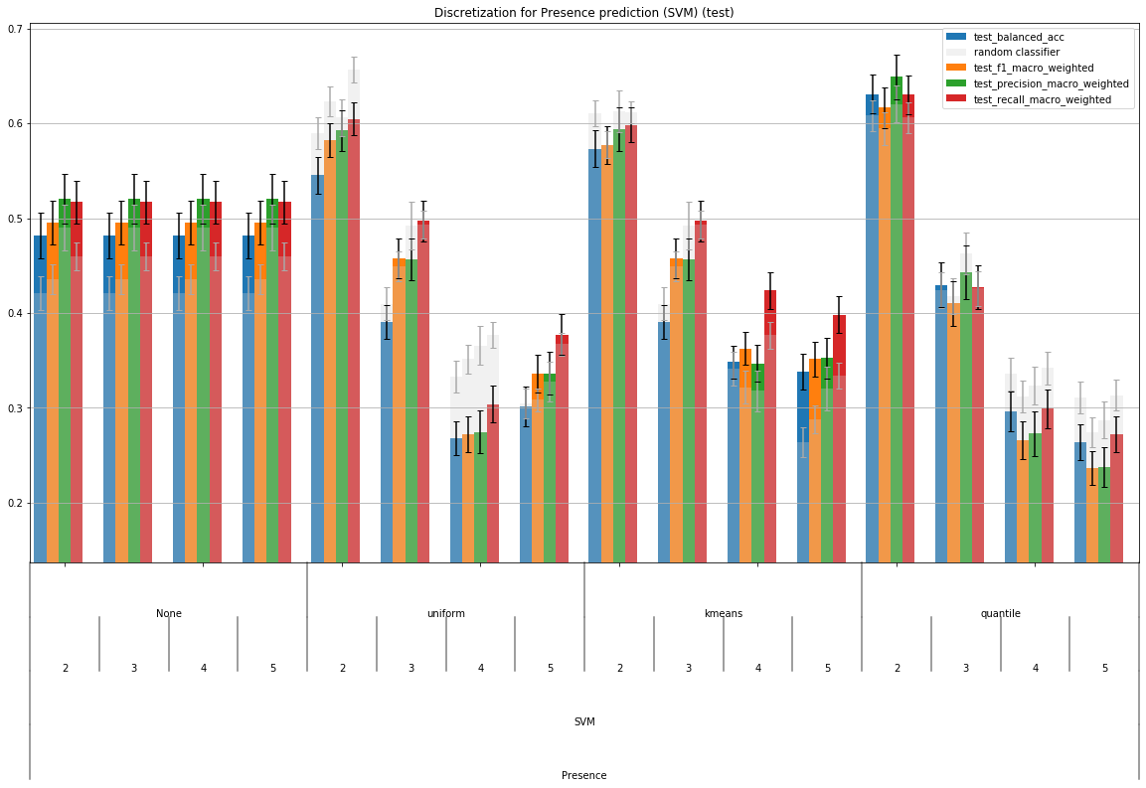
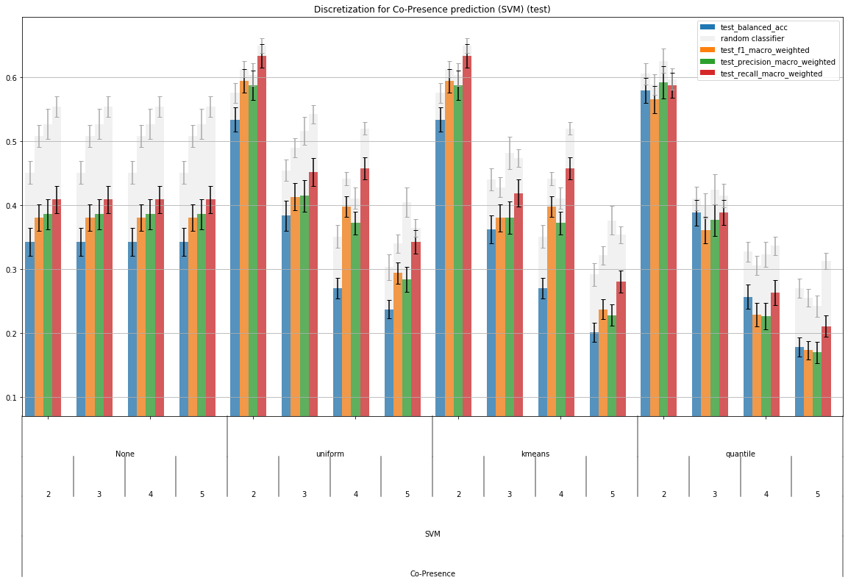
Class discretization - SVM
Not as good as Random Forest, also bad at co-presence prediction.

Slide 30
Random Forests – work on overfitting
Initially, nb trees = 300 and default values for all hyper-parameters (except criterion=[gini, entropy])
But after some research, some other parameters do not only impact memory consumption, but also complexity of learned model
So they could be useful to avoid overfitting !
Tried the following:
max_features = sqrt(n_features) (instead of n_features)
Impacts complexity of each tree in terms of n_features
min_samples_leaf > 1 (instead of 1)
To make a leaf it must have at least min_samples_leaf samples, with 1 trees are fully developed

Slide 31
Random Forests - Results
New hyper-parameters searched (m_f=sqrt, m_s_l=5)
<graph to be added>
No improvement

Slide 32
Idea: difficulty to predict co-presence, maybe perform multi-label classification (predict both presence and co-presence) ?

