Slide 1
GED Python Workgroup
Week 2
2/27/2020

Slide 2
Codacademy assignment
Lesson 1 - Syntax (10-20 min)
Variables
Data types
Whitespace
Comments
Math
Lesson 2 – Strings (15-30 min)
Strings
Escape characters
Index
String methods (dot notation)
Coercing variables
Datetime

Slide 3
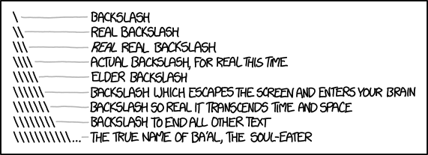
Escape Characters
Problem:
In python the backslash “\” is a special character known as an escape character
It represents certain whitespace characters within a string variable: “\n” -> newline
“\t” -> tab
Solutions:
Prefixing a backslash with a backslash e.g. “\\” turns it into a normal character
If referencing a directory/path name, e.g.:
path = “L:\Public\jbousqui\someFile.txt”
“L:\\Public\\jbousqui\\someFile.txt”
r“L:\Public\jbousqui\someFile.txt”
“L:/Public/jbousqui/someFile.txt”
Complication:
These won’t work across all operating systems (Unix uses forward slashes, and although Windows uses mainly backslashes it will usually accept either)
The ‘one obvious way to do it:
Use the os module

Slide 4
Codacademy assignment for next week
Lesson 3 - Conditionals: (Jumps into functions :/)
Comparisons (<, >, <=, !=, ==)
And/or/not
If statements
Lesson 4 - Functions
Functions
Imports (Functions in modules)
Lesson 5 – Lists
Lists
Lists indexing
Loops over lists
Dictionaries

