Slide 1
Predicting Comment Volume for News Articles
Metis
Natural Language Processing and Unsupervised Learning
Jonathon Bowyer
Notes:
Initially tried doing a count of each word (CountVectorizer) and passing that into naïve bayes
Sparsity of it makes it difficult to work with, over 4,000 words, so I tried ways of reducing dimensionality
Using principle component analysis, LSA, was able to find topic vectors I could pass into more complex classification algorithms
Reduce it to dimensions along which they are most different
Can do as many dimensions as you’d like, I manually gridsearched and landed on 15

Slide 2
Introduction and Domain
NYT News Articles
Classify articles as high-comment or low-comment
Better engagement
Increase repeat customers
Determine high-comment topics
Placement of articles
Number of articles per topic

Slide 3
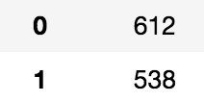
Data
2 Kaggle datasets: 1) NYT Articles & 2) Comments on articles
~1,200 Articles from April 2018
Utilized keywords from datasets
Target: article received above 100 comments
(0 = below, 1 = above)
Fairly balanced dataset:
Notes:
Examples of over and under

Slide 4
Data Cont.

Slide 5
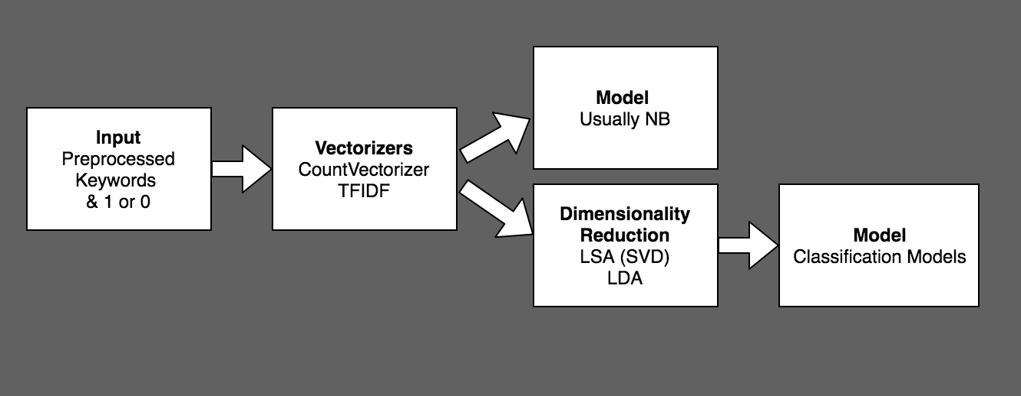
NLP Modeling
Notes:
86% on train then 70% on test
Initially tried doing a count of each word (CountVectorizer) and passing that into naïve bayes
Sparsity of it makes it difficult to work with, over 4,000 words, so I tried ways of reducing dimensionality
Using principle component analysis, LSA, was able to find topic vectors I could pass into more complex classification algorithms
Reduce it to dimensions along which they are most different
Can do as many dimensions as you’d like, I manually gridsearched and landed on 15

Slide 6
NLP Modeling
Curse of dimensionality: overfitting
Train: 89% accuracy
Test: 69% accuracy
Notes:
86% on train then 70% on test
Initially tried doing a count of each word (CountVectorizer) and passing that into naïve bayes
Sparsity of it makes it difficult to work with, over 4,000 words, so I tried ways of reducing dimensionality
Using principle component analysis, LSA, was able to find topic vectors I could pass into more complex classification algorithms
Reduce it to dimensions along which they are most different
Can do as many dimensions as you’d like, I manually gridsearched and landed on 15

Slide 8
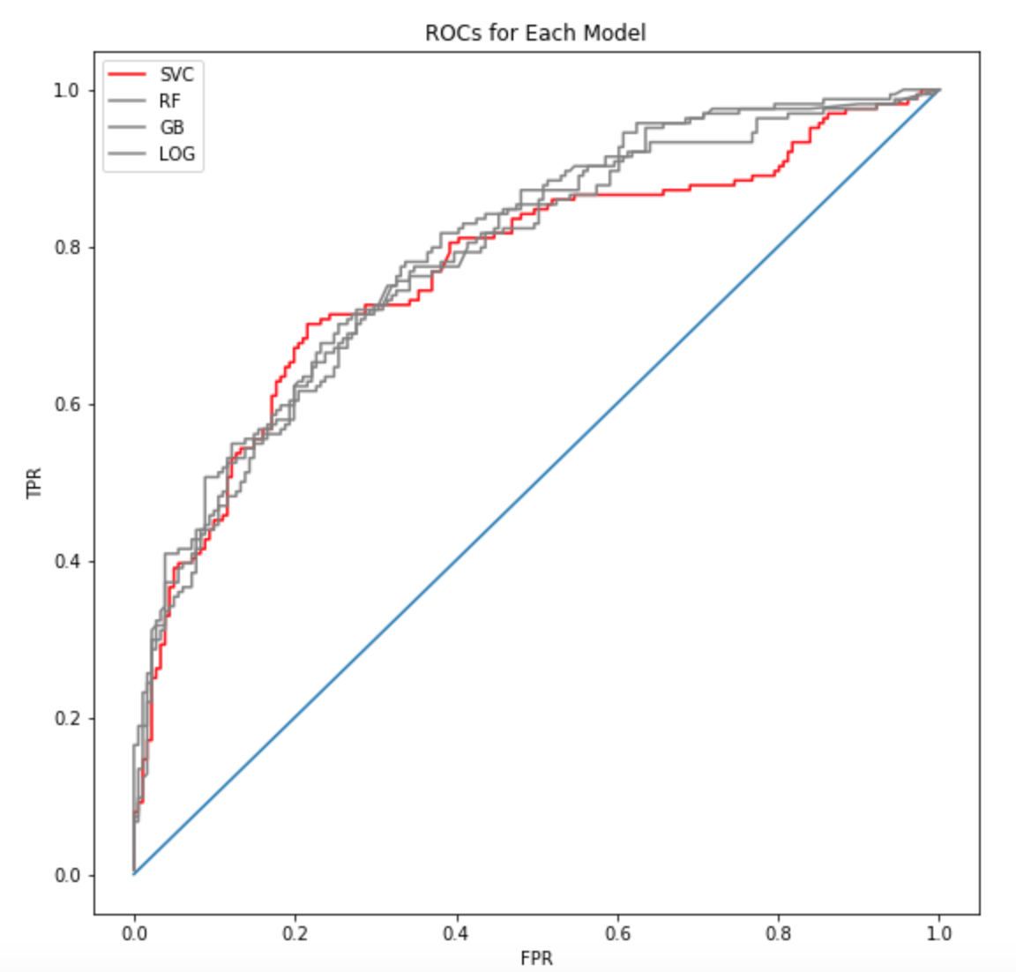
Modeling
Models similar and successful: train/test ~77%
Recommendation:
SVM, minimizing FPR

Slide 9
Topics in Low Comment Articles
Cultural (tv, art, photography, crosswords)
Real estate
Women + culture

Slide 10
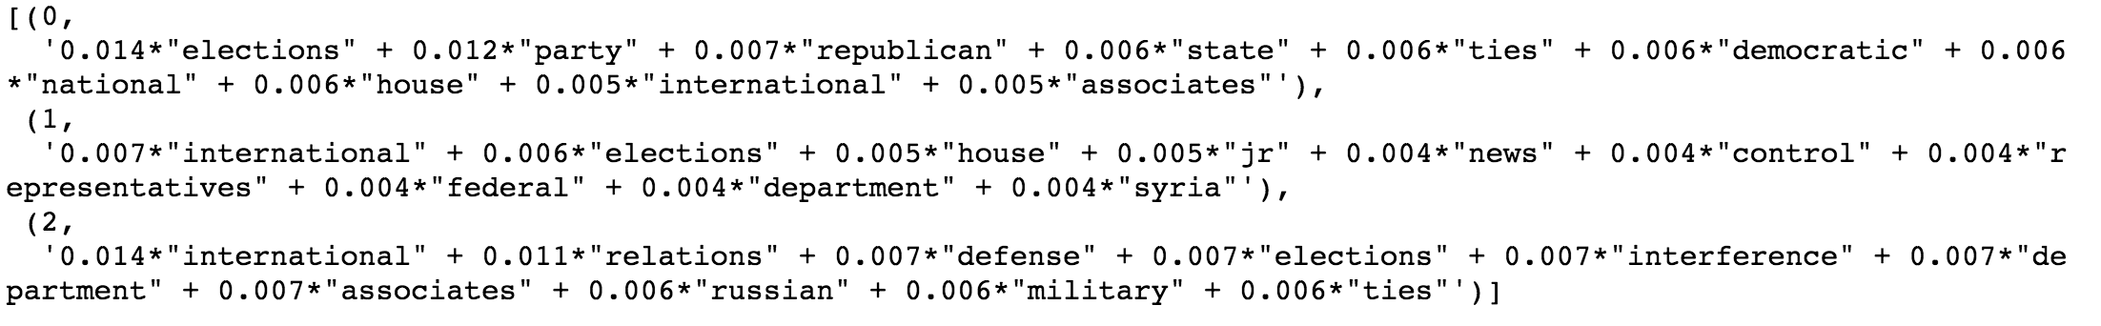
Topics in High Comment Articles
Politics: Trump (stop word), elections, international relations, military

Slide 11
Conclusion + Future Work
Conclusion
Can accurately predict high-comment articles
Have topics readers are interested in
Add more data (more months)
Weight older articles as less important
K-means clustering for these topics (similar to topic modeling)
Future work

Slide 12
Appendix

Slide 13
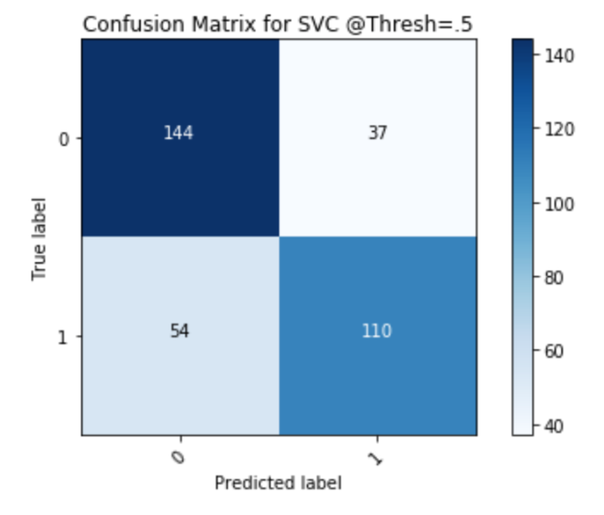
SVM Confusion Matrix

Slide 14
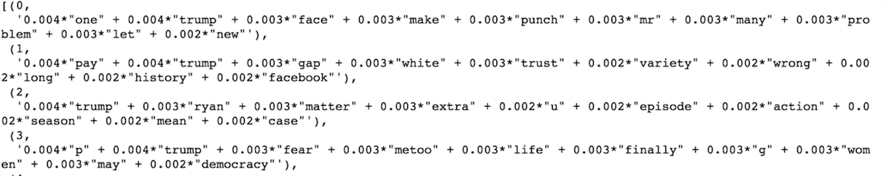
Headlines
Headlines were way less predictive, in fact most models went below 50%
Topics were odd
Headlines aim to be unique and catchy, less able to sort through actual meaning/connection to what the article is about. Worse proxy

Slide 15
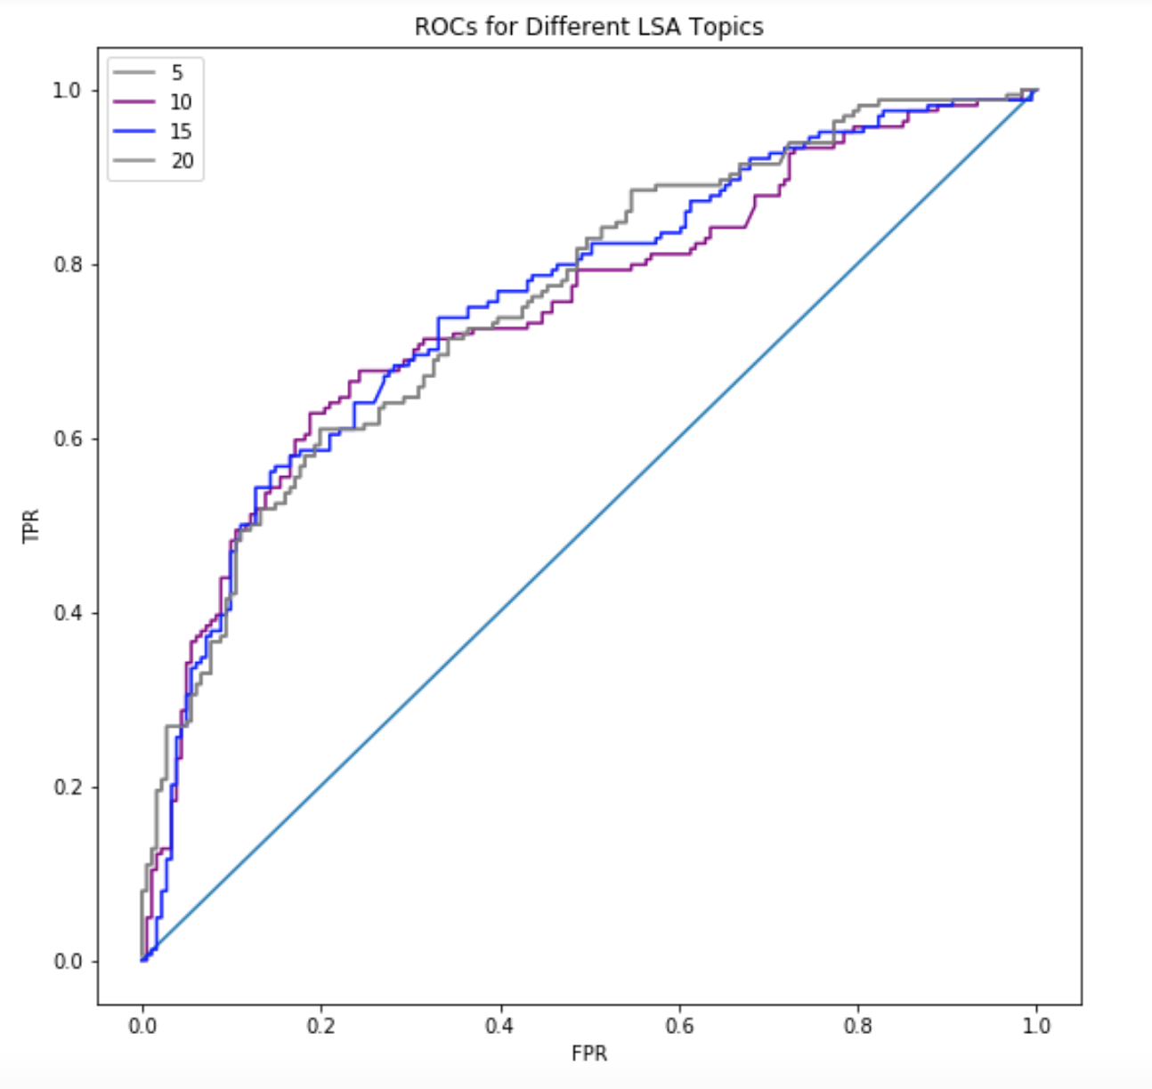
LSA Topic Number

Slide 16
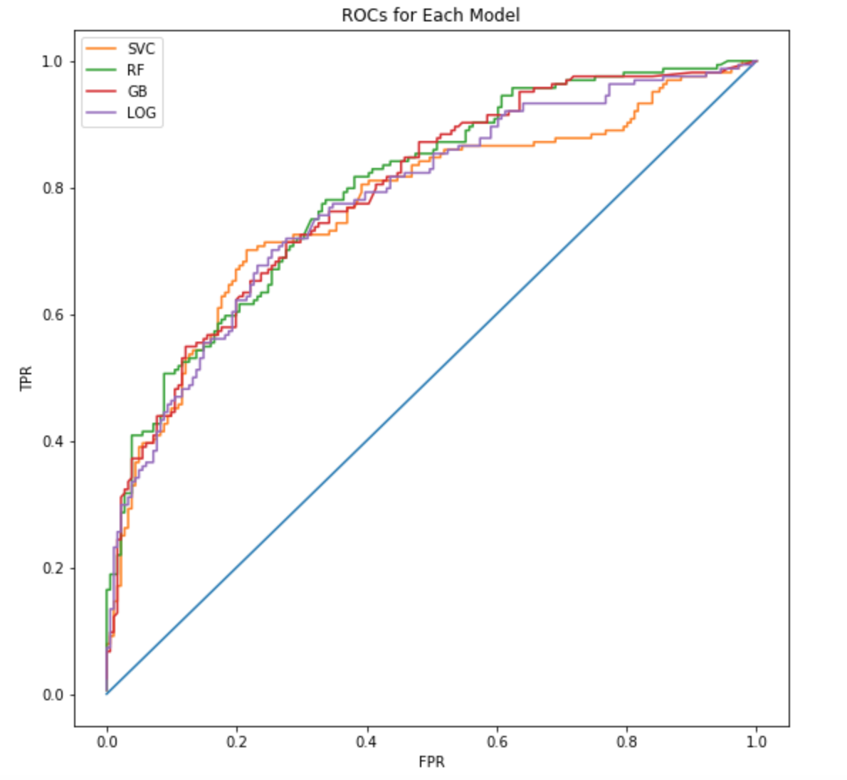
Modeling with colors

Slide 17
Sentiment analysis trouble
Article: President Trump welcomed President Emmanuel Macron of France to the White House on Tuesday for the first state visit since taking office.
Comments:
Macron, and every other world leader, must be aware that whatever agreement they think they come to, can and will be undone by the toxic personalities on Fox who Trump gives more credibility to than our intelligence agencies. Mr. Macron will be embarrassed by Trump, sure as everyone else in his coterie has been. Sentiment (polarity=0.28125, subjectivity=0.5034722222222222)
Enjoy the Enfant Terrible, Mr. Macron.<br/><br/>Don't forget to change his dirty diapers. Sentiment (polarity=-0.39999999999999997, subjectivity=0.7666666666666666)
Sentiment will be negative if: against Trump, against Trump meeting with Macron, dislike the article (how it’s written), etc. Too many possible attributions

