Slide 1
What you see is what you get
Cognitive Dissonance in Practice

Slide 2
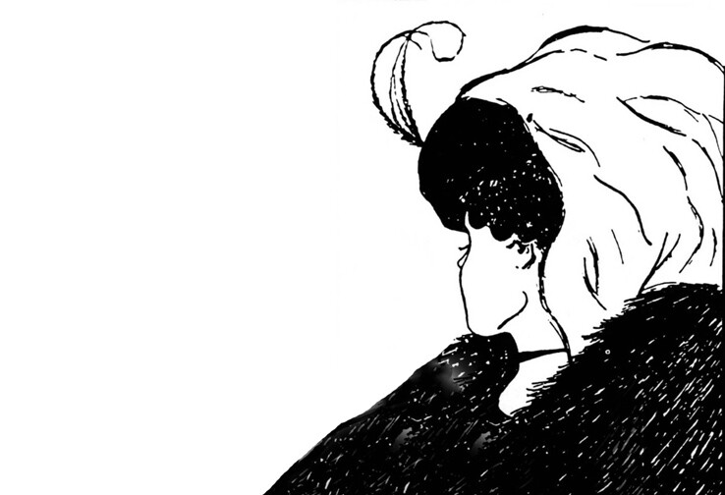

Slide 3

Two Faces or a Vase

Slide 4
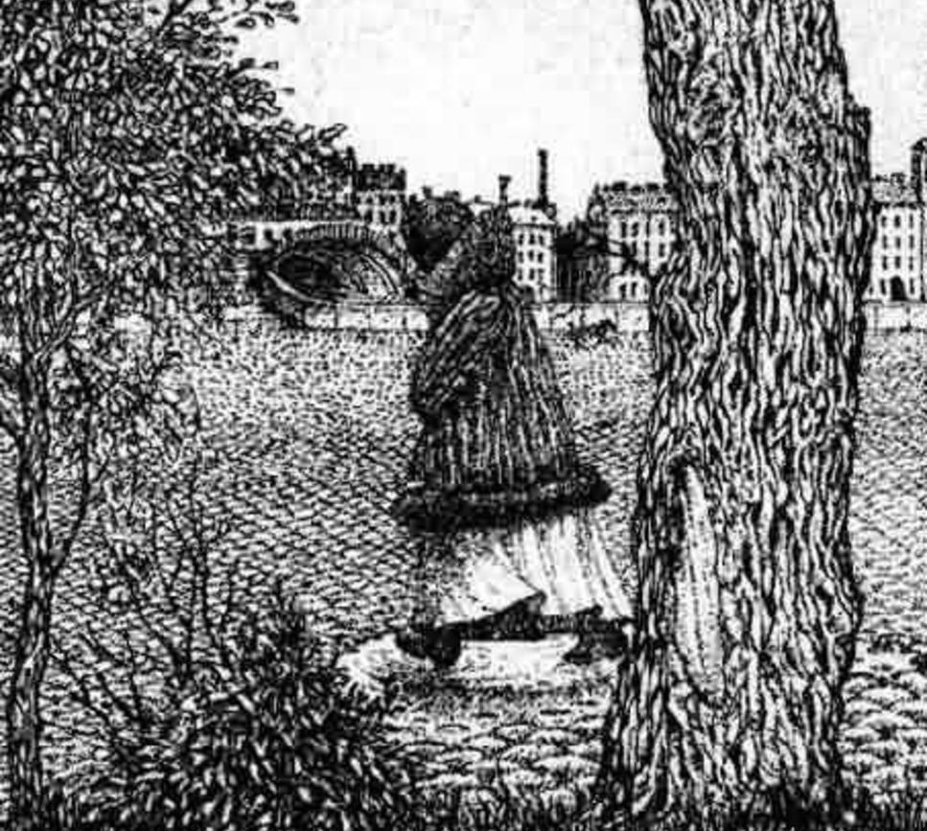

Slide 5
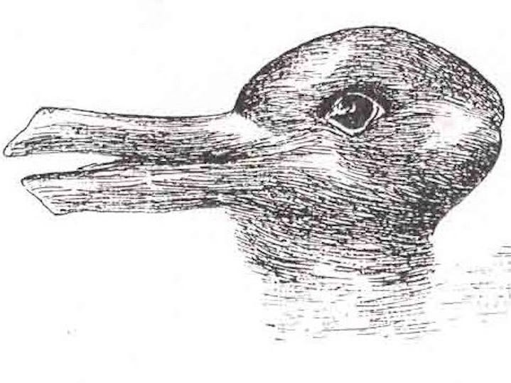

Slide 6
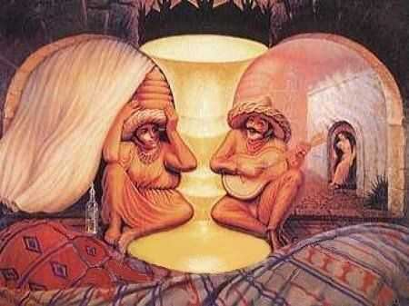

Slide 7


