Slide 1
Lesson 1: Fundamentals and Concepts of NIMS
We’ll now begin with the content of the first lesson. This lesson presents key concepts and principles underlying NIMS.
Objectives: At the end of this lesson, you should be able to:
Describe applicability and scope of NIMS.
Describe the key concepts and principles underlying NIMS.

Slide 2

What is NIMS? Video

Slide 3
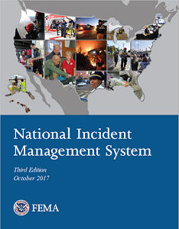
NIMS Overview
WHAT? The National Incident Management System (NIMS) defines the comprehensive approach guiding…
WHO? …the whole community - solutions that serve the entire community are implemented while simultaneously making sure that the resources the different members of the community bring to the table are leveraged across all levels of government, nongovernmental organizations (NGO), and private sector organizations to work together seamlessly
WHY? …to prevent, protect against, mitigate, respond to, and recover from the effects of incidents.
WHEN? NIMS applies to all incidents, regardless of cause, size, location, or complexity, from planned events to traffic accidents and to major disasters.

Slide 4
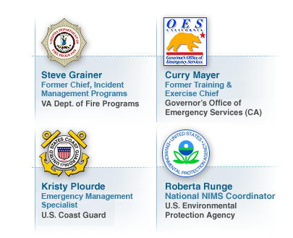

Slide 5

NIMS Applicability and Scope
NIMS is a common framework for emergency management and incident response that is applicable to all stakeholders with incident related responsibilities.
The audience for NIMS includes:
Emergency responders
Other incident personnel
Non-Governmental Organizations (NGOs) such as faith-based and community-based groups
The private sector
Elected and appointed officials
People with disabilities or access and functional needs
The scope of NIMS includes:
All incidents, regardless of size, complexity, or scope
Planned events such as sporting events

Slide 6
Overview of NIMS
The National Incident Management System (NIMS) defines the comprehensive approach guiding the whole community - all levels of government, nongovernmental organizations (NGO), and the private sector - to work together seamlessly to prevent, protect against, mitigate, respond to, and recover from the effects of incidents.
NIMS Is | NIMS Is Not
A comprehensive, nationwide, systematic approach to incident management, including the command and coordination of incidents, resource management, and information management | Only the Incident Command System Only applicable to certain emergency/incident response personnel A static system
A set of concepts and principles for all threats, hazards, and events across all mission areas (Prevention, Protection, Mitigation, Response, Recovery) | A response plan
Scalable, flexible, and adaptable; used for all incidents, from day-to-day to large-scale | Used only during large-scale incidents
Standard resource management procedures that enable coordination among different jurisdictions or organizations | A resource ordering system
Essential principles for communications and information management | A communications plan

Slide 7

Discussion Question
What are some common features of NIMS?

Slide 8

NIMS Guiding Principles
Incident management is the application of resources by organizations to plan for, respond to, and recover from an incident.
Priorities for incident management in planning, response, and recovery efforts include saving lives, stabilizing the incident, and protecting property and the environment.
To achieve these priorities, incident management personnel use NIMS components in accordance with three NIMS guiding principles:
Flexibility
Standardization
Unity of Effort

Slide 9
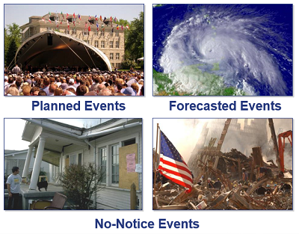
Flexibility
The NIMS guiding principle of flexibility allows NIMS to be scalable from routine, local incidents through those requiring interstate mutual aid up to those requiring Federal assistance.
Flexibility enables NIMS to be applicable to incidents that vary widely in terms of hazard, geography, demographics, climate, cultural, and organizational authorities.
NIMS components are adaptable to any type of event or incident.

Slide 10
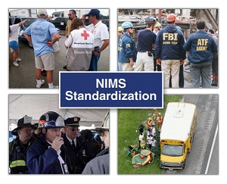
Standardization
The NIMS guiding principle of standardization supports interoperability among multiple organizations in incident response.
NIMS defines standard organizational structures that improve integration and connectivity among organizations.
NIMS defines standard practices that allow incident personnel and organizations to work together effectively.
NIMS includes common terminology, which enables effective communication.

Slide 11
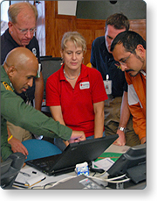
Unity of Effort
The NIMS guiding principle of Unity of Effort means coordinating activities among various organizational representatives to achieve common objectives. Unity of effort enables organizations with jurisdictional authority or functional responsibilities to support each other while allowing each participating agency to maintain its own authority and accountability.

Slide 12
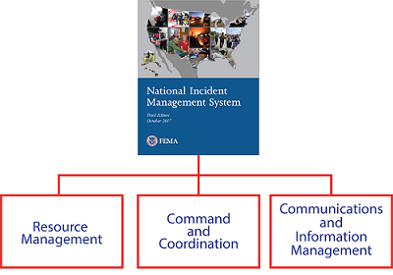
NIMS Framework - Major Components
Jurisdictions and organizations involved in the management of incidents vary in their authorities, management structures, communication capabilities and protocols, and many other factors. The major Components of NIMS provide a common framework to integrate these diverse capabilities and achieve common goals.
Resource Management
Command and Coordination
Communications and Information Management
The application of all three components is vital to successful NIMS implementation.

Slide 13
Discussion Question
What actions does your organization take that exemplify NIMS best practices?

Slide 14
Lesson 1: Fundamentals and Concepts of NIMS Summary
This lesson presented an overview of the Fundamentals and Concepts of NIMS.
The lesson specifically discussed:
An Introduction and Background to NIMS
NIMS Applicability and Scope
NIMS Guiding Principles
An Overview of the NIMS components
The next lesson will introduce you to NIMS Resource Management.

