Slide 1
Lesson 2: NIMS Resource Management
This lesson presents an overview of NIMS Resource Management.
Objectives:
At the end of this lesson, you will be able to:
Describe the four key activities of NIMS Resource Management Preparedness.
Identify the methods for Managing Resources during an Incident.
Describe features of Mutual Aid.
(National Incident Management System, Third Edition, October 2017)
https://www.fema.gov/media-library/assets/documents/148019

Slide 2

What is NIMS Resource Management? Video
During an incident, getting the right resources, to the right place, at the right time, can be a matter of life and death.

Slide 3

Resource Management Key Activities Overview
Resource management preparedness involves four key activities:
Identifying and typing resources
Qualifying, certifying, and credentialing personnel
Planning for resources
Acquiring, storing, and inventorying resources

Slide 4
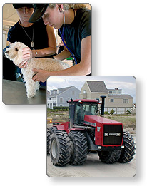
Typing Resources
Resource typing defines and categorizes incident resources by capability.
Resource typing establishes common definitions for capabilities of personnel, equipment, teams, supplies, and facilities.
Typing definitions include the following information:
Capability: the resource's capability to perform its function in one or more of the five mission areas: Prevention, Protection, Mitigation, Response, and Recovery.
Category: the function for which a resource would be most useful (e.g., firefighting, law enforcement, health and medical).
Kind: a broad characterization, such as personnel, equipment, teams, and facilities.
Type: a resource's level of capability to perform its function based on size, power, capacity (for equipment), or experience and qualifications; Type 1 has greater capacity than Type 2, 3, or 4.
The current FEMA Resource Management and Mutual Aid link contains information on NIMS Resource Typing and Credentialing: http://www.fema.gov/resource-management-mutual-aid
The NIMS Resource Typing Library Tool, also available at the link above, is an online catalog of all NIMS resource typing definitions and job titles/position qualifications that have been released by FEMA.

Slide 5

Discussion Question
What are the benefits of typing resources?

Slide 6
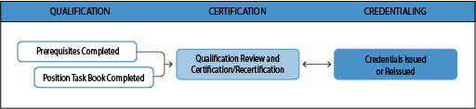
Qualifying, Certifying and Credentialing Personnel
The Authority Having Jurisdiction (AHJ) has the authority and responsibility for qualification, certification, and credentialing within its organization or jurisdiction.
The establishment of national standards provide common, compatible structures for the qualification and certification of emergency management personnel.
Qualification, certification, and credentialing are the essential steps to help ensure that personnel deploying under mutual aid agreements can perform their assigned roles.
Qualifying: Personnel meet the minimum established standards (including training, experience, physical and medical fitness) to fill specific positions.
Certification: recognition from an Authority Having Jurisdiction (AHJ) or a third party that an individual has completed qualification for a position (one example of a third party is an accredited body such as a state licensure board for medical professionals).
Credentialing: documentation – typically an identification card or badge – that identifies personnel and verifies their qualifications for a particular position.
NIMS Overview of Supporting Tools and Aids: www.fema.gov/nims-doctrine-supporting-guides-tools
NIMS Guidelines for Credentialing Personnel are in PDF at: http://www.fema.gov/pdf/emergency/nims/nims_cred_guidelines_report.pdf

Slide 7
Discussion Question
What is your organization’s process for credentialing personnel?

Slide 8
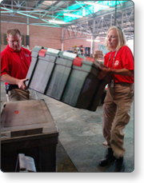
Planning for Resources
Coordinated planning provides a foundation for interoperability and compatibility of resources.
Jurisdictions and organizations work together before incidents to develop plans that identify, manage, estimate, allocate, order, deploy and demobilize resources.
The planning process includes identifying resource requirements to meet anticipated threats and vulnerabilities.
Resource management planning should consider resources needed to support all mission areas: Prevention, Protection, Mitigation, Response and Recovery.
Resource management strategies for planners to consider include:
Stockpiling resources
Establishing mutual aid agreements to obtain resources from neighboring jurisdictions
Determining how and where to reassign resources performing non-essential tasks
Developing contracts to acquire resources from vendors
Estimating resource needs is a key activity in resource planning that enables jurisdictions to assess their ability to take a course of action.

Slide 9
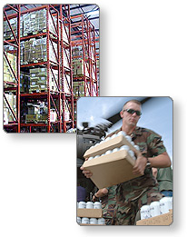
Acquiring, Storing and Inventorying Resources
Organizations acquire, store, and inventory resources for both normal operations and incidents.
Effective resource management requires a current, accurate resource inventory to track resource status and availability.
This inventory can be as simple as a paper spreadsheet or as advanced as computer-based inventory systems.
Accurate resource inventories:
Enable organizations to resource incidents promptly when needed
Support day-to-day resource management
In NIMS, resource inventorying refers to preparedness activities conducted outside of incident response; resource tracking occurs during an incident.

Slide 10
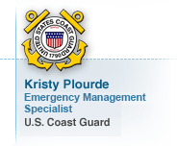
Voices of Experience:
Resource Management Words of Advice
Kristy Plourde, Emergency Management Specialist, U.S. Coast Guard
"With standardized resource management of type and kind you know, when I order a type 2 law enforcement vessel and I've standardized that vessel, I know what capability I’m getting and because I’ve standardized it before the incident, I know exactly what I am getting and it is, it is very cool."

Slide 11
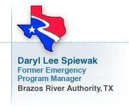
Voices of Experience:
Resource Management Words of Advice
Daryl Lee Spiewak, Former Emergency Programs Manager, Brazos River Authority, TX
"Resource management is certainly important. We know each jurisdiction is going to have to have some resources available but they’re never going to have enough, there is always going to be shortfalls, and part of resource management is to manage those gaps in the availability of the resources. So, resource management under NIMS gives us a structure and a process to be able to do that. Part of it was the resource typing, so it streamlines the requesting of equipment, particularly among different jurisdictions and agencies. If I ask for a particular type of vehicle with certain equipment and with the right number of people, then I only need to make one request and I’ll get all of that. If there is something else, I ask for a different type of equipment. So the typing is going to help us tremendously under resource management. It also requires that we do inventories. Inventories let us know what equipment we have on hand. We compare that to what we think we’re going to need based on our planning and our exercising, we identified some of the gaps, and then we start looking for ways of filling those shortfalls. Mutual aid is one of those activities under resource management that is important in helping us use resources across levels, among different agencies, helps the taxpayers, helps the responders, helps the whole Nation."

Slide 12
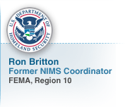
Voices of Experience:
Resource Management Words of Advice
Ron Britton, Former NIMS Coordinator, FEMA, Region 10
"Resource management is much bigger than just identifying and moving vehicles or planes or so forth, that really, really involves the entire credentialing process of knowing all of our personnel resources capabilities and training background and so forth, that all needs to be done in a prior preparation event, so that we really know that when those folks arrive on scene, they’re capable of doing the job we’re asking them to do. So it starts with those folks, their credentialing, their qualifications, and then as well knowing the types of equipment that we would need to have on scene. So the equipment and the things that need to be there, and that would go under the communications as well because resource typing would involve the radios, the satellite phones, and all of the kinds of support communications that we would need for something to respond. So resource management is huge, and it really has to be done prior to the event."

Slide 13
Discussion Question
Has anyone been involved in any of these key activities? What are some of the challenges you experienced?

Slide 14
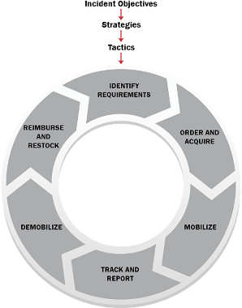
Resource Management During an Incident Overview
The graphic depicts the resource management process during an incident; this process describes the six resource management tasks performed in an incident.
The resource management process includes methods to identify, order, mobilize, track, demobilize, and reimburse and restock resources during an incident.
While in a small incident the Incident Commander may order resources directly, in more complex incidents the Incident Commander relies on the resource management process and personnel to identify and meet resource needs.

Slide 15
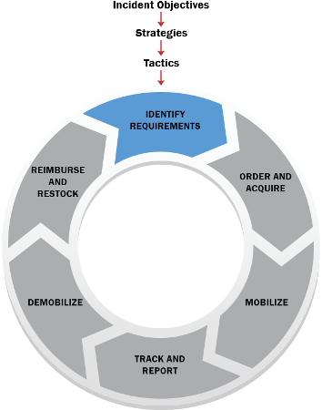
Identify Requirements
During an incident, personnel continually identify, validate, and refine resource needs. The process involves identifying:
Type and quantity of resources needed
Location where resources should be sent
Who will receive and use the resources
Because the type and quantity of resources required and their availability changes as an incident progresses, incident management personnel and organizations should identify and coordinate as closely and as early as possible, both in advance of and during incidents.

Slide 16
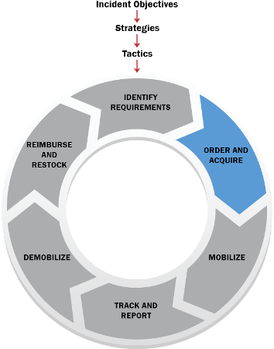
Order & Acquire
Both incident command and emergency operations center staffs make initial and ongoing assessments of resource requirements based on incident priorities and objectives.
If identified resource requirements are available locally they will be activated or ordered.
Resources that are not available locally can be ordered by executing contracts, implementing mutual aid agreements, or requesting assistance from another level of government (local government to a State, State to the Federal Government).
An external jurisdiction or organization that is requested to provide resources must consent to the request.
NIMS resource typing (discussed previously) is designed for use when ordering resources to ensure the resource provided meets the mission needs. A jurisdiction can use these resource type definitions to clearly define their resource requirements.

Slide 17
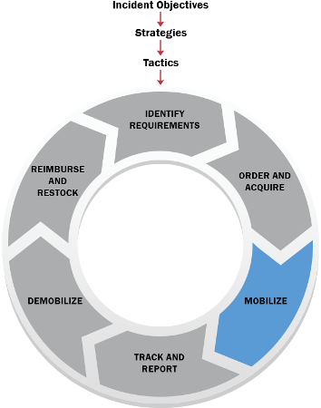
Mobilize
Personnel and other resources begin mobilizing when notified through established channels.
Upon notification, deploying personnel receive information to include:
Date, time, and place of departure
Mode of transportation to the incident
Estimated date and time of arrival
Reporting location and assigned supervisor
Anticipated incident assignment
Anticipated duration of deployment
Resource order number
Incident number
Applicable cost and funding codes
Resource tracking directly links to the mobilization process.
Resources arriving on scene check in according to the receiving organization’s check-in process.
The mobilization of fixed facility resources is referred to as activation rather than deployment.

Slide 18
Mobilize
Unrequested Resources
During incidents responders sometimes arrive at the incident site without being requested.
This can interfere with incident management by:
Responders should wait for official deployment notification rather than self-deploying to an incident. Responders should wait for official deployment notification rather than self-deploying to an incident.

Slide 19
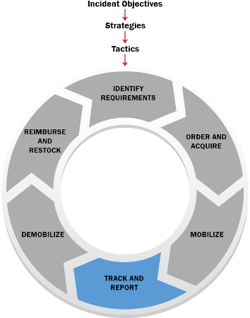
Track and Report
Incident personnel track resources from mobilization through demobilization using established resource tracking procedures.
This process:
Tracks the location of resources
Helps staff prepare to receive and use resources
Protects the safety and security of personnel, equipment, teams and facilities
Enables resource coordination and movement
Information management systems can aid in collecting, updating, and processing resource-related data and in real-time tracking of resources.

Slide 20
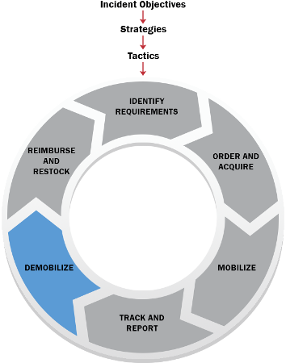
Demobilize
Managers begin planning and preparation for the demobilization process at the same time they begin mobilizing resources.
Those responsible for resources in an incident should either reassign or demobilize resources as soon as they are no longer needed.
Prior to demobilization, incident planning and logistics personnel plan for rehabilitation, replenishment, disposal of, and/ or return or restoration to operational condition for incident resources.
The goal of demobilization is the orderly, safe, and efficient return of a resource to its original location and status.

Slide 21
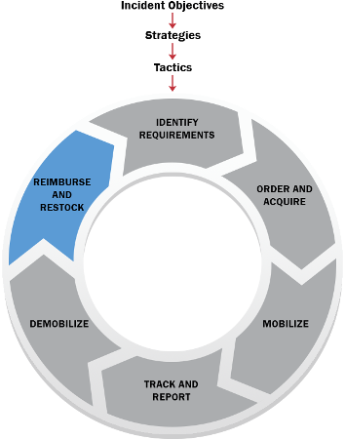
Reimburse and Restock
Reimbursement provides for payment of expenses incurred by resource providers.
Reimbursement processes:
Establish and maintain the readiness of resources
Collect bills and validate costs
Ensure that resource providers are paid in a timely manner
Restock through replacement or repair of damaged equipment
Reimbursement procedures are often specified in mutual aid and assistance agreements.

Slide 22
Discussion Question
Where have you seen this process used before?

Slide 23
Discussion Question
Why is it important to begin demobilization planning as soon as feasible?

Slide 24
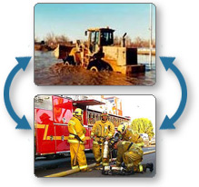
Mutual Aid Overview
Mutual aid is the sharing of resources and services between jurisdictions or organizations.
Mutual aid occurs routinely and is based on the resource needs identified by the requesting organization.
This assistance can range from routine dispatch of resources between local communities up to movement of resources across state lines for large-scale incidents.

Slide 25
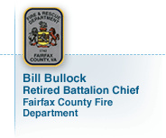
Voices of Experience:
Mutual Aid Agreements and Assistance Agreements
Bill Bullock, Retired Battalion Chief, Fairfax County Fire Department, VA
"Traditionally we’ve always considered mutual aid between fire departments, EMS agencies, or law enforcement agencies. In today’s world it is expanded to virtually every emergency function identified in either the national, State, or local response plan. It includes communications assets, public health assets. Some cases may include military affairs, may include animal refuge, may include search and rescue assets, and a host of others."

Slide 26

Voices of Experience:
Mutual Aid Agreements and Assistance Agreements
Bill Metcalf, Former Fire Chief, North County Fire Protection District, CA
"At its simplest level, mutual aid is neighbor helping neighbor. It is adjoining fire departments sharing resources to suppress a fire that’s bigger than one agency can handle. It’s adjoining water companies helping each other replace a broken pipeline in an emergency because they don’t have sufficient manpower or equipment to do it. It’s anytime that neighboring agencies leave their jurisdictions to help each other."

Slide 27
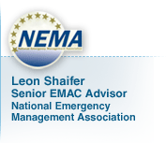
Voices of Experience:
Mutual Aid Agreements and Assistance Agreements
Leon Shaifer, Senior EMAC Advisor, National Emergency Management Association
"NIMS has proposed a number of solutions that could be applied very readily to mutual aid. One of the problems with mutual aid in the past has been a common terminology, a common nomenclature, speaking the same language. One term to one particular level of government doesn’t necessarily mean the same thing to another, and NIMS addresses those particular types of issues. We all try to speak in a common language, plain English. The other real benefit that NIMS can bring is resource typing. We all know that when you need something that is not readily available within your jurisdiction, you need it fast. It speeds up the process when a person that has an asset can understand very quickly what you are asking for, and if those resources are typed, the benefit to one of the NIMS requirements is that a person requesting something and asks for it knows what they are going to get when they follow a typing scheme."

Slide 28
Mutual Aid Agreements and Compacts
Mutual aid agreements establish the legal basis for two or more entities to share resources.
Various forms of mutual aid agreements and compacts exist among and between all levels of government in the United States.
These agreements may authorize mutual aid:
Between two or more neighboring communities
Among all jurisdictions within an state
Between States, Territories and Tribal Governments
Between Federal agencies
Internationally
Between government and NGOs and/or the private sector
Among NGOs and/or private sector entities

Slide 29

Mutual Aid Process
Upon receipt of a mutual aid request, the supporting jurisdiction evaluates the request against its capacity.
The supporting jurisdiction determines if it is able to meet its own requirements during the temporary loss of the resource(s).
If the providing jurisdiction determines it can accommodate the deployment of resources, it will identify and arrange the deployment of these resources in accordance with the mutual aid agreement.
The receiving jurisdiction can decline resources if they do not meet its needs.

Slide 30
Discussion Question
What are some examples of Mutual Aid in your community?
What actions has your organization taken to strengthen those agreements?

Slide 31
Lesson 2: NIMS Resource Management Summary
This lesson presented an overview of NIMS Resource Management.
The lesson specifically discussed:
Resource Management Preparedness
Resource Management During an Incident
Mutual Aid
The next lesson will introduce you to NIMS Management Characteristics.

