Slide 1
Lesson 3: NIMS Management Characteristics
This lesson presents an overview of the NIMS Management Characteristics.
Objective:
At the end of this lesson, you will be able to:
Differentiate among the fourteen NIMS Management Characteristics
(National Incident Management System, Third Edition, October 2017)

Slide 2
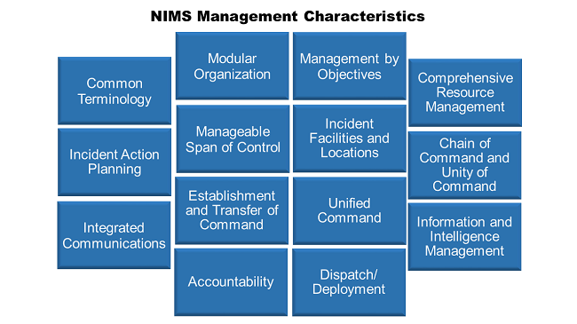
NIMS Management Characteristics
NIMS bases incident command and coordination on fourteen NIMS Management Characteristics. These fourteen characteristics are building blocks that contribute strength and efficiency to the National Incident Management System.

Slide 3

NIMS Management Characteristic: Common Terminology
NIMS establishes common terminology that allows different organizations to work together in a wide variety of emergency functions and hazard scenarios.
Common terminology helps by reducing confusion and enhancing interoperability.
This common terminology covers:
Organizational Functions: Major functions and units are named and defined using standardized terms
Resource Descriptions: Resources (personnel, equipment, teams and facilities) have common naming based on their type and capabilities
Incident Facilities: Facilities in an incident area are designated using common terms

Slide 4

NIMS Management Characteristic: Modular Organization
Organizational structures for incident management (ICS and EOCs) are modular, meaning that they are each building blocks that are put in place as needed based on an incident’s size, complexity and hazards.
The ICS Commander and EOC director are responsible for the establishment and expansion of the modular organization based on the specific requirements for their incident.
As incident complexity increases, the organizational structure expands and management responsibilities are further divided.
The number of management, supervisory, and support positions expand as needed to meet the needs of the incident.

Slide 5

NIMS Management Characteristic: Management by Objectives
In an incident, all activities are directed to accomplish defined objectives. This is called Management by Objectives.
Under ICS the Incident Commander (or Unified Command) establishes incident objectives.
Management by objectives includes:
Establishing specific, measurable objectives
Identifying strategies, tactics, tasks, and activities to achieve the objectives
Developing and issuing assignments, plans, procedures and protocols to accomplish tasks
Documenting results against objectives to measure performance, facilitate corrective actions, and inform development of objectives for the next operational period

Slide 6
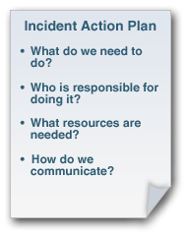
NIMS Management Characteristic: Incident Action Planning
Incident action planning guides incident management activities.
Incident Action Plans:
Record and communicate incident objectives, tactics, and assignments for operations and support
Are recommended for all incidents
Are not always written, but a written IAP is increasingly important when an incident or activation:
Is likely to extend beyond one operational period
Becomes more complex
Involves multiple jurisdictions or agencies

Slide 7
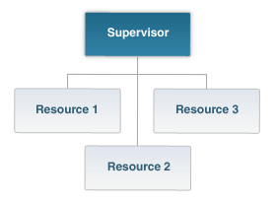
NIMS Management Characteristic: Manageable Span of Control
Span of control refers to the number of subordinates that directly report to a supervisor.
Maintaining an appropriate span of control ensures effective incident management by enabling supervisors to:
Direct and supervise subordinates
Communicate with and manage resources
The optimal span of control for incident management is one supervisor to five subordinates; however, the 1:5 ratio is only a guideline and effective incident management often calls for different ratios.
When a supervisor’s span of control becomes unmanageable, they can assign subordinate supervisors or redistribute subordinates to manage portions of the organization in order to regain a manageable span of control.
Span of control can change based on:
Type of incident
Nature of the task
Existing hazards and safety factors
Distances between personnel and resources

Slide 8

NIMS Management Characteristic: Incident Facilities and Locations
The Incident Commander, Unified Command or EOC director establishes incident support facilities for specific purposes.
These facilities are identified and located based on the requirements of the situation.
Incident size and complexity will influence the designation of facilities and locations.
Typical designated facilities include:
Incident Command Post (ICP)
Incident base
Staging Areas
Camps
Mass casualty triage areas
Points-of-distribution
Emergency shelters

Slide 9
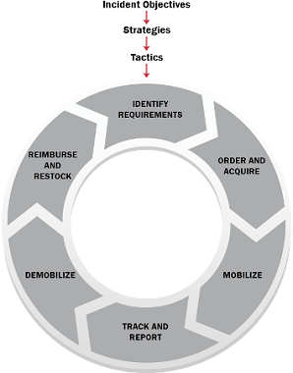
NIMS Management Characteristic: Comprehensive Resource Management
Maintaining accurate and up-to-date resource inventories and resource tracking are essential components of incident management.
Resources include personnel, equipment, teams, supplies, and facilities available or potentially available for assignment or allocation.

Slide 10

NIMS Management Characteristic: Integrated Communications
Integrated communications allow units from diverse agencies to connect, share information and achieve situational awareness.
Incident managers facilitate communications through the development and use of:
A common communications plan
Interoperable communications processes and systems
Systems that include both voice and data links
Integrated Communications Planning occurs both before and during an incident to provide equipment, systems, and protocols needed to achieve integrated voice and data communications.

Slide 11

NIMS Management Characteristic: Establishment and Transfer of Command
When an incident is anticipated or occurs the organization with primary responsibility for the incident establishes command by designating the Incident Commander (IC) or Unified Command (UC). Command may need to be transferred to a different IC/UC one or more times over the course of a long duration or increasingly complex incident.
The current command determines the protocol for transferring command. This transfer process should always include a briefing for the incoming IC/UC on all essential information for continuing safe and effective operations. The transfer of command should also be communicated to all incident personnel.

Slide 12
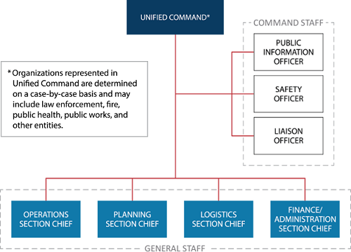
NIMS Management Characteristic: Unified Command
In some incidents the Incident Command function is performed by a Unified Command (UC).
UC is typically used for incidents involving:
Multiple jurisdictions
A single jurisdiction with multiagency involvement
Multiple jurisdictions with multiagency involvement
UC allows agencies with different authorities and responsibilities to work together effectively without affecting individual agency authority, responsibility, or accountability.

Slide 13
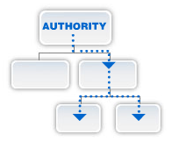
NIMS Management Characteristic: Chain of Command and Unity of Command
Chain of command refers to the orderly command hierarchy within an incident management organization.
Unity of command means that each individual reports to only one designated supervisor.
These principles:
Clarify reporting relationships
Eliminate confusion caused by conflicting instructions
Enable incident managers at all levels to direct the actions of all personnel under their supervision

Slide 14

NIMS Management Characteristic: Accountability

Slide 15

NIMS Management Characteristic: Dispatch/Deployment
Resources should deploy only when requested and dispatched through established procedures by appropriate authorities.
Resources that authorities do not request should not deploy spontaneously - unrequested resources can overburden the IC/UC and increase accountability challenges.

Slide 16
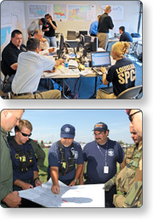
NIMS Management Characteristic: Information and Intelligence Management
Incident-related information and intelligence is managed by the incident management organization through established processes for:
Gathering
Analyzing
Assessing
Sharing
Managing
Information and intelligence management includes identifying essential elements of information (EEI). EEI ensures incident personnel gather the most accurate and appropriate data, translate it into useful information, and communicate it with appropriate personnel.

Slide 17
Activity 2.1: NIMS Management Characteristics
Instructions:
Work within your group to further explain your assigned NIMS Management Characteristics and give an example for each
Select a spokesperson and be prepared in 15 minutes.

Slide 18
Lesson 3: NIMS Management Characteristics Summary
This lesson presented an overview of NIMS Management Characteristics. The lesson specifically discussed:
Common Terminology
Modular Organization
Management by Objectives
Incident Action Planning
Manageable Span of Control
Incident Facilities and Locations
Comprehensive Resource Management
Integrated Communications
Establishment and Transfer of Command
Unified Command
Chain of Command and Unity of Command
Accountability
Dispatch/ Deployment
Information and Intelligence Management
The next lesson will introduce you to the Incident Command System.

