Slide 1
Lesson 4: Incident Command System (ICS)
This lesson presents an overview of the Incident Command System (ICS).
Objective:
At the end of this lesson, you will be able to:
Describe the Incident Command System (ICS) Organizational Structure
(National Incident Management System, Third Edition, October 2017)

Slide 2

What Is NIMS Command and Coordination?
This lesson is about the Incident Command System (ICS). ICS is one of the four NIMS structures. Before we explore ICS, let's briefly look at all four NIMS structures.
“NIMS is a system to provide a framework for all of the team to work together towards common goals.” Craig Fugate, former FEMA Administrator (and past Director, FL Division of Emergency Management).

Slide 3
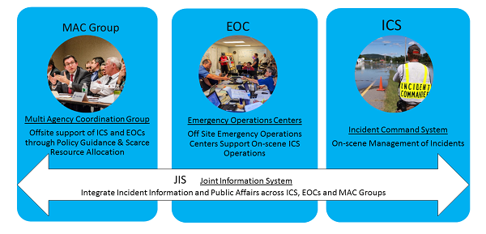
NIMS Command and Coordination Structures

Slide 4
NIMS Command and Coordination Structures (Continued)
NIMS structures enable incident managers to manage incidents in a unified, consistent manner.
When an incident occurs or threatens, local emergency personnel manage response using ICS.
If the incident is large or complex, off-site EOCs activate to support on-scene operations.
The incident personnel in the field and in EOCs receive policy guidance from MAC Groups.
A Joint Information Center manages the Joint Information System (JIS) to ensure coordinated and accurate public messaging among all levels: ICS, EOC and MAC Group.
The first NIMS structure we will examine is ICS.

Slide 5

Voices of Experience: Incident Command System
George Nuñez, Emergency Management, George Washington University
"ICS is a system to allow responders to be able to organize and respond to an incident. It is specifically useful during on-scene response. It is a format, a system of tools that allow police, fire, and other personnel to respond to that incident in a systematic way to facilitate the response but also meet the needs of those impacted."

Slide 6
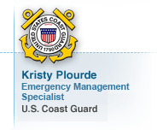
Voices of Experience: Incident Command System
Kristy Plourde, Emergency Management Specialist, U.S. Coast Guard
"You use NIMS and ICS and you organize yourself around this structure. It’s got the common language, its common command structure. You work out who is in the Unified Command, you know, and you work this all out, and so that’s what they did, and it was, you know, it’s not perfect because we’re not there yet, we’re getting there with how we organize ourselves, but the key is, is that: is it better than when we did it before? And that’s the bottom-line answer of that is that NIMS has helped us be better structured, have less duplication, be more organized and more efficient."

Slide 7
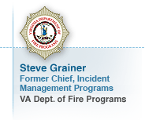
Voices of Experience: Incident Command System
Steve Grainer, Former Chief, Incident Management Programs, VA Dept. of Fire Programs
"The basic functional elements of ICS are the way everything is managed. What ICS has done has provided a template, a flexible yet standardized template that is available on a moment’s notice and is constructed in such a manner that you just basically open the book or pull the template off the shelf and identify which component parts of command or management, if you will, are needed at any moment in time. It just provides you a fill-in-the-blanks format for what is necessary, and the good thing about it is you use what you need and you don’t use what you don’t need."

Slide 8
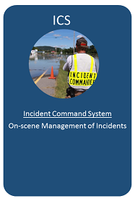
ICS Introduction
The Incident Command System (ICS) provides:
A standardized approach to the command, control, and coordination of on-scene emergency management
A common structure within which personnel from different organizations can work together
A structure for incident management that integrates and coordinates procedures, personnel, equipment, facilities, and communications
ICS is used by all levels of government and many NGOs and private sector organizations.
This system includes five major functional areas: Command, Operations, Planning, Logistics, and Finance/Administration.

Slide 9

Discussion Question
What are examples of incidents or planned events where you have used ICS?
What were the benefits of using ICS?

Slide 10
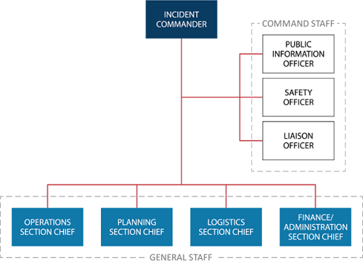
Incident Command Concept
The ICS term Incident Command refers to the person or group responsible for overall on-scene management of an incident.
There are two general forms of the incident command function:
A single Incident Commander
A Unified Command
Command and General Staff support the incident command in management of the incident.

Slide 11
Incident Commander
When an incident occurs within a single jurisdiction and there is no overlapping responsibility, the appropriate authority designates a single Incident Commander who has overall incident management responsibility.
When incident management crosses jurisdictional and/or functional agency boundaries, the various jurisdictions and organizations may still agree to designate a single Incident Commander.
The Incident Commander establishes the incident objectives that guide incident action planning and operations.
When there is a single Incident Commander, he or she is solely responsible (within limits of authority) for:
Establishing incident objectives, and
Ensuring that incident activities work to accomplish objectives.

Slide 12
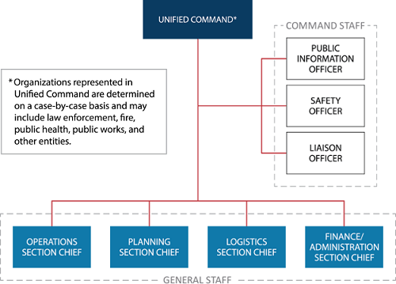
Unified Command
Unified Command is used for improved unity of effort in multijurisdictional or multiagency incident management.
Unified Command enables different jurisdictions and organizations to jointly manage and direct incident activities through a common set of incident objectives, strategies and a single incident action plan.
Each partner in the Unified Command maintains authority, responsibility and accountability for its own personnel and other resources, but the members of the Unified Command work together to:
Determine objectives, priorities and strategic guidance
Establish a single system for ordering resources
Execute integrated incident operations
Maximize the use of assigned resources
Because requirements vary based on the location and type of incident, the composition of the Unified Command structure adapts to fit the specific incident.

Slide 13
Command Staff
The Command Staff are incident management personnel that the Incident Commander or Unified Command assign to directly support the command function.
Command Staff positions are established by the Incident Commander or Unified Command as needed to support the management of an incident.
Command staff report directly to the Incident Commander or Unified Command and are assigned assistants as necessary to perform their duties.
The ICS Command Staff typically includes:
The Public Information Officer (PIO) who interfaces with the public, media, and others needing incident information
The Safety Officer who monitors incident operations and advises the Incident Commander or Unified Command on matters relating to health and safety
The Liaison Officer who serves as the incident command’s point of contact for organizations not included in the Incident Command or Unified Command

Slide 14
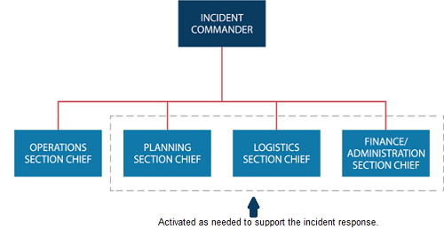
General Staff Overview

Slide 15
General Staff Sections

Slide 16
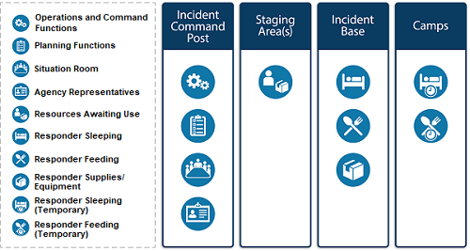
Common Types of ICS Facilities
The Incident Commander or Unified Command determines the kinds and locations of ICS facilities based on what is required to support the incident.
The Incident Commander or Unified Command may establish several different kinds of facilities in and around the incident area.

Slide 17
Discussion Question
Who interfaces with the public media needing incident information?
Who monitors incident operations advises the IC/UC on matters relating to health and safety?
Who serves as the incident command’s point of contact for organizations not included in the UC?
Who plans and performs tactical activities to achieve the incident objectives established by the IC/UC?
Who supports the incident action planning process by tracking resources, collecting/analyzing information, and maintaining documentation?
Who sets the incident objectives, strategies, and priorities, and has overall responsibility for the incident?
Who ensures that all intelligence/investigations operations and activities are properly managed, coordinated, and directed?
Who monitors costs related to the incident, provides accounting, procurement, time recording, and cost analyses?
Who arranges for resources and needed services to support achievement of the incident objectives?

Slide 18
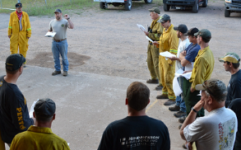
Incident Management Teams
Incident Management Teams (IMT) are a rostered group of ICS-qualified personnel composed of an Incident Commander, other incident leadership, and personnel qualified for other key ICS positions.
IMTs are:
Established at local, regional, state, tribal, and national levels with formal notification, deployment, and operational procedures in place.
Typed based on the team member qualifications.
Assigned to manage incidents or to accomplish supporting incident-related tasks or functions.
When assigned to an incident, IMTs are typically delegated the authority to act on behalf of the affected jurisdiction or organization.

Slide 19

Incident Management Assistance Teams
Some IMTs are referred to as Incident Management Assistance Teams (IMAT) to clarify that they support on-scene personnel and/or the affected jurisdiction(s).
IMATs ensure that federal activities align with local priorities through participation in Unified Command or a Unified Coordination Group with representatives from local, state, and/or tribal government.
IMATs exist at various levels of government and within the private sector.
Regardless of who owns particular IMATs or their specific missions, IMATs operate using the principles and practices of ICS.
Example: FEMA IMATs deploy to an incident or venue to assist in the identification and provision of Federal assistance, and coordinate and integrate inter-jurisdictional response in support of an affected state or tribe.

Slide 20
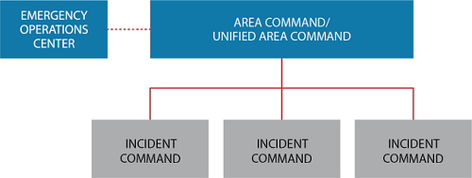
Area Command
An Area Command organization oversees the management of multiple incidents or a very complex incident through establishing multiple ICS organizations.
An Area Command is activated only if necessary based on the complexity of the incident and span-of-control considerations.
Area Command is particularly relevant to situations with several ICPs requesting similar, scarce resources.
Area Commands are frequently established as Unified Area Commands and use the same principles as a Unified Command.
Additional coordination structures, such as EOCs or MAC Groups, may assist with coordinating the resource needs of multiple incidents.

Slide 21
Discussion Question
What are some examples when Area Commands have been established?

Slide 22
Discussion Question
What are the commonalities between Area Command and Unified Command? What are the differences?

Slide 23

Unit 4: Knowledge Review 2
Which of the following statements are accurate about an Area Command? More than one may be correct.
Area Commands are frequently established as Unified Area Commands and use the same principles as a Unified Command.
An Area Command is generally activated during all incidents and is solely based on the complexity of the incident.
An Area Command organization oversees the management of multiple incidents or a very large or evolving situation.
Area Command is particularly relevant to situations with several Incident Command Posts (ICPs) requesting similar, scarce resources.

Slide 24
Lesson 4: Incident Command System (ICS) Summary
This lesson presented an overview of the Incident Command System (ICS).
The lesson specifically discussed:
Incident Command
Command Staff
General Staff
Incident Management Teams
Incident Management Assistance Teams
Area Command
The next lesson will introduce you to Emergency Operations Centers.

