Slide 1
Lesson 5: Emergency Operations Centers (EOC)
This lesson presents an overview of Emergency Operations Centers.
Objective:
At the end of this lesson, you will be able to describe basic:
Emergency Operations Center (EOC) Functions
EOC Staff Organization Models
EOC Activation Levels
(National Incident Management System, Third Edition, October 2017)

Slide 2
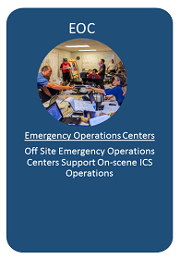
Introduction
Emergency Operations Centers are one of four NIMS Command and Coordination structures.
ICS is used to manage on-scene, tactical-level response; EOCs are off site locations where staff from multiple agencies come together to:
Address imminent threats and hazards
Provide coordinated support to incident command, on-scene personnel and/or other EOCs

Slide 3

Configuration of Emergency Operations Centers (EOCs)
EOC teams vary widely. Organization of the EOC staff can vary based on:
Jurisdictional/organizational authorities
Staffing
Partner and stakeholder agencies represented
EOC facilities
EOC communications capabilities
Political considerations
The mission
NIMS identifies three common ways of organizing EOC Teams:
ICS or ICS-like structure
Incident Support Model structure
Departmental structure
Like ICS, EOCs utilize the NIMS management characteristic modular organization.

Slide 4
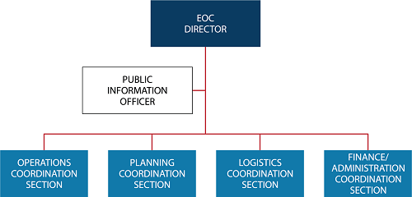
ICS or ICS-like EOC Structure
Many jurisdictions/organizations configure their EOCs using the standard ICS organizational structure, either exactly as it is performed in the field or with slight modifications. The structure is familiar and it aligns with the on-scene incident organization.

Slide 5
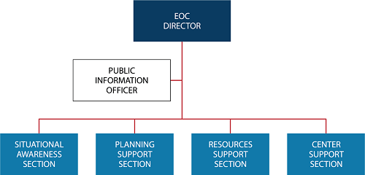
Incident Support Model (ISM) EOC Structure
Jurisdictions/organizations that focus their EOC team's efforts on information, planning, and resource support may choose to separate the situational awareness function from planning and combine operations and logistics functions into an incident support structure.

Slide 6
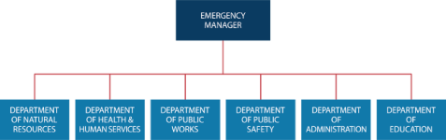
Departmental EOC Structure
Jurisdictions/organizations may opt instead to use their day-to-day departmental/agency structure and relationships in their EOC. By operating in the context of their normal relationships, department/agency representatives can function in the EOC with minimal preparation or startup time.

Slide 7

Discussion Question
What type of EOC configuration is used in your organization?

Slide 8
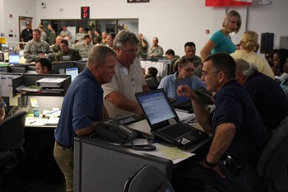
EOC Activation and Deactivation
Emergency Operations Centers are activated for a variety of incidents, threats and events.
Some circumstances that might trigger center activation include:
Multiple jurisdictions or agencies involved in an incident.
The Incident Commander or Unified Command indicates an incident could expand rapidly, involve cascading effects or require additional resources.
A similar incident in the past led to EOC activation.
The EOC Director or an appointed or elected official directs EOC activation.
An incident is imminent such as predicted hurricane, flooding, hazardous weather, or elevated threat levels.
Threshold events described in an emergency operations plan occur.
Significant impacts to the population are anticipated.

Slide 9
EOC Activation Levels
Emergency Operations Centers frequently have multiple activation levels to allow for:
Response scaled to the incident
Delivery of the exact resources needed
A level of coordination appropriate to the incident
The level of activity within a center often increases as the size, scope, and complexity of the incident grow. If the incident requires additional support and coordination, the EOC director may activate additional staff to involve more disciplines, mobilize additional resources, inform the public, address media inquiries, involve senior elected and appointed officials, and request outside assistance.

Slide 10
Discussion Question
What is an example of an incident that would cause an Enhanced Stead-State/Partial Activation?
What is an example of an incident that would cause a Full Activation?

Slide 11
Lesson 5: Emergency Operations Centers Summary
The lesson presented an overview of NIMS Emergency Operations Centers.
The lesson specifically discussed Emergency Operations Center:
EOC Functions
EOC Staff Organization Models
EOC Activation Levels
The next lesson will introduce you to other NIMS Structures and Interconnectivity.

