Slide 1

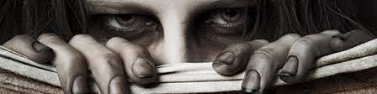
Z-Team Assignment 1
Know Thy Enemy

Slide 2

Assignment
Create a zombie that describes itself by:
  Cutting out a life size (or larger) zombie
  Writing informative texts ( 1 per group member)
  Combining informative texts with the zombie in an aesthetically frightening way

Slide 3
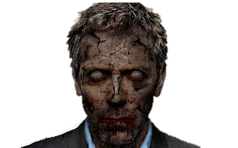
You will present your zombie to the class

Slide 4
Basic survival team elements
You don’t know who is going to survive the invasion so you don’t get to pick your team
If someone is loafing they need to be cast out of the group, only group members who contribute will continue
  If someone is freeloading and are not cast out of the group Mr. Boyce will turn them into a zombie and they will have to select another group member to become a zombie as well.
    Zombies will complete an individual assignment

Slide 5
Basic survival team elements
Groups perform best under leadership, either appoint a leader or become one
  The leadership role is just as vital as every other role, treat the leader like a team member whose job it is to keep the group on track
  Leadership styles based on personality

Slide 6
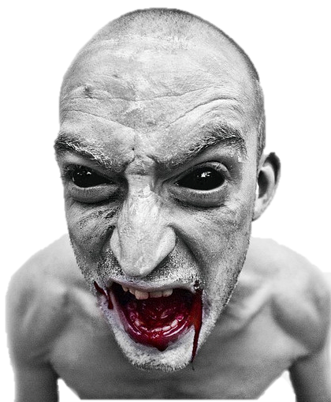
Basic survival team elements
Take initiative under a lack of orders
  Never find yourself with nothing to do
  Begin with the end in mind
  Make a plan that accounts for everyone
  Communicate Constantly
  Hustle where you can
  Keep an eye on the clock

Slide 7
Assessment: Self- Directed Learning
Get together and review the rubric while discussing what you want to end up with
Plan: Write down a plan that includes the specific tasks you will have to complete
Action: Hold one another accountable to completing the plan and make adjustments as needed
Result: Review the final product and ensure self-assess on the rubric

Slide 8
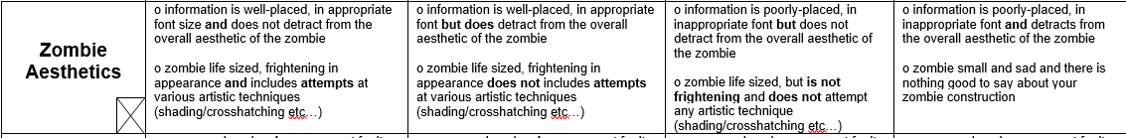
Assessment: Aesthetics
The overall aesthetic of the zombie should be purposeful, you may take creative liberties but ensure you can justify any deviation from the rubric
Crayons are your best bet for this requirement. Only use markers to outline. Materials are in the back of the classroom on the file cabinets. Put materials back after use.

Slide 9
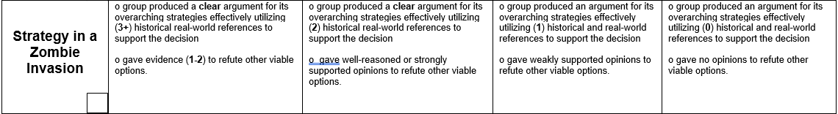
Assessment: Strategy
Strategies are not tactics, these are overarching goals and methods (on the road, hunker down, etc…)
Utilize the PDFs ‘Survival’ folder in the ‘2018 Zombie Prep’ folder.
  Cite your sources in accordance with the PDF name (S-A, S-B)
  Cite real world examples of people using your strategy in a disaster (i.e. evacuation, shelter in place)

Slide 10
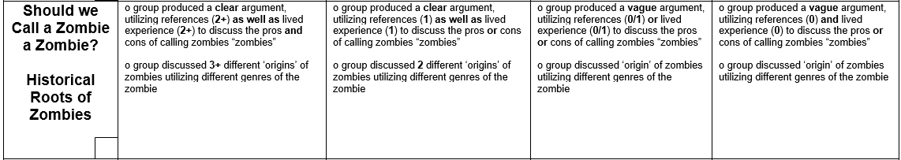
Assessment: Roots
Write an argument (1-3 paragraphs) that gives the most valid points of calling zombies a “zombie” and contains
Utilize the PDFs ‘Origins’ folder in the ‘2018 Zombie Prep’ folder.
  Cite your sources in accordance with the PDF name (S-A, S-B)

Slide 11
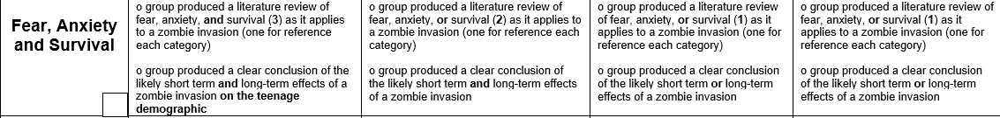
Assessment: Fear
Write a review (1-4 paragraphs that can be independent from one another) about the most relevant points concerning fear anxiety and survival in a zombie invasion that includes the impact on teens
Utilize the PDFs ‘Fear’ folder in the ‘2018 Zombie Prep’ folder.
  Cite your sources in accordance with the PDF name (S-A, S-B)

Slide 12
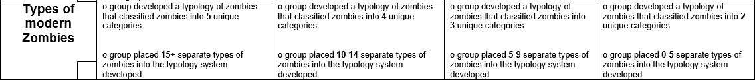
Assessment: Typography
Create and original typography of modern zombies
Categorize zombies in relation to the types you created with references to the shows/movies/books they originated from

Slide 13
Helpful Hints
Start with a good understanding of what you need to end up with
Split the task and complete portions of it on separate pieces of paper and glue them onto the zombie
Start making the zombie early and leaving room for the separate sections
Do what you are best at first and work in small teams to complete what you struggle with

