Slide 1
IoT Smart Home Project
Julianne Daly
Student no. 20082215

Slide 2
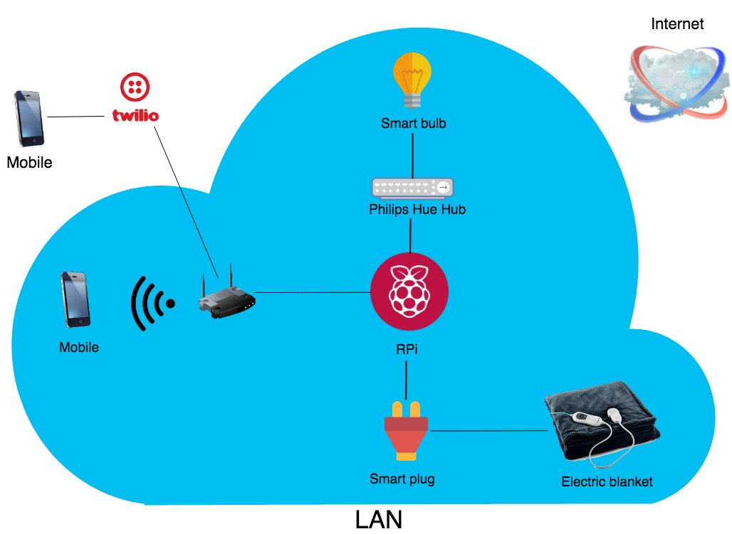
Pictorial (block level) representation of project

Slide 3
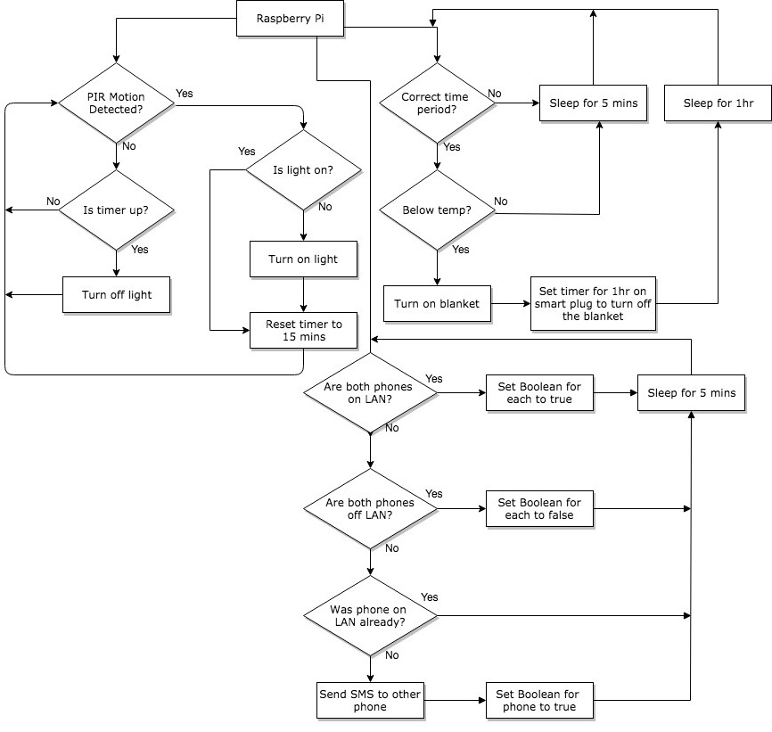
Flow chart of potential algorithm/logic

Slide 4
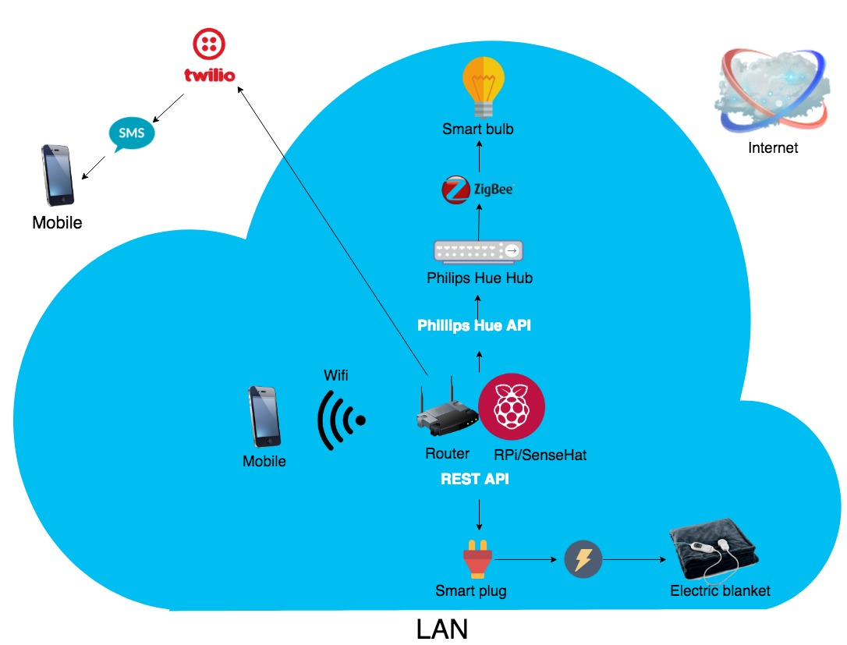
Informational flow diagram

