Slide 1
Raspberry Pi Temperature/Humidity Sensing
John Pormann
Head, IT Core Services

Slide 2
Goal – “Large-Scale” Monitoring
Regularly log temperature and humidity data to a centralized server
Cheap!
Initial cost
Effort to create the code, deploy the system, etc.
Bonuses:
At least some mechanism to query/analyze the data
If possible, some graphical output

Slide 3
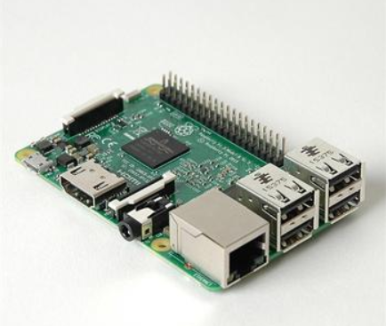
Ras-Pi 3, Model B+
Single-Board Computer
Quad-Core ARM CPU @ 1.4GHz
1GB RAM, MicroSD
~Gig-Eth/Wired, WiFi, BLE
HDMI, Audio, 4 x USB 2.0
GPIO, Camera ports
All for $35

Slide 4
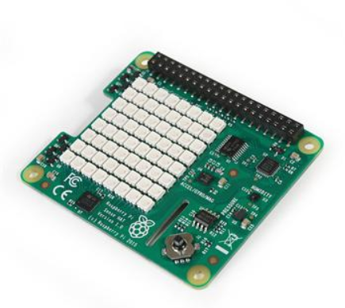
Ras-Pi “Sense-HAT”
HAT = Hardware Attached on Top
(2) Temp/Humidity/Pressure sensors
8x8 LED matrix
Gyroscope, Magnetometer
Joystick controller
And it has a Python library!
$30

Slide 5
Goal – “Large-Scale” Monitoring
Systemd daemon to read temp/humidity every N minutes
~100 lines of Python code
~20 lines for systemd code
Auto-restart if daemon dies
Dump to syslog for easy retention
from sense_hat import SenseHat
. . .
sensor = SenseHat()
. . .
def log_data( humantime ):
temp = sensor.get_temperature()
humid = sensor.get_humidity()
temp2 = sensor.get_temperature_from_pressure()
pressure = sensor.get_pressure()
. . .
while True:
log_data( timestamp )
. . .
time.sleep( num_sec )

Slide 6
Example output
May 18 07:03:35 jp-raspi d4[17604]: temp=36.3768463135 humidity=40.0431365967 \
temp2=36.1687507629 pressure=1001.35644531
May 18 07:08:35 jp-raspi d4[17604]: temp=36.5038452148 humidity=39.4808883667 \
temp2=36.3375015259 pressure=1001.43920898
May 18 07:13:35 jp-raspi d4[17604]: temp=36.703414917 humidity=39.2042236328 \
temp2=36.4666671753 pressure=1001.3828125
May 18 07:18:35 jp-raspi d4[17604]: temp=36.703414917 humidity=38.8055953979 \
temp2=36.5708312988 pressure=1001.4519043
May 18 07:23:36 jp-raspi d4[17604]: temp=36.7578430176 humidity=38.1868209839 \
temp2=36.6583328247 pressure=1001.42944336
May 18 07:28:36 jp-raspi d4[17604]: temp=36.8848419189 humidity=37.8447113037 \
temp2=36.7166671753 pressure=1001.37695312

Slide 7
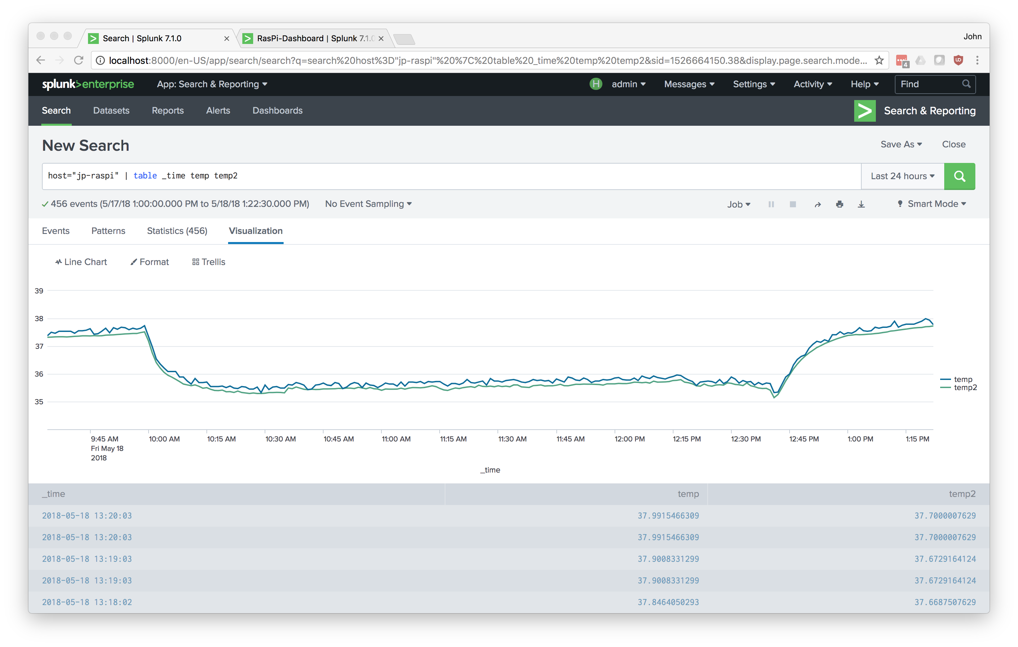
Splunk
Splunk can forward the syslog file to a central server for processing
One server can receive from many “sensors”
Splunk has “dashboard” functionality so it could be a presentation layer

Slide 8
“Cost” to Develop
Basic device code
~2-3 days of real effort
It’s python and systemd ... well-worn territory
Splunk
~1-2 days of real effort
Once you “get” Splunk, it’s easy to process this kind of data
To Do:
How to manage 10++ devices
Push new code
Alter config files

Slide 9
Next Step (R&D Project)
Higher-Accuracy
Current Specs:
+/- 2º C
Without good venting, the board itself heats up the sensors!
+/- 4.5% RH
Options:
I2C spec allows connections to a variety of sensors
Con: Wiring/Soldering it yourself
USB temp probes
Con: Most don’t support Linux
Custom PCB development
Con: major up-front costs!

Slide 10
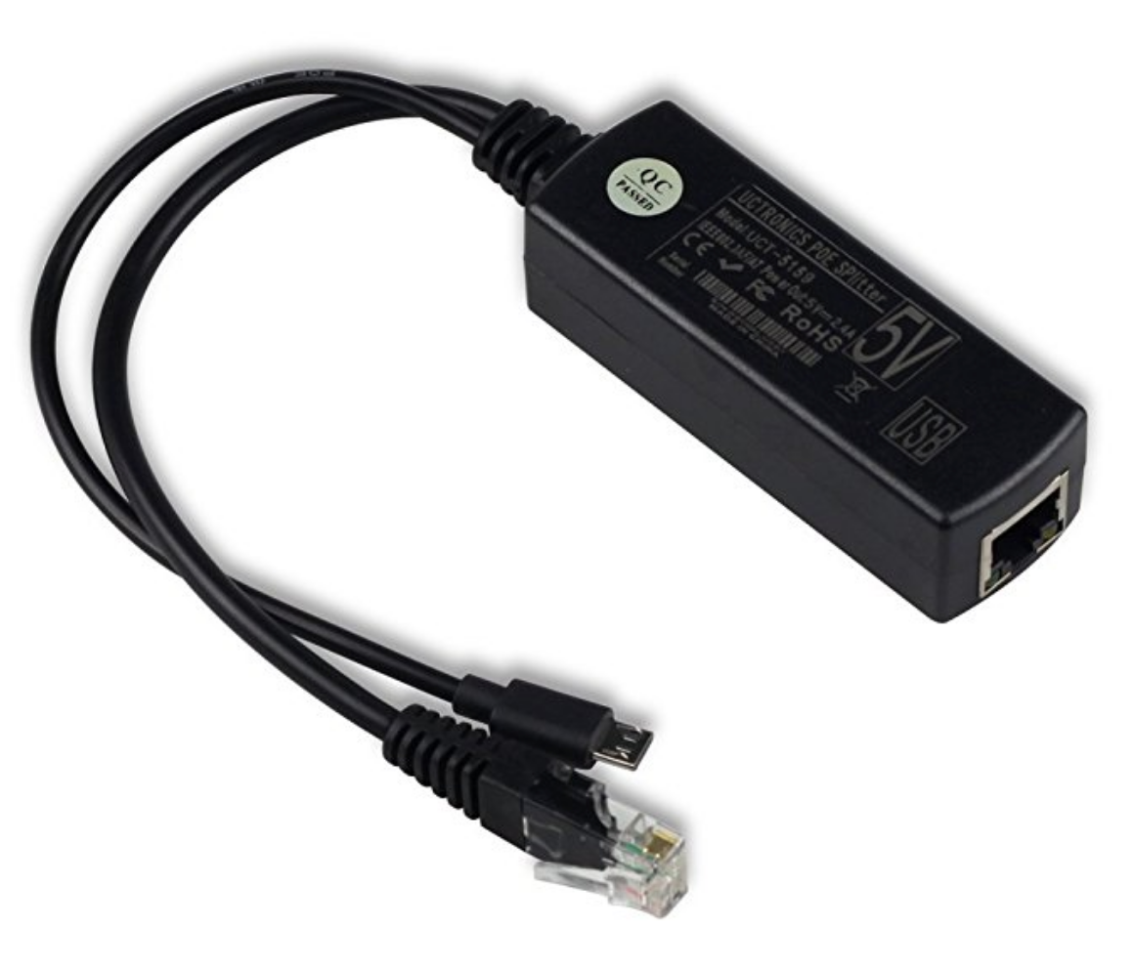
Possible Add-On
Power-Over-Ethernet (PoE)
w/o PoE, we need power-drop to each sensor (and some kind of network)
w/ PoE, we could use the network cable for power and connectivity
+ $10-15 per device
Plus potentially increased costs at the network switch level (OIT)

Slide 11

Next Step (For Real)
Re-assess the commercial landscape
IOT space is exploding
Home Automation space is exploding
But IOT companies are also imploding!
wirelesstag.net .. $30

Slide 12
Questions ?

